Slide 1
DE-PBS Cadre Meeting
February 17, 2022

Slide 2
Meeting Expectations
We are... | Virtual Meetings
ENGAGED | Unmute yourself or use chat box to ask questions Participate in polls and breakout rooms Use video when possible, especially when speaking
REFLECTIVE | Share questions you have for full group Note follow up questions for PBS team and/or individuals Focus on problem solving around areas of concern
SUPPORTIVE | Share successes, ideas, useful resources Listen with openness and understanding Attend to your own needs

Slide 3
Welcome and Agenda
Revisiting A Year at a Glance in Coaching Guidance for MTSS-SEB Coaches
Updates on Phase Recognition and Delaware School Climate Survey
Indicator 4 updates from Susan Veenema with DDOE
Reflecting on disproportionality to connect to our equity resources and proactive & restorative practices
Brandywine School District highlight
Professional learning opportunities and resources

Slide 4
Tool Reminder: A Year at a Glance in Coaching Guidance for MTSS-SEB Coaches
This document is for you to use however best fits your needs.
The intent of this document is to help you organize all of the many parts of PBS/MTSS
It is organized by systems, practices and data. The front page is the overall picture and the second page is outlined by seasons.
You are doing amazing work - be kind to yourself.

Slide 5
Coaching Activities Calendar
Winter | Systems: | Hold scheduled Team Leader meetings (bi-monthly, quarterly, etc.)
 | Practice: | Send mid-year PBS/MTSS updates, success stories, and/or gratitude
 | Data: | Send reminder of school team’s DDRT to be submitted to DE-PBS Project by January 14, 2022

Slide 6
Coaching Activities Calendar
Spring | Systems: | Hold scheduled Team Leader meetings (bi-monthly, quarterly, etc.) Define District expectations for MTSS action planning for the 2022/2023 school year.
 | Practice: | Provide Tier 1 Team learning opportunities (often early Summer) to leads and/or team members Send a reminder to new teams to encourage their participation & discuss readiness. Plan to attend training to provide support to new PBS/MTSS teams and new school members. Share district expectations and protocols for attendance and any post-training expectations. Provide support to convene team time over summer for additional action planning.
 | Data: | Send reminder that School team’s DDRT to be submitted to DE-PBS Project by June 17, 2022 Send reminders to teams to review existing data and conduct fidelity checks to support action planning Distribute and encourage teams to apply for DE-PBS Phase Recognition.

Slide 7
DE-PBS Phase Recognition
2021-2022 School Year applications coming soon
Phases 1 & 2 – Focus on Tier 1: School-wide PBS
Phases 3 & 4 – Tier 2: Targeted PBS
Reminder: applications prompt reflection of current year & planning for next SY; perfect for May/summer meetings
Deadline options

Slide 8
2022 School Climate Survey
Projected Timeline:
Enrollment Window: Early-Mid March
updates & confirmation provided to coaches & contacts
Administration Window: Late March – Early May
schools can self-select within window to accommodate other survey/testing plans & needs
Enrollment Process:
Finalizing administration plan & invitation correspondence for DDOE leadership review
Participation invitation to be distributed to Superintendents, district coaches & data contacts, and building administrators
Participation voluntary (overall & by population)

Slide 9
2022 School Climate Survey
Survey Inventory Summary & Reflection
Many valuable survey instruments are available
Consider utilizing a survey inventory & reflection process (see template)
Information gathered can inform enrollment in DSCS and/or be utilized as a communication tool for strategic use of surveys

Slide 10
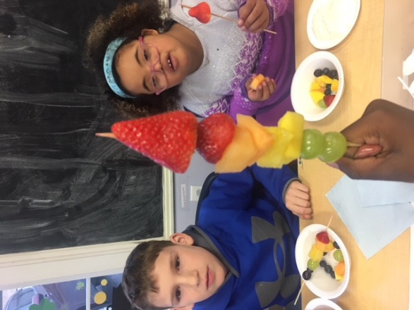
FFY 20-25 APR Target Setting

Slide 11
Target Setting
Indicator 4B (Compliance Indicator) Target is set at 0%
4A (Results Indicator) Stake holders met and set targets in 2018.
FFY17 - 50%
FFY18 - 50%
FFY 19 - 40%
FFY20 - 40%
FFY21 - 32%
FFY22 - 32%

Slide 12
Target Setting
Based on Stakeholder feedback from DE-PBS Cadre, Equity in IDEA and GACEC the follow decisions were made for targets:
FFY20 - 40%
FFY21 - 32%
FFY22 - 32%
FFY23 - 32%
FFY24 - 32%
FFY25 - 32%

Slide 13
Discipline Data
Indicator 4 data will be sent to LEAs in late March for review
Significant Disproportionality determinations sent early May

Slide 14
Questions to ask
How do we make connections between Indicator 4 and broader discipline data?
Do we need to conduct a review of our Policies, Procedures and Practices?
Does that mean conducting a self-assessment?
Determining root cause?

Slide 15
As MTSS Coaches, let’s ask
How can I connect with those in my district receiving this data? OR If I receive this data, who else should I connect with others to be part of the data review process?
Is there someone on the data review team that is data savvy? Someone with additional data access?
How can I support the data review and problem solving process?
You are equipped with MTSS/PBS knowledge! You have the questions to ask and resources to guide planning.

Slide 16
5 Questions Every Team Should Ask
About Racial Disproportionality
Dr. Ruthie Payno-Simmons
1: Is there an inequity problem in our district and/or school?
2: What is it about our people, policies, and practices that contribute to this inequity?
3: Which equitable practices can address discipline inequity?
4: Did the equity strategies decrease discipline disparity?
5: Who is at the table when decisions are made about our school systems?

Slide 17
5 Questions Every Team Should Ask
About Racial Disproportionality
Question 1: Is there an inequity problem in our district and/or school?
[Language Matters] This allows teams to view disciplinary disparities as systemic inequity rather than a deficit characteristic of a group of students based on identity markers.
What is/are the inequities leading to our disproportionate discipline outcomes for the group(s) of students identified?
[Disaggregate] Teams can look at Referrals by Ethnicity Reports and Risk Ratios as a starting point to identify if there is a discipline disparity. If yes, dig deeper to understand more about what in their systems affects this group the most.
Where does the inequity occur?
When does it happen?
Why does the inequity happen?
Notes:
Question 1: Is there an inequity problem in our district and/or school?
This allows teams to view disciplinary disparities as systemic inequity rather than a deficit characteristic of a group of students based on identity markers.

Slide 18
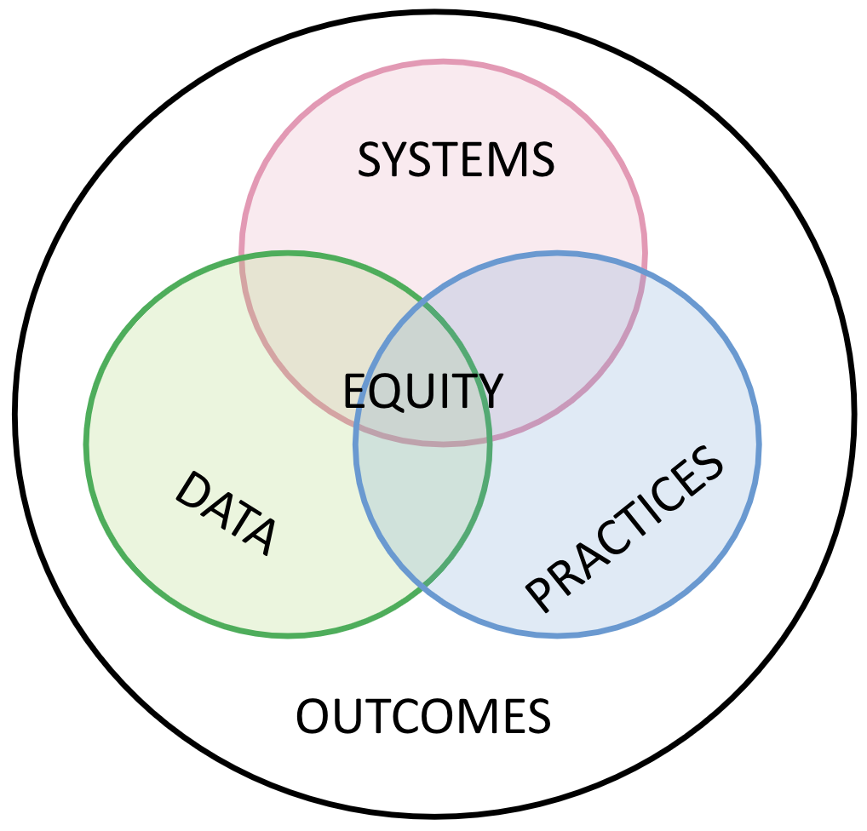
5 Questions Every Team Should Ask
About Racial Disproportionality
Question 2: What is it about our people, policies, and practices that contribute to this inequity?
[System Focus] Utilizing this question allows school leadership and MTSS/PBS teams to focus more on the “system”, rather than putting effort into “fixing” students or teachers.
[Multiple data sources] Teams can use the Tiered Fidelity Inventory or Tier 1 Key Feature Status Tracker to help assess systems, practices, and outcomes. Exploration of the Integrated TFI Companion Guide can support school teams, coaches, and trainers working to focus on cultural responsiveness and support for mental health and wellness within the MTSS/PBS framework.
Notes:
18
Question 2: What is it about our people, policies, and practices that contribute to this inequity?
Utilizing this question allows schools leadership and MTSS/PBS teams to focus more on the “system”, rather than putting effort into “fixing” students or teachers

Slide 19
5 Questions Every Team Should Ask
About Racial Disproportionality
Question 3: Which equitable practices can address discipline inequity?
[Decision-Making] When teams develop actions plans to address racial disproportionality, they should select activities and tasks that directly support implementing equity strategies.
What evidence-based equitable practices/strategies can address this discipline inequity?
What activities/tasks are needed to implement these practices/strategies?
Who is at the planning table?
[Cultural Responsiveness] Leverage the PBIS Cultural Responsiveness Field Guide: Resources for Trainers and Coaches to consider strategies aligning with their goal of providing cultural elaboration to MTSS/PBS systems.
Notes:
Question 3: Which equitable practices can address discipline inequity?
When teams develop actions plans to address racial disproportionality, they should select activities and tasks that directly support implementing equity strategies.

Slide 20
5 Questions Every Team Should Ask
About Racial Disproportionality
Question 4: Did the equity strategies decrease discipline disparity?
[Multiple data sources] Schools should use multiple data sources to monitor and the data should assess systems and methods in seeking to understand student outcomes rather than only looking at outcome data as a measure of determining equitable outcomes. Revisit:
Tiered Fidelity Inventory or Tier 1 Key Feature Status Tracker
Stakeholder or climate data
Notes:
Question 4: Did the equity strategies decrease discipline disparity?
Schools should use multiple data sources to monitor and the data should assess systems and methods in seeking to understand student outcomes rather than only looking at outcome data as a measure of determining equitable outcomes.

Slide 21
5 Questions Every Team Should Ask
About Racial Disproportionality
Question 5: Who is at the table when decisions are made about our school systems?
“These questions serve as a starting point that can support equity efforts within our PBIS systems. So, lean into the problem-solving process, knowing that by asking questions such as the five highlighted above and applying strategies to mitigate disproportionality that you are tackling systemic inequities head-on.”
Dr. Ruthie Payno-Simmons
Notes:
Question 5: Who is at the table when decisions are made about our school systems?
This question surfaces who is present and included and who is not as systems are created and maintained.

Slide 22
Tools to Support Enhancing Equity in School Discipline
A 5-Point Intervention Approach for Enhancing Equity in School Discipline (PBIS.org)

Slide 23
Tools to Support Enhancing Equity in School Discipline
1. Collect, Use, and Report Disaggregated Discipline Data
2. Implement a Behavior Framework that is Preventive, Multi-Tiered, and Culturally Responsive
3. Use Engaging Instruction to Reduce the Opportunity (Achievement) Gap
4. Develop Policies with Accountability for Disciplinary Equity
5. Teach Strategies for Neutralizing Implicit Bias in Discipline Decisions
A 5-Point Intervention Approach for Enhancing Equity in School Discipline (PBIS.org)

Slide 24
Tools to Support Data Disaggregation
1. Collect, Use, and Report Disaggregated Discipline Data
Calculating Risk Ratios – How To [Recommended for District Coaches and Teams]
Wisconsin RtI Center Risk Ratio Module [Recommended for District Coaches and Teams]
Using Data (and Data Systems) to Address Discipline Disproportionality [Recommended for District Coaches and Teams]
Data Analyst’s Worksheet [Recommended for Teams]
PBIS: Using Discipline Data within SWPBIS to Identify and Address Disproportionality [School Teams Guide]
PBIS: Equity in School Discipline: Enhancing Commitment Through Teacher Training [Recommended for Districts]
DE-PBS Major vs. Minor Behavior Resources [Recommended for Teams]

Slide 25
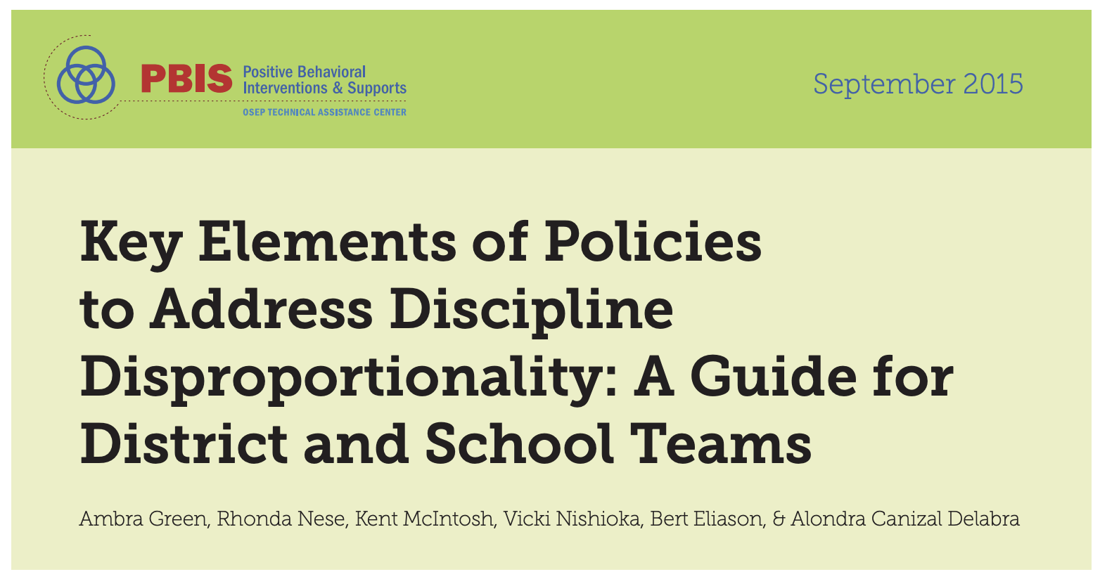
Related Center on PBIS (PBIS.org) Tools
Discussing Race, Racism, and Important Current Events with Students: A Guide with Lesson Plans and Resources
Key Elements of Policies to Address Discipline Disproportionality: A Guide for District and School Teams

Slide 26
As coaches, how can we align Restorative Practices and MTSS to support the Whole Child?

Slide 27
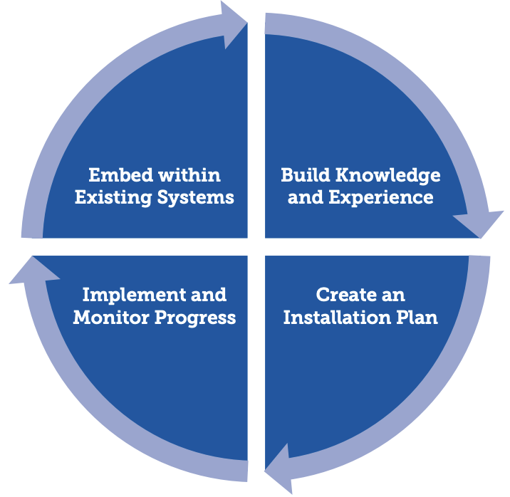
A Recursive Process for Deep Implementation:
Planning, Action, Reflection
PBIS.org
Discussing Race, Racism, and Important Current Events with Students: A Guide with Lesson Plans and Resources
Statewide Implementation of Evidence-Based Programs (Fixson et al., 2013)

Slide 28
District Sharing:
Planning, Action, Reflection
The District Context
District Communication Tool
Leadership Support & SWOT Process

Slide 29
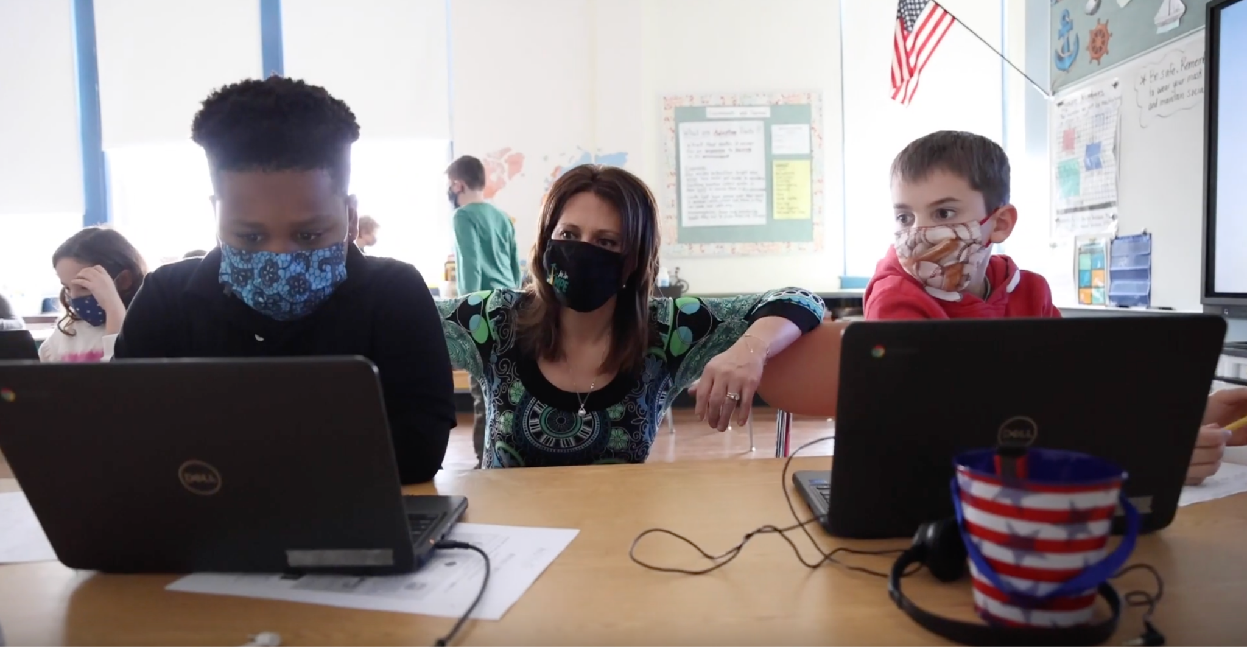
Brandywine School District Highlight

Slide 30
BSD Guiding Questions for SWOT Analysis
Strength
What part of this school community is your contribution the greatest? Why?
What are we doing well related to school climate and culture?
What resources have been most helpful in supporting our school environment?
What has been your greatest success related to classroom environment (DPASII Component 2)?
Weakness
What part of this school community is your contribution the least? Why?
What barrier is in your way related to classroom environment (DPASII Component 2)?
What expertise do you need support with related to school climate and culture?
What resources would be helpful to improve our school climate and culture?
Opportunities
What are our next steps as a school community for collaboration in creating our desired culture?
What strengths can we capitalize on for continuous improvement?
What is unique to our school that might provide us opportunities for success and early wins?
What weaknesses can we eliminate to create opportunities for success?
Threats
What threats may affect the viability of us improving the culture and climate of our school?
What obstacles do you face as it relates to our school and classroom environment?
What weaknesses will prevent us from achieving the culture and climate we desire?
Who or what may cause us challenges with achieving our goals?

Slide 31
Upcoming Professional Learning & Resources

Slide 32
Check-In/Check-Out (CICO, CI/CO)
Date: March 10th
Time: 2:30-4pm
PDMS: 30416
Intent: Introduce and reinforce…
core components of this Tier 2 intervention
available tools for implementing and monitoring this intervention

Slide 33
Preparing Teams for Summer 2022 Team-Based Training
Teams |  | Team Composition Team Operating Procedures Screening Request for Assistance
Interventions |  | Options for Tier 2 Interventions Tier 2 Critical Features Practices Matched to Student Need Access to Tier 1 Supports Professional Development
Evaluation |  | Level of Use Student Performance Data Fidelity Data Annual Evaluation

Slide 34
Spring 2022: Tier 3: Systems Session
Have you ever wondered how to evaluate and respond to the overall effectiveness of your Tier 3 system?
This session is for you!
This spring on May 4 (tentative date) we look forward to hosting a professional learning session for those focused on Intensive (T3) data, systems and practices.
Key Tier 3 Systems Topics:
Teams | Teaming Identifying students
Resources | Staffing and professional development student/family/community involvement
Support Plans | Assessments Comprehensive supports Tier 3 is not separate from Tier 1 and 2
Evaluation | Data systems exist for school and student Tier 3 teams Evaluation of school and student team success

Slide 35
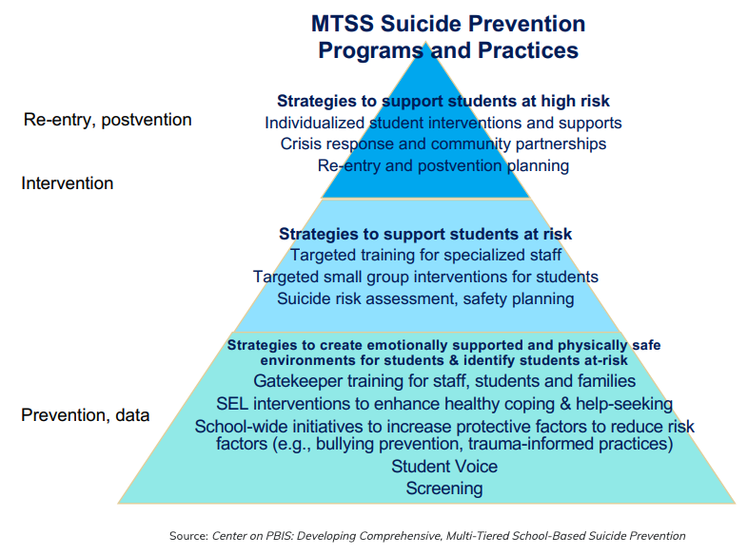
Resources: Suicide Prevention Using MTSS
Suicide Prevention Using MTSS
With student mental health and suicide prevention being at the forefront of priorities, the DE-PBS Project has compiled helpful resources to implement suicide prevention, intervention, and postvention strategies within a multi-tiered system of support. Suicide Prevention Using MTSS resources include Center on PBIS webinar Developing Comprehensive, Multi-Tiered School-Based Suicide Prevention, presentation slides, and examples of a risk assessment checklist, after risk assessment checklist, family notification form, and safety plan.
Notes:
https://www.delawarepbs.org/suicide-prevention-using-mtss/

Slide 36
Youth Mental Health First Aid -
Trainings & Action Plan Reminder
Participant Trainings
March 7 - open session (#58740)
March 28 - open session (#58745)
March 30 - Social Workers (#58904)
April 9 - open session (#58746)
April 27 - open session (#58747)
Train the Trainer
New cohort will be trained February 21st-23rd
Next opportunity:
June 20-22, 2022

Slide 37
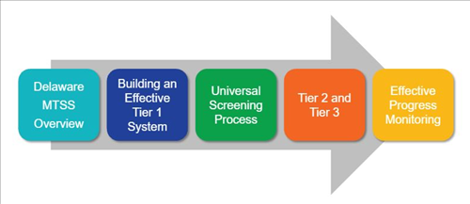
PL Resource: DE-MTSS
DE-MTSS Module Series
Schoology Course (Course # 30130 Section # 57818)

Slide 39
Northeast PBIS Leadership Forum
May 12, 2022 - Full day - IN PERSON!
Mystic, CT
Keynote Speaker - Dr. Nikole Hollins-Sims from the Pennsylvania Department of Education
School-Wide PBIS – provides an overview of the first tier of School-Wide PBIS, including school climate and contextual fit.
Equity – Will focus on how to implement a Positive Behavior Interventions framework within a culturally responsive lens.
Mental Health – focuses on braiding mental health supports across our PBIS framework of multi-tiered supports.
Systems to Support Staff – this strand will share content on systems that support staff to successfully implement our positive support elements and increase effectiveness.

Slide 40
Reminder: 2022 Whole Child CoP Opportunity
Register for PDMS: 30373
TIPSEL-A 2022 Whole Child Community of Practice
Questions? Contact Teri Lawler
teri.lawler@doe.k12.de.us

Slide 41
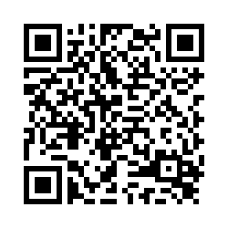
Coaches Networking
Thursday March 17, 2022
1-2:30 pm
NEXT MEETING:
Please take a few minutes to fill out our participant survey!
Reminder to follow us on Twitter & share the handle with your schools.
@Delawarepbs

