Slide 1
DE-PBS Coach Networking Meeting
Thursday March 17th, 2022
1-2:30 pm

Slide 2
Meeting Expectations
We are... | Virtual Meetings
ENGAGED | Unmute yourself, raise hand or use chat box to ask questions Participate in polls and discussions Use video when possible, especially when speaking
REFLECTIVE | Share questions you have for full group Note follow up questions for PBS team and/or individuals Focus on problem solving around areas of concern Share if you have a “parking lot” question
SUPPORTIVE | Share successes, ideas, useful resources Listen with openness and understanding Attend to your own needs

Slide 3
Welcome and Agenda
DE-PBS Coach Networking Goals
Our collective opportunity
...to create space and time for fellow coaches to connect & collaborate around key topics of particular interest and need
...for district MTSS coaches to share best SEB practices, ask questions, gain support from one another
...for hearing diverse voices from across the state.
Today’s Key Topic:
Universal Social Emotional Behavioral (SEB) Screening

Slide 4
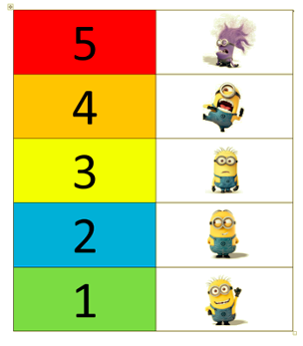
In the chat box…
How do you feel about the plans you are making or have already enacted to install a universal SEB screener in your district?

Slide 5
Let’s Network
Getting Schools Ready to Screen:
What types of professional development or guidance has your district provided (or plans to provide) schools related to universal screening readiness?
Using Screening Data:
How comfortable do you and your school teams feel about using the results from your screener (or screeners you are considering)?
Evaluating your Screener:
If your district selected and used an SEB screener this year, how can you evaluate its impact?
If your district is planning to implement an SEB screener, how will you determine its impact?

Slide 6
Getting schools ready to screen
Universal Screener Action Steps:
Establish a district implementation team
Complete tool selection process
Determine readiness criteria (e.g., high level of DBDM or high fidelity to PBIS implementation) and select schools to participate
Establish or modify school’s meeting structures to support screening work
Complete resource map and gap analysis with each school
Confirm that each school has adequate SEB supports
Introduce screening initiative to school community
Consult with legal team about consent/finalize consent forms
Train teachers
Conduct screening
Prevention support planning
Targeted intervention planning
Evaluate the usability and reach of your screener

Slide 7
Example: Selecting Universal Screener Schools
Administrator buy in
High level of implementation fidelity with MTSS/PBIS framework
Or effective teams with strong literacy in data based decision making
Prevention (Tier 1) support(s) are available and aligned to screener
Teams have a targeted intervention planning process
OR
Administrator buy in
District level commitment to dedicate personnel time and training resources to
Build the school’s SEB supports
Establish effective teams with data based decision making skills
Adapted from Project Georgia AWARE

Slide 8
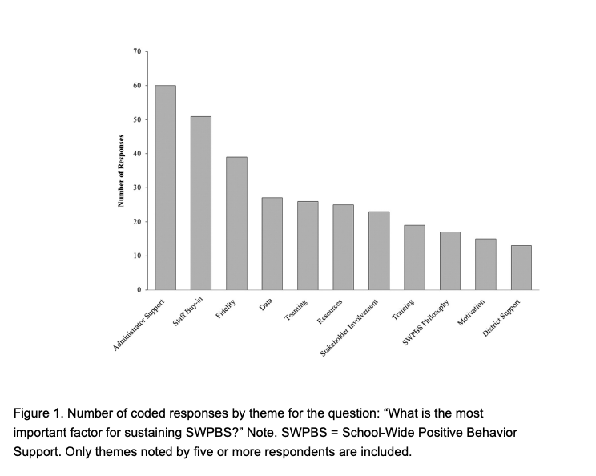
Administrator Buy In
One of the strongest predictors of PBIS sustainability
Assures school staff that implementation will be supported with resources (e.g., time, incentives, training)
Orients staff to new ways of doing business and provides clear expectations to staff
Promotes frequent feedback from staff regarding the progress of implementation (and needed supports)
Addresses competing practices that may decrease resources
McIntosh, Predy, et al., (2013)

Slide 9
Who should manage the screening process?
Identify and support a universal screening facilitator in the school(s) using the tool
Responsible for:
Procedures and expectations for screener
Screener administration and dissemination
Technology Support (e.g., securing data)
Report generation and data access
Supports MTSS teams with:
Establishing data use routines and decision rules
Data analysis
Monitoring implementation
Professional learning to help ensure a clear understanding of how data is used

Slide 10
Example Resource Map using the SAEBRS
3 x 3 Intervention Resource Guide
 | Social Behavior | Academic Behavior | Emotional Behavior
Universal | School-wide expectations teach relationship skills, friendship building, impulsiveness, or socially appropriate behavior Second Step whole class lessons (Unit 2: Empathy; Unit 4: Problem Solving) | School wide expectations teach organization, self-monitoring, and motivation Second Step whole class lessons (Unit 1: Skills for Learning) | School wide expectations teach coping strategies, adaptability, or positive psychology (e.g., gratitude and hope) Second Step whole class lessons (Unit 3: Emotion Management)
Tier 2 Relationship Building | CICO | CICO | CICO
Tier 2 Skill Building | Second Step small group (Unit 2: Empathy; Unit 4: Problem Solving) | Second Step small group (Unit 1: Skills for Learning) | Second Step small group (Unit 3: Emotion Management)

Slide 11
Let’s Chat Getting Schools Ready
If you used a screener this year:
How can you use what you learned in your pilot to scale up installation?
What strategies helped you gain administration buy in?
What teaming strategies and roles were helpful?
What gaps in prevention supports or interventions did you identify?
What gaps in staff knowledge did you identify?
Do you have any plans to scale up your screening installation? If so, how will you prepare new teams?
If you are preparing to screen:
What resources, training and coaching have you considered to prepare teams to use your screener?

Slide 12
Making decisions with screener data
Universal Screener Action Steps:
Establish a district implementation team
Complete tool selection process
Determine readiness criteria (e.g., high level of DBDM or high fidelity to PBIS implementation) and select schools to participate
Establish or modify school’s meeting structures to support screening work
Complete resource map and gap analysis with each school
Confirm that each school has adequate SEB supports
Introduce screening initiative to school community
Consult with legal team about consent/finalize consent forms
Train teachers
Conduct screening
Prevention support planning
Targeted intervention planning
Evaluate the usability and reach of your screener

Slide 13
A summary of (14 DE Admin. Code § 508.6.1.1 - 508.6.1.1.4): MTSS Framework and Procedures
First stage is universal screening to identify students who may need additional supports
If 20% of students in a classroom are not meeting a benchmark consider the need for additional classroom, instructional and systems level supports and strategies
Second stage (within two weeks) is data analysis to confirm there are specific areas of need for Tier 2 supports
Based on results identified students matched to supports delivered in the classroom by teacher or outside of the classroom with other staff as appropriate to the intervention
Section 6.0 After no more than six to eight school weeks of Tier 2 intervention the problem-solving team shall conduct a review of the plan as described in Section 5.0… Section 7.0 LEA shall provide a description of the methods used to implement and evaluate the effectiveness of the program (Section 5.0) must include fidelity data, baseline data, learning targets, type and frequency of intervention, progress monitoring data)

Slide 14
Prevention Support Planning
Problem Identification
Solution Development
Staff Training
Fidelity
Evaluation
Look for trends in the data (If 20% of students in a classroom are not meeting a benchmark consider the need for additional classroom, instructional and systems level supports and strategies)
Anchor solutions to your existing prevention supports (first) and then consider the need to adopt a new initiative
Consider the “one strategy equals 30 minutes of training” approach (Vannest, 2012)
Once you come up with a plan… set a date to evaluate the impact before you leave the planning meeting

Slide 15
Precision Problem Statement: | Fall screening data indicates that 68% of our 6th graders self reported difficulties with social behavior. After meeting with a group of students and reviewing our discipline data (50% of ODRs involved peer to peer conflict) , the primary need is relationship skills (solving conflicts with peers).
Set Measurable Goal: | # lessons taught Reduction in ODRs for peer to peer conflict
Proposed Solution and Action Plan: | Prevention strategies: Teaching strategies: solving conflict skills will be added to the matrix and lessons shared with advisory staff to deliver Recognition strategies:
Fidelity Monitoring Plan: | A weekly google form will be completed by advisory teachers that reports which SEB lessons have been taught.
Monitor Outcome vs Goal: | What outcome data do you see as a result? Did you achieve the goal, or do you need to revise a component of your problem-solving process?
Social Behavior (SAEBRS example)
Key Skills: relationship skills, friendship building, impulsiveness, or socially appropriate behavior Connected to: Second Step Units (Unit 2: Empathy; Unit 4: Problem Solving)

Slide 16
Targeted Intervention Planning
Problem Identification
Intervention Selection
Staff Training
Fidelity
Progress Monitoring
Find a way to assess the validity of the students identified as “at risk”
Be efficient but precise in your problem identification
Look for trends in the student’s data!
When selecting interventions you have a few options (Vannest, 2012)
“low-target” or standard protocol interventions (e.g., CICO, Mentoring, re-teaching expectations/SEL lessons)
“Moderate-target” interventions (use your screening data to identify group needs)
“High-target” interventions (require additional screening to make a match)
Ask for the student what type of support they prefer

Slide 17
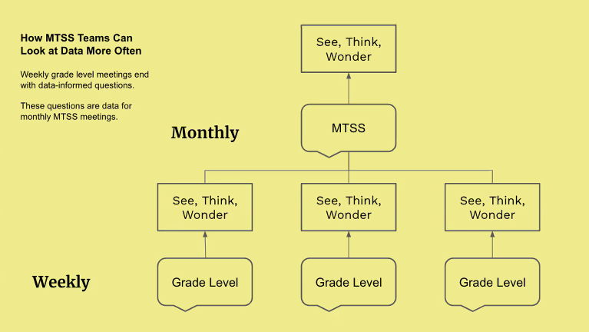
Find an Opportunity for a Routine
Include regular and brief data items to:
Email newsletters
Monthly staff meetings
Weekly check-ins
PLCs
Bonus Tip:
Go for consistency over complexity
https://ryanestrellado.com

Slide 18
Using Screening Data for Decision Making
If you screened:
How comfortable do your teams feel about responding to the data?
How did the data inform your prevention (tier 1) supports?
In what ways did you share the data with your staff, families and community?
If you have data that hasn’t been used, what are some next steps you plan to take?
If you are preparing to screen:
What are some steps you are taking to prepare implementers to respond to the data?

Slide 19
Determining the fit of a Screener
Universal Screener Action Steps:
Establish a district implementation team
Complete tool selection process
Determine readiness criteria (e.g., high level of DBDM or high fidelity to PBIS implementation) and select schools to participate
Establish or modify school’s meeting structures to support screening work
Complete resource map and gap analysis with each school
Confirm that each school has adequate SEB supports
Introduce screening initiative to school community
Consult with legal team about consent/finalize consent forms
Train teachers
Conduct screening
Prevention support planning
Targeted intervention planning
Evaluate the usability and reach of your screener

Slide 20
3 things to keep in mind while exploring evaluating your tools
Your selected tool(s) should be:
Contextually appropriate
Usable
Defensible
Adapted from Glover & Albers, 2006

Slide 21
Contextually Appropriate
Items relate to categories of behavior that are relevant to the social and academic success of your students
Results lead to intervention planning and service delivery
The screener should improve the reach of your Tier 1 supports and targeted interventions
Stakeholders understand the implications associated with the results
Improves prioritized student outcomes

Slide 22
Usable
Cost should not outweigh benefits
Consider both human and fiscal resources
Acceptability to multiple stakeholders
The benefits should be evident!
The system for collecting, managing, and interpreting data
Available accommodations for different populations
Frequency of delivery
(Glover & Albers, 2007)

Slide 23
Defensible
Leads to accurate identification of individuals at risk
Pay close attention to predictive validity
Accurately measures what it is intended to measure
Pay close attention to the construct validity
Repeatable
Pay close attention to test-retest reliability
(Glover & Albers, 2007)

Slide 24
Decide if the tool is the right fit
If you have a tool:
Have you evaluated your tool (formally or informally)? What did you notice?
Is it appropriate, usable, defensible?
We’ve met with some coaches who were not part of the selection process, but have concerns about the fit of their tool. Any advice?
If you are preparing to screen:
In what ways did you/will you consider the fit of a tool during the selection process?

Slide 25
Coming this Spring: New Screening Mini Webinars
Webinar 1: universal SEB screening overview
Webinar 2: universal screening tool selection
Webinar 3: universal screening readiness, resource mapping, gap analysis
Webinar 4: parental consent, action planning and gaining stakeholder buy in
Webinar 5: Data-based decision making

Slide 26
Reminder - DE-PBS/DelAWARE Project: Screening Resources
Top Ten Questions Answered about Universal Screening Webinar
Time: 40 minutes
Intended audience: all educators looking to understand the key ideas of universal screening
How: Watch asynchronously or download and use the materials! Register via PDMS course # 29663 or visit: www.delawarepbs.org/universal-screening/
DE-PBS Universal Screening Webpage
District Level Action Plan
School Level Action Plan

Slide 27
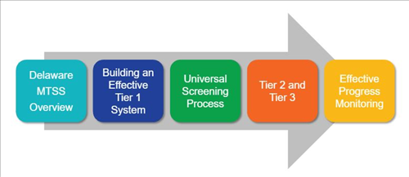
Reminder - DE-MTSS: MTSS/Screening Resource
DE-MTSS Module Series
Schoology Course (Course # 30130 Section # 57818)

Slide 28
Tier 2 Team Training - Summer 2022
Thursday June 23rd
Wednesday June 29th
Thursday June 30th

Slide 29
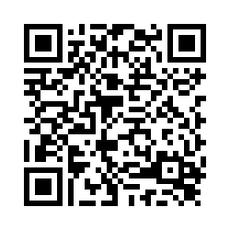
DE-PBS Cadre Meeting
Thursday April 14, 2022
10:00 am-12:00 pm
Please fill out our feedback survey - we use the information to plan for our upcoming meetings and events!
Reminder to follow us on Twitter & share the handle with your schools.
@Delawarepbs

