Slide 1
MTSS Tier 2 Check-In/Check-Out:
The Fundamentals & Tools
Thursday, March 10, 2022
Delaware Positive Behavior Support Project
We will be recording today’s session.

Slide 2
Agenda
Increase understanding of comprehensive implementation of CICO as a Tier 2 intervention
Explore tools to implement CICO with fidelity as part of a T2 System
Hear school example of considerations to enhance CICO efficacy and efficiency
Now can be the time to Start, Revitalize, Revamp CICO as needed in your school and district.

Slide 3
Meeting Expectations
We are... | Virtual Meetings
ENGAGED | Unmute yourself or use chat box to ask questions Use video when possible, especially when speaking
REFLECTIVE | Consider how to implement or refine CICO in your context Note follow up questions for District MTSS/PBS Coach or DE-PBS Team
SUPPORTIVE | Share successes, ideas, useful resources Listen with openness and understanding Attend to your own needs

Slide 4
MTSS for Social Competence &
Academic Achievement
Outcome data (social behavior, academic achievement), Progress Monitoring, Fidelity
OUTCOMES
SYSTEMS
DATA
EQUITY
What we do to support adults to implement the practices
PRACTICES
What we do to
support students
Notes:
4

Slide 5
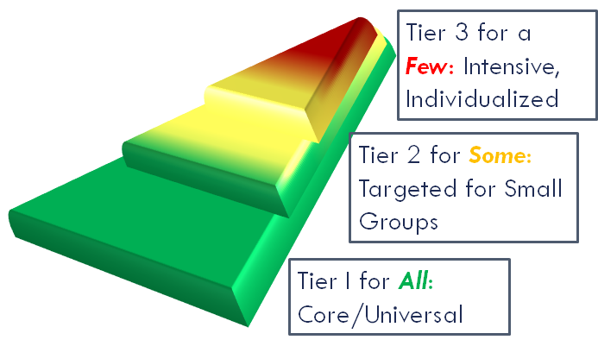
Layers that build, not dividers that separate

Slide 6
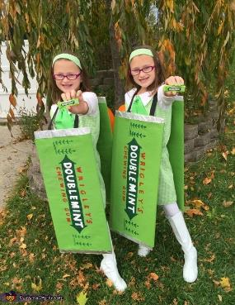
Tier 2 gives students a higher dosage of what we already do at Tier 1
Teach Expectations & Skills
Prompt use
Reinforce the use of skills
Monitor effectiveness
Communicate

Slide 7
Reflecting on Tier 1 Practices
Often focusing on Tier 2 interventions identifies needs for enhancing Tier 1 practices
How consistent are Tier 1 Routines for:
Teaching of expectations and social emotional competencies
Opportunities for positive interactions with adults
Use of data to guide Tier 1 focus and problem solving

Slide 8
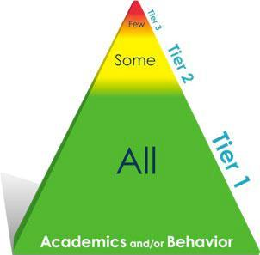
Check-in-Check-out (CICO): The Match to School
An extension of Tier 1 through increased positive adult-student interaction
Most likely to benefit students who desire increased positive adult attention
Minimal time required from teacher
Can be a first stop intervention
Having 5/7-12% students accessing CICO supports routine establishment of intervention
If you only have 1-2% on CICO, you may be waiting for kids who will likely need more….
Adapted from Illinois PBIS Network

Slide 9
Check-in-Check-out (CICO): The Match to Student
Preventive/Pre-Correct: New students entering building mid-year (like orientation to the building)
Reinforce teaching: Students with low-level problem behavior (identified by # of ODRs, teacher referral based on classroom management charts, etc.)
Provide additional explicit adult support: Children who are internalizers (identified by visits to nurses office, sits alone at lunch, etc.) and who are reinforced by adult attention
Supplement existing supports at Tier 3 level: As one part of an individual support plan for a student (another layer of intervention)
Illinois PBIS Network

Slide 10
Research shows function matters
Study of CICO based on function:
Results indicated that, for students with attention-maintained behavior, implementation of Check-In/Check-Out was associated with statistically and clinically significant improvements in ratings of problem behavior, ratings of prosocial behavior, and office discipline referrals.
However, for students with escape-maintained behavior, no statistically significant effects were found.
There exists the need for multiple tier two interventions in both academic and behavior support.
McIntosh et al., 2009

Slide 11
Components that make CICO an efficient intervention
Adult check in/outs with students are brief
Dedicate adult could have 10-15 students
The intervention is the same for all youth
Same check-in and check-out time daily
School-wide behavioral expectations are the fundamental goals and are the same for all students. Modifications only made after trying this starting point - as part of fading or intensifying.
Rating scale is the same for all students
All students use Daily Progress Report (DPR)
Adapted from Illinois PBIS Network

Slide 12
Let’s Reflect: Check In Check Out Video Tutorial: Educational Behavior Intervention
As you view this video, reflect on the following…
Are there aspects of the process you feel are strongly in place? Aspects that surprise you?
What challenges do you think you might encounter in implementing CICO? Or what have you encountered?
What do you wish your school or district community understood about the effective implementation of CICO?

Slide 13
We know the intent of CICO
Let’s make sure we are on the same page in terms of what CICO includes and looks like overall…
Cico Initiative https://www.youtube.com/watch?v=vP7GJ72UxsA

Slide 14
CICO: Components: The Daily Cycle (March & Horner, 1998)
Start of School Day
Throughout the Day
End of School Day
1. Check-in with assigned adult upon arrival to school
* Adult positively greets student
* Review School-wide expectations (daily goals)
* Students pick up new Daily Progress Report card
* Provide materials (pencil etc.) if needed
* Turn in previous day’s signed form (optional)
* Provide reinforcer for check-in (optional)
Illinois PBIS Network
Notes:
14

Slide 15
CICO: Components: The Daily Cycle (cont.)
Start of School Day
Throughout the Day
End of School Day
2. At each class:
Teacher provides positive feedback and, if needed, corrective behavioral feedback
Teacher completes DPR or
Student completes self-monitoring DPR/teacher checks and initials card (self-monitoring normally happens as students begin to successfully exit the intervention)
Illinois PBIS Network
Notes:
15

Slide 16
CICO: Components: The Daily Cycle (cont.)
Start of School Day
Throughout the Day
End of School Day
3. Check-out at end of day:
Review points & goals
Reinforce youth for checking-out (token/recognition optional, think beyond school-wide token)
Receive reinforcer if goal met (optional, but good idea)
Take DPR card home (optional)
Illinois PBIS Network
Notes:
16

Slide 17
CICO: Components: Daily Cycle (cont.)
Start of School Day
Throughout the Day
End of School Day
4. Share DPR with parent (optional)
Students may receive reinforcer from parent
Invite parents to sign card
No consequence to students if not signed by parent
5. Return signed card next day
Celebrate and prepare for the next day
Adapted from Illinois PBIS Network
Notes:
17

Slide 18
CICO: Components: Daily Cycle (cont.)
Start of School Day
Throughout the Day
End of School Day
Next Day: Check-in with assigned adult upon arrival to school
* Adult positively greets student
* Review School-wide expectations (daily goals)
* Students pick up new Daily Progress Report card
* Provide materials (pencil etc.) if needed
* Turn in previous day’s signed form (optional)
* Provide reinforcer for check-in (optional)
Adapted from Illinois PBIS Network
Notes:
18

Slide 19
CICO: Roles-The Adult Network

Slide 20
CICO: Roles-The Adult Network
Tier 2 Team Leader(s)
Schedules routine meetings (at least monthly)
Collects & reviews data to share during team meetings
Provide general staff updates
CICO Intervention Coordinator
Organizes and/or oversees the CICO intervention
Communicates with CICO intervention facilitators & stakeholders
Gathers and organizes data on student progress
May also be a CICO facilitator
CICO Facilitators-Trained Staff
Directly provides CICO support services to students
Role includes: meeting with students for CICO
Report student progress

Slide 21
CICO: Roles-The Adult Network
CICO Intervention Coordinator
Organizes and/or oversees the CICO intervention
Communicates with CICO intervention facilitators
Gathers and organizes data on student progress
May also be a CICO facilitator

Slide 22
CICO Intervention Coordinator
Who would make good CICO Intervention Coordinator ?
Flexibility in schedule to support intervention planning
Solid organizational skills
Strong data collection, presentation and review skills
Good communication skills with school & community

Slide 23
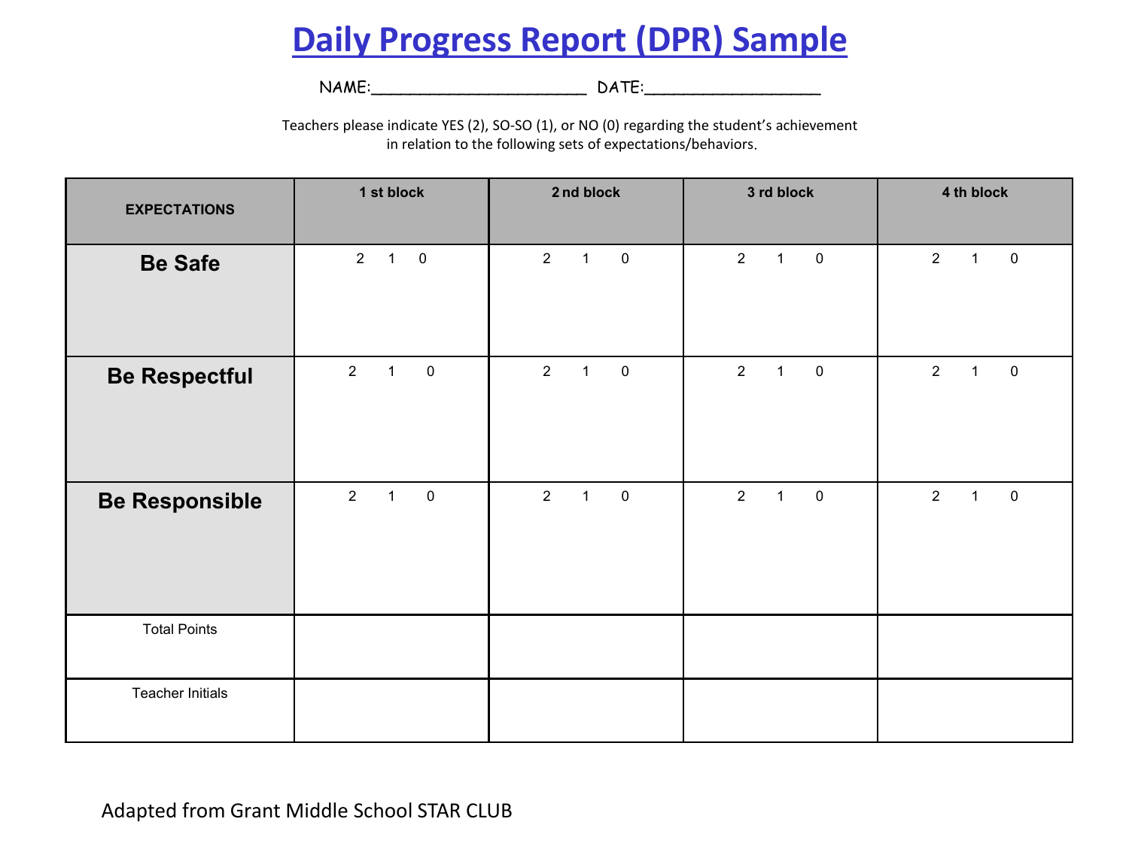
CICO Intervention Coordinator
How would coordinators prepare for this role?
Training for self
Preserving time for coordination, support and communication
Preparation of CICO materials to be utilized
Identify avenues for communication with stakeholders

Slide 24
CICO Intervention Coordinator
How would coordinators prepare the school community for CICO?
Prepare training & communication for others involved
Staff
Student
Families
Resource: Tier 2: Initial Overview & Training Checklists
Includes a checklist per population and a sample CICO FAQ for use with staff that will help support your training and communication efforts.

Slide 25
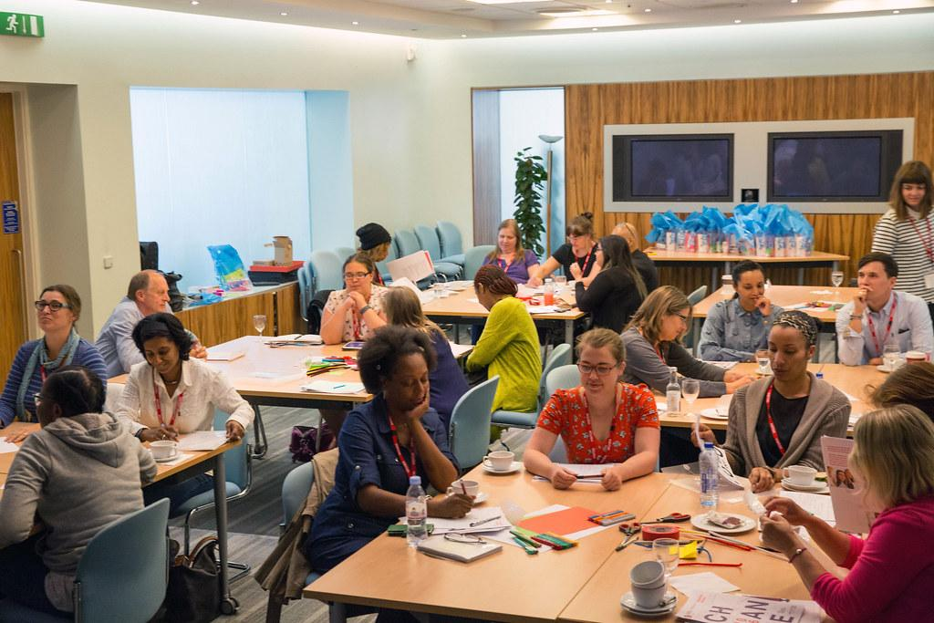
Staff Overview & Training
Rolling out CICO Training for ALL staff
Provide an overview of CICO as part of Tier 2 System
What is CICO / FAQ
Characteristics of students who are good candidates for Check-in/Check-out
How to make a nomination for intervention / Request for Assistance or Nomination Form
Solicit interest in being a CICO Facilitator
Train staff in how the intervention will work and use of CICO Daily Progress Report (DPR)
Emphasis on increased positive interaction and relationship building
Corrective vs. negative feedback
Provide other prompts for teachers, based on common student reactions (e.g., “What to do when a student is unhappy with their score”)

Slide 26
Staff CICO Intervention Updates
Provide routine information about enrollment, graduation, staff participation, and resources.
Give opportunity for questions or discussion.
Staff Update Example:
CICO Outcomes for February 2022
Reminder that info on CICO can be found on the MTSS page of our website.
Current enrollment in CICO Intervention = 32
Number of students that graduated this month = 7!
Thanks to the following staff who have been active with the CICO program so far this year. (list names) To join us as a facilitator see Ms. Checker. We’d love to have you!
Check out our current data (show chart) and let us know if you have data questions.

Slide 27
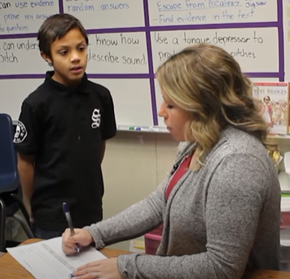
Student Overview & Training
Rolling out CICO Training for students
For students participating in CICO
Purpose of CICO
Process -
CICO Facilitator & logistics of when/where to meet
Use of DPR & goal setting
Reinforcement system
Process of receiving feedback (positive & corrective)

Slide 28
Systems for Reinforcing
Students
Will students receive “ticket” or other type of reinforcement for checking in/out? Daily? Weekly?
Unexpected or Intermittent reinforcement for “being brave” and handing in a DPR with low scores
Intermittent reinforcement for checking out with DPR ('catch kids' doing the right thing, look for other opportunities to provide intermittent reinforcement)
Staff
How will you acknowledge staff for participating in CICO?
What intermittent unexpected reinforcement will be offered to staff?
Illinois PBIS Network

Slide 29
Parent/Family Overview & Training
Rolling out CICO Training for families
For all families, provide general information about CICO as part of MTSS:
Post on school website and/or via handbook
Share through school newsletter
Orient during open house
For families of participating students:
Orient to process via direct contact (phone/zoom call/meeting)
Followed up with written information (email/letter/sample DPR)
Consent: check with your district’s decision makers
Provide routine updates about progress

Slide 30
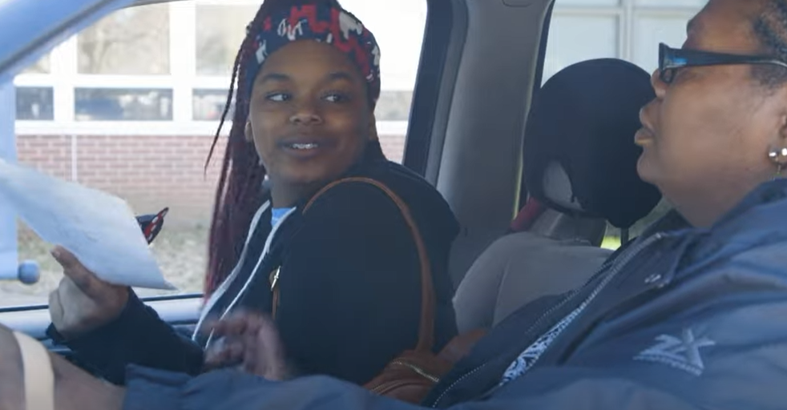
Parent/Family Overview & Training
Rolling out CICO Training for families
Provide an overview of CICO for families of participating students
Purpose of CICO
Expectations for their child’s participation
Check-in with partner CICO Facilitator
Teacher feedback throughout the day
Check-out partner CICO Facilitator
Reinforcement system
Home component
Reviewing DPR & providing positive feedback
Contact for questions
Resource: Best Practices and Tips for Working with Families on CICO
Includes additional guidance, sample scripts, and resources to support collaboration with families.

Slide 31
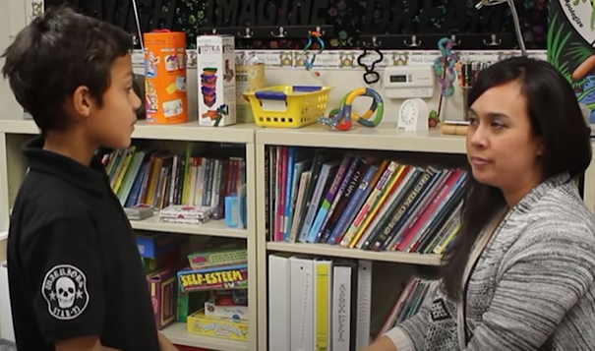
CICO: Roles-The Adult Network
CICO Facilitators-Trained Staff
Provides CICO support services to students via brief meetings
Tracks and reports student progress

Slide 32
CICO Intervention Facilitators
Who would make good CICO Intervention Facilitator?
Positive orientation
Ability to build strong student relations
Flexibility in schedule to support brief AM/PM check-in
Solid organization & communication skills
How would facilitators prepare for this role?
Engage in training with CICO coordinator
Preserving time for check-ins with back up plan as needed
Preparation of DPR forms for assigned students & data collection plan
Establish routines for data collection, entry support
How would facilitators prepare others for CICO?
Support CICO coordinator in training for students, families

Slide 33
CICO Facilitator Training
Rolling CICO Training for Facilitators
Build upon CICO Overview provided to all staff to support facilitators to…
Understand their role in the process
Identify strategies to build and maintain positive relationships
Set up and use of CICO Daily Progress Report (DPR) with each assigned student
Practice and use positive, specific praise when meeting goals; tangible reinforcement based on plan
Practice and use corrective rather than negative feedback to support reaching goals/meeting expectations

Slide 34
Students need effective and equitable intervention systems and practices so data is integral:
OUTCOMES
SYSTEMS
DATA
EQUITY
PRACTICES
Notes:
34

Slide 35
Now, we are going to talk about data-related considerations and tools to support your CICO:
Student Matching
Start of School Day
Monitoring Throughout the Day
End of School Day
Review Cycle(s)

Slide 36
Interventions Need People and Progress-Monitoring
….this is where DATA comes into play
Student Matching
Start of School Day
Monitoring Throughout the Day
End of School Day
Review Cycle(s)
1
2
3
IN
ON
OUT

Slide 37
Student Matching
Start of School Day
Throughout the Day
End of School Day
Review Cycle
How you recognize students as possible candidates for CICO:
Referral for Assistance for additional supports to layer onto Tier 1
Tier 2 team has RFA and/or referral process
Existing data
Office discipline referrals (ODRs)
Observed changes in behavior
Screening data
Characteristics of student for CICO consideration
IN rule for CICO (guidance should be determined for all Tier 2 interventions)

Slide 38
Appropriate & Inappropriate Candidates for CICO
Student Matching
Start of School Day
Throughout the Day
End of School Day
Review Cycle
Appropriate Candidates | Inappropriate Candidates
Engage in problem behavior throughout the day, in multiple settings | Engage in problem behavior during one class period or only in unstructured settings (e.g., playground, hallways, lunchroom, bus area)
Engage in mild acting-out behaviors, such as talking out, off task, or out of seat | Engage in serious or violent behavior, such as extreme noncompliance or defiance, aggression, unjury to self or others
Problem behavior is not solely related to trying to escape difficult academic work. Assessments indicate instructional material is at the student’s level | Problem behavior mainly occurs when student is trying to escape a difficult task or academic subject. Assessments indicate instructional material is not at the student’s level
Excerpt from Michigan’s Integrated Behavior and Learning Support Initiative (MIBLSI)

Slide 39
Research shows function matters
Student Matching
Start of School Day
Throughout the Day
End of School Day
Review Cycle
Research results indicate that:
for students with attention-maintained behavior, implementation of CI/CO was associated with statistically and clinically significant improvements in ratings of problem behavior, ratings of prosocial behavior, and office discipline referrals.
However, for students with escape-maintained behavior, no statistically significant effects were found.
There exists the need for multiple tier two interventions in both academic and behavior support.
McIntosh et al., 2009

Slide 40
Matching begins with anchors…
 | School Name:______________________________________ Updated:_______________________
 | School Name | Intervention Name | Contact Name | Skill or Relationship (S/R) | Data Rules:
 |  |  |  |  | In | On | Out
 | SES | CICO | Ms. Coordinator | S+R
…on your team IN/ON/OUT worksheet.

Slide 41
Matching begins with anchors…
 | School Name:______________________________________ Updated:_______________________
 | School Name | Intervention Name | Contact Name | Skill or Relationship (S/R) | Data Rules:
 |  |  |  |  | In | On | Out
 | SES | CICO | Ms. Coordinator | S+R
Your Tier 2 team decides IN threshold. Consider behaviors that indicate that student is beginning to show need for Tier 2 supports. Consider attendance, ODRs, behavior types, and screening data. This IN rule may change as the year goes on and Tier 2 team reviews current CICO programming.

Slide 42
Sample A…
 | School Name:______________________________________ Updated:_______________________
 | School Name | Intervention Name | Contact Name | Skill or Relationship (S/R) | Data Rules:
 |  |  |  |  | In | On | Out
 | SES | CICO | Ms. Coordinator | S+R | Frequency of incidents, failing 1 or more academic subjects, 2+ referrals (discipline), 8+ unexcused absences in 1 marking period, attention seeking behavior

Slide 43
Sample B…
 | School Name:______________________________________ Updated:_______________________
 | School Name | Intervention Name | Contact Name | Skill or Relationship (S/R) | Data Rules:
 |  |  |  |  | In | On | Out
 | SES | CICO | Ms. Coordinator | S+R | 2 or more ODRs

Slide 44
Student Matching
Start of School Day
Throughout the Day
End of School Day
Review Cycle
In MTSS - Progress-Monitoring is Key
Daily Review Cycle
Individual student data review by Facilitator with Student
Intervention Review Cycle
Individual student data review by Coordinator/Tier 2 Team
Across students by Coordinator/Tier 2 Team

Slide 45
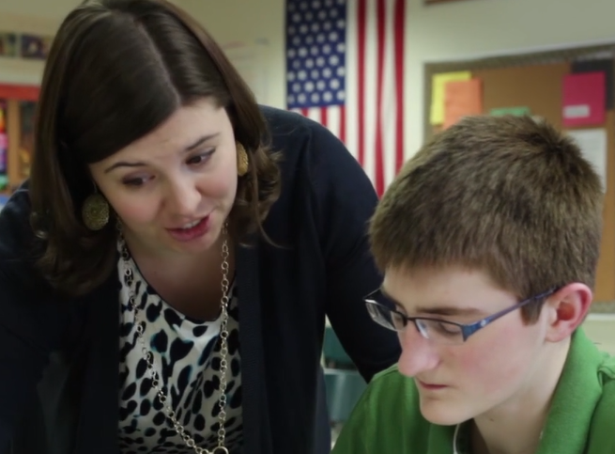
Student Matching
Start of School Day
Throughout the Day
End of School Day
Intervention Review Cycle
Daily Review Cycle
Daily Review Cycle
Individual student data review by Facilitator with Student
Intervention Review Cycle
Individual student data review by Coordinator/Tier 2 Team
Across students by Coordinator/Tier 2 Team

Slide 46
Daily Progress Report (DPR) - Elementary Level
Name: _____________________________
Date: ________________________
Points Goal:________
Points Earned: ___/24 Points Possible
= 2 Points
=1 Point
=0 Points
Expectation. We Are | Period 1 | Period 2 | Period 3 | Period 4
Safe
Respectful
Responsible
Staff Initials
Total Points
Goal Reached? Yes No
Teacher Signature:___________________________________________________________
Comments:____________________________________________________________________________

Slide 47
Daily Progress Report (DPR) - Secondary Level
Can keep but also need to reformat/recreate w/ in slide
Name: _____________________________ Date: ___________
Rating Scale: 2-Great, 1-Sorta, 0-Try Again
Goal: We are… | Period 1 | Period 2 | Period 3 | Comments
Safe | 0 1 2 | 0 1 2 | 0 1 2
Kind | 0 1 2 | 0 1 2 | 0 1 2
Responsible | 0 1 2 | 0 1 2 | 0 1 2
Total Points
Points Possible: 18 Goal to Meet:_____ Points Received:_____
Goal Met? Yes No
Comments:_________________________________________________________________________________________________________________________________________________________________________________________________________
Parent/Guardian Signature:________________________________________________________________

Slide 48
Daily Progress Report (DPR) - Secondary Level (HS)
Name:_____________________________ Date:______________
Teachers: Please indicate Yes (2), So-So (1), or No (0) regarding student’s achievement for the following goals today.
Goals | Period 1/5 | Period 2/6 | Period 3/7 | Period 4/8
Be There | 2 | 2 | 2 | 1
Be Ready | 1 | 1 | 1 | 2
Best Effort | 2 | 1 | 2 | 1
Homework Complete | 1 | 0 | 1 | 0
Teacher Comments: Please state briefly any specific behaviors or achievements that demonstrate the student’s progress
Period 1/5:______________________________, Period 2/6:______________________________, Period 3/7:______________________________,

Slide 49
Paper Isn’t Your Only Option…consider electronic DPRs
Class Dojo - track points earned, not lost
PBIS Apps - CICO- SWIS app
Excel/Google
Tips: Teacher/Student conversation per class should accompany teacher completing the Daily Progress Report

Slide 50
Student Matching
Start of School Day
Throughout the Day
End of School Day
Review Cycle
Daily Review Cycle
Daily Review Cycle
Individual student data review by Facilitator with Student
Intervention Review Cycle
Individual student data review by Coordinator/Tier 2 Team
Across students by Coordinator/Tier 2 Team
A tool to help track this progress monitoring effort…
CICO Daily Progress Report Data Tracking Tool

Slide 51
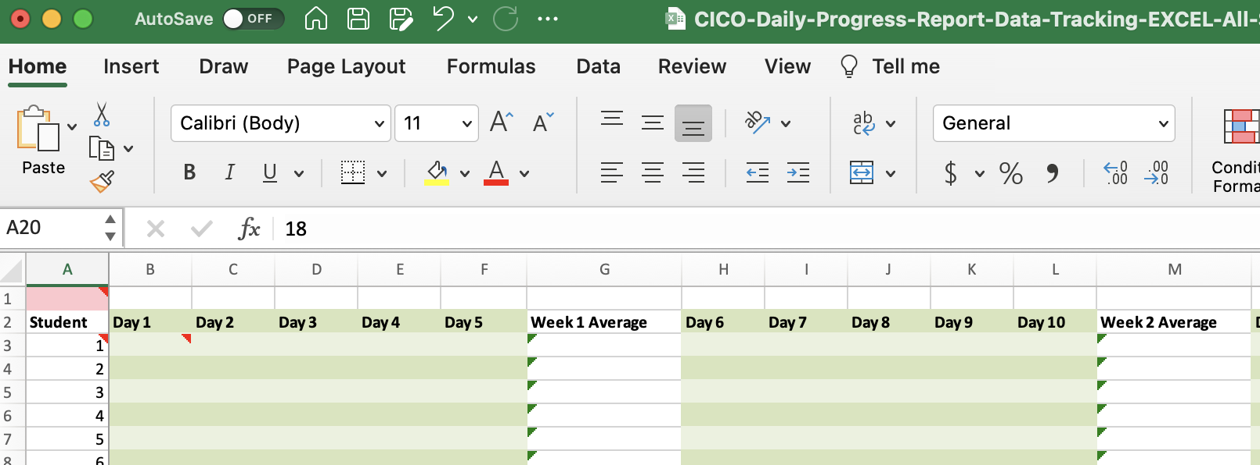
Success
CICO Daily Progress Report Data Tracking Tool

Slide 52
Tracking Sheet
CICO Daily Progress Report Data Tracking Tool

Slide 53
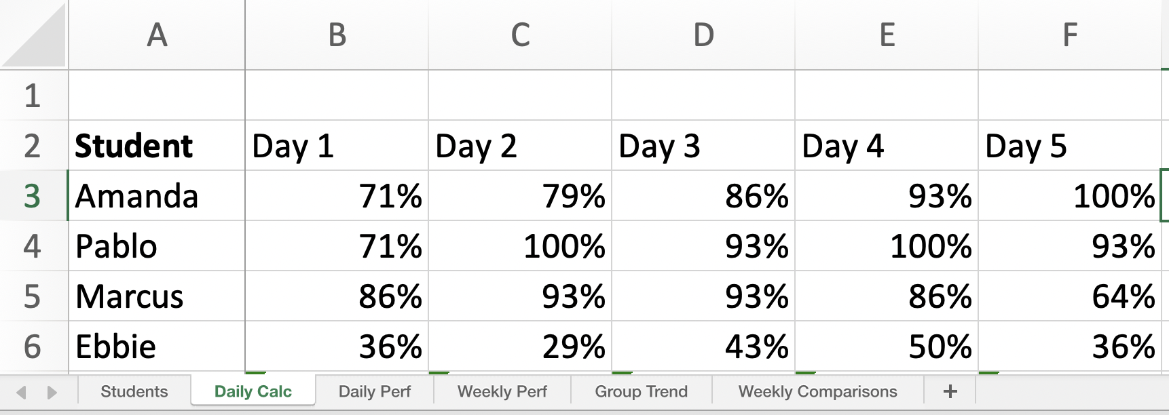
Tracking Sheet
CICO Daily Progress Report Data Tracking Tool

Slide 54
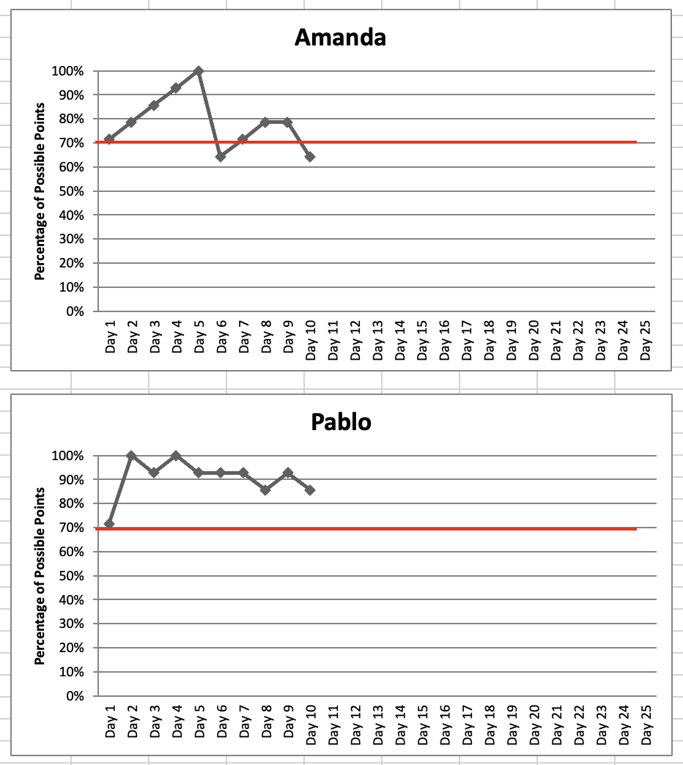
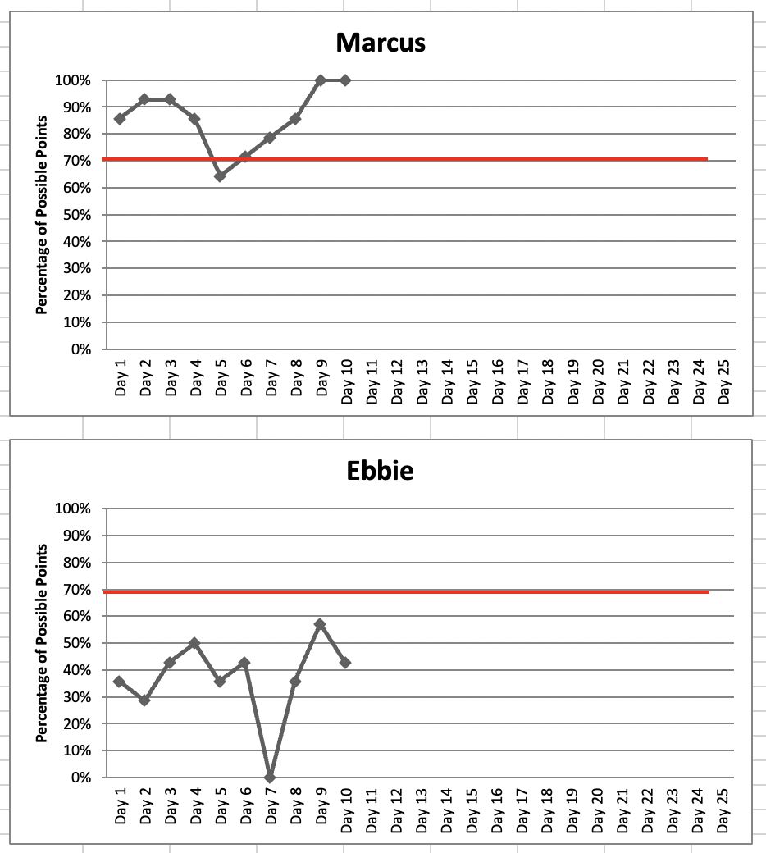
Tracking Sheet
CICO Daily Progress Report Data Tracking Tool

Slide 55
Student Matching
Start of School Day
Throughout the Day
End of School Day
Review Cycle
Daily Review Cycle
Individual student data review by Facilitator with Student
Intervention Review Cycle
Individual student data review by Coordinator/Tier 2 Team
Across students by Coordinator/Tier 2 Team
Again…the…
CICO Daily Progress Report Data Tracking Tool

Slide 56
Now what?
 | School Name:______________________________________ Updated:_______________________
 | School Name | Intervention Name | Contact Name | Skill or Relationship (S/R) | Data Rules:
 |  |  |  |  | In | On | Out
 | SES | CICO | Ms. Coordinator | S+R | Frequency of incidents, failing 1 or more academic subjects, 2+ referrals (discipline), 8+ unexcused absences in 1 marking period, attention seeking behavior | Check in after 2 weeks: 70% CICO tracker for 2 weeks, increase in academic performance, fewer referrals, attendance improvement

Slide 57
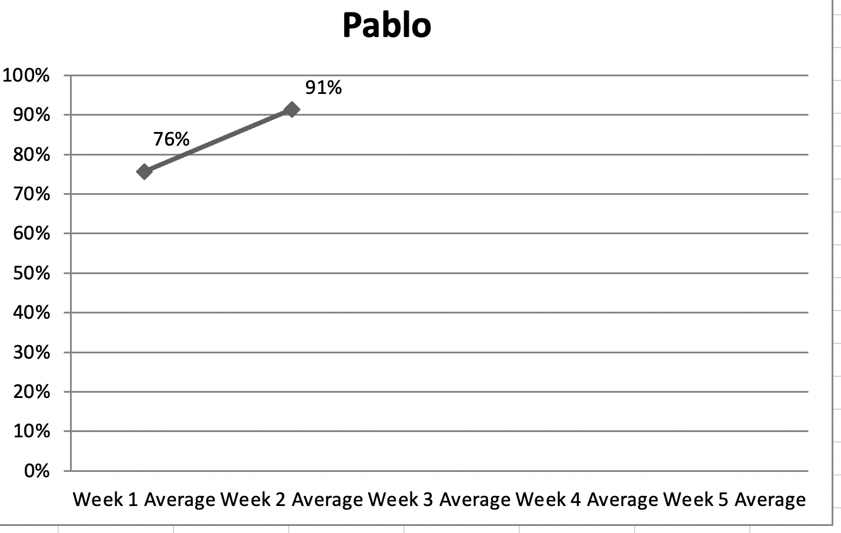
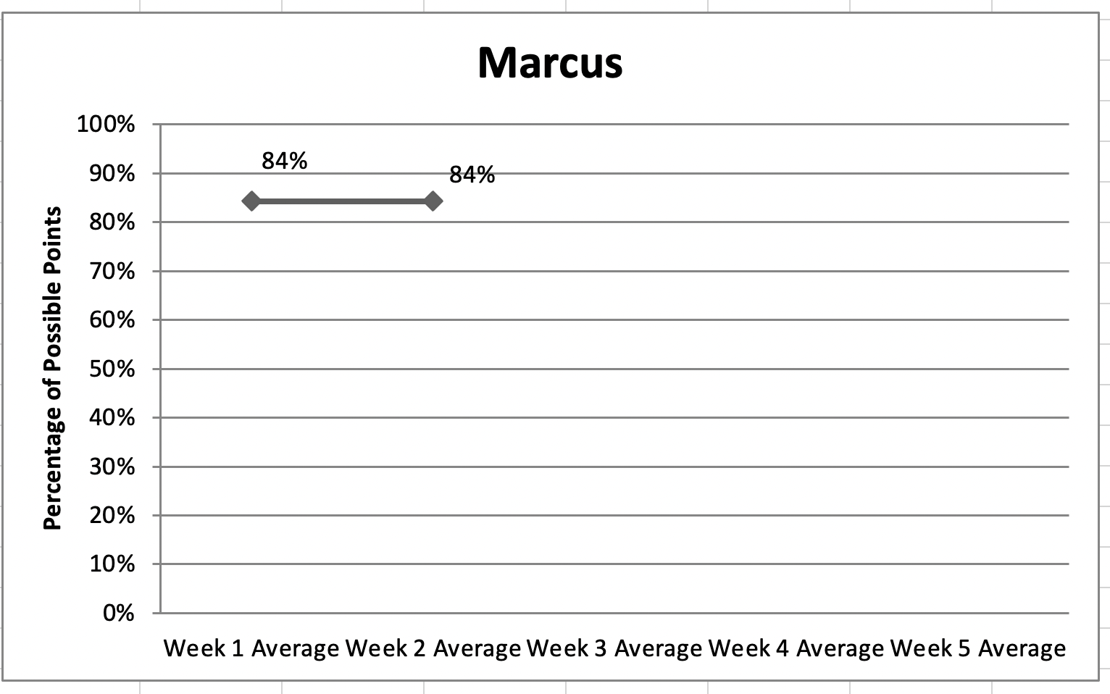
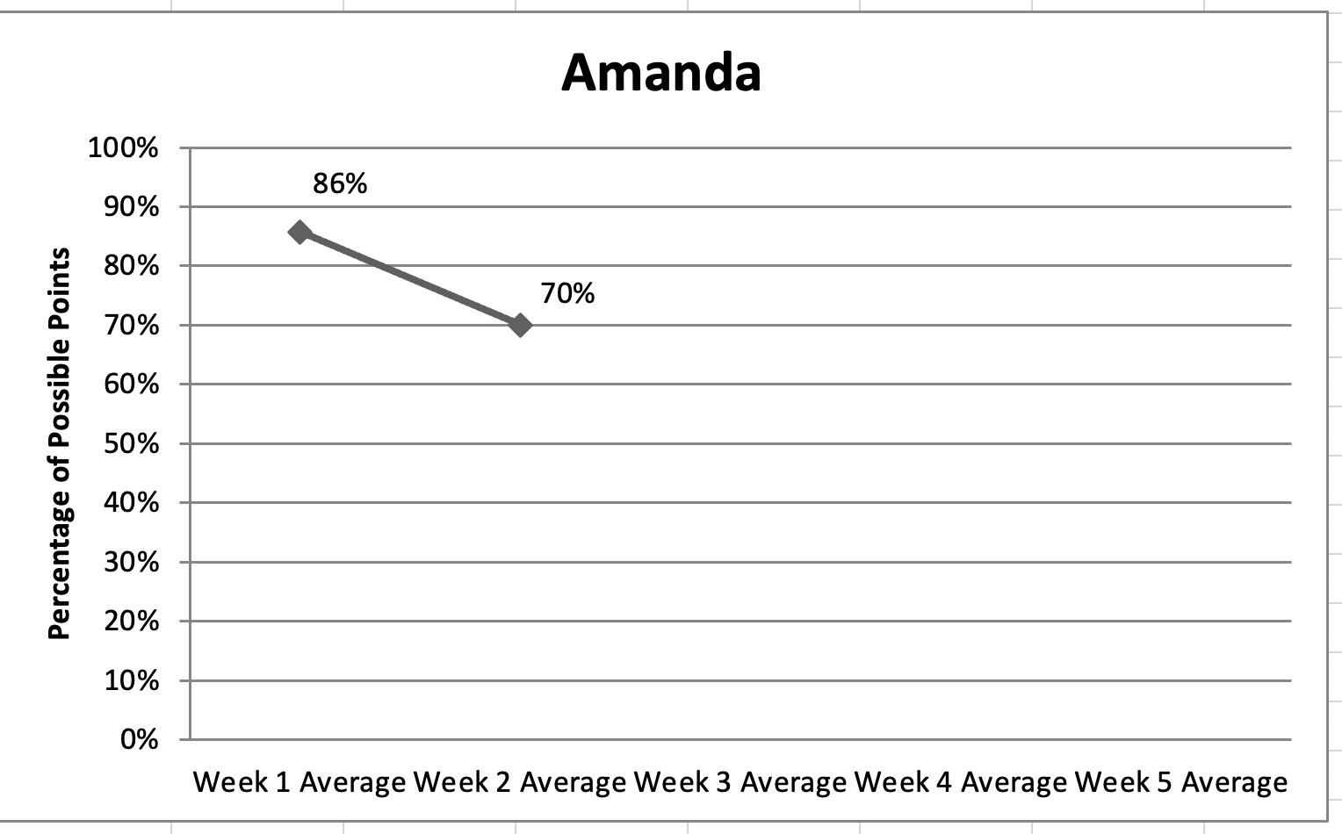
Tracking Sheet (cont.)
CICO Daily Progress Report Data Tracking Tool

Slide 58
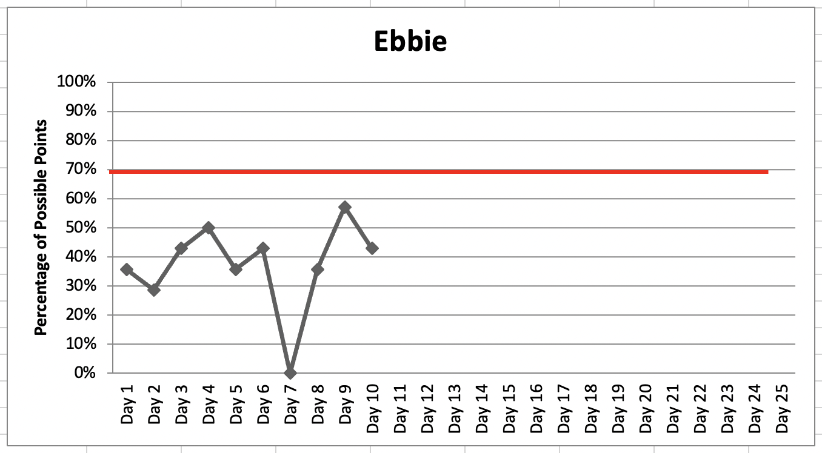
Tracking Sheet (cont.)
CICO Daily Progress Report Data Tracking Tool

Slide 59
Data-Based Problem-Solving Decision-Rules
& What To Do Next:
When A student is not making progress or starting to thrive more (consistently 70% below meeting ON rules, overall response to intervention)
Look at program components for that student
Use Reverse Request for Assistance
Consider alternative and/or additional interventions

Slide 60
Alright! Way to go for meeting the OUT criteria!
 | School Name:______________________________________ Updated:_______________________
 | DE School Name | Intervention Name | Contact Name | Skill or Relationship (S/R) | Data Rules:
 |  |  |  |  | In | On | Out
 | SES | CICO | Ms. Coordinator | S+R | Frequency of incidents, failing 1 or more academic subjects, 2+ referrals (discipline), 8+ unexcused absences in 1 marking period, attention seeking behavior | Check in after 2 weeks: 70% CICO tracker for 2 weeks, increase in academic performance, fewer referrals, attendance improvement | 70% or higher CICO average across 5 week, 5 weeks of <2 referrals, 5 weeks with <5 absences, decrease in attention seeking behaviors, passing all academics

Slide 61
Alright! Way to go for meeting the OUT criteria!
 | School Name:______________________________________ Updated:_______________________
 | DE School Name | Intervention Name | Contact Name | Skill or Relationship (S/R) | Data Rules:
 |  |  |  |  | In | On | Out
 | SES | CICO | Ms. Coordinator | S+R | Frequency of incidents, failing 1 or more academic subjects, 2+ referrals (discipline), 8+ unexcused absences in 1 marking period, attention seeking behavior | Check in after 2 weeks: 70% CICO tracker for 2 weeks, increase in academic performance, fewer referrals, attendance improvement | 70% or higher CICO average across 5 week

Slide 62
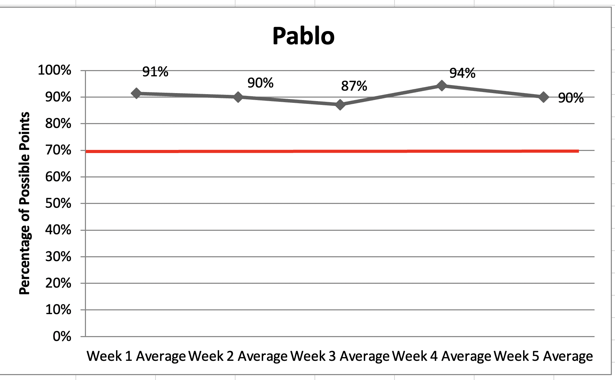
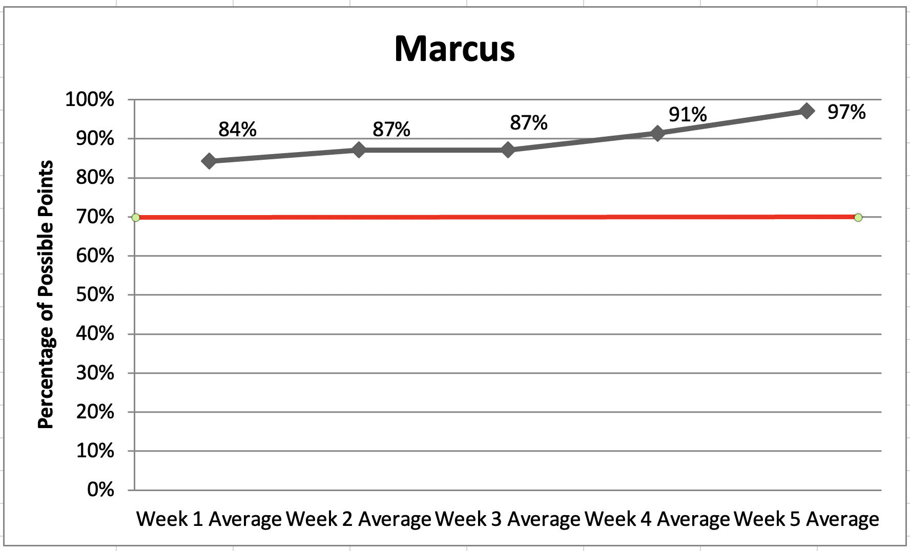
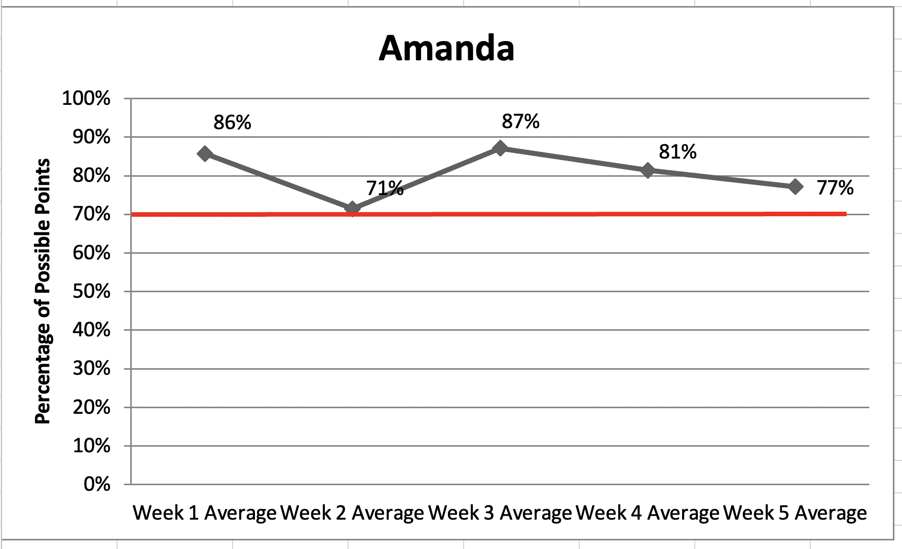
Tracking Sheet (cont.)
CICO Daily Progress Report Data Tracking Tool
OUT: 70% or higher CICO average across 5 week

Slide 63
Data-Based Fading/Exiting Decision-Rules
& What To Do Next:
Sample case: 70% or higher CICO average across 5 week, 5 weeks of <2 referrals, 5 weeks with <5 absences, decrease in attention seeking behaviors, passing all academics
Consider using student self-monitoring, fading # of classes, and/or # of expectations to cover each day within a next data-collection cycle
Consider graduation and celebration messages and/or events with student, staff, family

Slide 64
Daily Progress Report (DPR) - Elementary Level
Name: _____________________________
Date: ________________________
Points Goal:________
Points Earned: ___/24 Points Possible
= 2 Points
=1 Point
=0 Points
Expectation. We Are | Period 1 | Period 2 | Period 3 | Period 4
Safe
Respectful
Responsible
Staff Initials
Total Points
Goal Reached? Yes No
Teacher Signature:___________________________________________________________
Comments:____________________________________________________________________________

Slide 65
DPR - Elementary Level- Fading and Self-Monitoring
Name: _____________________________
Date: ________________________
Points Goal:________
Points Earned: ___/24 Points Possible
= 2 Points
=1 Point
=0 Points
Expectation. We Are | Period 1 Teacher | Period 1 Me | Agreement | Period 3 Teacher | Period 3 Me
Safe
Respectful
Responsible
Staff Initials
Total Points
?
?
?
?
?
?
Goal Reached? Yes No
Teacher Signature:___________________________________________________________
Comments:____________________________________________________________________________

Slide 66
Daily Progress Report (DPR) - Secondary Level
Name: _____________________________ Date: ___________
Rating Scale: 2-Great, 1-Sorta, 0-Try Again
Goal: We are… | Period 1 | Period 2 | Period 3 | Comments
Safe | 0 1 2 | 0 1 2 | 0 1 2
Kind | 0 1 2 | 0 1 2 | 0 1 2
Responsible | 0 1 2 | 0 1 2 | 0 1 2
Total Points
Points Possible: 18 Goal to Meet:_____ Points Received:_____
Goal Met? Yes No
Comments:_________________________________________________________________________________________________________________________________________________________________________________________________________
Parent/Guardian Signature:________________________________________________________________

Slide 67
DPR - Secondary Level- Fading and Self-Monitoring
Name: _____________________________ Date: ___________
Rating Scale: 2-Great, 1-Sorta, 0-Try Again
Goal: We are… | Period 1 TEACHER | Period 1 ME | Match | Period 3 TEACHER | Period 3 ME | Match
Responsible Overall | 0 1 2 | 0 1 2 | 100% | 0 1 2 | 0 1 2 | 100%
Turn-In Homework | 0 1 | 0 1 | 100% | 0 1 | 0 1 | 100%
Total Points
Points Possible: Goal to Meet:_____ Points Received:_____
Goal Met? Yes No
Comments:_________________________________________________________________________________________________________________________________________________________________________________________________________
Parent/Guardian Signature:________________________________________________________________

Slide 68
DPR - Secondary Level- Fading and Self-Monitoring
Name: _____________________________ Date: ___________
Rating Scale: 2-Great, 1-Sorta, 0-Try Again
Goal: We are… | Period 1 TEACHER | Period 1 ME | Match | Period 3 TEACHER | Period 3 ME | Match
Responsible Overall | 0 1 2 | 0 1 2 | Yes No | 0 1 2 | 0 1 2 | Yes No
Turn-In Homework At Class Start | 0 1 | 0 1 | Yes No | 0 1 | 0 1 | Yes No
Total Points
Points Possible: 12 Possible Matches: 4 Points Goal:_____ Points Received:_____ Matches Goal:_____ Matches Made: __
Goals Met? All Some None
Comments:_________________________________________________________________________________________________________________________________________________________________________________________________________
Parent/Guardian Signature:________________________________________________________________

Slide 69
DPR - Secondary Level- Fading and Self-Monitoring
Name: Marcus Date: March 10, 2022
Rating Scale: 2-Great, 1-Sorta, 0-Try Again
Goal: We are… | Period 1 TEACHER | Period 1 ME | Match | Period 3 TEACHER | Period 3 ME | Match
Responsible Overall | 0 1 2 | 0 1 2 | Yes No | 0 1 2 | 0 1 2 | Yes No
Turn-In Homework At Class Start | 0 1 | 0 1 | Yes No | 0 1 | 0 1 | Yes No
Total Points
Points Possible: 12 Possible Matches: 4 Points Goal:8 Points Received: 9 Matches Goal: 4 Matches Made: 3
Goals Met? All Some None
Comments: Period 1: Excellent day. Period 3: Almost there. Please complete all classwork in Period 3. Nice job on HW.
Parent/Guardian Signature:________________________________________________________________

Slide 70
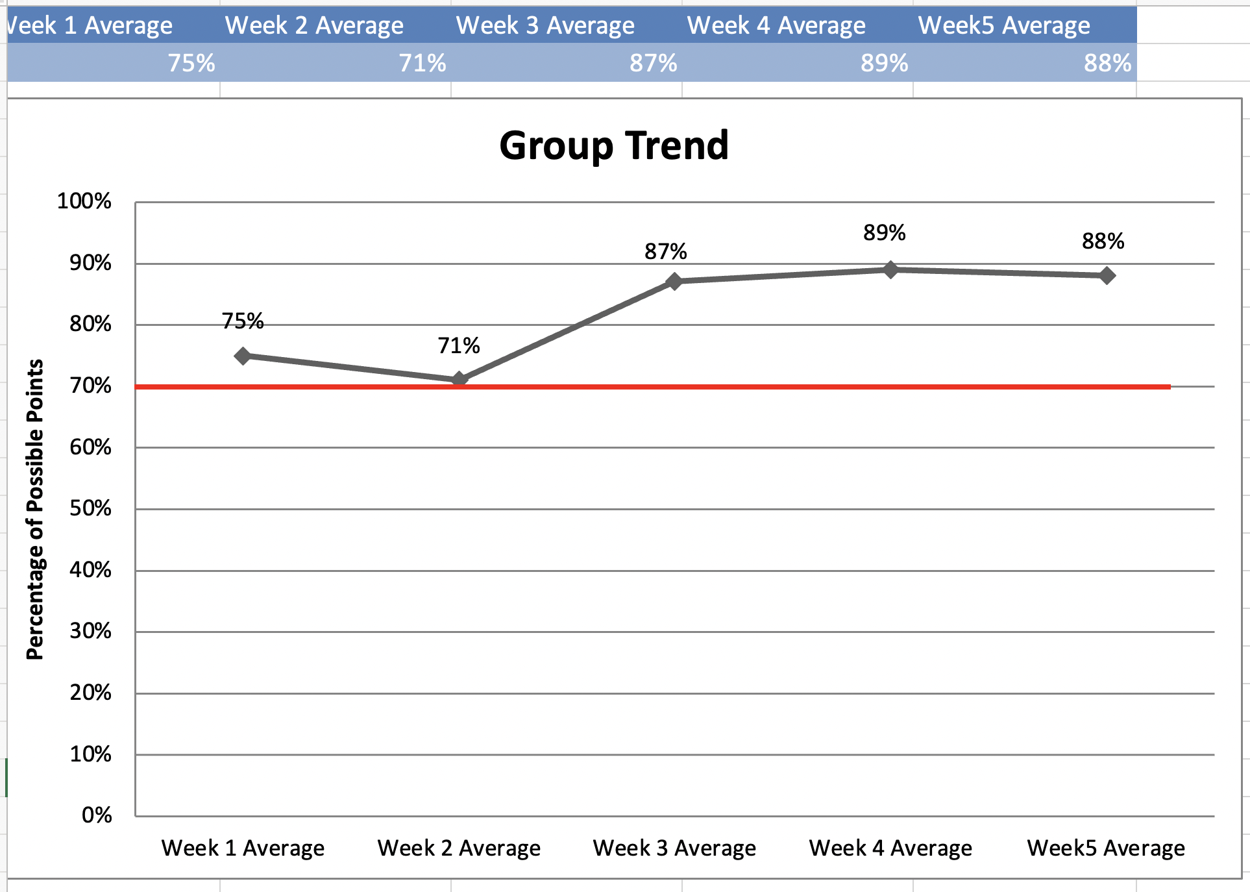
Tracking Sheet (cont.)
CICO Daily Progress Report Data Tracking Tool

Slide 71
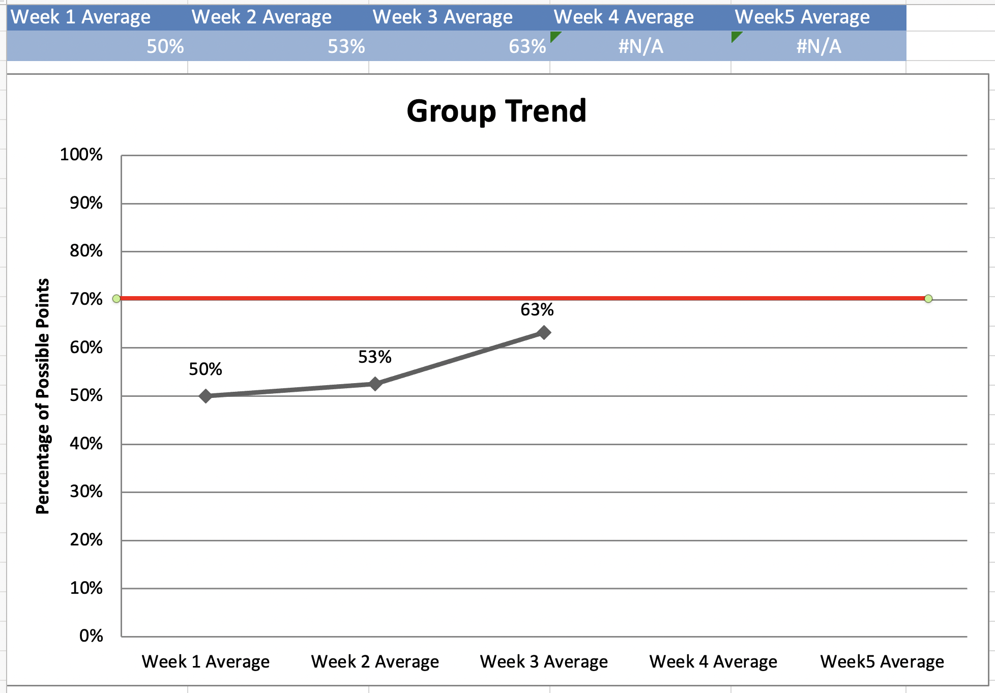
Tracking Sheet (cont.)
CICO Daily Progress Report Data Tracking Tool

Slide 72
Data-Based Problem-Solving Decision-Rules
& What To Do Next:
When students as a group are not making progress (70% meeting ON rules)
Consider impact of individual students
Look at program components for students
Fidelity check is key

Slide 73
Fidelity check
Your training checklists for student, staff, and family
Missouri: Monitoring Fidelity of Implementation Observation Checklist
Colorado: CICO Self-Assessment and Action Plan

Slide 74
9 Major Check-Up Points for Revitalizing
Buy in from majority of staff on why and how CI/CO should be implemented Process for identifying students including data rules Linked to School-wide Expectations Students taught how CI/CO works prior to starting Teachers trained in how to appropriately implement CICO in classroom Parents notified about program and receive progress updates Fidelity of implementation assessed – including CICO Facilitators and Teachers Student progress monitored by the team and determinations made for fading or changing intervention Set criteria for considering if CICO is an effective intervention (e.g. 70% percent of students meeting point card goals)

Slide 75
5 Tips from an experienced CICO Implementer
Dr. Melinda Tartaglione
Talley Middle School and Claymont Elementary School
Brandywine School District

Slide 76
[Melinda’s slide(s), she is sending]
10 mins

Slide 82
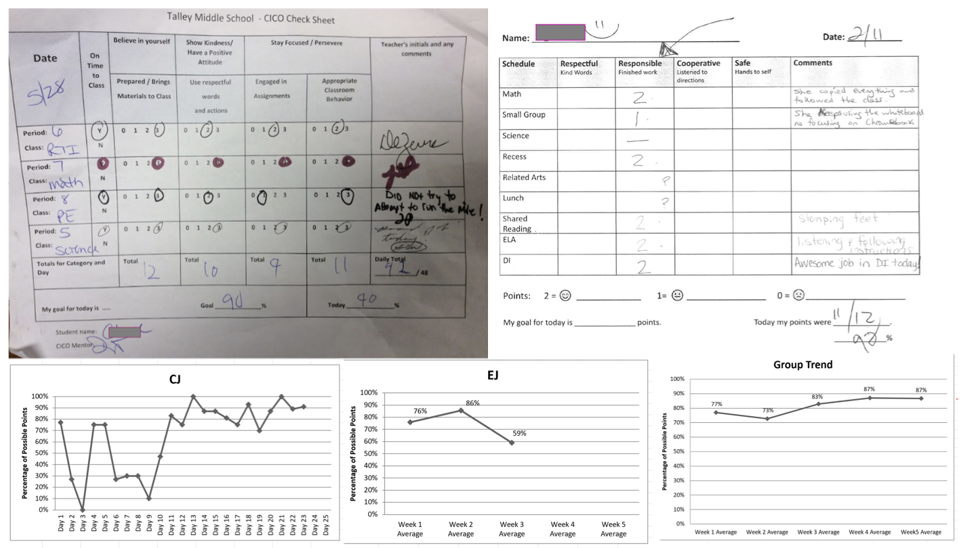

Slide 83
For more information, especially if you are coaching teams:

Slide 84
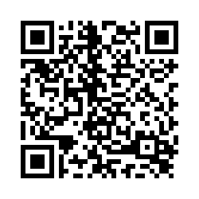
Thank you for joining us!
Please fill out our evaluation

