Slide 1
DE-PBS Cadre Meeting
April 14, 2022

Slide 2
Meeting Expectations
We are... | Virtual Meetings
ENGAGED | Unmute yourself or use chat box to ask questions Participate in open discussion and breakout rooms Use video when possible, especially when speaking
REFLECTIVE | Share questions you have for full group Note follow up questions for PBS team and/or individuals Focus on problem solving around areas of concern
SUPPORTIVE | Share successes, ideas, useful resources Listen with openness and understanding Attend to your own needs

Slide 3
Welcome and Agenda
Phase Recognition
Data Updates & Reminders
School Year Reflection & Summer Planning for Coaching
Upcoming Events

Slide 4
Phase Recognition
2021-22

Slide 5
DE-PBS Phase Recognition
Maintaining for 2021-2022 School Year
Phases 1 & 2 – Focus on Tier 1: School-wide PBS
Phases 3 & 4 – Tier 2: Targeted PBS
Reminder: applications prompt reflection & planning; perfect for summer meetings
Deadline is August 5th

Slide 6
Recognition
Phase 1 and 2...focus on Tier 1
Phase 3 and 4...focus on Tier 2
Tier 1 and 2 teams in a school can both apply for 2021-2022 Recognition
Your input, the FAQs & the Word versions of the online application questions will help teams decide which phase is a match for current implementation
All application materials include opportunities for team reflections

Slide 7
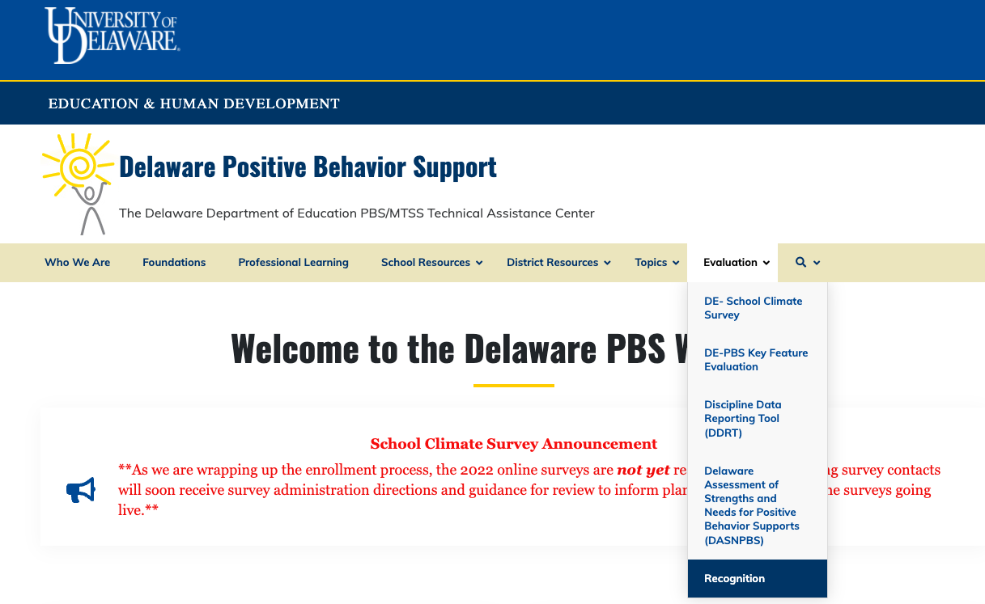
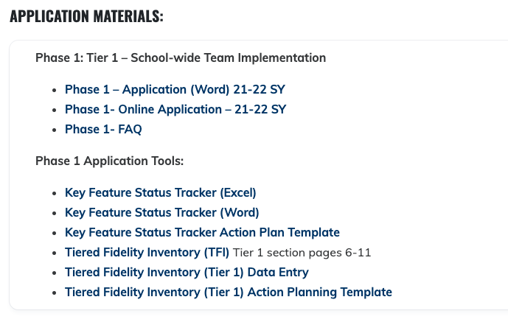
Recognition
Start here!

Slide 8
Recognition
Dates To Keep in Mind:
Recognition process reflects = 2021-2022 SY
Online submission due date: August 5th, 2022
DE-PBS Project receipt sent: August 12th, 2022
Notification of recognition phase earned sent: Week of September 19th, 2022

Slide 9
DATA Updates & Reminders

Slide 10
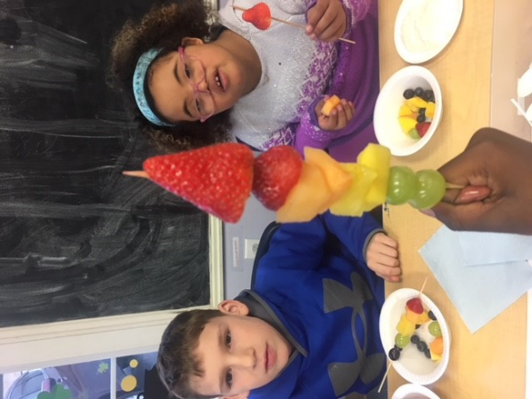
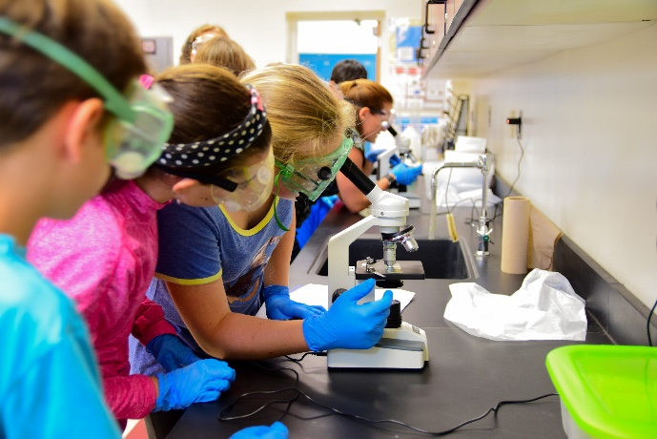
Significant Disproportionality

Slide 11
Significant Disproportionality
Data sent to Superintendents and Special Education Directors early May
Data includes Identification, Placement and Discipline
Discipline Categories include:
Total Removals, ISS > 10 days, ISS < 10 days, OSS > 10 days, OSS < 10 days
Hispanic/Latino, Native American, Asian American, African American, Native American/Pacific Islander, White, and Multi-Racial

Slide 12
Significant Disproportionality
Please reach out to Susan Veenema if there are ways that your LEA would like to look at the data deeper.
Susan.Veenema@doe.k12.de.us

Slide 13
Discipline Data Reporting Tool (DDRT)
2021-22 Templates available on website along with a tutorial as needed
Submissions are 2x per year to district coach and project
January submission - (N=82)
Full year submission due June 17th & coaches will receive reminder prior

Slide 14
Delaware School Climate Survey
Enrollment update:
159 schools from 13 districts plus charters
11 districts fully enrolled
Administration Window: April 25 - May 27
districts/schools can self-select within window to accommodate other survey/testing plans & needs
Administration Resources
Online directions with sampling guidance
Home survey letters & flyer
Completion updates
Administration & Data use strategies to share!

Slide 15
Key Feature Status Tracker
Purpose: To support teams to assess implementation in four core Tier 1 categories & plan next steps
Four sections include:
SWPBS Tier 1, Prevention, Correcting Problem Behaviors, and Developing Self-Discipline
Tracker includes:
–Key program components for each section
-Teams can use prompts to reflect on implementation and identify areas to modify or build upon
–Action plan to develop steps towards improving or modifying Tier 1 MTSS components
Used for ongoing monitoring

Slide 16
Tiered Fidelity Inventory
Tier 1
Teams, Implementation, and Evaluation
Tier 2
Teams, Interventions, and Evaluation
Tier 3
Teams, Resources, Support Plans, and Evaluation
Algozzine, B., Barrett, S., Eber, L., George, H., Horner, R., Lewis, T., Putnam, B., Swain-Bradway, J., McIntosh, K., & Sugai, G (2019). School-wide PBIS Tiered Fidelity Inventory. OSEP Technical Assistance Center on Positive Behavioral Interventions and Supports. www.pbis.org.

Slide 17
School Year Reflection and
Summer Goal Setting

Slide 18
School Year Reflection
One year of DE-MTSS Regulation 508
Year two of COVID recovery
Successes and challenges of MTSS/PBIS

Slide 19
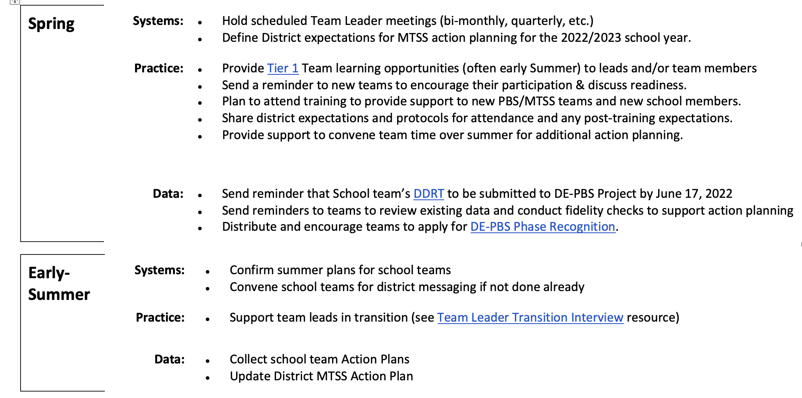
Guidance for MTSS-SEB District Coaches (21-22 SY)

Slide 20
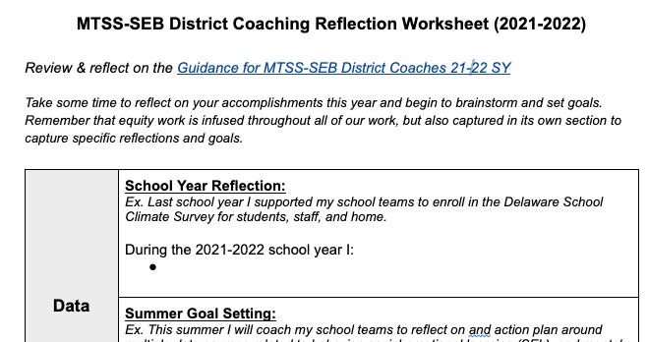
Coaching Self-Reflection Worksheet
Independently reflect on your accomplishments this school year and goal set for your work this summer
Share reflections with small group
Come back to large group to share for Project and peer support

Slide 21
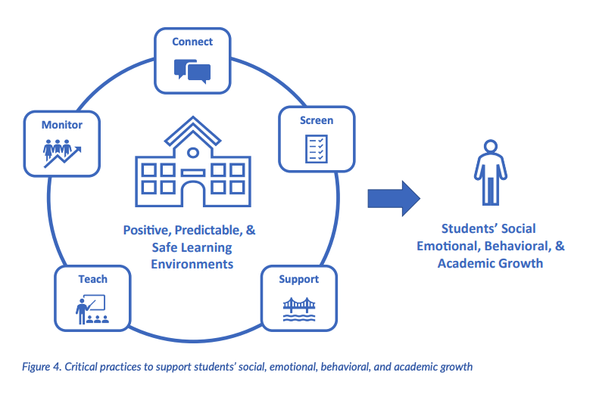
Guidance for District Leadership Teams (pages 19-26)

Slide 22
Upcoming Events: Professional learning, conferences, meetings…

Slide 23
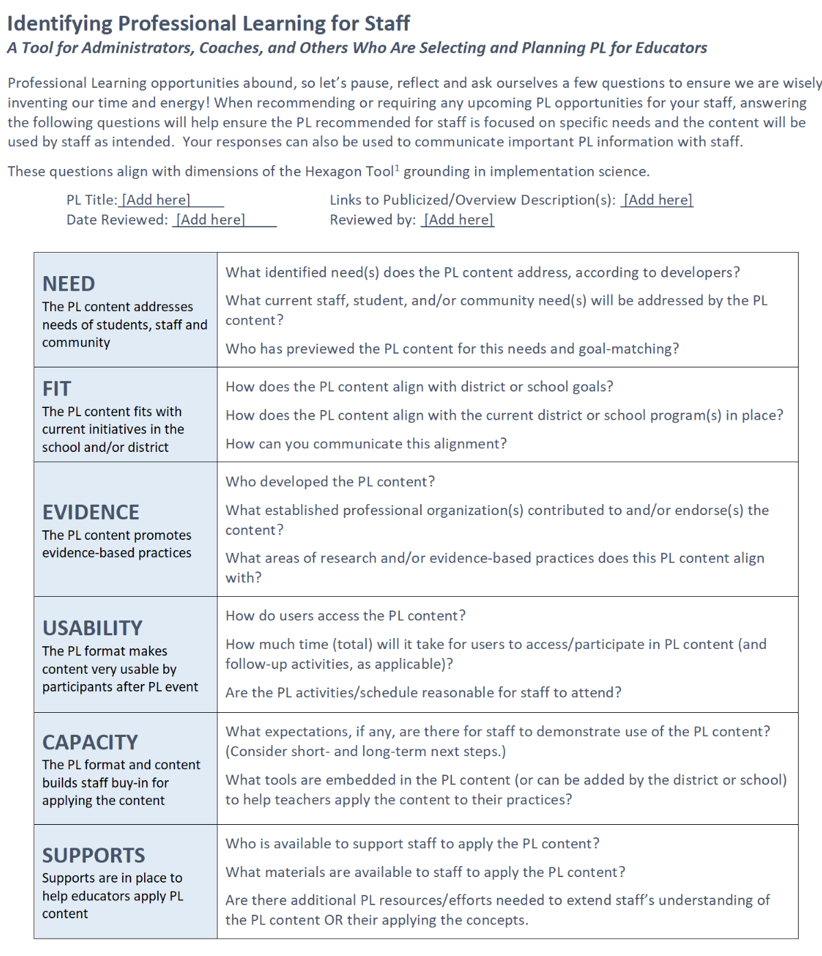
Identifying Professional Learning for Staff - A Selection Tool
Implementation Science - “Hexagon Thinking”
NEED
The PL content addresses needs of students, staff and community
FIT
The PL content fits with current initiatives in the school and/or district
EVIDENCE
The PL content promotes evidence-based practices
USABILITY
The PL format makes content very usable by participants after PL event
CAPACITY
The PL format and content builds staff buy-in for applying the content
SUPPORTS
Supports are in place to help educators apply PL content

Slide 24
Wednesday May 4th 9-12:30 (virtual)
Outline foundational Tier 3 school-level systems features (e.g., teaming, student identification, staff training, matching students with functional behavioral supports, and evaluating the overall effectiveness of Tier 3 interventions)
Move from “how” to implement FBA/BIPs toward building Tier 3 systems
Come with at least one teammate or thought partner
Register PDMS #30541 or email Brynn at bfallah@udel.edu

Slide 25
Northeast PBIS Leadership Forum
May 12, 2022 - Full day - IN PERSON!
Mystic, CT
Keynote Speaker - Dr. Nikole Hollins-Sims from the Pennsylvania Department of Education
School-Wide PBIS – provides an overview of the first tier of School-Wide PBIS, including school climate and contextual fit.
Equity – Will focus on how to implement a Positive Behavior Interventions framework within a culturally responsive lens.
Mental Health – focuses on braiding mental health supports across our PBIS framework of multi-tiered supports.
Systems to Support Staff – this strand will share content on systems that support staff to successfully implement our positive support elements and increase effectiveness.

Slide 26
Tier 2 Team Training: June 29th, 2022
In-person, extended AM
PBS Teams registration:
Tier 2 Team Leader
Committed Tier 2 Team Administrator
Tier 2 Team Member
Pre-Work
TEAMS
INTERVENTIONS
EVALUATION

Slide 27
Tier 1 Professional Learning - Summer 2022
Tier 1 MTSS/PBS Team Training - Date TBD
Think of potential teams based on interest and need
Support Readiness
Plan with administration; Administrator team buy-in is key!
Discuss team structure
Provide overview of MTSS & Tier 1 efforts

Slide 28
Upcoming DE-PBS Developed Modules
Building Strong Team-Based Leadership Module
This module is for schools and districts to build or strengthen solid teaming foundations. The module is intended for both academic and non-academic teams and committees to view collaboratively. Viewers will learn about strategies for effective teaming and will be led through a series of team-based reflections and opportunities for implementation action-planning in order to increase best practices and ultimately lead to stronger systems and successful outcomes.
Selecting and Installing a Universal SEB Screener
Webinar 1: Top Ten Questions about SEB Screening
Webinar 2: Universal Screening Tool Selection
Webinar 3: Universal Screening Readiness, Resource Mapping, Gap Analysis
Webinar 4: Parental Consent, Action Planning and Gaining Stakeholder Buy-In
Webinar 5: Data-Based Decision Making

Slide 29
Mental Health First Aid (Adult, Youth, and Teen) are all Tier 1 gatekeeper trainings
Evidence-based international mental health literacy curriculums
Equip participants to recognize signs and symptoms of mental health or substance use challenges, provide support through crisis and non-crisis situations, connect individuals to the professional help they need
Tier 1: ALL

Slide 30
Mental Health First Aid Upcoming Opportunities
Private sessions (5-30 participants) also available!
YMHFA (for adults who support youth):
PDMS Course # 29435
Wed. 4/27 9-2 section #58747
Wed. 5/18 9-2 section #59140
Mon. 5/23 9-2 section #59141
Thurs. 6/16 9-2 section #59142
Mon 6/20 9-2 section #59143
Become a YMHFA instructor:
June 20-22 -
it’s FREE!
(register by May 6th)
Contact: Adriana Ignudo adriana.ignudo@doe.k12.de.us

Slide 31
Save the Date: Youth Empowerment The Power of Voice and Choice to Overcome Trauma
Join the virtual event, Youth Empowerment: The Power of Voice and Choice to Overcome Trauma, from 9:00 a.m. to 12:00 p.m. on Saturday, April 30. Attendees will learn more about making schools and organizations physically, emotionally, and psychologically safe environments for today’s youth, including how to promote healing-centered engagement as well as build alliances with students to transform their lives and learning. Speakers will also explore ways to help students overcome systemic adversities and find equality and justice within their schools and communities. This event kicks off Trauma Awareness Month in May.
Contact Teri Lawler teri.lawler@doe.k12.de.us

Slide 32
Save the Date: Student Voices Summit
Mark your calendars for this year’s inaugural Student Voices Summit on Wednesday, July 20. This full-day experience allows youth an opportunity to build their collective efficacy and agency to advocate for physically and emotionally safe school environments. Adults may also join and help further advance social and emotional learning as well as build capacity for listening and facilitating youth on their journeys.
Questions? Email Teri Lawler at teri.lawler@doe.k12.de.us

Slide 33
DE-PBS Coach Networking: Thursday May 19th 1-2:30 pm
Center on PBIS Webinar Series:
Moving to a Culture of Coaching as Part of our Way of Work
Building shared capacity of individuals within an organization to utilize coaching practices as a way of work
Structured discussion
Sharing resources and coaching tools

Slide 34
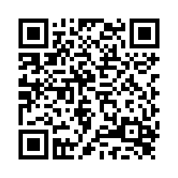
Thank you for coming!
Please fill out our survey
Last Meeting of the 21-22 SY:
Coach Networking
Thursday May 19th 1-2:30 pm

