Slide 1
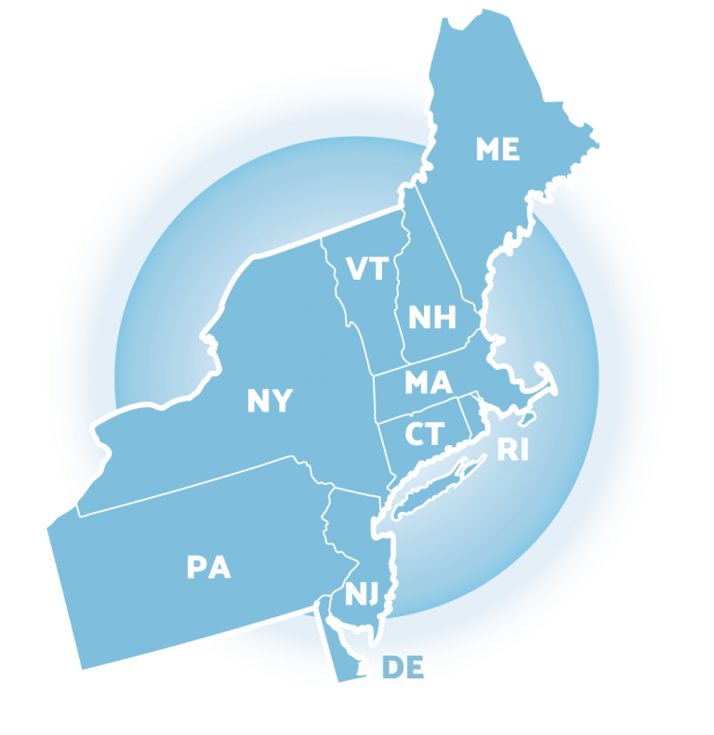
Using MTSS to Align & Integrate
SEB Practices
Debby Boyer
Sarah Hearn
Adriane Simpson
Northeast
PBIS Network
Leadership Forum
MAY 12, 2022

Slide 2
The Delaware Positive Behavior Support Project is a collaboration with the DE Department of Education, the UD Center for Disabilities Studies, and
Delaware Public Schools.
Vision create safe and caring learning environments to promote the social-emotional and academic development of all children.

Slide 3
Quick Delaware & Red Clay Statistics
DELAWARE INFORMATION
“The First State”
2nd Smallest State in the US with a length of 96 miles long and a width between 9 and 35 miles
3 counties with 43 LEAs – approximately 220 Public Schools with 64% involved with DE-PBS Project
RED CLAY CONSOLIDATED SCHOOL DISTRICT
Largest public school district in the state
Serves more than 16,000 students
15 elementary schools, 6 middle schools, 5 high schools, and 4 special education schools

Slide 4
Overview
Why integration and alignment
Using the PBIS Technical Guide for Alignment
State examples/strategies for integrating PBIS and SEL as part of Self-discipline
District and school examples for integrating PBIS and Restorative Practices
Roundtable discussion

Slide 5
TURN & TALK
Share the names of initiatives or practices related to the social, emotional or behavioral wellbeing of students your school or district has engaged over the last 2 years
When you think about your experiences with integration what comes to mind?

Slide 6
“One of the major variables affecting sustained implementation of effective practices is the introduction of new initiatives that either (a) compete with resources needed for sustained implementation or (b) contradict existing initiatives.”
McIntosh (2015)

Slide 7
Why Integrate or Align?
Reduce fragmentation, redundancy and conflict
Increase fidelity; Multiple initiatives in silos often result in none achieving fidelity - aka: it is too hard to do all the things
Build on initiatives by leveraging funding, training, coaching and evaluation in ways to improve MTSS implementation
Support efficient, effective, sustainable and scalable practices

Slide 8
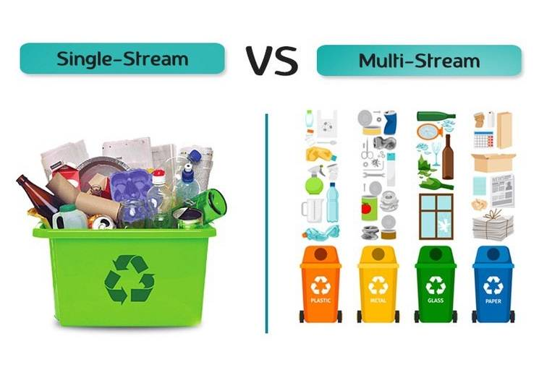
Integrated
Siloed

Slide 9
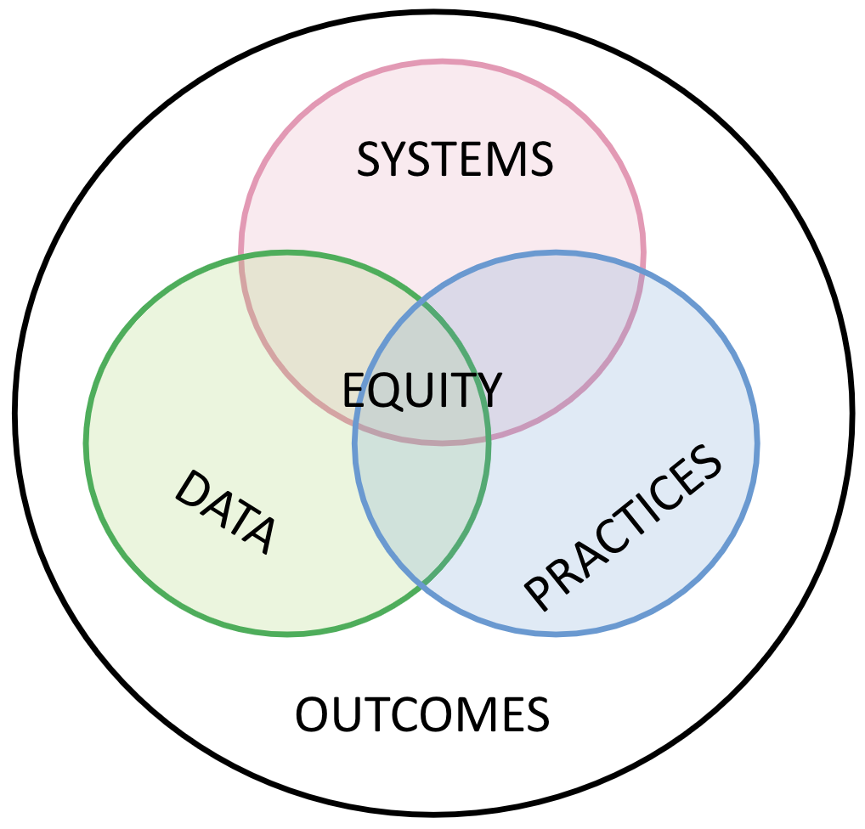
Notes:
9

Slide 10
Supporting Integration and Alignment across the Cascade
State
District
School

Slide 11
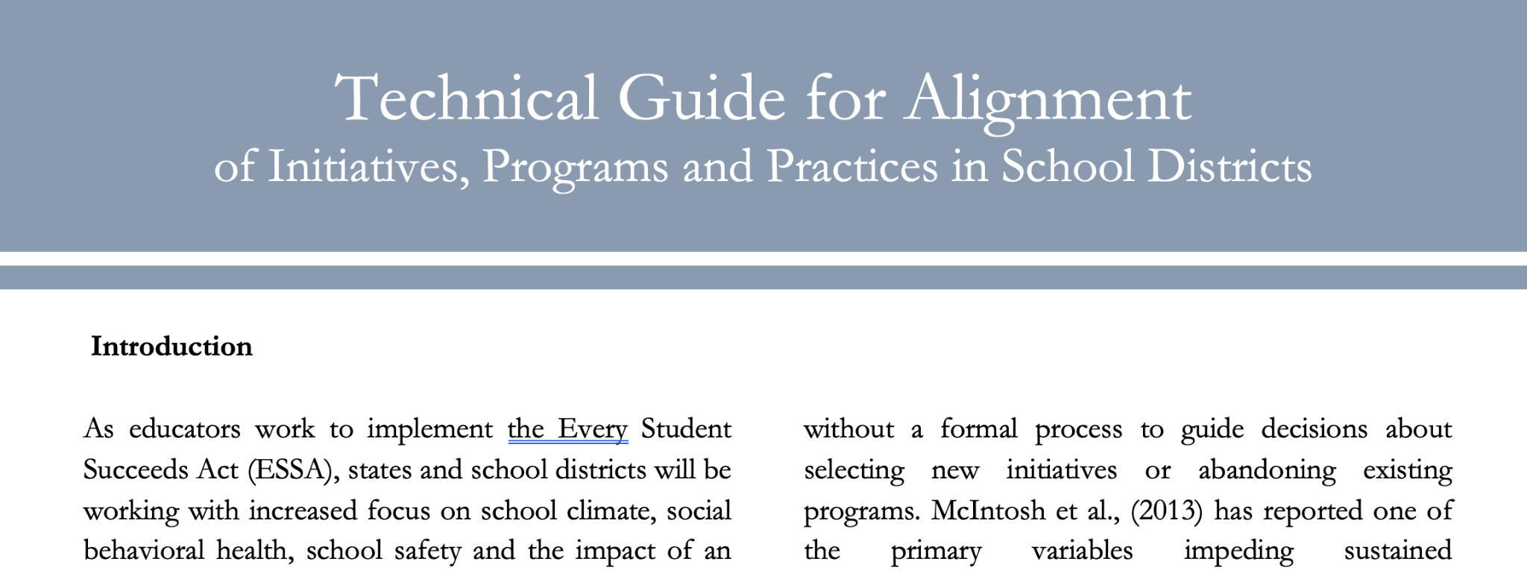
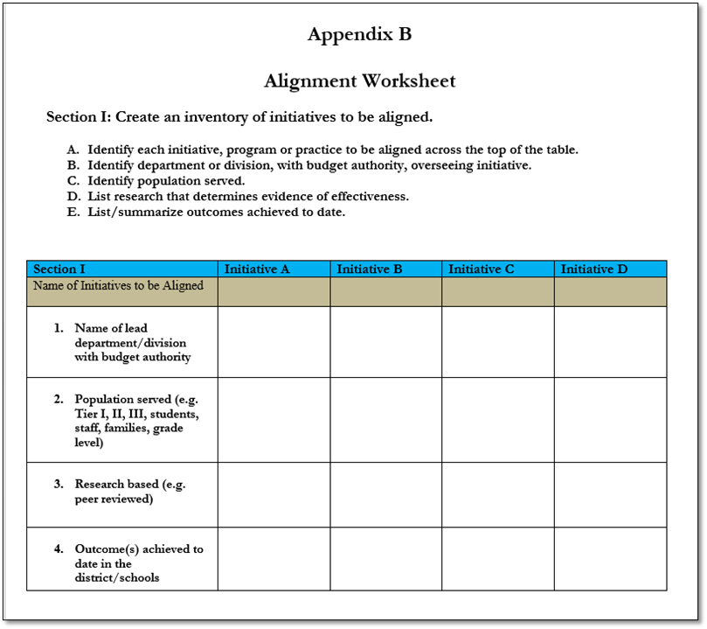
PBIS Technical Guide for Alignment
Alignment Steps
Self Assessment
Initiative Inventory
Action Planning Template
https://www.pbis.org/resource/technical-guide-for-alignment-of-initiatives-programs-and-practices-in-school-districts

Slide 12
Initiatives/Programs/Practices
Understanding -> Alignment
Coordinate and lead process with executive level team
Define valued outcome(s)
Develop inventory of current related initiatives
Identify core systems features for initiatives targeted for alignment
Analyze and make decisions about conflicts and duplicative elements; identify missing fidelity and outcome measures
Design plan for effective alignment including implementation, evaluation and PD

Slide 13
Coordinate and lead process with executive level team
Reminders:
Be strategic - think role & skills
Knowledgeable of core practices of proposed initiatives
Open to add/change if voices are missing

Slide 14
2. Define the valued outcome(s) to be achieved
Determine & define valued outcomes for learners and families
Ensure initiatives have common outcomes when selecting ones for alignment

Slide 15
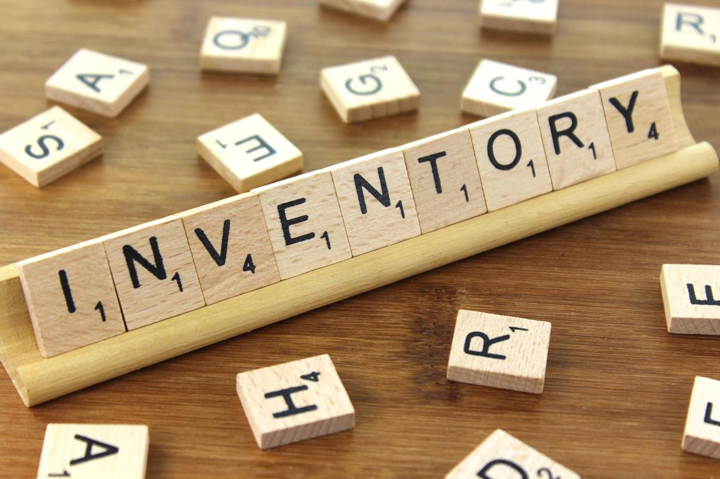
3. Develop inventory of current related initiatives
List of related grants, initiatives and practices
Capture population served
Identify initiative leads (department/agency/individual)
Explore evidence & effectiveness
Expected outcomes & documented results

Slide 16
4. Identify core systems features for initiatives targeted for alignment
Identify for each targeted initiative
Team-based leadership & coordination
Fidelity measures
Core practices at each tier
Data-based progress monitoring
Professional learning & coaching

Slide 17
5. Analyze and make decisions for alignment of initiatives.
Team to discuss commonalities & differences & potential overlap
Identify & resolve conflicts or duplicative systems features (e.g. teams)
Key in on practices without measure of fidelity and outcomes

Slide 18
6. Design the plan for effective alignment including evaluation, implementation, and professional development.
Team reflects on how system features will align (e.g. teaming structure, data system, training/coaching)
Determine how practice features will align (e.g. social skills anchored to behavioral expectations)
Decide common fidelity tool(s) to assess aligned system features and core practices
Define when & how training & coaching are provided

Slide 19
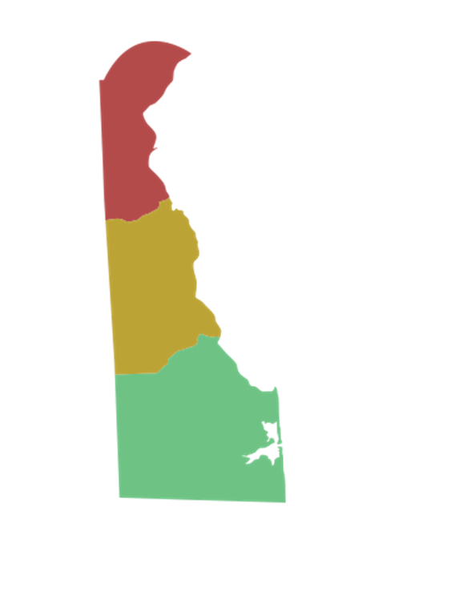
Delaware’s approach to PBIS
Delaware’s approach (DE-PBS) integrates common features of PBIS with those of the Social and Emotional Learning approach
In integrating these two popular approaches, the primary goal of DE-PBS is to create safe and caring learning environments that promote the social-emotional and academic development of all children.

Slide 20
Model for Prevention
PBIS
(Structure)
Internalizing Problems
Positive School Climate
SEL
(Support)
Externalizing Problems

Slide 21
 | Approach
Components of Comprehensive School Discipline | Traditional SWPBS | SEL
Develop social and emotional competencies | Weakness | Strength
Preventing behavior problems | Strength (more so for immediate environment) | Strength (more lasting effects)
Correcting behavior problems (short-term goal) | Strength | Weakness
Addressing Tier 2 and 3 Needs | Strength | Weakness

Slide 22
Integration Team & Process
Gathered vested partners committed to integration of PBIS & SEL
Department of Education
University of Delaware: School of Education & Center for Disabilities Studies
Multiple district coaches from across the state

Slide 23
Redefining Vision & Key Features of DE-PBS
For each component of PBIS, we asked the following:
Is this a belief or a practice ?
Do we keep, delete or modify?
How do we clarify/further define?
Does this component apply to Tier 1, 2, 3 or All?
How do we currently measure implementation?
How do we currently provide training?
Conversations entailed
Grows & Glows of PBIS
Analyzing state-wide school climate data
Examining current PBIS definition elements

Slide 24
Aligning Social-Emotional Learning & PBIS at the State Level
Delaware inclusion of Developing Self-Discipline in comprehensive MTSS framework
Promotes school-wide use of SEL (specific programs or integration in academics)
Integration in evaluation tools (fidelity measures, School Climate Survey, implementation self-assessments)
Focus of professional development to expanded tier 1 (focus to include relationship building, SEL curriculum, correction as reflection & learning opportunity)

Slide 25
Tier 1 Framework for Positive Behavior Supports and Interventions
School-wide PBS Tier 1: Program Development & Evaluation Systematic Collection & Use of Multiple Data Sources Established Representative Problem-Solving Teams Ongoing Professional Development & Resources to Sustain Implementation | Prevention: Implementing Schoolwide & Classroom Systems Establish Positive Relations (Student, Teacher, Parents) Establish, Teach, and Acknowledge Positive Behavioral Expectations Support a Safe School Environment
Correcting Problem Behavior Establish System to Manage Office Discipline Referrals Support Use of Strong Classroom Management Techniques Systematic Response to Behavior Includes Problem-Solving | Developing Self Discipline Policy Commitment to Goal of Developing Self-Discipline Social Emotional Learning (free standing or integrated within Curriculum) Students Active in Decision-making

Slide 26
3 & 4 - Initiative Inventory + Systems Features
Name | DE - PBS Project/Initiative
Lead organization | DE Department of Education UD Center for Disabilities Studies
Population served | MTSS – Tier 1-2-3
Goals of initiative | Create safe and caring learning environments that promote the social-emotional and academic development of all children Improve school climate Decrease office referrals, suspensions Decrease disproportionality rates
Outcomes & fidelity measures | School climate data ODR Systems fidelity – Tier 1 & Tier 2 Tier 3 – support plan fidelity (TATE)
Type of PD & Coaching | In-person workshops Online PD materials (new) Coaching through district staff

Slide 27
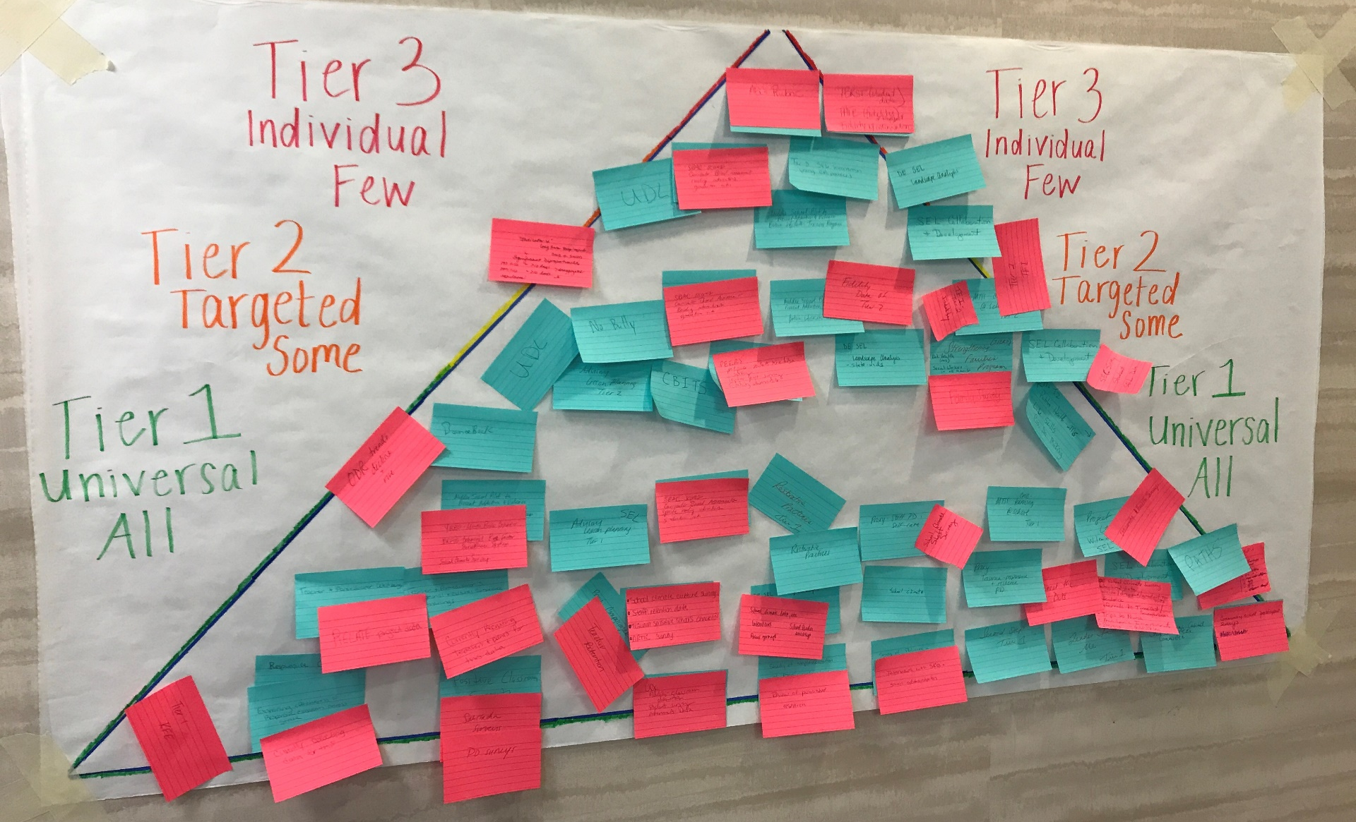

Slide 28
Delaware’s Ongoing Integration Efforts
Glows
State ESSER II funds used to develop the Social, Emotional Well-being Plan for the state.
Developed by integrated team
Organized SEB related training and supports using MTSS framework and Implementation Science
Monthly Newsletter

Slide 29
Delaware’s Ongoing Integration Efforts
Grows
Negotiating the grant impact on maintaining silos at State/ LEA/Schools
Separate SEL initiatives in state not connected to DE-PBS work

Slide 30
Stakeholder Engagement
Resource Alignment, Funding & Allocation
Policy & Systems Support
Workforce Capacity
Executive Functions
LEADERSHIP TEAMING
Implementation Functions
Professional Development
Coaching & Technical Assistance
Evaluation
Local Implementation Demonstrations

Slide 31
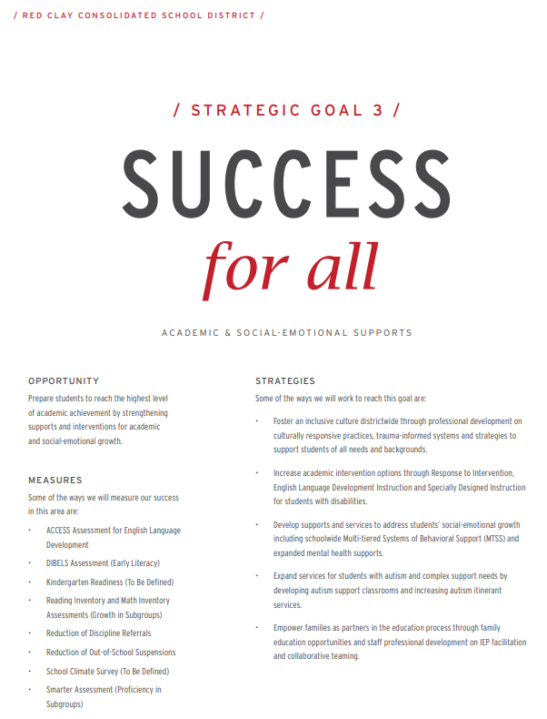
About Red Clay Consolidated School District
27 Schools and Programs
15 Elementary Schools
6 Middle Schools
5 High Schools
4 Specialized Programs
Approximately 16,000 Students
42% White
27% Hispanic
21% African American
7% Asian
3% Multi-Racial
15% English Learners
14% Special Education
36% Low Income

Slide 32
Red Clay’s MTSS PD/TA Structures
District MTSS Leadership Team
Team Structure & Language Used:
Tier 1 Teams = School-wide Teams
Tier 2/3 Teams = Problem-Solving Teams
Team Leaders - one per building for each tier (or co-leaders)
District Coach trains & supports team leaders on the following schedule:
Tier 1 team leaders and Tier 2/3 leaders meet monthly
District coach supports building level custom PD
Maintenance - District coach meets individually with building admin and team leader throughout the year and facilitates the Tiered Fidelity Inventory Scoring in the spring

Slide 33
Red Clay’s Restorative Practices Integration Plan
Need Identified
Delaware State Senate Bill 85 and The School Discipline Improvement Program
Schools who have exceeded the required threshold for the same sub-group(s) for the previous 3 (three) consecutive years will be required to initiate the School Discipline Improvement planning process
Tiered Fidelity Data
Out-of-date Code of Conduct
Interdepartmental Effort
Office of Student Services
Office of Equity and Strategic Partnerships
Operations Office
MTSS Expert + Content Expert
Framework vs. Practices

Slide 34
Red Clay’s Restorative Practices Integration Plan
School Level Need
Thomas McKean High School
History of RP however it had not been integrated into the system
Disconnect between the RP Trainer and the Tier 1 Team
RP not evident in general procedures for responding to behaviors of concern
Fidelity and outcome data not collected
District Level Need
Code of Conduct
Out-of-date
Counterintuitive to RP integration
Punitive consequences
Not connected to MTSS

Slide 35
Red Clay’s Restorative Practices Integration Plan
School Level Planning
Professional Development
3 sessions
Focused on Proactive Circles and Affective Statements and Questions and increasing understanding of how RP fits within the context of MTSS
Coaching and TA
Monthly District Tier 1 Leader meetings
One-on-one Coaching
Evaluation - fidelity and outcome
Staff report - # of Circles facilitated and perception of the impact
School Climate Survey - punitive and positive techniques subscales
District Level Planning
District MTSS Leadership Team initiated district level asset mapping
MTSS Coaches joined the Code of Conduct Revision Committee
3 days of summer professional learning with administrators, MTSS Leaders & Diversity Champions
Introduction to Restorative Practices and MTSS Integration and Alignment

Slide 36
Red Clay’s Restorative Practices Integration Plan
School Level Strategy Glows
Leveraged staff’s prior knowledge of trauma-informed care
RP Trainer joined the Tier 1 Team
Three professional development sessions were facilitate with staff
Encouraged staff to use the SW behavior expectations as the foundation for setting the Circle agreements
Fidelity and outcome data was collected
School Strategy Grows
Increase the number of professional development sessions
Add Tier 2 and Tier 3 Responsive Circles
Include student voice in the data collection process
Explicitly embed RP into the general procedures for responding to behaviors of concern
Develop inventory of current related initiatives (i.e. connect RP and AVID)
Facilitate a family symposium

Slide 37
Red Clay’s Restorative Practices Integration Plan
District Level Strategy Glows
District MTSS Leadership Team began asset mapping
MTSS Coaches joined the District Code of Conduct Revision Committee
Facilitated 3 full day sessions of professional learning for administrators, MTSS Leaders and Diversity Champions
Introduction to Restorative Practices and MTSS Integration and Alignment
Leveraged staff’s prior knowledge of trauma-informed care
District Level Strategy Grows
District MTSS Leadership Team to continue asset mapping
Fully embed RP as a focus of the District MTSS Leadership Team
Increase the number of professional development sessions offered

Slide 38
ROUNDTABLE DISCUSSION PROMPTS
What are alignment successes you've had? What strategies did you use?
What was your biggest takeaway from this session? ​
What will you bring back to your organization? ​Next steps?
How does the content in this strand align with the work you are already doing? ​
What do you want to learn more about?​

Slide 39
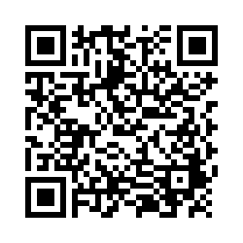
Session Evaluation
Your feedback is critical to future planning of this event.
PLEASE take a moment to share your valuable insight!
THANK YOU!
https://bit.ly/NEPBISForum2022

