Slide 1
Tier 3 School Level Systems Training
DE-PBS Project
May 4, 2022

Slide 2
https://www.delawarepbs.org/universal-screening/
The DE-PBS Project serves as a technical assistance center for the Delaware DOE to actualize the vision to create safe and caring learning environments that promote the social-emotional and academic development of all children.
The statewide initiative is designed to build the knowledge and skills of Delaware educators in the concepts and evidence-based practices of Positive Behavior Support (PBS) as a Multi-tiered System of Support (MTSS).

Slide 3
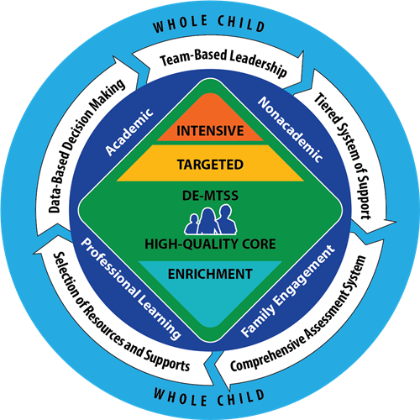
Core Features of DE-MTSS
Team-Based Leadership
Tiered Delivery System
Selection and Implementation of Academic and Non-Academic Supports
Comprehensive Screening and Assessment System
Continuous Data-Based Decision Making

Slide 4
Expectations for making the most of our time
BE ENGAGED | Share your experiences and ideas Ask questions via the chat box Turn video on for breakout rooms
BE REFLECTIVE | Compare the ideas shared to your current context and experiences Recognize areas of glow and growth Monitor your own reactions to content
BE STRATEGIC | Stay on task and use parking lot for issues you can’t address today

Slide 5
Setting Up Our Time for Success
This is not a Tier 3 practices training: we won’t discuss the steps to complete an FBA and BIP or specific interventions
This is a Tier 3 systems training, we will discuss:
Tier 3 teams
Qualities of tier 3 practices
Tier 3 professional learning topics to share with entire staff
Evaluation of student plans and tier 3 systems
Our goal is to give you enough information and sample activities to start moving the work forward in your buildings

Slide 6
What are systems and why do they matter?
The way schools operate are their foundational systems. In an MTSS these systems support accurate, durable implementation of practices and the effective use of data to achieve better outcomes.
When it comes to systems, ask yourself: What can we do to sustain this over the long haul?
Center on PBIS

Slide 7
Organizational Supports for Tier 3 Implementation
Necessary Supports
Helps with…
Leadership and Management
Leads to
Improved delivery of effective Tier 3 practices
What to do, why do it and assistance to get it done
Results in
Professional Learning/ Coaching
How to do it
Improved outcomes for students with the most severe and persistent learning and behavioral needs
Promoting Effective Environments
Makes it easier to do it right
Data Systems
Makes it easier to know what to do
Adapted from Chan, Goodman, Kincaid, Kern & Simonsen
Notes:
Adapted from kincaid training

Slide 8
5 Big Systems Ideas for Tier 3
Promote effective environments
Teaming
Screening
Data systems
Professional Development

Slide 9
Tier 3 Myths
Students must progress sequentially through each tier— a student must receive Tier 1 before moving to Tier 2, and they must receive Tier 2 before moving to Tier 3.
Tier 1 and Tier 2 must be in place and perfectly functional before we start Tier 3 supports.
Tier 2 supports are not necessary at Tier 3
Tier 3 may only be implemented by experts, so all staff should become experts in Tier 3 assessment, intervention and implementation.
Students in need of Tier 3 have either significant academic deficits or externalizing behaviors, and these deficits or behaviors are rooted in the child.
Conducting diagnostic or functional assessment always leads to high quality Tier 3 supports.
Most Tier 3 interventions are complex and difficult to implement. We just need an easy menu of interventions to choose from.
Tier 3 data collection is difficult, if not impossible, to accomplish especially with fidelity.
I can’t implement a Behavior Intervention Plan in a class with 20+ other students!
Do I just keep implementing the BIP forever?
As a Teacher, am I responsible for everything this student needs?
Special education is a Tier 3 intervention.
Compliance is all we need to be concerned about at Tier 3.
Kincaid and Iovannone, 2020

Slide 10
Jot down your definition of Tier 3 practices…

Slide 11
Should all students access Tier 2 before Tier 3?
National Center on Intensive Intervention, 2014

Slide 12
Takeaways from Dr. Eber…
Tier 3 Interventions are NOT done in isolation
Layer up from Tier 1 and 2 supports
Rely on a highly individualized student team
Tier 3 support plans are FILLED with Tier 1 and Tier 2 interventions
Be fluid, use data, avoid 1 size fits all approach
Do not expect or wait for a student to experience failure before you move into a Tier 3 intervention

Slide 13
DE-MTSS Definitions of Tier 3 Practices…
Definition: Highly individualized and intensive interventions that may include increased intensity through smaller group sizes, more instructional time, and increased use of explicit instruction. In Tier 3, educators frequently review progress monitoring data and make changes to the intervention based on what works for the student (DE-MTSS Implementation Guide)
Relationship to Tier 1: (1) decisions regarding student participation in Tier 3 intervention are on a case-by-case basis, according to student need; (2) Tier 3 interventions address the general education curriculum and universal behavior practices in an appropriate manner for students (DE-MTSS Needs Inventory)

Slide 14
Tier 3 is supports are more effective when layered within Tiers 1 and 2
School & Classroom Wide
Individualized
Outcomes | Goals
Effectively design space | Individualize physical space
Develop and teach routines | Individualize routines
Teach classroom norms and SEB Skills | Teach individualized skills and align them with classroom norms and expectations
Provide specific positive feedback on SEB skills | Function-Based Reinforcement Plan
Provide supportive corrective feedback on SEB errors | Function-Based Consequence Strategies
Kincaid and Iovannone, 2020

Slide 15
Effective environments make it easier to do the right thing.
Schools who are implementing SWPBIS create higher quality behavior support plans when compared with schools who are not implementing (Medley, Little, & Atkin-Little, 2008)
A strong Tier 1 will improve your Tier 3 supports!
Fewer challenges allow for allocation of resources to appropriately meet needs
Adapted from miblsi.org

Slide 16
An Underlying Belief Must Be Established
“...Faculty and staff must believe that any change in student behavior starts with the adults in the school changing their approach to behavior support.”
(Sprick, 2009, p. 427)

Slide 17
Tier 3 practice resources on our website
Choosing interventions collaboratively
Functional links between behavior and interventions
Intensifying universal practices to use as a tier 3 intervention
Examples & task analysis of interventions

Slide 18
Defining Tier 3 practices
One key idea: All staff should be able to answer the question, “what are T3 SEB practices?”
What is going well?
What are you going to do…
Tomorrow?
Next week?
This summer?
Next school year?

Slide 19
Tier 3 Teams

Slide 20
 | Necessary Tier 3 Conversations
T3 Leadership Team | **Not a place for individual student problem solving** Systems: How many students received Tier 3 support? Do we implement plans with integrity? Are students successful? Are all subgroups successful? Do we follow our assessment and planning protocols with integrity? How is our staff support working (training, coaching, etc.)? Screening: Who needs Tier 3 support? What level of support is needed (e.g., brief, comprehensive, wraparound)?
Individual Support Team (IST) | Are the right team members at the table? What supports does this student need/want? Did this student get what they needed in our Tier 3 support? Did we implement with integrity? Was this student successful? Do we need to make changes? Do we maintain or begin to fade supports
Adapted from Chan, Goodman, Kincaid, Kern & Simonsen

Slide 21
Tier 3 Leadership Team
Screening Conversations
Uses decision rules and multiple sources of data to identify students who require Tier 3 support
System Conversations
Uses process data; evaluates overall effectiveness; does not involve discussion of individual students
Individual Support Team 1
Individual Support Team 2
Adapted from the Illinois PBIS Network
Notes:
21
21
.

Slide 22
What do you need to make a Tier 3 leadership team happen?
Tier 3 Leadership Team Feature | Description
People | Tier 3 Systems coordinator(s) A school administrator A representative group of educators Relative community partners (e.g., mental health providers)
Expertise | Applied behavior support Mental health and trauma Academic instruction Coaching | Equity Physical health and wellness Data systems Operations of the school across grade levels and programs
Things | Tier 3 team meeting agendas, minutes and team norms Tier 3 meeting role descriptions Tier 3 action plan
Schedules | Monthly (minimum) Tier 3 leadership team meetings Regular communication with tier 1 and tier 2 team (e.g., quarterly) Twice annual evaluation of team meeting procedures
Adapted from Chan, Goodman, Kincaid, Kern & Simonsen

Slide 23
Purpose, Functions, Authority: Individual Support Team
Purpose
The purpose of our individual support teams is to collaboratively develop Tier 3 supports that lead to improved outcomes for individual students with the most intensive academic and SEB needs.
Function
Implement FBA/BIP protocols
Monitor impact and fidelity to BIPS
Solicit participation of individual support team members (including family members and student if appropriate)
Facilitate BIP Review meetings at least every 6-8 weeks
Collect and share impact and fidelity data with Tier 3 leadership team
Authority
Establish student specific teams
Monitor impact and fidelity data collection
Facilitate Tier 3 FBA/BIP meetings
Implement coaching of plan implementers

Slide 24
Tier 3 Leadership Team Agenda Items
Review enrollment data
Review implementation data
Review fidelity data
Discuss barriers to implementation
Make an action plan to improve implementation.
Review student outcome data
Review student outcomes data
Discuss ways to improve outcomes
Updates from BIP Review meetings
Students ready to fade support
Students in need of adjusted support
Screening discussions
What students meet the decision rules for T3 support
What level of support is recommended
Next steps
Adapted from Integrated Multi-Tiered Systems of Support: Blending RTI and PBIS by Kent McIntosh and Steve Goodman. Copyright © 2016 The Guilford Press.

Slide 25
Updates from BIP Review Meetings
from Integrated Multi-Tiered Systems of Support: Blending RTI and PBIS by Kent McIntosh and Steve Goodman. Copyright © 2016 The Guilford Press.

Slide 26
Individual Support Team
The individual support team is the team that conducts the FBA and develops the BIP
Each team membership will shift and look different from student to student (i.e. teacher and family, possibly mental health providers)
At least one member of the Tier 3 Leadership Team participates as a member on each student support team
May identify systems issues to forward to T3 leadership team
Adapted from Chan, Goodman, Kincaid, Kern & Simonsen

Slide 27
But we have a psychologist that does our FBAs...
“The most sustainable process for completing a school-based FBA will be team based.”
(Scott, Anderson, Mancil, & Alter, 2009)

Slide 28
Purpose, Functions, Authority: Tier 3 Leadership Team
Purpose
Our team supports Strategic Goal #3 (Success for All). Our purpose is to support implementation of Tier 3 supports within our MTSS for SEB framework and create an outcomes driven Tier 3 system that leads to improved outcomes for students with the most intensive academic and SEB needs.
Function
Establish and implement a standard process to identify students for Tier 3 support
Establish standard FBA/BIP protocols
Establish processes for monitoring BIPS
Create methods to identify and solicit participation of individual support team members (including family members and student if appropriate)
Establish a professional learning and coaching plan
Facilitate monthly Tier 3 leadership team meetings
Collect and share Tier 3 outcomes data with other MTSS teams (e.g., Tier 1 team)
Authority
Active leadership participation
Release time for meetings
Facilitate Tier 3 FBA/BIP meetings with individual support teams
Implement and monitor approved Tier 3 protocols
Implement approved professional learning plans and coaching

Slide 29
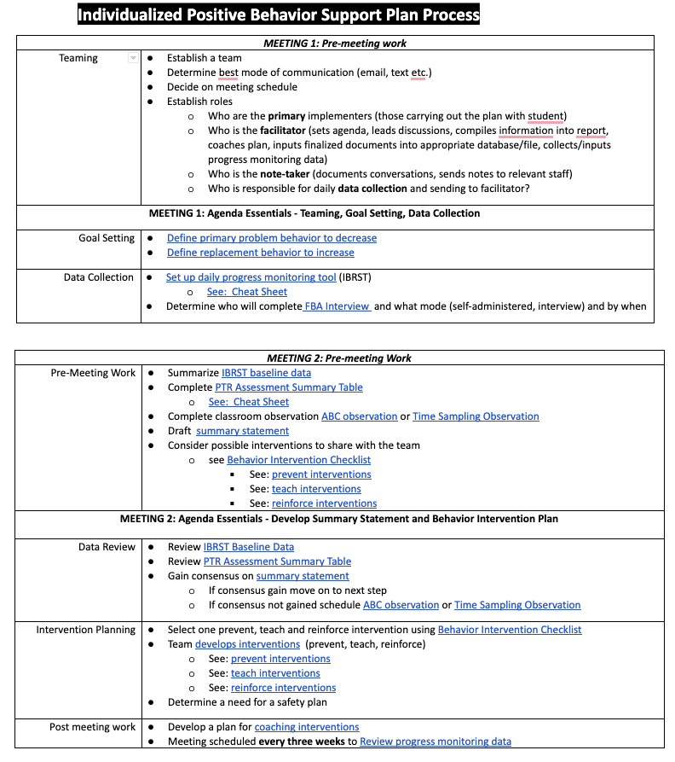
Individual Support Teams: Plan Development Agenda Items
Plan Development: Provide facilitators with an outline of the steps for each team meeting during plan development

Slide 30
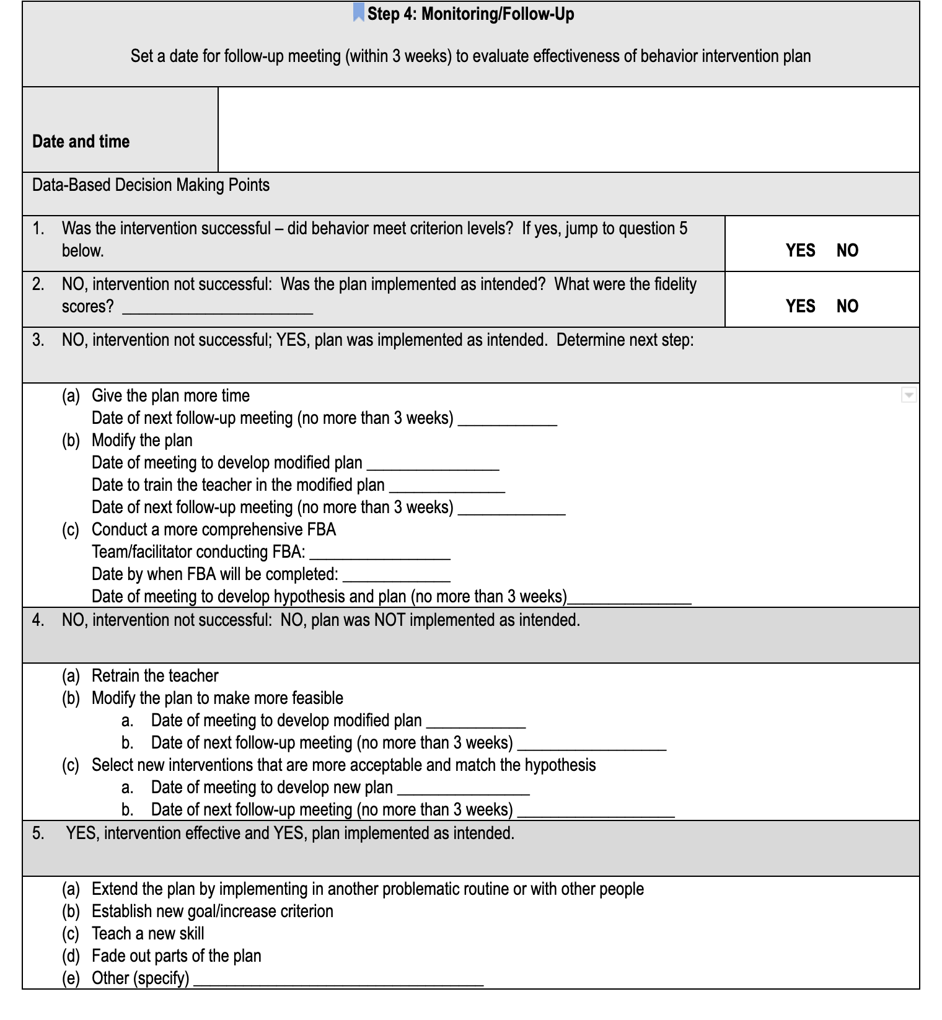
Sample BIP Review Agenda
Address fidelity
Address fading

Slide 31
DE-PBS Online Module: Building Strong Team-Based Leadership Module
This module is for schools and districts to build or strengthen solid teaming foundations. The module is intended for both academic and non-academic teams and committees to view collaboratively. Viewers will learn about strategies for effective teaming and will be led through a series of team-based reflections and opportunities for implementation action-planning in order to increase best practices and ultimately lead to stronger systems and successful outcomes.
Recording and materials can be accessed at DE-PBS Teaming Module and PDMS course #30542.

Slide 32
T3 Teaming
One key idea: There are two types of T3 teams (T3 Leadership and Individual Support Teams). Both teams should have a defined purpose, regular meeting format/agenda, minutes, defined meeting roles, and a current action plan.
What is going well?
What are you going to do…
Tomorrow?
Next week?
This summer?
Next school year?

Slide 33
T3 Screening Conversations
Who needs Tier 3 support?
What level of support is needed (e.g., brief, comprehensive, wraparound)?
Wraparound based (Person-centered plans, functional analysis, multiple expertise)
Function based behavior support plan
Function based adjustments to classroom support
There are multiple levels of Tier 3 Support
Adapted from Kincaid and Iovannone, 2020

Slide 34
Establish a T3 Screening Protocol
Use multiple strategies
Develop decision rules
Use multiple informants (e.g., teacher, family, student)
Review at multiple points in time
Screening at multiple times
On-going data review and access to nomination process
34

Slide 35
In your experience, how are students typically identified for Tier 3 Supports?
Disciplinary actions
Academic progress
Screening tools
Attendance
Nominations
Request for assistance process and Tier 2 performance
Teacher nomination
Behavior goals added to IEP
Something else?

Slide 36
Common strategies
Office Discipline Referrals (ODRs)
Strengths:
Identifies students with serious problem behavior
Limitations:
Only catches students with externalizing behavior
Adapted from Chan, Goodman, Kincaid, Kern & Simonsen
36

Slide 37
Common strategies
Responsiveness to tier 2 intervention
Strengths:
Good for identifying students who need more support
Limitations
Measures not precise (e.g., CICO ratings)
Student might not actually need tier 3 intervention
Adaptations to tier 2 interventions, multiple tier 2 interventions might be effective
Adapted from Chan, Goodman, Kincaid, Kern & Simonsen
37

Slide 38
Common strategies
Universal screeners
Strengths
Identifies students with internalizing and externalizing problems
Provides an opportunity for student voice
Limitations
Schools not ready for universal screener
Some students underreport symptoms/behaviors (e.g., EBD)
Adapted from Chan, Goodman, Kincaid, Kern & Simonsen
38

Slide 39
Who needs Tier 3 support?
Student | GPA | Course Failures | Days Absent | Concerning Behaviors | SAEBRS (SR)
Josh | 3.1 | 0 | 2 | 0 | 35
Mary | 4.1 | 0 | 0 | 0 | 25
Kelly | 2.8 | 1 | 0 | 1 | 36
Jacob | 1.4 | 3 | 11 | 12 | 22
Susan | 3.5 | 0 | 3 | 0 | 38
Mark | 1.9 | 1 | 5 | 7 | 26
Schoolwide Data Decision Rules
 | Not at Risk | Some Risk | At Risk
ODR | 0-1/quarter | 2-3/quarter | 4+/quarter
Absences | 0-3/quarter | 4/quarter | 5+/quarter
Nurses Visits | No Concern | Moderate Concern | High Concern
GPA | 3.0+ | 2-2.9 | Less than 2.0
Course Failures | 0 | 1 | 2+
SAEBRS (SR) Total Risk Score | 35+ | 25-34 | 0-24
Adapted from PBIS Vermont

Slide 40
Tier 3 Screening Decision Rules
Lack of progress with a related Tier 2 SEB Intervention
OR any combination of the following:
High risk (0-7) on Screener
Nurse visits (High concern)
Attendance (High risk)
Request for assistance (urgent need)
ODRs (High risk)

Slide 41
Match the level of support to the level of need
Level of Support | Description
Brief FBA/BIP | Appropriate for students who engage in persistent non-dangerous challenging behavior (such as talk-outs, work avoidance, or out-of-seat behavior) Universal and/or group interventions have not been effective Patterns of behavior are easy to identify Behaviors occur in 1 to 2 school routines Includes a small number of T3 practices
Comprehensive FBA/BIP | Appropriate for the most intensive student behaviors (such as aggression or self-injury) and those that are chronic/long-lasting. Behaviors serve multiple functions Behaviors occur in 3 or more school routines or across the entire school day Assessment protocol will include multiple domains (behavioral, mental health, academic, physical health, basic needs)

Slide 42
4 Possible Student Need Types…
(4)
Interrelated challenges
(1) Academic Challenges
(2) SEB Challenges
(3) Non-related Academic and SEB Challenges
from Integrated Multi-Tiered Systems of Support: Blending RTI and PBIS by Kent McIntosh and Steve Goodman. Copyright © 2016 The Guilford Press.

Slide 43
Type of Need | Example | Intervention Suggestions
Academic only | Student has challenges in understanding math concepts, but there are no related behavioral difficulties | Academic intervention
SEB only | Student seeks peer attention with challenging behavior on the playground and during lunch but not related to academic difficulties | Function based behavior support
Non-related academic and SEB | Student has academic and SEB challenges. Challenges in one area are not linked to challenges in another. | Separate academic and SEB interventions (either simultaneously or in sequence)
Interrelated academic and SEB | Student has difficulty reading grade level material and engages in challenging behavior to escape the academic task. | Academic intervention with integrated or embedded function-based behavior support strategies
from Integrated Multi-Tiered Systems of Support: Blending RTI and PBIS by Kent McIntosh and Steve Goodman. Copyright © 2016 The Guilford Press.

Slide 44
Example: Integrated BIP and Academic Intervention
Desired Alternative
Do work successfully without complaints
Typical Consequence
Told “good job,” more work, good grades
Academic Skill Development
Reading: decoding words fluently
Setting Events
Corrected for reading error earlier in period
Triggering
Antecedents
Asked to complete reading assignment
Unwanted Behavior
Argue, threaten, use profanity
Maintaining Consequences
Removed from class
Function
Escapes academic task
Acceptable Alternative
Ask for break, ask for help
from Integrated Multi-Tiered Systems of Support: Blending RTI and PBIS by Kent McIntosh and Steve Goodman. Copyright © 2016 The Guilford Press.

Slide 45
Who needs to be on the individual support team?
Individualized
Constructed in collaboration with the family and student
Matched to the support needs of students
Brief consult (2 people)
Comprehensive team (a few school staff, student and family members)
Wraparound (broader team with community, medical, mental health etc.)

Slide 46
Tier 3 Screening
One key idea: The Tier 3 Leadership team should establish data decision rules to identify who needs T3 support (and what type) using multiple sources of data from multiple informants.
What is going well?
What are you going to do…
Tomorrow?
Next week?
This summer?
Next school year?

Slide 47
Data systems that help us know what to do
Data systems exist that facilitate Tier 3 leadership team and individual support team conversations
Aggregated data (e.g., overall school level) are summarized and reported to staff at least monthly on (1) fidelity of support plans and (2) impact on student outcomes
Data are used to track access and success of students receiving Tier 3 support
Individual support teams, collect fidelity and impact data (at least weekly) and review with the student’s team (at least every 6-8 weeks)
Kincaid & Iovannone, 2020

Slide 48
Data Systems: What do we need to help us problem solve?
Data System Feature | Description
Data Types | Fidelity Outcome Programmatic (e.g. enrollment)
People | Data collector(s) Data entry person Data systems technician
Information | Data analyzed and summarized Form/format for sharing data with others
Things | Assessment and support plan forms and protocols Electronic data storage system
Schedules | Individual support teams review student progress every 6 - 8 weeks (Regulation 508) Student progress is checked weekly T3 Leadership team reviews systems monthly

Slide 49
Necessary conversations
Data system is used by individual student teams to answer:
What supports does this student need/want?
Did this student get what they needed in our Tier 3 support?
Did we implement with integrity?
Was this student successful?
Do we need to make changes?
Do we maintain or begin to fade supports

Slide 50
Individual Support Teams: Weekly Progress Checks
Check on student and teacher progress with the plan weekly
Fidelity Checks
Student Self Monitoring
Daily Progress Monitoring
Additional fidelity checks during walkthroughs
Sample PTR Fidelity Check
Complete an observation prior to BIP review meeting
5.4 The team shall collect progress monitoring data at regular intervals. Data collection must include documentation of fidelity of implementation, consisting of differentiated, evidence-based instruction, pacing and appropriateness of instructional groupings.
Thanks to Dr. Eileen Baker for these resources

Slide 51
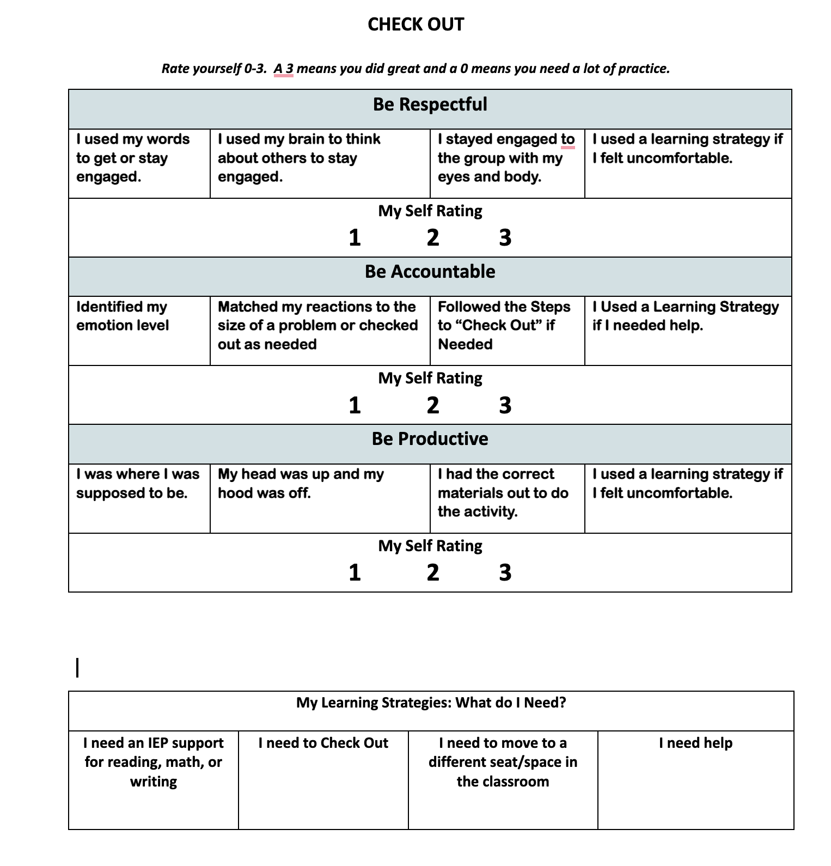
Daily Student Self Monitoring

Slide 52
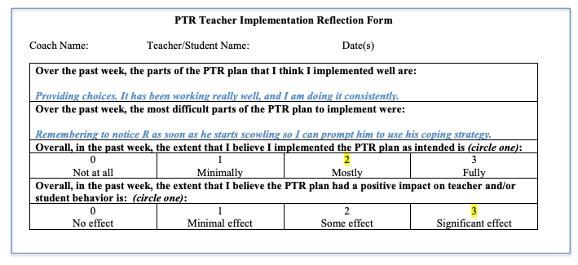
Weekly BIP Teacher Check In (Example)

Slide 53
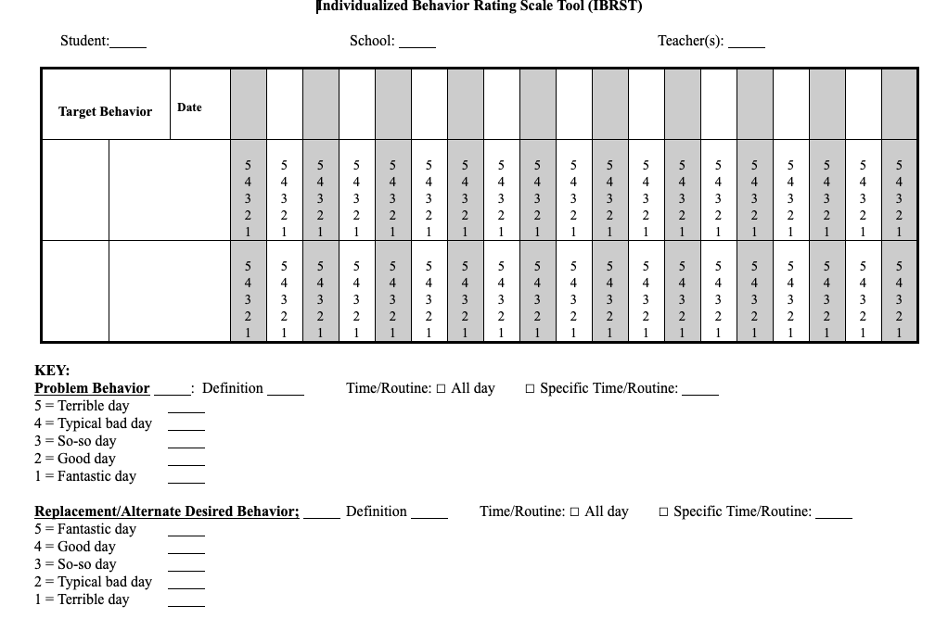
IBRST Progress Monitoring

Slide 54
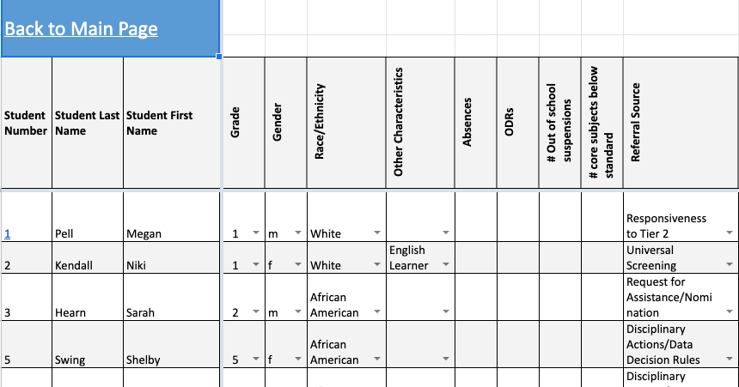
Tier 3 Data Sheet

Slide 55
Individual Support Teams: BIP Review Meetings
Set up regular cycles of behavior plan reviews (6-8 weeks)
Sample BIP Review Schedule
Sample BIP Review Teacher Letter
Sample BIP Review Parent Letter
Sample BIP Review Agenda with decision rules
Conduct a classroom observation prior to the meeting
Compile impact and fidelity data for team problem solving
5.5 The team shall hold meetings after the six to eight-week intervention cycle to monitor progress toward identified targets, the fidelity of implementation and determine the next steps. Teams may meet earlier, as needed.
Thanks to Dr. Eileen Baker for these resources

Slide 56
Data Systems to Support Individual Support Teams
One key idea: individual support teams ensure student progress is monitored weekly and meet to review review impact at least every 6-8 weeks (more as needed)
What is going well?
What are you going to do…
Tomorrow?
Next week?
This summer?
Next school year?

Slide 57
Necessary conversations
Data system is used by the Tier 3 Leadership team to answer:
How many students received Tier 3 support?
Do we implement plans with integrity?
Are students successful?
Are all subgroups successful?
Do we follow our assessment and planning protocols with integrity?
How is our staff support working (training, coaching, etc.)?

Slide 58
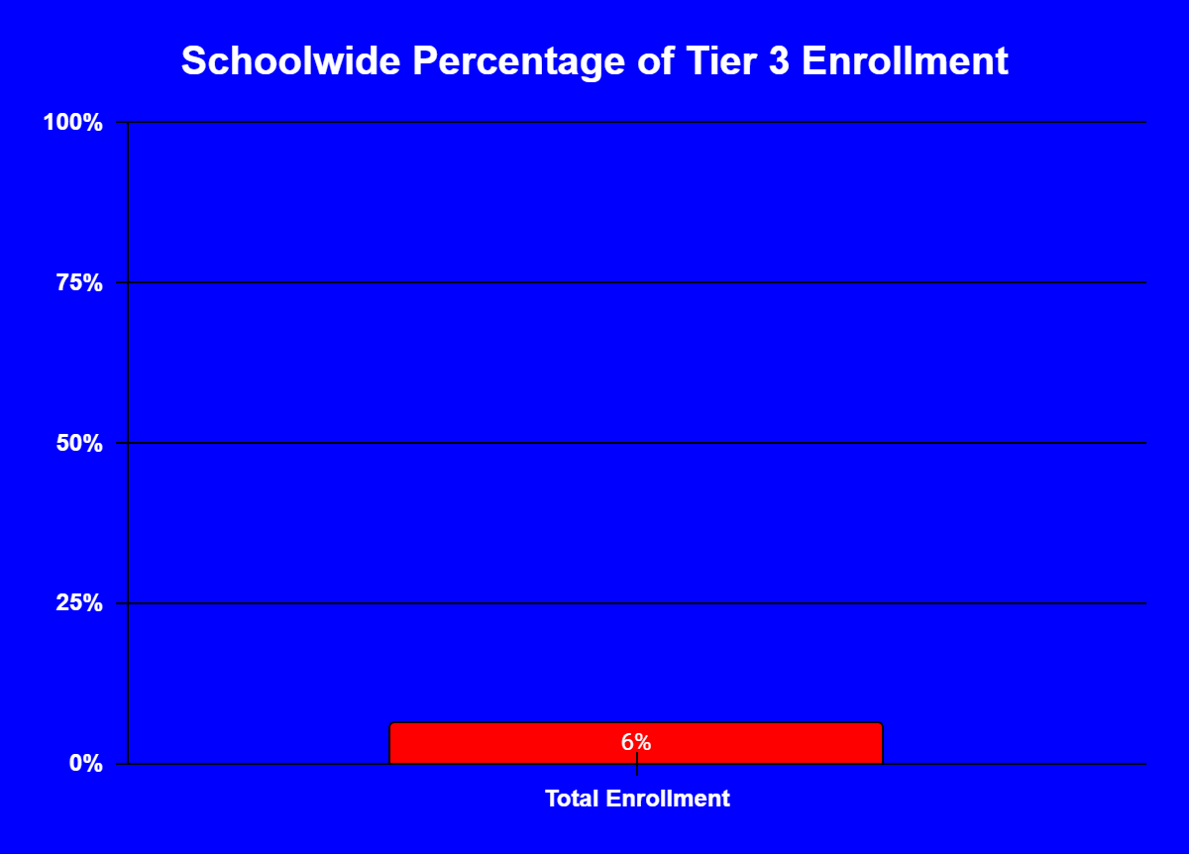
How many students receive(ed) Tier 3 support?
Schoolwide Total Tier 3 Enrollment
By Grade
By Other Characteristics (e.g., Disability Status)
By Gender
By Race/Ethnicity
By Referral Source (e.g., discipline action, progress with Tier 2 support, universal screening process)

Slide 59
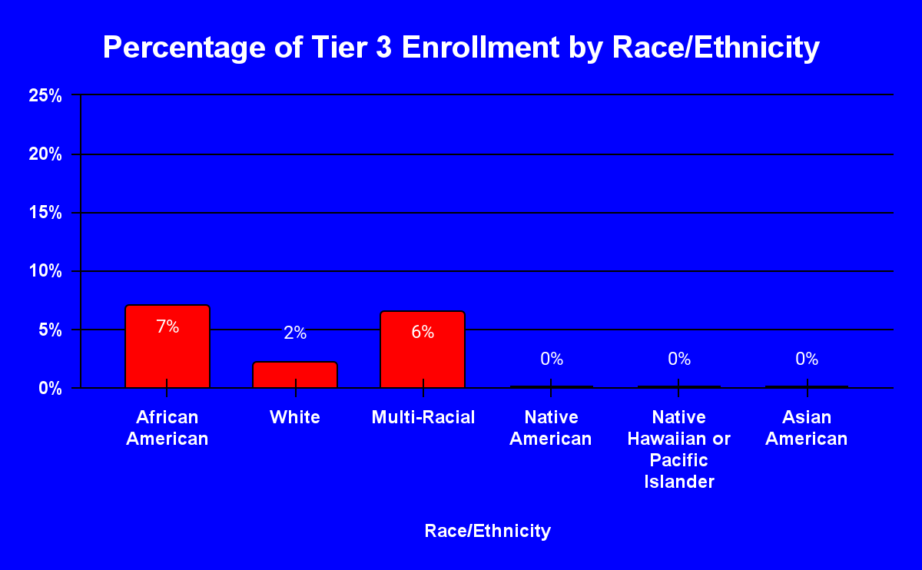
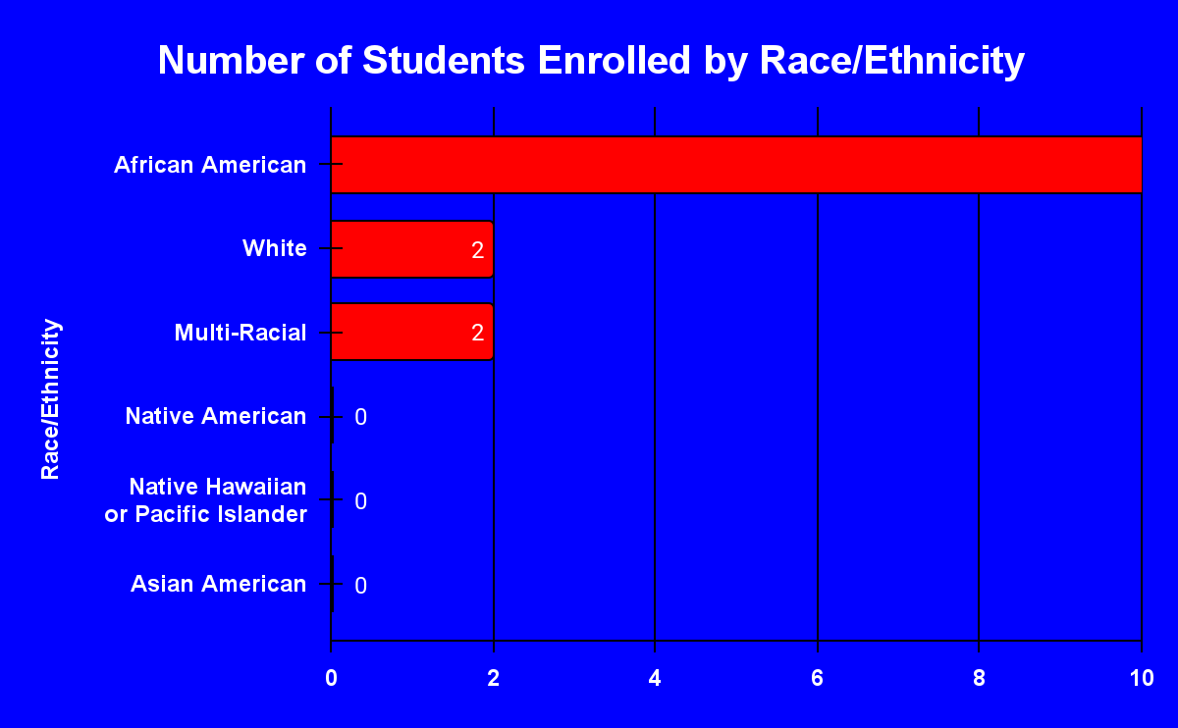
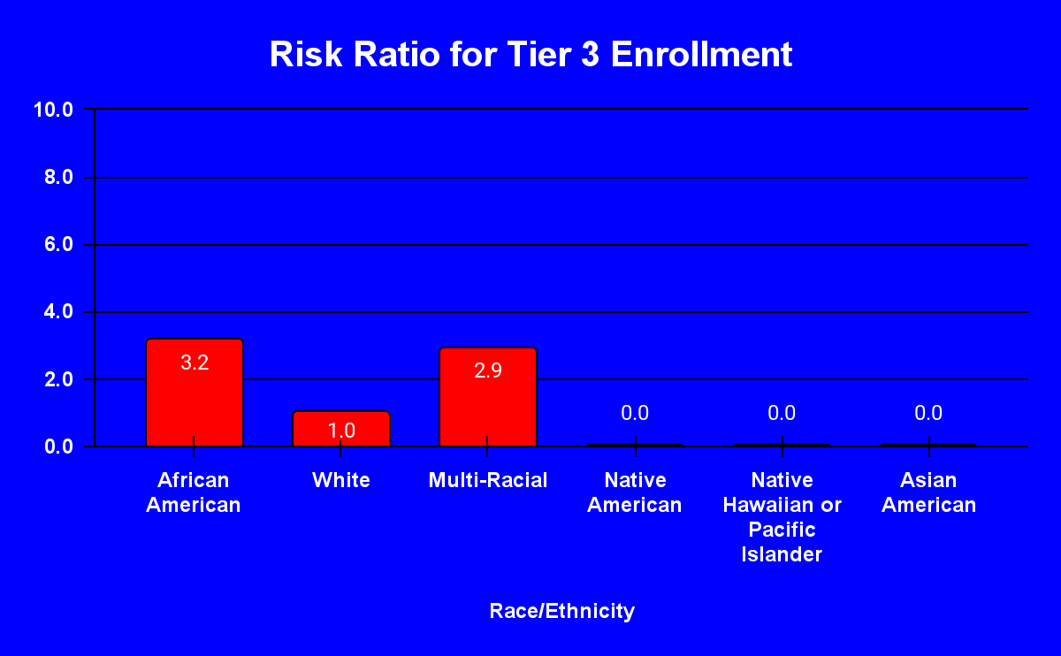
Total %age of all students with that Race/Ethnicity with a Tier 3 Plan
The likelihood of receiving a Tier 3 plan compared to white students

Slide 60
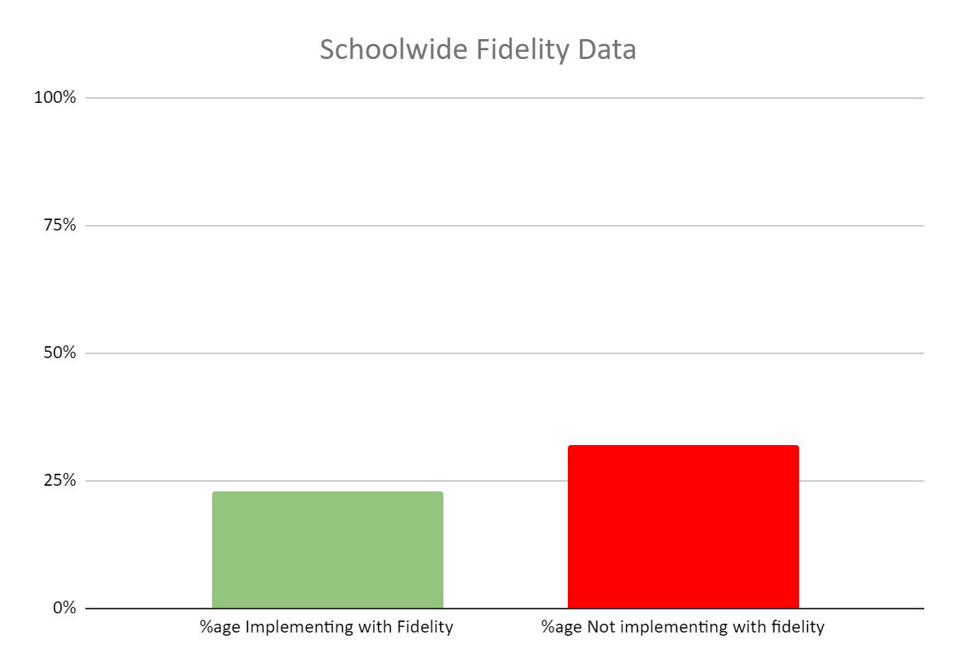
Did we implement with integrity?
Schoolwide Total Tier 3 Fidelity
By Grade
By Other Characteristics (e.g., Disability Status)
By Gender
By Race/Ethnicity
By Referral Source

Slide 61
Discussion:
What would you do if a particular grade was having a difficult time with Tier 3 plan fidelity?
What personal connections come to mind?
What other questions do you have?
What additional information do you need?
How could you intervene?

Slide 62
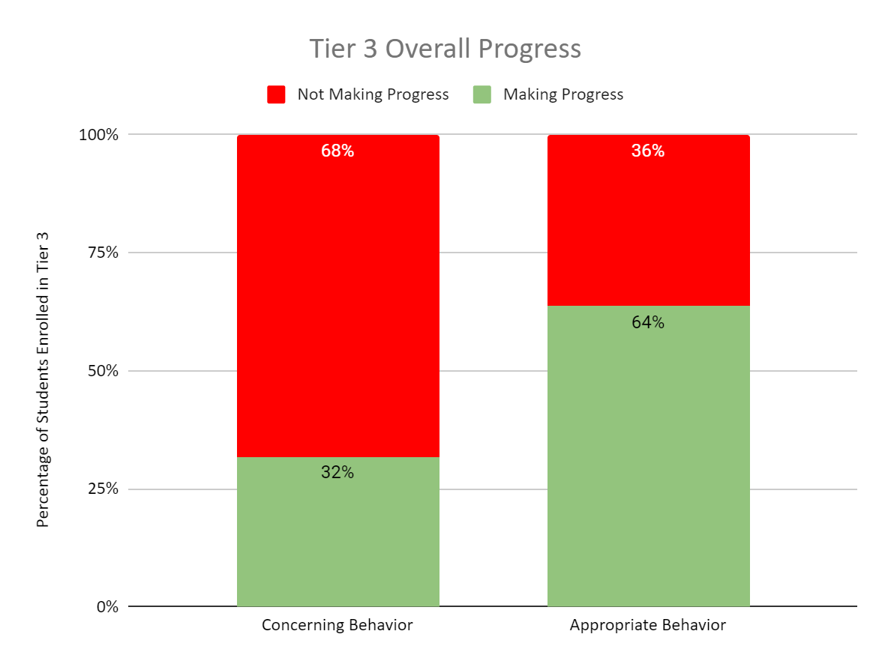
Were students successful?
Tier 3 Overall Progress with Concerning Behavior and Appropriate Behavior

Slide 63
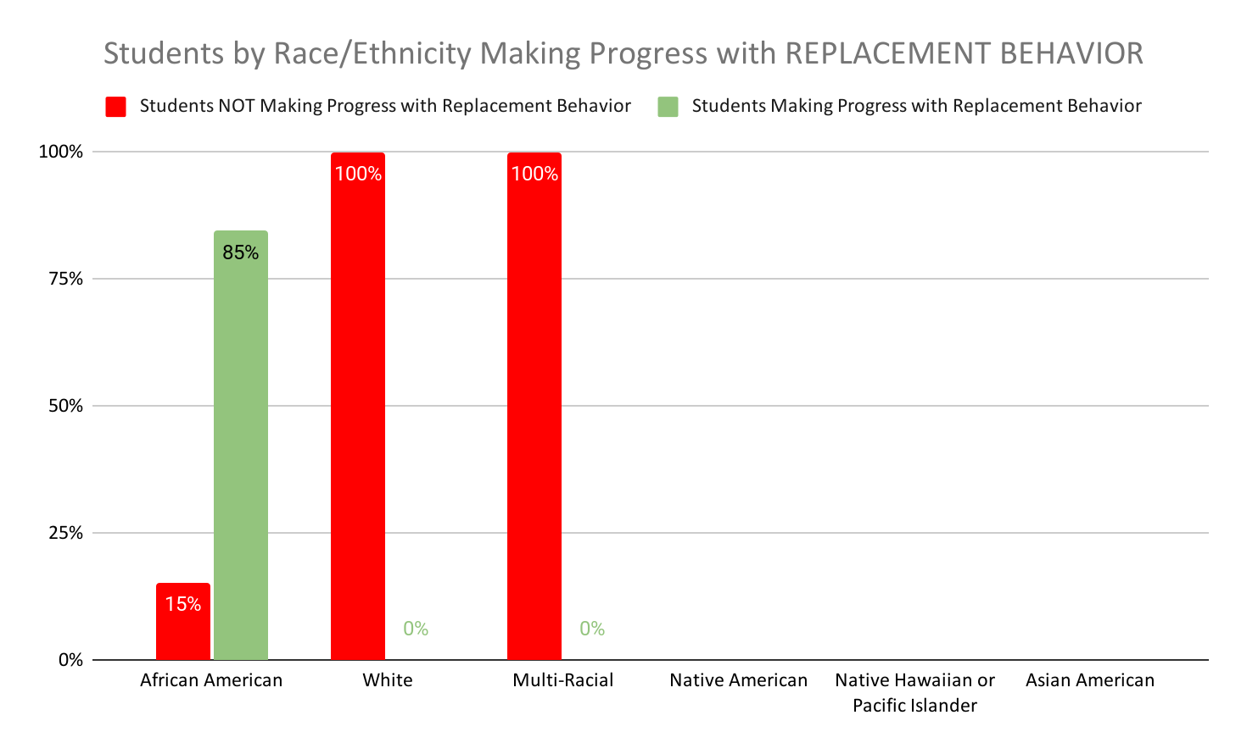
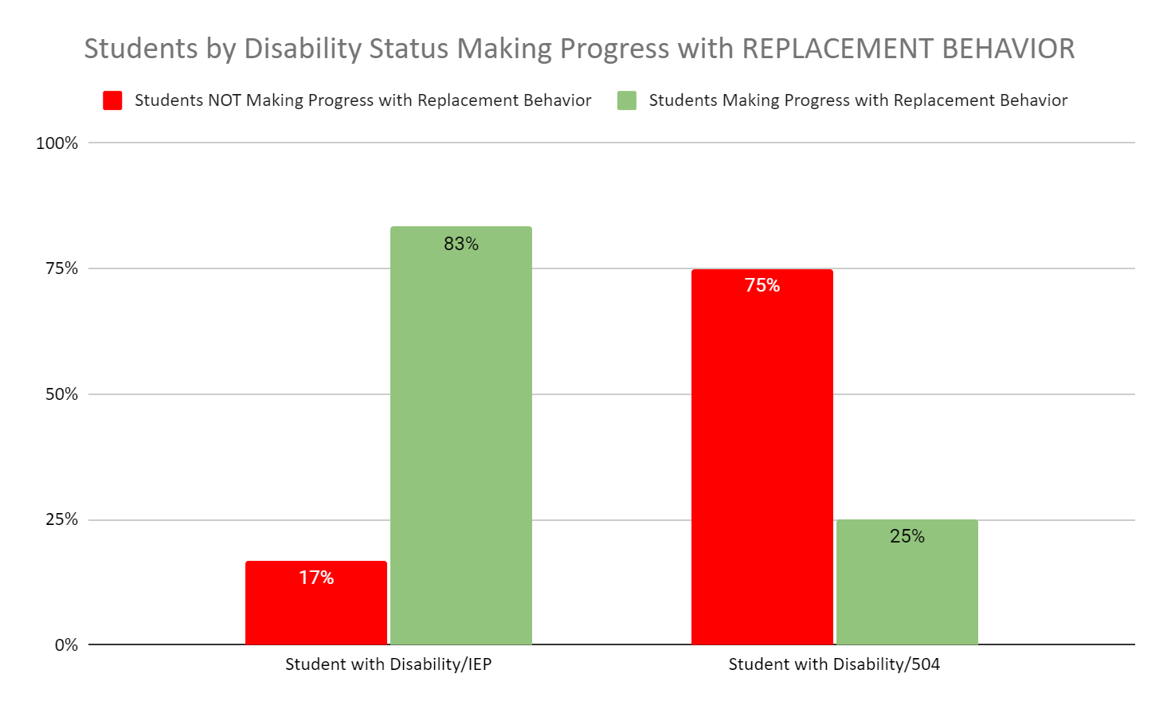
Were all subgroups of students successful?

Slide 64
Discussion:
What would you do if all students with Tier 3 plans were showing low rates of improvement with replacement behaviors?
What personal connections come to mind?
What other questions do you have?
What additional information do you need?
How could you intervene?

Slide 65
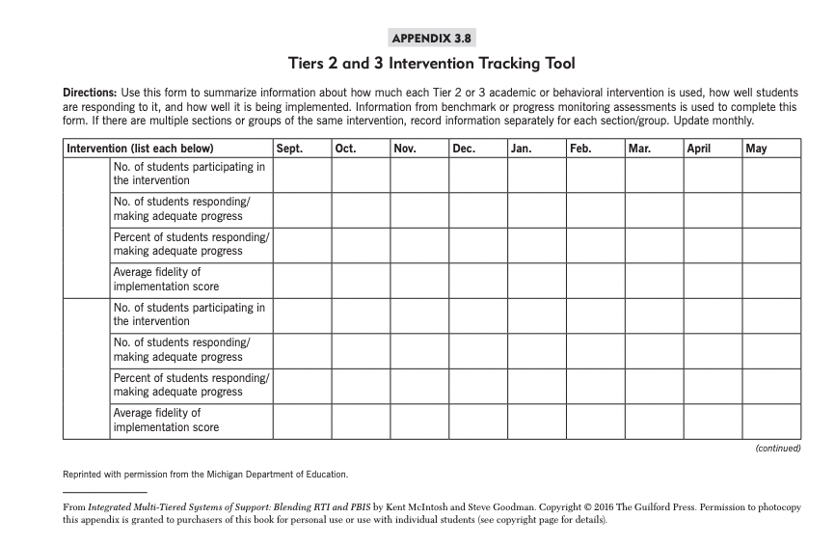

Slide 66
Data Systems to Support T3 Leadership Team
One key idea: Tier 3 data are summarized and reviewed at least monthly on (1) fidelity of plan implementation, (2) success of students receiving Tier 3 supports, (3) access to Tier 3 supports
What is going well?
What are you going to do…
Tomorrow?
Next week?
This summer?
Next school year?

Slide 67
Professional Learning
One Big Idea:
We need to shift the focus of professional development from primarily workshops, presentations, institutes to job-embedded PD and coaching that will build competencies of professionals within authentic environments
Not every professional needs the same level of competencies.

Slide 68
Planning Professional Learning
Problem Identification
Solution Development
Staff Training
Fidelity
Evaluation
Look for trends in the data (e.g., If a majority of students are struggling to make progress with their replacement skills, consider PL on teaching SEB skills)
Consider the “one strategy equals 30 minutes of training” approach (Vannest, 2012)
Once you come up with a plan… set a date to evaluate the impact before you leave the planning meeting

Slide 69
Supporting All-Staff
Key Ideas:
Everyone understands the “f” word
Everyone understands the core features of SEB support
Everyone understands the escalation cycle

Slide 70
Common Background Knowledge
Behavior is learned
Any behavior that occurs repeatedly is serving some function for the individual exhibiting the behavior
Altering the classroom environment can change student behavior
(Reinke, Herman, & Sprick, 2011)

Slide 71
Staff Development in the Science of Behavior
Allows teachers to:
Frame their thinking when problem behavior arises in their classroom
Become more fluent at thinking about function of behavior at Tiers 1, 2, & 3
Take action immediately to address behavior concerns (instead of waiting for a team of “experts”)
More effectively support ALL students
Resource:
FBA to BIP for Educators

Slide 72
Four Core Features of Effective SEB Support
Prevent SEB challenges by setting students up for success
Teach critical SEB skills
Respond in ways that encourage SEB skills and decrease SEB challenges
Decide whether to maintain or adjust (e.g., intensify, adapt, or fade) support based on data
“Establishing these core features allows different implementers to select the strategy or practice that best fits their context (Horner & Sugai, 2015)”

Slide 73
What Do We Know About Behavioral Escalation
We know the course it takes
We know the behaviors that students engage in during that course
We know what the appropriate adult responses should be

Slide 74
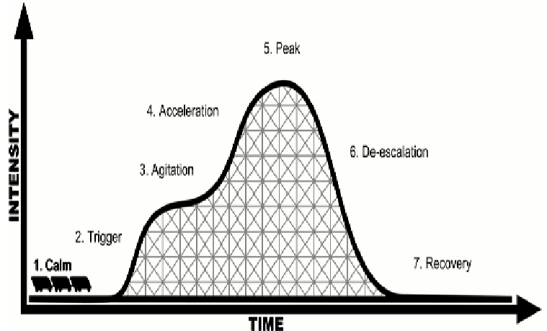
7 Phases of Acting-Out Behavior (Geoff Colvin)

Slide 75
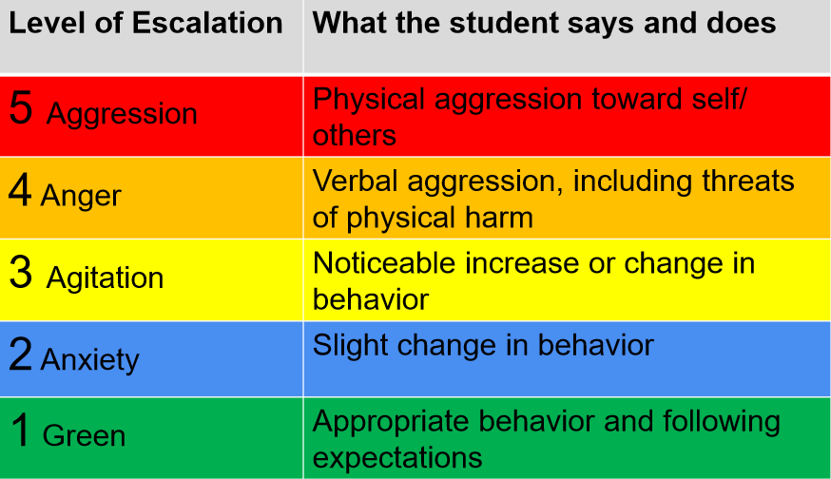
Incredible 5-Point Scale

Slide 76
Supporting FBA/BIP Facilitators
Tools:
Product Review (TATE)
Innovation Configuration Map
Uses:
Identify professional development needs for FBA/BIP Facilitators
Establish baseline and ongoing improvement
Can be used as needs-assessment, self-assessment, external assessment or combination

Slide 77
Purpose of TATE
Develop a “district/educator” friendly tool that could be used by practitioners to evaluate FBA/BIPs
Determine the technical adequacy of FBA/BIPs and establish baseline for:
District
Campus/School
Individual
Second step in requesting Tier 3 technical assistance from Florida PBS/RTI:B Project (Interview of Tier 3 process first step)
Provide information to generate data to guide district action planning
Iovannone, 2019

Slide 78
Essential Components of FBA/BIPs
Input obtained from multiple sources
Problem behavior that is the focus of the FBA is identified and defined in measurable terms
Baseline data is provided on the identified problem behavior
Setting events are considered and identified if pattern of predictability is present
Antecedent events triggering problem behavior are identified and described adequately
Antecedent events present when no problem behavior occurs are identified and described adequately
Responses made by others following the problem behavior are identified and described adequately
Hypothesis statement is written and uses the information from the FBA
Function in hypothesis is valid (negative or positive reinforcement-i.e., escape/avoid/delay; access/obtain)
Iovannone, 2019

Slide 79
Essential Components of FBAs/BIPs
BIP is developed in timely manner after FBA
Hypothesis from FBA is included or referenced in BIP
A minimum of one antecedent strategy is described that links with the hypothesis and provides enough detail so that it would be implemented consistently each day by multiple people
A minimum of one teach (functionally equivalent replacement behavior/alternate skill) strategy is described that links with the hypothesis and provides enough detail so that it could be implemented consistently each day by multiple people
A minimum of one reinforcement strategy is described that links with the hypothesis (provides the function and provides enough detail so that it could be implemented consistently each day by multiple people
A minimum of one strategy that changes the response after problem behavior is present, is linked with the hypothesis and provides enough detail so that it could be implemented consistently each day by multiple people.
A crisis plan was considered and if necessary, is described in enough detail so that it could be implemented consistently each day by multiple people.
An evaluation plan for determining effectiveness is described
A plan for measuring fidelity is described
Iovannone, 2019

Slide 80
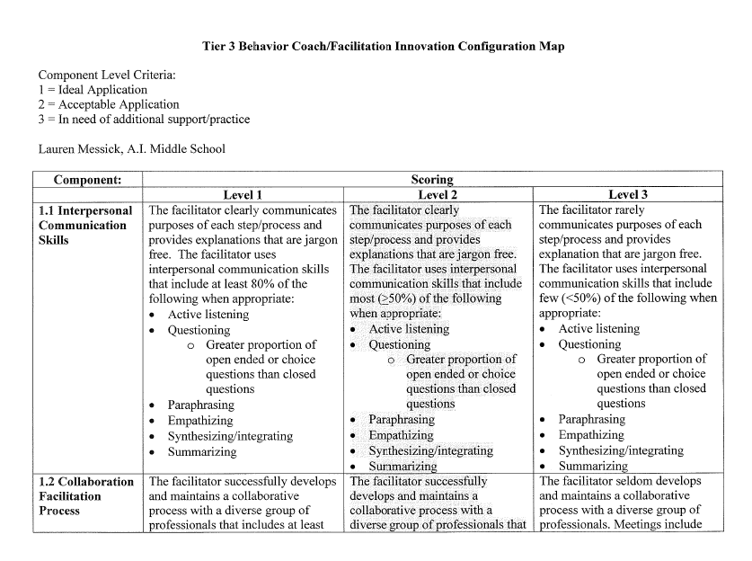
Innovation Configuration Map (IC Map)
Several purposes/uses:
Needs assessment
Self-assessment
Reflection
Framework for setting goals and action plan steps
Pre/post
Iovannone, 2019

Slide 81
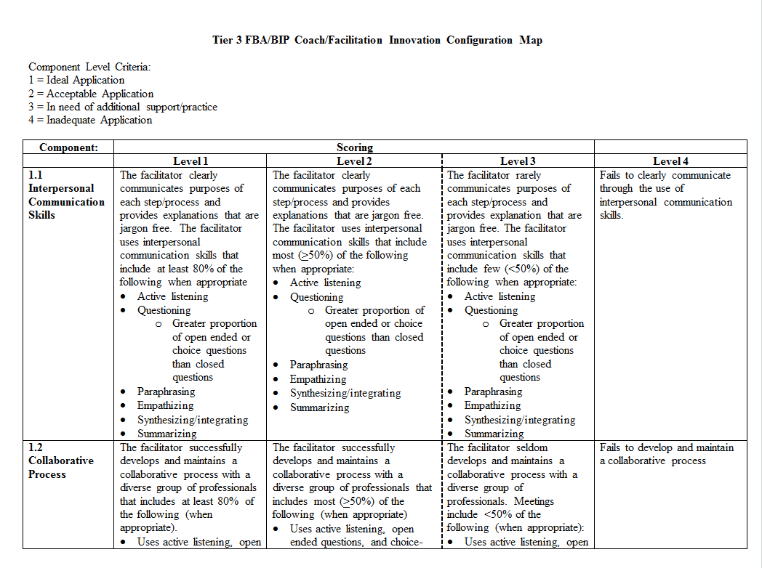
Ongoing Skill Self-Assessment
Weekly Targets-List all targets self-identified and/or discussed with your supervisor; add targets as needed. | IC Map # | Start Date | End Date | Notes | Goal Met?
Iovannone, 2019

Slide 82
Supporting Plan Implementers
Key Ideas:
Build rapport
Collaboratively select interventions (come with ideas)!
Make connections to Tier 1
Show up the first day of implementation
Create a checklist of steps
Resources:
PTR Coaching Manual
T3 Practices Page

Slide 83
Some consultation questions to support Tier 1 connections:
Prevent:
Do you have a system for routinely checking in with your students?
What are your classroom norms?
Teach:
When/how do you teach your norms and routines?
Do you have an SEL curriculum or routinely teach SEB skills?
Respond:
What type of reinforcement systems do you use with your class?
How do you respond to students in your class when they make an SEB error?

Slide 84
Professional Learning
One Key Idea:
What is going well?
What are you going to do…
Tomorrow?
Next week?
This summer?
Next school year?

Slide 85
Content Shoutouts and Links:
Michigan’s Integrated Behavior and Learning Support Initiative
Rose Iovannone T3 Coaching Materials
Don Kincaid and Iovannone T3 Forum Presentation
DE-MTSS School Needs Inventory
Integrated Multi-Tiered Systems of Support: Blending RTI and PBIS by Kent McIntosh and Steve Goodman.
Chan, Goodman, Kincaid, Kern & Simonsen - Implementing Tier 3 Takes Work
T3 BIP Review Materials - Eileen Baker Contact Information
eileen.baker@cape.k12.de.us

