Slide 1
How can school leaders increase protective
factors to improve mental health?
DASL Policy & Practice Institute
June 28, 2022

Slide 2
Community Resilience Model
About Your Presenters
Adriana Ignudo - Delaware DOE Social, Emotional, Behavioral Wellbeing (SEBW) Plan Coordinator
Takeisha Edmonds - Project DelAWARE Coordinator
Sandi Syglowski - Project DelAWARE Co-Coordinator
Brynn Fallah - Delaware Positive Behavior Support Project Coach
Valerie Brown - Delaware Positive Behavior Support Project Coach
9
5
7

Slide 3
Community Resilience Model
Expectations
We are...
ENGAGED | Leave electronics and distractions to the side Participate in discussions Take notes, if helpful to you
REFLECTIVE | Share questions you have for full group Note follow up questions for presentation team and/or individuals Focus on problem solving around areas of concern Make note if you have a “parking lot” question
SUPPORTIVE | Share successes, ideas, useful resources Listen with openness and understanding Attend to your own needs
9
5
7

Slide 4
Community Resilience Model
Learning Objectives
Understand how Regulation 508 (MTSS) applies to social and emotional wellbeing
Understand and identify Tier 1 interventions and supports
Understand the importance of mental health literacy as a Tier 1 universal strategy
Understand how to access supports through the SEBW Plan
Understand the impact of Youth Mental Health First Aid as a Tier 1 curriculum

Slide 5
Community Resilience Model
National Level Guidance
9
5
7

Slide 6
Community Resilience Model
What Educators, School Staff, and School Districts Can Do
Create positive, safe, and affirming school environments.
Expand social and emotional learning programs and other evidence-based approaches that promote healthy development.
Learn how to recognize signs of changes in mental and physical health among students, including trauma and behavior changes. Take appropriate action when needed.
Provide a continuum of supports to meet student mental health needs, including evidence based prevention practices and trauma-informed mental health care.
9
5
7

Slide 7
Community Resilience Model
What Educators, School Staff, and School Districts Can Do
Expand the school-based mental health workforce.
Support the mental health of all school personnel.
Promote enrolling and retaining eligible children in Medicaid, CHIP, or a Marketplace plan, so that children have health coverage that includes behavioral health services.
Protect and prioritize students with higher needs and those at higher risk of mental health challenges, such as students with disabilities, personal or family mental health challenges, or other risk factors (e.g., adverse childhood experiences, trauma, poverty).
9
5
7

Slide 8
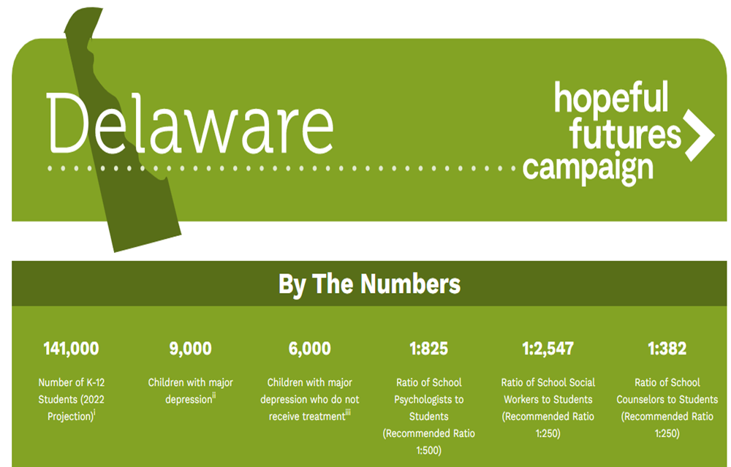
We need more support . . .
9
5
7

Slide 9
The State of Delaware Youth
Depression
1 in 5 Delaware youth age 12 to 17
experienced a major depressive episode each year
Citation: Title : Mental Health Surveillance Among Children — United States, 2013–2019, Personal Author(s) : Centers for Disease Control and Prevention (U.S.). Published Date : 02/24/2022, URL : https://stacks.cdc.gov/view/cdc/113924
Anxiety
1 in 10 Delaware youth age 12 to 17 have been diagnosed with anxiety.
Citation: Title : Mental Health Surveillance Among Children — United States, 2013–2019, Personal Author(s) : Centers for Disease Control and Prevention (U.S.). Published Date : 02/24/2022, URL : https://stacks.cdc.gov/view/cdc/113924
Suicide
The 2017 Youth Risk Behavior Survey (YRBS) data indicated that:
27.6% felt sad or hopeless (almost every day for 2 or more weeks),
16.1% seriously considered attempting suicide (during the past 12 months before the survey),
12.0% made a suicide plan, and
7.2% attempted suicide one or more times
9
5
7

Slide 10
Community Resilience Model
Building a Culture of Care
DDOE
SEBW Plan
3 State Level MH Initiatives
9
Project DelAWARE
Project THRIVE
5
7

Slide 11
Community Resilience Model
Social Emotional Behavioral Wellbeing (SEBW) Plan
Website
Newsletters
Overview Video
Self-paced modules through PDMS
MTSS Coaching

Slide 12
Federal grant funded by SAMHSA in 2018
Purpose - implement evidence-based mental health services in school settings within the context of the Multi-Tiered System of Support (MTSS) in order to promote wellness and resilience in school-aged children
Strengthen school referral and assessment process Additional human resources in each District - mental health professionals Youth Mental Health First Aid - mental health literacy Universal Screening Process Mental Health Awareness Campaign

Slide 13
Community Resilience Model
End the Stigma Campaign
Audience - DE parents of elementary, middle and high school students, teachers and school staff, as well as middle and high school students
Social Media Ads Facebook, Instagram, TikTok and SnapChat
Grassroots - Boy and Girls Clubs, Big Brother and Big Sisters,
Opinion Piece online/in-print
YMHFA Curriculum
Posters in AWARE schools
Mentalhealthde.com
9
5
7

Slide 14
Community Resilience Model
9
5
7

Slide 15
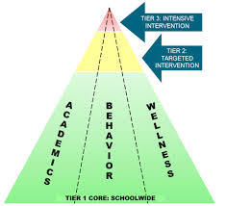
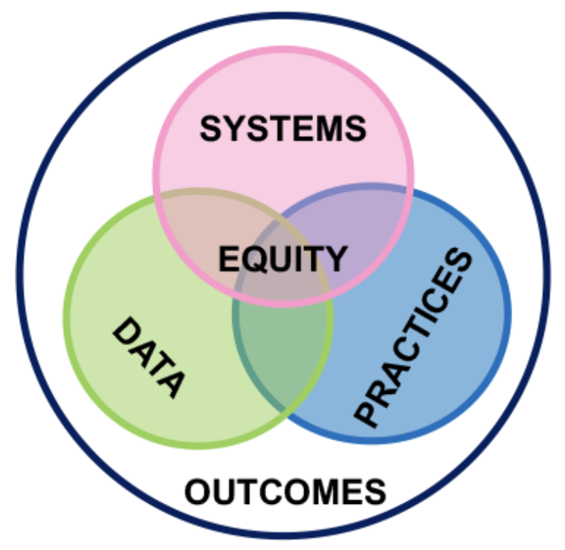
Community Resilience Model
Multi Tiered System of Support
9
5
7

Slide 16
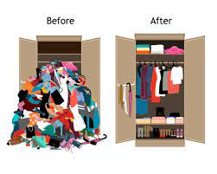
Community Resilience Model
Multi Tiered System of Support
Without MTSS:
Messy
Disorganized
Reactive
Confusing
Split focus areas
Ineffective
With MTSS:
Structure
Organized
Proactive
Defined goals
Data-driven
Equity-driven
Effective
9
5
7

Slide 17
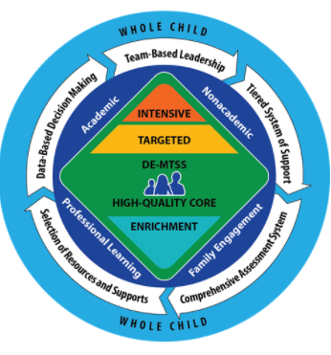
Community Resilience Model
DE-MTSS (Regulation 508)
“DE-MTSS is a framework designed to meet the needs of the whole child through an integrated, multilevel prevention system that optimizes team-based leadership and data-driven decision making to meet the academic and nonacademic (e.g., behavioral, social and emotional) needs of all students.”
9
5
7
DDOE. (2021). Delaware’s MTSS Framework

Slide 18
Community Resilience Model
Tier 1 Universal Mental Health
What do ALL Students Need?
9
5
7
Center on PBIS

Slide 19
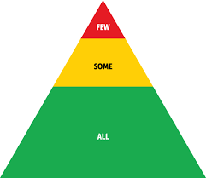
Community Resilience Model
Tier 1 SEB in Delaware
Teaching core SEL skills (CASEL, Second Step, Leader in Me, etc.)
Universal Positive Expectations (DE-PBS)
Student voice prioritized
Mental health literacy for all (TREP, SSET, Neurologic Classroom, YMHFA)
DDOE Whole Child Community of Practice (focus on Restorative Practices, Equity, Data)
Universal SEB Screening (modules)
Rethinking policy and exclusionary practices (Code of Conduct → Student Success Guide)
9
5
7

Slide 20
What are risk and protective factors?
As defined by SAMHSA:
Risk Factors are characteristics at the biological, psychological, family, community, or cultural level that precede and are associated with a higher likelihood of negative outcomes.
Protective Factors are characteristics associated with a lower likelihood of negative outcomes or that reduce a risk factor’s impact. Protective factors may be seen as positive countering events.
9
5
7

Slide 21
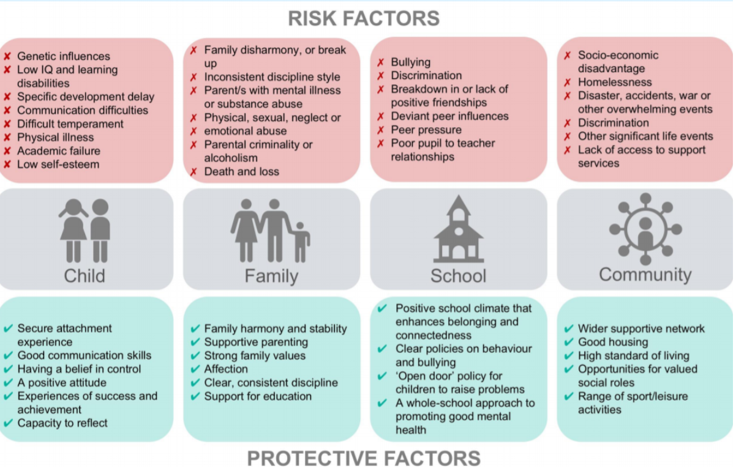
What are risk and protective factors?
9
5
7

Slide 22
Community Resilience Model
Mental Health Literacy as a Protective Factor
What is Mental Health Literacy?
Mental health literacy includes the knowledge, attitudes, and skills needed to develop and maintain positive mental health, identify mental health challenges in self and others, reduce stigma, and seek appropriate help.
https://dpi.wi.gov/sspw/mental-health/framework/universal-practices/literacy
What are the benefits to Mental Health Literacy?
Good mental health literacy helps us understand and destigmatize mental disorders and treatments while promoting and optimizing good mental health.
https://www.mentalhealthcollaborative.org/what-we-do/
9
5
7

Slide 23
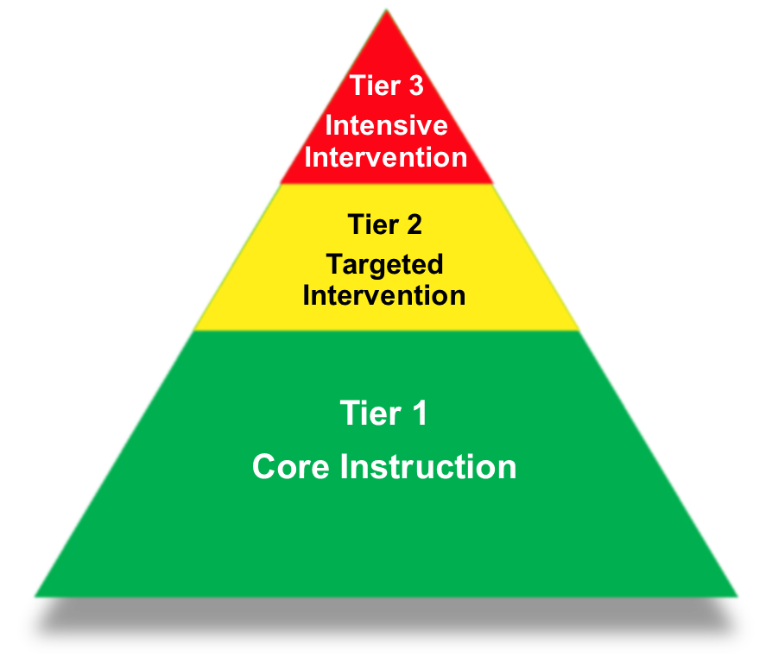
YMHFA as a Tier 1 Preventive Framework
Reduction in:
Response to:
External Indicators
Office Discipline Referrals
Crisis Calls
Risk Assessments
Truancy Cases
Overwhelming student
support team
Internal Indicators
Anxiety
Depression
Low self-esteem
Burnout
Stress
Somatic Symptoms
9
5
7

Slide 24
Community Resilience Model
Using YMHFA to Build Protective Factors
Increase in:
Identification of students struggling with a mental health challenge
Ability to respond to students struggling with a mental health challenge
Connecting students to professional help
9
Overall better mental wellness of students
5
7
Notes:
Sandi

Slide 25
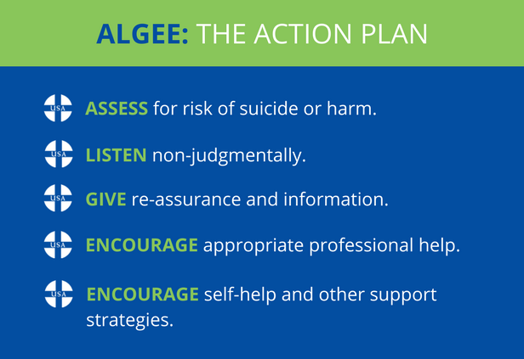
Community Resilience Model
Youth Mental Health First Aid (YMHFA)
9
5
7

Slide 26
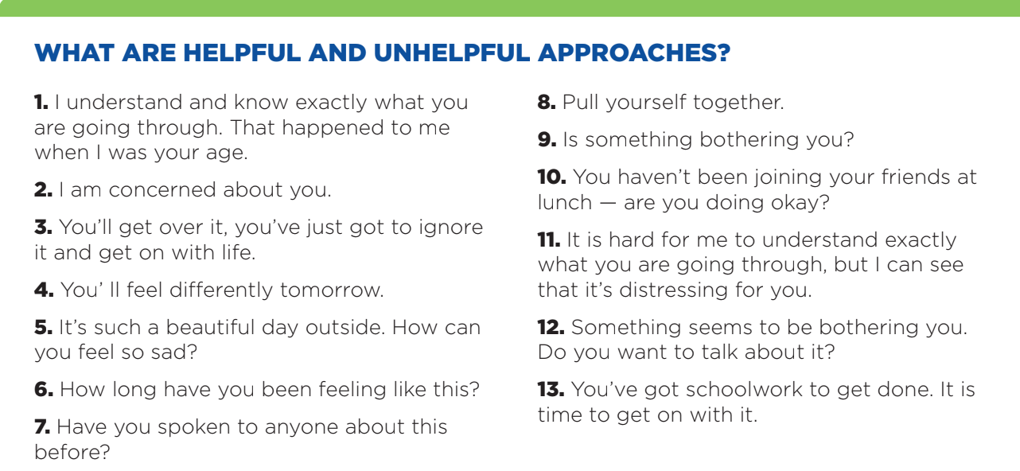
Community Resilience Model
Youth Mental Health First Aid (YMHFA)
A - Assess and Approach
9
5
7

Slide 27
Community Resilience Model
Youth Mental Health First Aid (YMHFA)
G - Give Reassurance and Information
Reassurance is a statement, comment, or action that helps remove a person’s fears.
Information helps a person understand a concept, discuss options and next steps, and indicate when they need additional help or support.
HOPE with FACTS
9
5
7

Slide 28
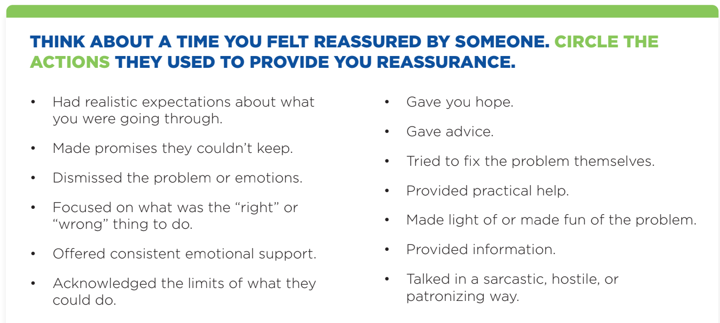
Community Resilience Model
Youth Mental Health First Aid (YMHFA)
9
5
7

Slide 29
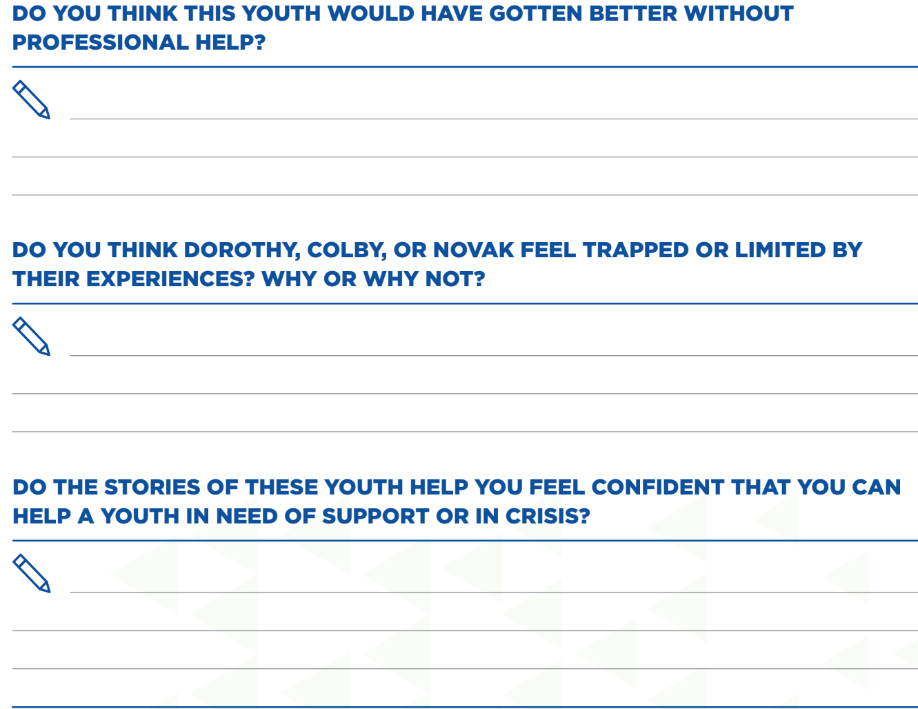
Community Resilience Model
Youth Mental Health First Aid (YMHFA)
Talking about it
Part 3 Video
https://vimeo.com/
438597438/d7bcdf035e
9
5
7

Slide 30
Community Resilience Model
Delaware DOE YMHFA Instructors
26
30
56
Instructors
Project AWARE
SEBW
Appoquinimink
Brandywine
Caesar Rodney
Cape Henlopen
Capital
Christina
Colonial
Indian River
Lake Forest
New Castle County Votech
Polytech High School
Red Clay
Kuumba
State Members
9
5
7

Slide 31
YMHFA Participants Trained Through SEBW 2021-22
230 participants
9 Charter Schools
18 School Districts
9
5
7

Slide 32
Community Resilience Model
YMHFA Implementation Highlights
Some districts and charters who are committed to increasing mental health literacy within their schools have used professional development time or offered compensation for trainings completed outside of contractual hour (i.e. EPER, SNOW Hours, Summer PD Days, Stipends).
Instructors have worked with state and local leadership to complete action plans of YMHFA implementation to incorporate district PD plans, MTSS framework, and utilize strategic planning.
9
5
7

Slide 33
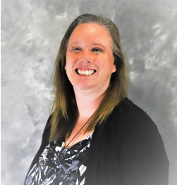
Community Resilience Model
Testimonials
“I thought the training was great -- fast paced, interactive and hands on. I thought it was super helpful and meaningful to have us teach the lesson to our peers and have to prepare for it. I also think it is great that we have co-instructors now around the state to partner with.” - Eileen Baker, School Psychologist, Cape Henlopen School District - newly certified Mental Health First Aider and Instructor
“For anyone considering taking a course on YMHFA or for becoming a YMHFA Trainer- it is definitely worth every minute. It may seem intense but this training is something that all ancillary and non-ancillary staff in education need to have access to. We are dealing with unprecedented times in our students’ lives and anything that we can do to support them, and proactively intervene when we, as adults, recognize signs and symptoms of non-crisis or crisis mental health concerns, will empower our educational community to respond in appropriate ways.” - Jennifer Martin, Supervisor of Instruction, Caesar Rodney School District - newly certified Mental Health First Aider and Instructor
9
5
7

Slide 34
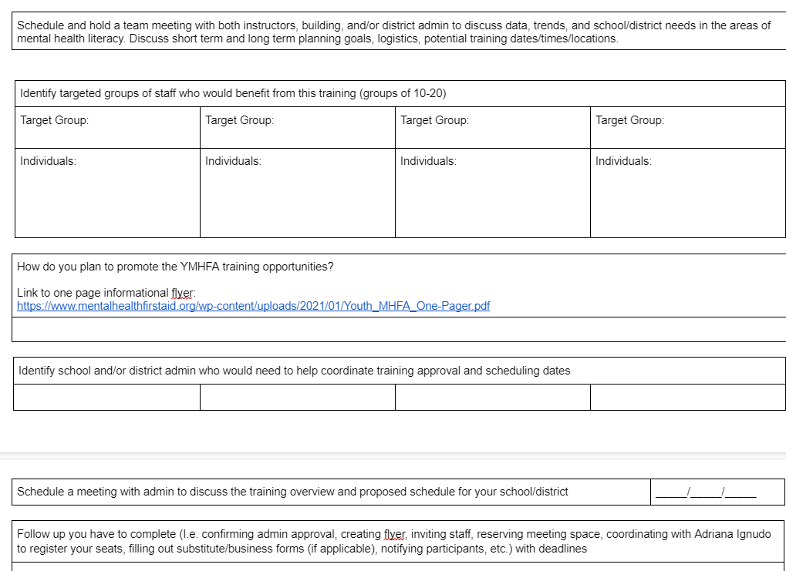
Community Resilience Model
Action Planning
9
5
7

Slide 35
Community Resilience Model
Q&A
9
5
7

