Slide 1
Universal SEB Screener Selection
Developed on behalf of the DE-PBS Project
by Niki Kendall, Rebecca Silver, and Alex Miller
Spring 2022
Notes:
Universal SEB screener selection
This webinar was developed on behalf of the DE-PBS Project by Niki Kendall. A special thanks to our graduate students Rebecca Silver and Alex Miller for all of their help and research to make this happen!

Slide 2
Webinar Development
The DE-PBS Project serves as a technical assistance center for the Delaware DOE to actualize the vision to create safe and caring learning environments that promote the social-emotional and academic development of all children.
The statewide initiative is designed to build the knowledge and skills of Delaware educators in the concepts and evidence-based practices of Positive Behavior Support (PBS) as a Multi-tiered System of Support (MTSS).
https://www.delawarepbs.org/universal-screening/
Notes:
The DE-PBS project is an ongoing collaboration between the Delaware department of education and the UD center for disabilities studies.
The DE-PBS Project serves as a technical assistance center for the Delaware Department of Education to actualize the vision to create safe and caring learning environments that promote the social-emotional and academic development of all children. The statewide initiative is designed to build the knowledge and skills of Delaware educators in the concepts and evidence-based practices of Positive Behavior Support (PBS) as a Multi-tiered System of Support (MTSS).
All resources from this webinar can be found on our website at: https://www.delawarepbs.org/universal-screening/

Slide 3
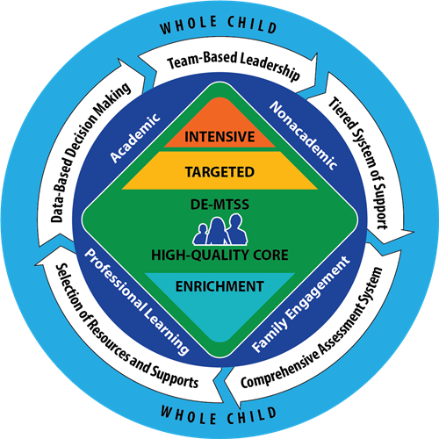
Core Features of DE-MTSS
Team-Based Leadership
Tiered Delivery System
Selection and Implementation of Academic and Non-Academic Supports
Comprehensive Screening and Assessment System
Continuous Data-Based Decision Making
Notes:
Before we begin, just a reminder to position your universal screening work within the context of the core features of Delaware MTSS.
All of this work overlaps. Screening data is meant to help leadership teams at the district and school level make data based decisions that inform the selection, implementation and delivery of academic and non-academic supports across their tiered delivery systems.

Slide 4
Installing a Universal SEB Screener Series
Key Webinars in this Series:
Webinar 1: introduction
Webinar 2: universal SEB screener selection
Webinar 3: universal screening readiness, resource mapping, gap analysis
Webinar 4: parental consent, action planning and gaining stakeholder buy in
Webinar 5: data-based decision making
Bonus Content for Enhanced Learning:
Webinar 1 bonus content: Top Ten Questions about Universal Screening
Webinar 2 bonus content: a review of select SEB screening tools
Notes:
These webinars are designed to be used during all phases of your installation of a universal SEB screener (from exploration to full implementation). Because the installation of a universal screener will require both fiscal and human resources for successful implementation, it is recommended the work is facilitated at the district level rather than the school level. However, a similar process could be conducted at the school level if district level support is unavailable.
In this webinar, we will primarily focus on selecting a universal SEB screener. However, it should be noted leadership teams interested in adopting an academic screener could benefit from following a similar process.

Slide 5
Universal Screener Installation Action Steps
Learn about comprehensive screening in the context of MTSS
Establish a district implementation team
Complete tool selection process
Determine readiness criteria (e.g., high level of DBDM or high fidelity to PBIS implementation) and select schools to participate
Organize school team(s) to support screening work
Complete resource map and gap analysis with each school
Confirm that each school has adequate SEB supports
Introduce screening initiative to school community
Consult with legal team about consent/finalize consent forms
Train/coach teachers to administer
Conduct screening (2 or 3 times)
Create data reports
Prioritize needs and act on data
Evaluate your screener implementation
Notes:
Here you will find the 14 universal screener installation action steps. Something important to recognize is the list looks linear but, you may find your team jumping ahead or back throughout the installation process. For example, step 9 asks teams to consult with their legal team about consent for screening. However, you may start discussing your consent process at the same time or before you start working on readiness with your school teams.

Slide 6
1. Establish a district implementation team
Notes:
Alright, so let’s get started with establishing a district implementation team.

Slide 7
Implementation Teams
“A group of stakeholders that oversees, attends to, and is accountable for key functions of innovation selection, implementation, and improvement related to an evidence-based practice or program.”
3 functions:
Ensure implementation
Engage the community
Create hospitable environments (e.g., scheduling, resources, curriculum choices, professional development, resource allocation)
National Implementation Research Network (NIRN)
Notes:
The National implementation research network (NIRN) defines an implementation team as “a group of stakeholders that oversees, attends to, and is accountable for key functions of innovation selection, implementation and improvement related to evidence based practices or program”
Primary functions of this implementation team include ensuring implementation, engagement with the community to establish buy-in and support and creating “hospitable environments” that help schools experience success.
Selecting and implementing an SEB screener is a new innovation for many districts and schools. Because of this, careful attention should be paid to all three functions throughout the process.

Slide 8
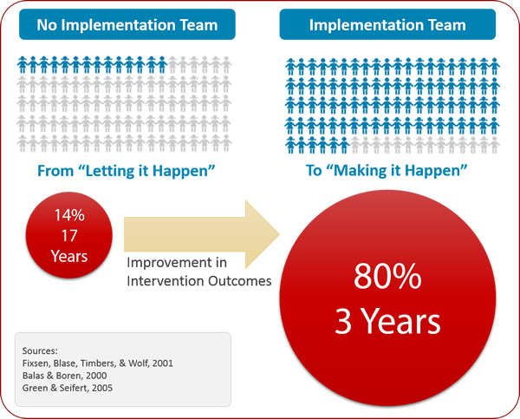
Implementation Science
Notes:
Implementation science research tells us that establishing an implementation team to oversee a new initiative like screening is a key factor in successful adoption.
There are three ways a new policy or initiative can be implemented.
“letting it happen” - A policy or program is mandated or adopted, and, with minimal supports, practitioners are expected to translate information to practice. Practitioners are held accountable for intended outcomes.
"Helping it happen" – A policy or program is mandated or adopted with materials, training resources, and websites to support practitioners. Practitioners are left to figure out how to solve problems while being held accountable for achieving positive outcomes.
"Making it happen"– A policy or program is been mandated or adopted. Active and purposeful implementation best practices are used to support practitioners and administrators. An Implementation Team is accountable for developing the implementation support systems, resolving organization and system issues, and achieving positive outcomes.
In these webinars, it is recommend that leadership teams take a “making it happen” approach, that includes active support to those required to adopt the universal SEB screener. You can see from this visual that when an implementation team adopts a “making it happen” approach outcomes jump from a 14% in 17 years successful adoption rate to 80% in 3 years.

Slide 9
Why is district leadership so important?
Screening activities should fit with the broader district improvement goals
Adopting a universal SEB screening tool will require community acceptance and buy-in
District level leadership is required to ensure family rights and values are upheld
Adopting a universal mental health screening tool WILL lead to an increased number of students identified as at risk (and that is a GOOD thing)
Screening data will assist in coordination of how and where services are provided
Notes:
Implementation teams that adopt a making it happen approach are essential to screening. Because there is a direct link between screening and support delivery, it is important to select a screener that fits within the broader district improvement goals. Even more importantly, the screener should be accepted by the community as a valuable tool to support students. With that, district leaders need to ensure family rights are upheld. To do so, the purpose and implications of the screener should be completely transparent to your families. They should understand the types of questions being asked, how the data will be used and trust the information will be kept secure. Finally, adopting a screener will require resources!!! You will gather valuable information about the SEB needs of your students. This information will inform how (and what) supports will be delivered across your tiered delivery system. Schools will need support to respond to the data.

Slide 10
Working Smarter - Team/Committee Map
District Level Team/Committee | Purpose & Goals Supported | Measurable Outcome(s)- Data-Based | Target Group | Staff Involved | How often? | Strategic Plan
First, decide if your screening work requires a new team or if an existing team could be expanded to do the work.
Notes:
When developing your district implementation team, it may be helpful to start with a team/committee map. We have provided a sample template on the webinar resources page. You can decide if it’s necessary to create a team specifically for screening to intervening work or modifying a current team to take the lead on the work.

Slide 11
Sample MTSS Teaming Structure
Tier 1 Committee
Tier 1 Administrators &
Team Leaders
MTSS Committee
(enacts district MTSS goals)
Universal Screening Coordinators & Data Analysts
Screening Implementation Committee
District Leadership Team
Advanced Tiers Committee
Notes:
If helpful, here is an example an MTSS teaming structure and where the screening work could potentially fit. In the graphic, the district leadership team supports an overall district level MTSS committee. District subcommittees operate under the overall goals of the larger MTSS committee and school based leaders work to connect work to school level implementation. In this example, a screening implementation subcommittee has been established.

Slide 12
Purpose, Functions, Authority: Screening Implementation Team
Purpose
Our team supports Strategic Goal #3 (Success for All). Our purpose is to support implementation of the MTSS for SEB framework at all schools by improving the data-based decision-making skills of MTSS team leaders and establishing procedures for universal screening.
Function
Select universal screener tools
Establish a screening/assessment timeline
Determine criteria for schools to participate in screening
Establish a professional learning and coaching plan
Facilitate monthly PLC with all school screening coordinators and data analysts
Collect and share district level screening reports with other MTSS committees (e.g., Tier 1 team)
Authority
Active leadership participation
Funding for screening tools
Monthly agenda item on district MTSS committee
Implement approved readiness criteria with schools
Implement approved professional learning plans, coaching and PLCs
Notes:
Whether or not the district decides to implement a specific screening implementation team or delegate the work to another subcommittee (e.g., the Tier 1 team) the following example outlines the purpose, functions and necessary authority of this team. In this example the purpose of the screening implementation team is to support the implementation of the MTSS for SEB framework across all schools by improving the data based decision making skills of MTSS team leaders and establishing procedures for universal screening. The main team functions are to select screener tool, establish assessment timelines and readiness criteria for participating schools and to coordinate a monthly PLC with all screening coordinators. The team has the authority to fund screening tools, set a monthly agenda item on the district MTSS committee and implement professional learning, coaching and PLCs to support screening implementation.

Slide 13
Membership/Roles/Expertise
Are the right people at the table?
Team Leader: District Universal Screening Coordinator (e.g., district Tier 1 coach)
Member of district MTSS committee
Someone with knowledge of SEB assessment (e.g., school psychologist)
Someone with decision making authority; funding support
District Data Specialist/Information Officer/Research and Evaluation
Someone with knowledge of district academic screening procedures
School level representation
School and community mental health providers
Consider:
Do members have time to participate?
Are members willing to do the work?
How will you access student and family voice?
Notes:
As you develop your implementation team, make sure you have the right people at the table. For screening work, we would recommend the following people. Someone that will be especially important for the selection process is a person who has expertise in SEB assessment and understands psychometric properties of various assessment tools, like a school psychologist.
You should also consider if the people you recruit have the time and willingness to do the work. Finally, please consider how you will ensure family, community and student voice informs your decision making throughout the implementation process.

Slide 14
2. Complete tool selection process
Notes:
Now that you have a team assembled, it is time to start thinking about which screener you’d like to adopt. At the project, we are often asked for a list of tools that we’d recommend. Unfortunately, simply selecting a tool from a list does not always lead to successful implementation. We have found in working with districts, the best way to help a team select a tool is to walk them through the following steps.

Slide 15
4 Steps to Selecting a New Screener
Gather and review existing SEB data sources to determine need
Determine what you want to be different as a result of implementing this screener
Explore screeners
Select a tool that supports your need and capacity
Notes:
First your team will review existing SEB data sources to determine need and explicitly identify the outcomes you hope to see as a result of implementation. And then you will exploring screeners and select a tool that supports your need and capacity.
This process can see overwhelming and time consuming. But it is necessary to ensure you are able to justify your selection which will help you establish buy-in and commitment from your stakeholders.

Slide 16
Review Existing Data Sources
Questions to ask:
What concerning trends do we notice?
Which groups are impacted?
What related supports do we have that address this trend?
What questions could you ask students (or ask teachers about students) to more effectively address these needs?
Sample data to review:
Student Data (e.g., early warning indicators such as attendance, academics, and discipline referrals)
School-Wide/Community Data (e.g., Delaware School Climate Data)
Notes:
Okay, step 1 is to do some data exploration. We have a template for you to use during this process. But generally, you will dig into some student data such as discipline, attendance or academic data to understand existing issues. You should also explore schoolwide/community data such as your district’s school climate results. As you explore the data, you will focus on the following questions.
what trends do you notice? which groups are impacted? what supports do you already have that address these trends? what types of questions could you ask students or teachers to better understand these needs?

Slide 17
Use your data trends to prioritize the behaviors, mind-sets and/or competencies you hope to impact
Externalizing behaviors (e.g., arguing, disruption) or internalizing behaviors (e.g., sadness, worry)?
Mind-sets or attitudes (e.g., motivation to learn, feelings about school)
Academic enablers (e.g., academic engagement)?
Social and emotional skills (e.g., responsible decision making, cooperation with peers)?
Mental health concerns (e.g., substance misuse, suicidal ideation)?
Notes:
A few things to keep in mind during this process. Remember the purpose of screening is to inform your supports. This means the focus of the screener should align with the behaviors, mind-sets or competencies you hope to impact. You can’t expect a single screener to capture everything.
Instead, use your existing data to help inform your focus. For example, the team may want to identify students at risk of behavioral or emotional challenges, thereby opting for a screening tool that encompasses a broad focus, or the team may be interested in identifying students with signs of specific support needs, such as suicidal ideation. Alternatively, schools may be interested in measuring the progress of their students with SEL skills and opt for a competencies focused screener.
Just remember the purpose of screening is to inform prevention and intervention… so make sure the data help move your priorities forward.
You may also find you need more than one screener or decide to use specific tools with certain grades.

Slide 18
Which groups are impacted?
Remember universal is all students…
All students (K-12)
All kindergartners
All transfers into school
All students during transition years
Not only those with known risk…
All students referred to Tier 2
All students returning from alternative placements
All students who visit the wellness center
Notes:
Next, pay close attention to who is impacted by the trends you notice in your data. Are there groups of students impacted more than others. You may opt to implement a screener with certain groups rather than all students k-12.
Just remember…universal screening prevents the wait to fail model – enabling teams to intervene early rather than waiting for a student to demonstrate persistent or profound challenges. This means we screen ALL students not only those with known risk. Jennifer Daugherty from Colonial School District always says, universal screening makes the unseen, seen.
For example, you may choose to screen all students transitioning to middle school. It does not mean you only screen the students with known risk (e.g., all students entering middle school with 2+ discipline referrals).

Slide 19
Who can provide screening information?
Teacher
May be more sensitive to externalizing than internalizing challenges
Primary use in Pre-K-6th grade; secondary use with 7-12
Parent
Primary use with PK and K
Response rates may be low
Student
Often best informant for internalizing challenges
Primary use with secondary students due to their increased awareness of their own psychological experiences
Adapted from Eklund, 2022 and Daniels, Fowler, Robinson-Link, Pearrow & Whitcomb, 2021
Notes:
When thinking about selecting a screener. It is important to think about who you want to answer the question. Some general guidelines from Katie Eklund, the co-author of a book called, Conducting Behavioral and Social Emotional Assessments in MTSS, are presented here. We have found secondary schools are very invested in student voice, while earlier grades rely on teacher reports. In many cases you may opt to use a multi-gate process. In this model, teachers or students could complete the first round of screening and those with needs could be screened by a second rater.
Citation:
Eklund, K. (2022, February). Universal screening for social, emotional and behavioral concerns: Using data to guide interventions [conference session]. National Association of School Psychologists Conference, Boston, MA.

Slide 20
Use existing data to start the conversation…
Data Source Reviewed | Common social, emotional, or behavioral challenges experienced by your students | Are there any groups that are disproportionately impacted? | What supports are available in our schools to address the need?* | What questions could you ask students (or ask teachers about students) to more effectively address these needs?
School Climate Data | (example) peer relationships are a concern | especially our high school girls | Elementary: Tier 1 (second step, schoolwide PBIS) Tier 2 (Social skills groups, lunch bunches) Secondary: Tier 1 (advisory, schoolwide PBIS) Tier 2: (overcoming obstacles) | Students: do you have friends at school? can you solve conflicts when they arise?
Questions adapted from: DuBois, Antonelli & Hill, 2022
Notes:
Okay, let’s put all this together. Here is an example of the template that is provided on the resources page. In the exemplar, this team reviewed their Delaware School Climate data and noted some concerns with peer relationships. In particular, the data indicated high school girls were really struggling. They did a quick brainstorm of the prevention supports and interventions that already exist in the district that may support this trend. And finally, they came up with some examples of specific questions they were interested in asking.
Use this as an opportunity to gain consensus on the mind-sets, competencies or behaviors you are invested in addressing with a screener, who you want to ensure is captured, what supports the data should inform and the types of questions you’d like to ask. Your data walk does not have to be exhaustive or overly complicated.
Citation:
DuBois, M., Antonelli, R. & Hill, E. (2022, February). Leveraging teacher buy in to implement school-wide SEB screening [conference session]. National Association of School Psychologists Conference, Boston, MA.

Slide 21
Three questions to ask while exploring screeners:
Does it meet your need?
Is it usable?
Is it defensible?
Adapted from Glover & Albers, 2007
Notes:
Now that you have come to consensus about what you hope to be different as a result of screening (e.g., what student trends you hope to impact) it is time to begin your research. When looking at tools, research on implementation science as well as specific recommendations from measurement experts (e.g., Todd Glover and Craig Albers) suggest keeping these three questions in mind when evaluating the utility of screening tools.
School-based assessments should have evidence to support their use in a problem-solving model. They should be defensible, with psychometric adequacy. They should be usable, meaning they present limited resource burden are efficient and repeatable. And most importantly, they should meet the needs you identified in your data dig. We will briefly look at each of these next.
citation:
Glover, Todd & Albers, Craig. (2007). Considerations for evaluating universal screening assessments. Journal of School Psychology. 45. 117-135. 10.1016/j.jsp.2006.05.005.

Slide 22
Will it meet your need?
Items relate to the mind-sets, behaviors and/or competencies that are relevant to the social and academic success of your students
Stakeholders (e.g., teaches, families, community members) understand and value the mind-sets, behaviors and/or competencies that are being assessed
The screener is designed with your prioritized population(s) in mind
There are available accommodations for targeted populations
Improves prioritized student outcomes
Notes:
When deciding if a screener meets your need make sure it relates to the student trends you prioritized. Do the items align? Do they make sense? You will also want to ensure the screener is designed to accurately capture the needs of the populations you’ve prioritized and whether there are accommodations to ensure the screener is universal (e.g., reading level, languages etc.). You should also consider whether or not the data can be used in ways that will contribute to your prioritized student outcomes. Ultimately, it should help you create a more effective tiered delivery system. Finally, consider whether or not your stakeholders will understand and value the results. Are they understandable to a wide audience?

Slide 23
Is it Usable?
Cost should not outweigh benefits
Consider human , time and fiscal resources
Results are understandable and lead to intervention planning and service delivery
There is an efficient system for collecting, managing, and interpreting data
It can be repeated
Treatment utility or the extent to which we can use the data to make effective decisions for students
Notes:
Next, think about the usability of the screener. Remember part of the job of an implementation team is to ensure “hospitable environments” for the educators tasked with implementing the screener experience success. If the screener requires a lot of resources, it will likely fail. It the results are hard to interpret, teams won’t use the data. If the data management system is cumbersome, your teams will require a lot of training and time. And finally, make sure the tool is sensitive enough to be used multiple times per year.

Slide 24
A word of advice…
When looking at screeners, spend some time learning about the associated technology such as the software company and data platform that supports the screener.
For example:
Illuminate Education is a software company that operates FastBridge, a data platform that supports the SAEBRS and mySAEBRS screeners.
MdLogix is the software company that operates the BHWorks Platform that supports the Behavioral Health Screener (BHS)
Panorama Education is the software company that operates numerous platforms such as an SEL Platform that supports their SEL Surveys
This felt confusing at first…
Notes:
When thinking about usability, you should also consider associated software. Make sure you check out the publishing company and associated data platform when looking at tools. Sometimes it is hard to discern which is which. But gathering information about each of these will help you determine the fit of a screener. For example, Panorama Education is a company that shares lots of webinars and resources. They also operate several data platforms and publish various screeners and surveys.

Slide 25
Is it Defensible?
Appropriately standardized for use with your target population(s)
Not all tools are appropriate for school settings or effective for students of all ages or abilities
Accurately measures what it is intended to measure
Leads to accurate identification of individuals who require further diagnostic assessment or intervention
Consistently measures what it is intended to measure
Notes:
Finally, the fun part. Is the screener technically adequate? For this section, we will need to get into some nuts and bolts of measurement. To summarize, make sure you check out the standardization to help ensure any comparisons made between your students and a sample are accurate. For example, I wouldn’t want to use a tool that compares my student’s scores to a group of European students. Second, consider whether or not the tool accurately measures what it is intended to measure. If it claims to be an SEL screener but the scales do not align with common definitions of SEL skills, it is probably not a fit. Similarly, the screener should reliably measure what it is intended to measure and lead to accurate identification of students who might need support. You don’t want to end up with too many students identified or missing students who might actually be at risk.

Slide 26
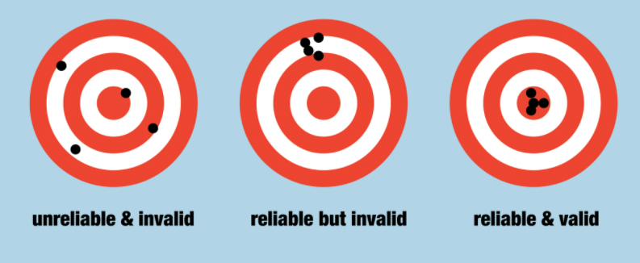
Things are about to get technical…
Notes:
In the next few slides, we will jump into some definitions of standardization, reliability and validity. Ultimately we want a tool that is both reliable (consistently measures what it is intended to measure) and valid (accurately measures what it is intended to measure).

Slide 27
Measurement 101: Sampling
 | Description | Interpretation Guidance
Normative Sample | The group of peers an individual score is compared to Should be representative, recent, & sufficiently large | Representativeness: age, gender, grade, race/ethnicity, socioeconomic status, geographic location, disability status Recency: Good = normed within last 10 years; Adequate = normed within last 11-15 years Sample size: adequate number of students at various age and grade levels At least 500 for the whole sample and at least 100 for each age group is preferable
Information adapted from Glover & Albers (2007), Gokiert et al. (2014), & Frick et al. (2020)
Notes:
First, let’s talk about sampling. When exploring screening tools make sure there is a description of the normative sample. The normative sample is the group of peers your student scores will be compared to. This sample should be representative, recent and sufficiently large. Ultimately, you should find evidence it is representative of your students in regards to age, gender, race, socioeconomic status, geographic location and disability status. These norms should be recent (within the last ten years) and contain an adequate sample size of students at various age and grade levels.
If you select a screener that provides norm referenced scores (compares your student scores to the normative sample) always ask the publisher to share this information with you. And be suspicious of the screener if you can’t find this information.

Slide 28
Measurement 101: Validity
Validity Definition:
The extent to which a screener measures what it claims to measure
Typically measured using Pearson’s r to determine the strength of the relationship between two variables
r coefficient range from -1 to 1
Scores close to 1 indicate a perfect positive relationship between variables
 | Description
Content Validity | The extent to which the content of the screener captures all aspects of the construct being measured (e.g., a screener for internalizing behaviors asks questions related to anxiety and depression)
Construct Validity | How well a screener relates as it should to other measures of similar and different constructs Includes convergent and divergent validity
Convergent/ Divergent Validity | Extent of the relationship between similar and dissimilar measures
Criterion Validity | The extent to which the test correspond to the results of a different test of the same thing Includes predictive validity and concurrent validity
Predictive Validity | How well the screener predicts another valid outcome in the future screener and student outcomes (e.g., GPA) screener and diagnostic assessment
Concurrent Validity | How well scores on one measurement relate to another valid instrument at the same time screener and student outcomes (e.g., GPA) screener and diagnostic assessment
Information adapted from Glover & Albers (2007), Gokiert et al. (2014), & Frick et al. (2020)
Notes:
Next, let’s talk validity. Validity measures the extent to which a screener measures what it claims to measure. All types of validity are typically measured using a statistic called Pearson’s r, which provides a useful metric to determine the strength of a relationship between two variables. Generally speaking, r coefficients range from -1 to 1, with scores closer to 1 indicating a stronger relationship.
Validity is captured in three main types: content, construct and criterion.
Content validity measures the extent to which the screener captures all aspects of the construct being measured.
Construct validity measures the extent to which the screener relates to other measures of similar or different constructions. Construct validity includes convergent (how similar) and divergent (how dissimilar) validity.
Criterion validity measures the extent to which the test corresponds to the results of a different test of the same thing. Two types of criterion validity include predictive (how well a test predicts scores on another valid outcomes in the future) and concurrent (how well scores relate to another instrument at the same time).
We will share some examples of these at the end of this webinar when we review several SEB screeners.
The take-away… do you feel confident the screener measures the mind-sets, behaviors or competencies you prioritized?

Slide 29
Measurement 101: Reliability
Reliability Definition:
The ability of a screener to produce stable and consistent results over time
Typically measured using Pearson’s r to determine the strength of the relationship between two variables
r coefficient ranges from -1 to 1
Scores close to 1 indicate a perfect positive relationship between variables
 | Description
Internal Consistency Reliability | An indicator of how consistently individuals respond across items or sets of items within the same instrument Important for estimating whether items within the same tool are measuring the same construct
Test-Retest Reliability | An indicator of how consistently an individual performs on the same instrument over time May be lower than other types of reliability due to measurement error or true changes in the individual over time (i.e., maturation; fluctuations in symptoms, or intervention)
Inter-rater/ Interscorer Reliability | Level of agreement between measure ratings obtained from different raters Important consideration for screeners that require the raters to make judgments There may be a lack of agreement because the student’s behavior is different across settings (e.g., two different classrooms; home and school)
Information adapted from Glover & Albers (2007), Gokiert et al. (2014), & Frick et al. (2020)
Notes:
Finally, you will want to consider reliability. Reliability describes the ability of an assessment to produce stable and consistent results over time. There are three main types of reliability that are of particular relevance to screeners. Internal reliability is an indicator of how consistently individuals respond to items within the same instrument. For example, I should respond similarly to all items that are meant to measure my peer relationships skills. Second, we have test-retest reliability which is an indicator of how consistently an individual performs on the same instrument over time. And finally, inter-rater reliability which gives us information about the level of agreement between different raters on an assessment.
we’ve provided some information about reliability of several instruments at the end of this webinar.

Slide 30
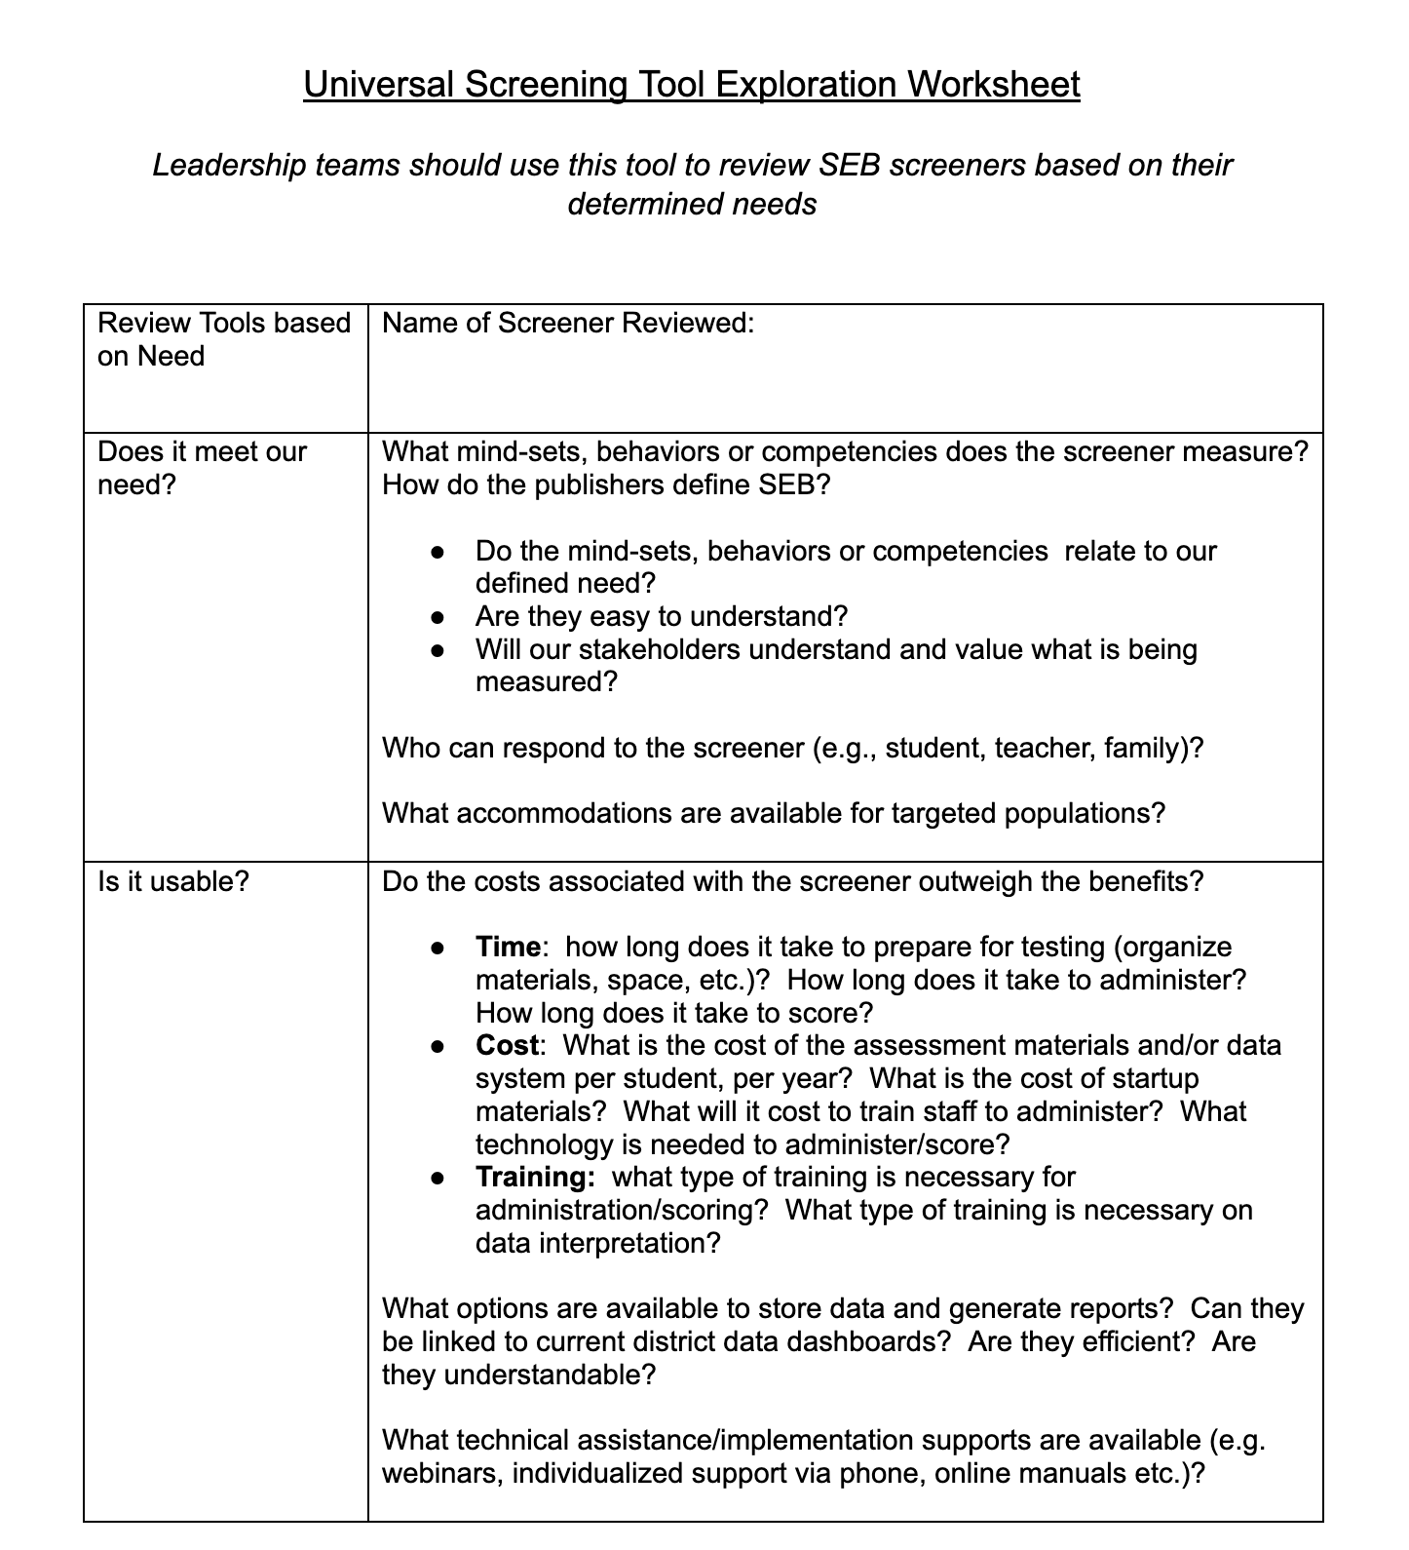
SEB Screener Review
Please see the bonus content slides for a review of the usability and defensibility of several common SEB screeners in use across Delaware LEAs.
Teams can use these slides and the screener tool exploration worksheet during their screener selection process
Notes:
We have created a set of bonus slides that reviews commonly used screening tools in Delaware. I would recommend using these slides to guide your conversations after you’ve mapped out your priorities for screening. Please use them as a reference and know we don’t endorse one specific tool. As you review tools, you will likely find this screening tool exploration worksheet helpful. The questions on this guide are based on implementation science research and are designed to help you do your own evaluation of screeners you are considering.

Slide 31
Coming soon…
Webinar 1: introduction
Webinar 2: universal screening tool selection
Webinar 3: universal screening readiness, resource mapping, gap analysis
Webinar 4: parental consent, action planning and gaining stakeholder buy in
Webinar 5: data-based decision making
Notes:
After you’ve selected a screener, the next step is to establish readiness for schools to effectively use and respond to the data. In webinar 3 we’ll share some guidance and resources related to these topics.

Slide 32
Available tools from this webinar can be found on our website
Working Smarter Meeting Map
Building Strong Team-Based Leadership Module
Exploring Data Trends Worksheet
Universal Screener Exploration Worksheet
Measurement 101 Handout
https://www.delawarepbs.org/universal-screening/
Notes:
This concludes the main content of this webinar. If you are interested in reviewing some screening tools, please continue watching to the end. Otherwise, please feel free to access the following references on our resources page.
Links to tools:
https://docs.google.com/document/d/1PQkhBK1FCXoeDOvAuJ9ZSwZpXAibFxBs/edit?usp=sharing&ouid=113000889763264230152&rtpof=true&sd=true (universal screener tool selection worksheet)
https://docs.google.com/document/d/1UKT2lQgiM1Z7zGOy8v0wln3PWzQgNpNjrrS6x9ORf9w/edit?usp=sharing (data trends worksheet)

Slide 33
Measurement References
Frick, P. J., Barry, C. T., & Kamphaus, R. W. (2020). Clinical assessment of child & adolescent personality & behavior (4th ed.). Springer. https://doi.org/10.1007/978-3-030-35695-8
Glover, T. A., & Albers, C. A. (2007). Considerations for evaluating universal screening assessments. Journal of School Psychology, 45(2), 117–135. https://doi.org/10.1016/j.jsp.2006.05.005
Gokiert, R. J., Georgis, R., Tremblay, M., Krishnan, V., Vandenberghe, C., & Lee, C. (2014). Evaluating the adequacy of social-emotional measures in early childhood. Journal of Psychoeducational Assessment, 32(5), 441–454. https://doi.org/10.1177%2F0734282913516718
Notes:
If you would like to learn more about these concepts, please see the following references.

