Slide 1
DE-PBS Cadre Meeting
October 20, 2022

Slide 2
The DE-PBS Project serves as a technical assistance center for the Delaware DOE to actualize the vision to create safe and caring learning environments that promote the social-emotional and academic development of all children.
The statewide initiative is designed to build the knowledge and skills of Delaware educators in the concepts and evidence-based practices of Positive Behavior Support (PBS) as a Multi-tiered System of Support (MTSS).

Slide 3
Meet our Team!
DE-PBS Project
Debby Boyer
UD/CDS Co-Director
Susan Veenema
DDOE
Co-Director

Slide 4
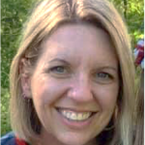
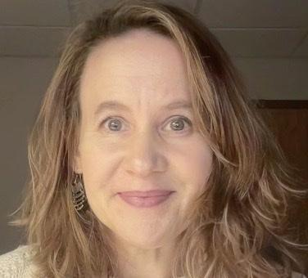
Meet our Team!
Full-Time Staff & Coaches
Brynn
Fallah
Sarah Hearn
Niki
Kendall
Megan Pell

Slide 5
Meet our Team!
Part-Time Coaches
Kitty Rehrig
Valerie Brown

Slide 6
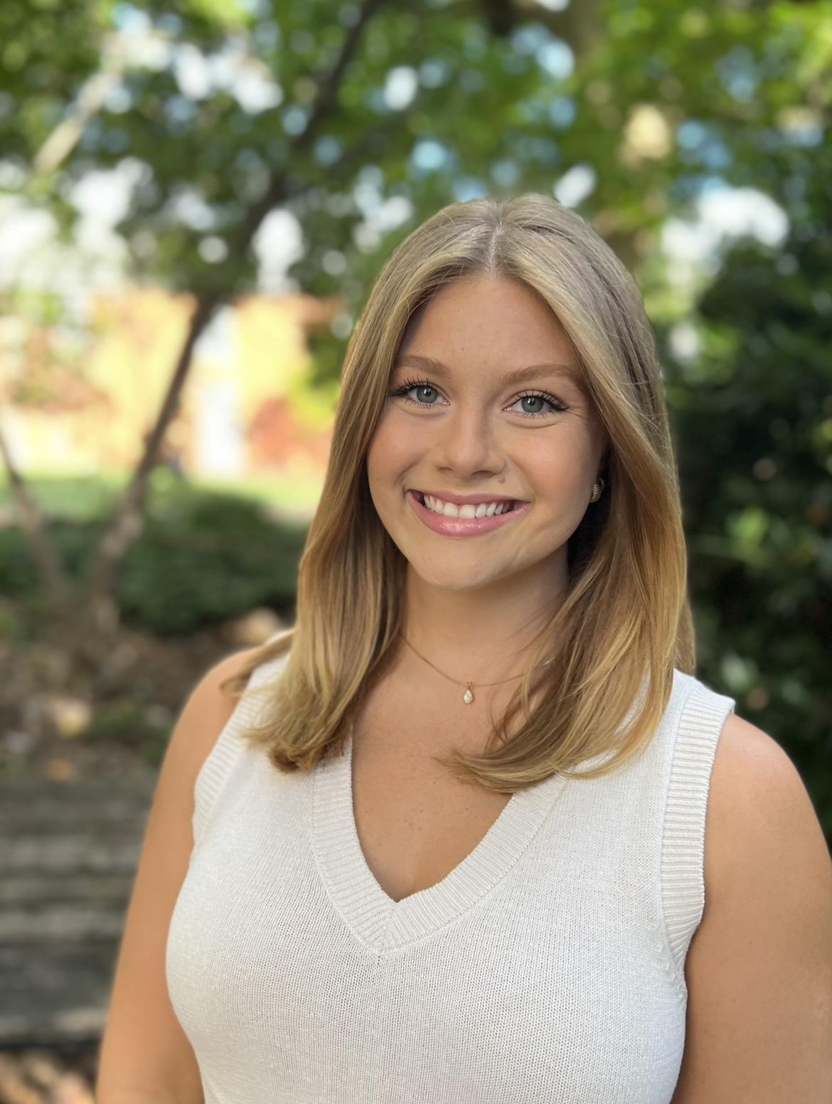
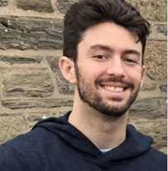
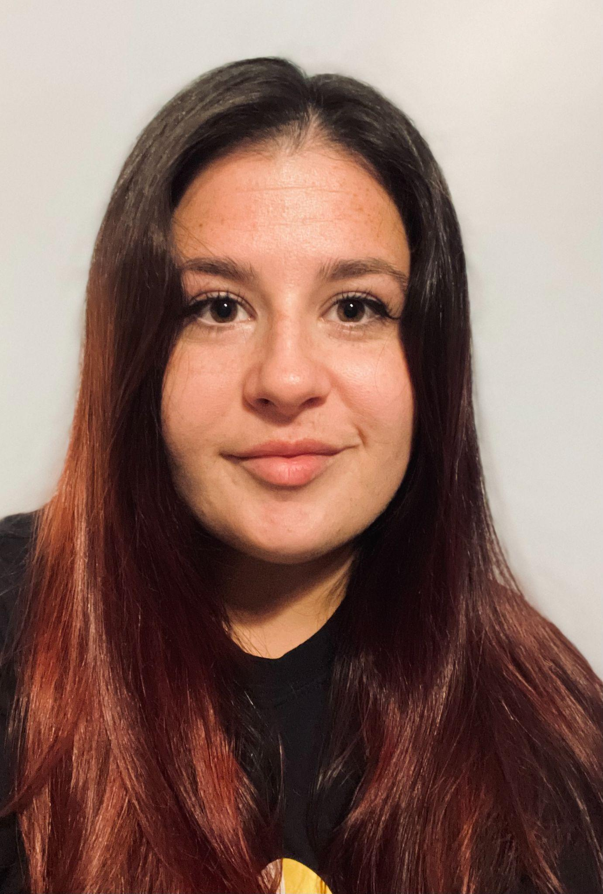
Meet our Team!
Graduate Assistants
Emily Consiglio
Mark Miller
Alex Miller

Slide 7
Meeting Expectations
We are... | Virtual Meetings
ENGAGED | Unmute yourself or use chat box to ask questions Participate in chat prompts, polls and breakout rooms Use video when possible, especially when speaking
REFLECTIVE | Share questions you have for full group Note follow up questions for PBS team and/or individuals Focus on problem solving around areas of concern
SUPPORTIVE | Share successes, ideas, useful resources Listen with openness and understanding Attend to your own needs

Slide 8
Today’s Agenda Topics
Cadre Purpose and MTSS Foundation
DE-PBS 2021-22 Phase Recognition Celebrations
Coaching Resources & School year kick off
Data
Professional Learning
Resource Spotlights

Slide 9
Cadre Purpose
Support district MTSS-SEB Coaches
Conduit between state to district to schools
Networking among districts
Guidance and feedback on project activities/resources
Share project and national resources
Connect and integrate related activities for greater impact

Slide 10
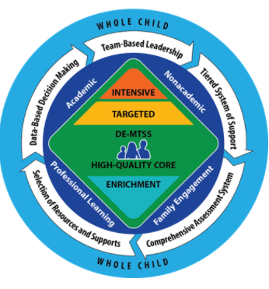
DE-MTSS Framework
“DE-MTSS is a framework designed to meet the needs of the whole child through an integrated, multilevel prevention system that optimizes team-based leadership and data-driven decision making to meet the academic and nonacademic (e.g., behavioral, social and emotional) needs of all students.”
DDOE. (2021). Delaware’s MTSS Framework

Slide 11
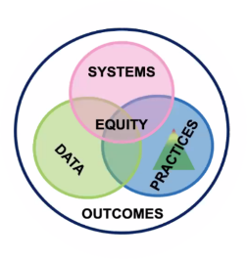
Multi-Tiered System of Support
MTSS organizes your district to achieve its identified outcomes (Academic and Social-Emotional, Behavioral (SEB)) through understanding its data, providing a continuum of practices, supporting staff through systems, and prioritizing equity.
www.pbis.org

Slide 12
Framework and Practices
Hexagon Tool helps you determine how practices fit within your framework but it doesn’t create the framework
Bring together your MTSS expert and content/practices expert to implement effectively

Slide 13
DE-PBS Phase Recognition

Slide 14
2021-22 SY Phase Recognition Recipients
Tier 1 School-wide Team
Implementation
Award Level | District | School
Phase 1 | Brandywine | PS DuPont Middle School
Phase 1 | Brandywine | Springer Middle School
Phase 1 | Indian River | Millsboro Middle School

Slide 15
2021-22 SY Phase Recognition Recipients
Tier 1 School-wide Team
Advanced Implementation
Award Level | District | School
Phase 2 | Brandywine | Carrcroft Elementary School
Phase 2 | Brandywine | Claymont Elementary School
Phase 2 | Lake Forest | Lake Forest Central Elementary School
Phase 2 | Red Clay | Anna P. Mote Elementary School
Phase 2 | Red Clay | Austin D. Baltz Elementary School

Slide 16
2021-22 SY Phase Recognition Recipients
Tier 2 Targeted Team
Implementation
Award Level | District | School
Phase 3 | Brandywine | Springer Middle School
Phase 3 | Brandywine | Talley Middle School
Phase 3 | Lake Forest | Lake Forest Elementary School

Slide 17
2021-22 SY Phase Recognition Recipients
Tier 2 Targeted Team Systems
Implementation
Award Level | District | School
Phase 4 | Christina | Robert S. Gallagher Elementary School
Phase 4 | Christina | Keene Elementary School
Phase 4 | Christina | Shue Medill Middle School
Phase 4 | Brandywine | Carrcroft Elementary School

Slide 18
2020-21 SY Phase Recognition Public Notices
School level messages
Website posting
Letters to district superintendents
and board presidents

Slide 19
Recognition Engagement Reflection
Looking ahead 2022-23 SY:
Maintaining Phases 1-4
Application release: late winter/early spring
Addition: Including coach review & sign-off of applications
Increasing Engagement:
For coaches of participating schools, what are the motivators?
For coaches of non-participating schools, what might increase participation?
Are districts doing their own reflection & planning process to recognize MTSS/PBS implementation?

Slide 20
Coaching Resources
and Starting off the School Year

Slide 21
Visit Cadre Corner
Guidance for MTSS-SEB District Coaches
2022/2023 School Year
Fellow district coach contacts
Previous/current Cadre Meeting and Coach Networking resources
Statewide resource:
DE Social, Emotional and Behavioral Wellbeing (SEBW) Plan

Slide 22
Coaching Guidance Calendar
Fall | Systems: | Hold scheduled Team Leader meetings (bi-monthly, quarterly, etc.) with agenda influenced by ongoing goals shared on page 1.
 | Practice: | Attend MTSS meetings and provide coaching feedback using Team Observation and/or ask Team Leaders to submit monthly agendas and minutes to preview & provide feedback Send reminder regarding DSCS enrollment based on DE-PBS Project timeline
 | Data: | Create and share a data collection plan for the year which includes the types of data (DDRT, DSCS, TFI) and collection schedule Send DDRT spreadsheet and instructions to Tier 1 PBS/MTSS Team Leaders Monitor DDRT submissions and identify trends to discuss at Team Leader Meetings; problem-solve with schools not yet utilizing DDRT.

Slide 23
Supporting your school teams
What are strategies you have used to help your school MTSS/PBIS teams kick off the school year?
How can we help teams avoid burnout?

Slide 24
Data &
Related Supports

Slide 25
DDOE Update - Discipline Data
⇸Data has been shared with LEAs:
State Discipline Improvement Program (SDIP),
Significant Disproportionality
Indicator 4
4a: Suspension and Expulsion of Students with Disabilities as compared to students without disabilities
4b:Suspension and Expulsion of Students with Disabilities as compared to students without disabilities by r
Overall discipline by building by ethnicity
Who has it? Superintendents and Special Ed Directors
Have you seen this data yet in your LEA?

Slide 26
Data Trends
⇸What are you seeing from the 2021-2022 SY data? And data so far this year?
⇸Data sources at the building level that could be looked at: School Climate, Tiered FIdelity Inventory (TFI) / Key Feature Status tracker / Office Discipline Referrals (ODR)

Slide 28
Discipline Data Reporting Tool (DDRT)
2022-23 Templates available on website & will also be shared via email
Submissions are 2x per year to district coach and project. January 13th and June 16th
New - DDRT 2021-22 Summary for Coaches

Slide 29
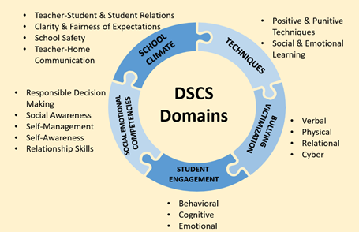
DE School Climate Survey (DSCS) Data Updates
2021-22 DSCS Reports (school-based) distributed to building survey contacts & district contacts in August
Data review resources:
Presentation: DSCS: Understand-Interpret-Use
Interpretation Worksheets per population
DSCS Module Series Reminder:
Teacher-Student Relationships
Student-Student Relationships
Bullying Prevention (DDOE Memo)
School-Wide Student Engagement
School Safety

Slide 30
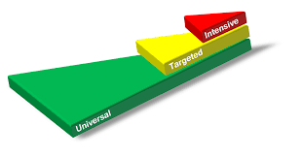
Professional Learning
2022-2023 SY

Slide 31
Tier 1 Professional Learning
Tier 1 MTSS/PBS Team Training - Teams and/or new members to existing teams
1-day training
Feedback:
Early December
Early January
Support Readiness
Plan with administration; Administrator team buy-in is key!
Discuss team structure
Provide overview of MTSS & Tier 1 efforts to build understanding

Slide 32
Tier 2 Networking
For: MTSS Coaches, Tier 2 team leaders and members, & interested educators and leaders.
When: Tuesdays afterschool 3:00-4:30 pm
Network Session #1- Dec. 13
Mapping your Tier 2 Staff and Interventions to Ensure Strong MTSS Systems and Positive Student Outcomes at the Targeted Level
Network Session #2 - Feb. 21
Including Critical Features for Success in Your Tier 2 interventions
Network Session #3 - Apr. 25
Data Tools to Gauge Student Progress and Performance at the Tier 2 level

Slide 33
Tier 3 Networking
For: MTSS Coaches, Tier 3 FBA/BIP facilitators and team members, & interested educators and leaders.
Time: 9:00-10:30
Network Session #1- 11/15/2022
Mapping out a Continuum of Function-Based Tier 3 Practices
Network Session #2 - 1/17/2023
Supporting Students with Autism Spectrum Disorders through Positive Behavioral Interventions in the General Education Classroom
Network Session #3 - 3/21/2023
Developing T3 Plans in Secondary Settings OR Progress Monitoring Strategies (TBD)

Slide 34
Universal Screening Process
Selecting and implementing a new universal screening method webinar series
Key Webinars in this Series:
Webinar 1: introduction
Webinar 2: universal SEB screener selection
Webinar 3: universal screener readiness (new!)
Webinar 4: universal screener implementation (new!)
Webinar 5: data-based decision making (coming soon)
www.delawarepbs.org/universal-screening/

Slide 35
Building Strong Team-Based Leadership Module
50 minute module for schools and districts to build or strengthen solid teaming foundations
Intended for both academic and non-academic teams and committees to view collaboratively
Learn about strategies for effective teaming and be led through a series of team-based reflections and opportunities for implementation action-planning in order to increase best practices and ultimately lead to stronger systems and successful outcomes
https://www.delawarepbs.org/teaming-module/
PDMS Course # 30542 Section # 59173

Slide 36
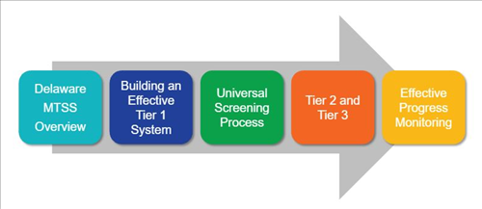
PL Resource: DE-MTSS
DE-MTSS Module Series
Schoology Course (Course # 30130 Section # 59788)

Slide 37
2023 Whole Child CoP Opportunity
Register for PDMS: 30944
Questions? Contact Teri Lawler
teri.lawler@doe.k12.de.us

Slide 38
Resource Spotlights

Slide 39
Considering New Initiatives and Interventions?
The Hexagon: A tool to help you align initiatives and interventions your organizational focus and control from National Implementation Research Network

Slide 40
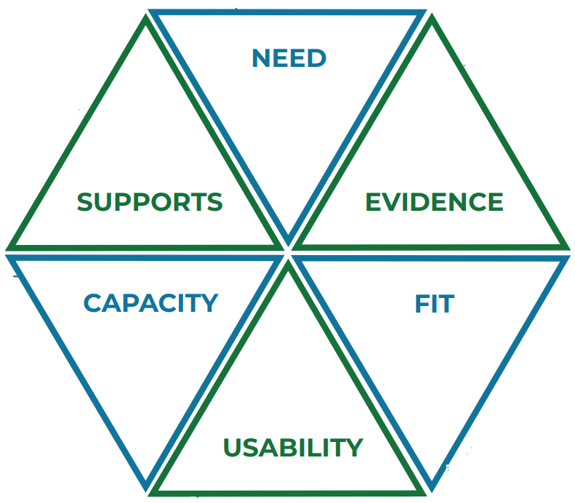
The Hexagon: An Exploration Tool
PROGRAM INDICATORS assess:
the extent to which new or existing programs or practices that will be implemented demonstrate evidence
Focuses your attention to: evidence-based, culturally responsive, trauma informed practices
Can find via: Intervention clearinghouses, individual research articles
supports for implementation
usability across a range of contexts
IMPLEMENTING SITE INDICATORS assess:
the extent to which a new or existing program or practice aligns with the implementing site along the following domains
population need
fit
capacity

Slide 41
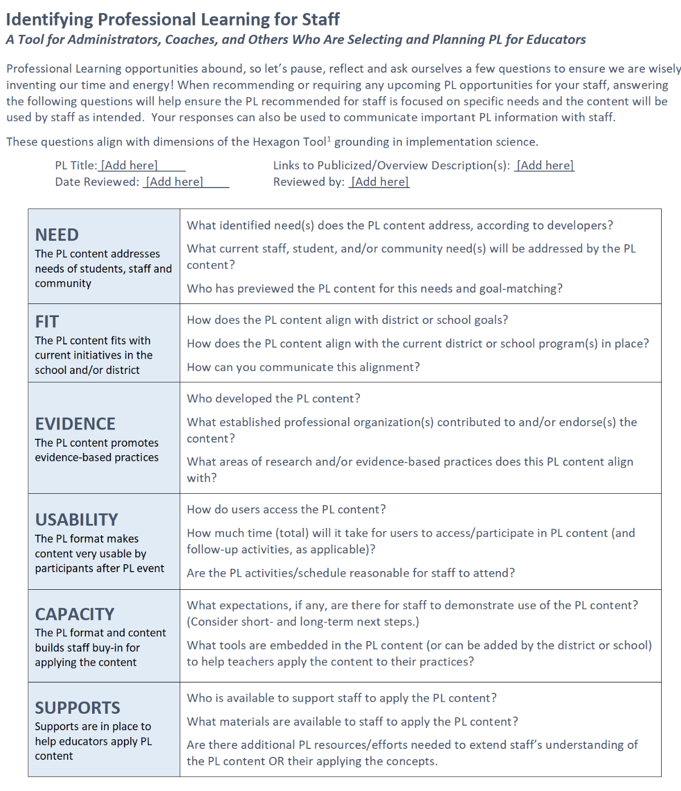
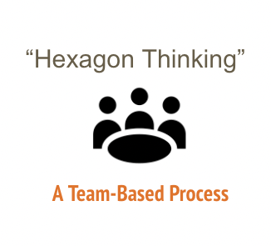
Considering New PL?

Slide 42
Strategies for De-escalating Student Behavior in the Classroom
"Whether working with students who experience low level or more intense behaviors, this practice brief can be a resource to help teachers feel better equipped to work through the de-escalation process.”
Strickland-Cohen et al. ( 2022).

Slide 43
Overview: Phases of de-escalation w/example strategies
 |  |  | Crisis
 |  | Acceleration |  | Crisis Recovery
 | Escalation |  |  |  | Restoration
Prevention
Adapted from Midwest (n.d.) and Strickland-Cohen et al. (2022)

Slide 44
Phases: Student Behavior & Sample
Effective Teacher Responses
Student needs support to regulate behavior & emotions.
Student displays high level accelerated behavior.
Student is able to regulate.
 |  |  | Crisis
 |  | Acceleration |  | Crisis Recovery
 | Escalation |  |  |  | Restoration
Prevention
Students are regulated, while occasionally engaging in minor challenging behavior.
Student displays low level agitation.
Student is able to re-integrate into the classroom.
Ex: Maintain safety w/district-approved protocols
Ex: Co-regulate using limited words
Ex: Welcome the student back into the space in a positive manner.
Ex: Use
Choice
Redirection
Co-regulation
Ex: Staff Debrief and Self-reflection
Ex: Model and regularly practice the regulation routine students are taught
Adapted from Midwest (n.d.) and Strickland-Cohen et al. (2022)

Slide 45
De-escalation and Equity
“All students…can benefit from a universal approach that promotes a consistent response to behavioral escalation by all staff that is not overly reliant on exclusionary practices and intrusive crisis responses, such as restraint and seclusion.”
Strickland-Cohen et al. (2022)

Slide 46
PBIS Apps Podcast
Explores the school-wide, classroom-wide systems and practices you can leverage to prevent problem behaviors from escalating in the first place.
With the two of the authors of the PBIS practice brief, Dr. Kathleen Strickland-Cohen and Alex Newson.

Slide 47
2022 DDOE Equity Summit
https://www.delawarepbs.org/what-educators-can-do/#behavior-framework

Slide 48
Resource
Reminder
Coaching Teams to Implement Personal Matrix discussions
•15 min video
•Facilitator Guide
Based on:
PBIS Culturally Responsive Field Guide

Slide 49
22-23 Equity Committee
Mission: At the Delaware Positive Behavior Support Project, we are committed to improving outcomes for each student. Educational systems cannot be considered effective until they are effective for all students. A Multi-Tiered System of Support (MTSS) can be a force for dismantling systemic racism and promoting equity or serve to perpetuate oppression. In recognition that black lives matter and given centuries of oppression, violence, and segregation, we must increase our commitment to improving outcomes for Black, Indigenous, and other Students of Color. PBIS teams embed equity into their implementation of all aspects of MTSS.
3 mtgs/SY
90 mins each

Slide 50
Cadre
December 15, 2022
February 13, 2023
April 20, 2023
Networking
November 17, 2022
January 19, 2023
March 16, 2023
May - TBD

Slide 51
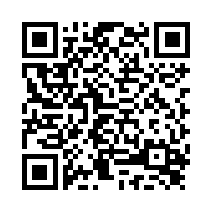
THANK YOU!
Reminder to follow us on Twitter & share the handle with your schools.
@Delawarepbs
Please take a few minutes to fill out our participant survey!

