Slide 1
DE-PBS Cadre Meeting
December 15, 2022

Slide 2
The DE-PBS Project serves as a technical assistance center for the Delaware DOE to actualize the vision to create safe and caring learning environments that promote the social-emotional and academic development of all children.
The statewide initiative is designed to build the knowledge and skills of Delaware educators in the concepts and evidence-based practices of Positive Behavior Support (PBS) as a Multi-tiered System of Support (MTSS).

Slide 3
Meeting Expectations
We are... | Virtual Meetings
ENGAGED | Unmute yourself or use chat box to ask questions Participate in chat prompts, polls and breakout rooms Use video when possible, especially when speaking
REFLECTIVE | Share questions you have for full group Note follow up questions for PBS team and/or individuals Focus on problem solving around areas of concern
SUPPORTIVE | Share successes, ideas, useful resources Listen with openness and understanding; assume good intentions Attend to your own needs

Slide 4
DE-PBS Cadre Purpose & Today’s Agenda
Overall Goals
Support district MTSS-SEB Coaches
Conduit between state to district to schools
Networking among districts
Guidance and feedback on project activities/resources
Share project and national resources
Connect, align and integrate related activities for greater impact
Agenda Topics
DE-PBS Equity Committee Update
Intro to ISLA
Fall 2022 PL & TA Recap
Looking Ahead PL & TA Preview & Discussion
Data Updates
Reminders

Slide 5
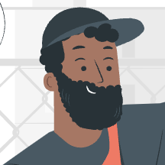
2022-2023
DE-PBS
Equity Committee Members
Jocelyn Brown
Marqueia Davis
Tongela Ginyard
Cliffvon Howell
Jennifer Martin
Nika Reid
Adriane Simpson
Adrienne Stansbury

Slide 6
Equity Mission Statement
At the Delaware Positive Behavior Support Project, we are committed to improving outcomes for each student. Educational systems cannot be considered effective until they are effective for all students. A Multi-Tiered System of Support (MTSS) can be a force for dismantling systemic racism and promoting equity or serve to perpetuate oppression. In recognition that black lives matter and given centuries of oppression, violence, and segregation, we must increase our commitment to improving outcomes for Black, Indigenous, and other Students of Color. PBIS teams embed equity into their implementation of all aspects of MTSS. Learn more about out community beliefs and practices here.

Slide 7
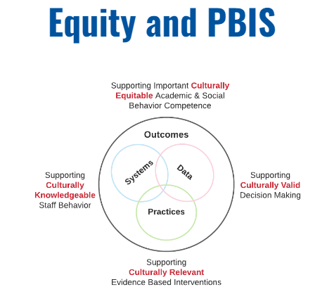
Ongoing Project-Based Reflection & Efforts
(https://www.delawarepbs.org/getting-started/)

Slide 8
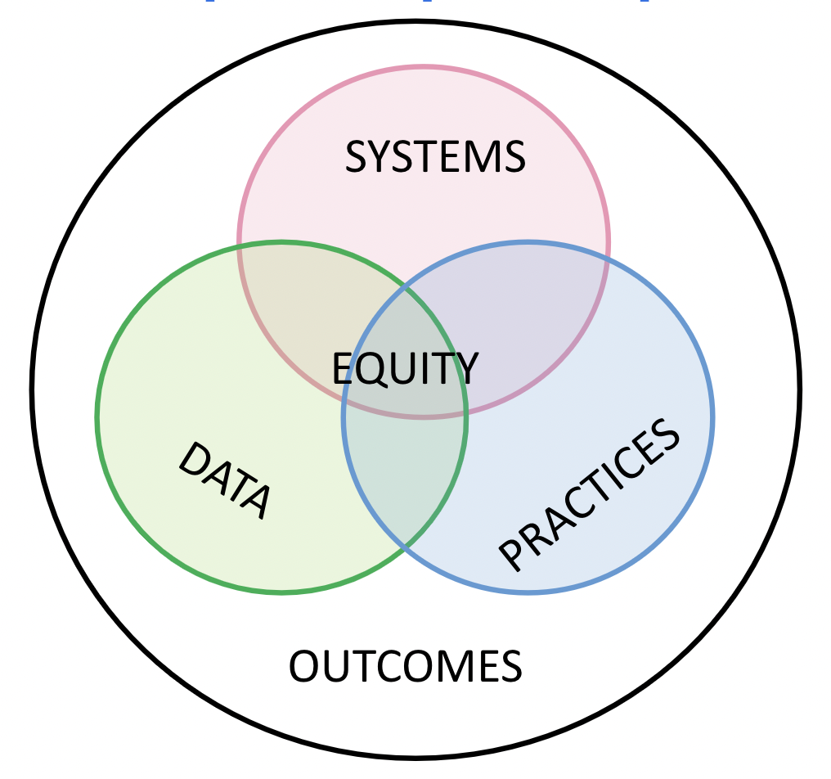
Ongoing Project-Based Reflection & Efforts
Equity Central to Effective MTSS/PBIS
(https://www.delawarepbs.org/getting-started/)

Slide 9
LEA-Based Reflection & Efforts
Looking at your LEA’s strategic plan and activities:
Where does equity appear? Where is it missing?
Are there aligned, braided, infused, or siloed plans of action to address equity?
Looking at your LEA’s ongoing collaboration with the Office of Equity and Innovation:
How are/could your MTSS/PBS coaching efforts included?
How can you reinforce the messages from this office (e.g., Equity Summit content in Tier 1, 2, 3 coaching)?
We are here to support your coaching to reinforce equity for all students through these plans and contacts!

Slide 10
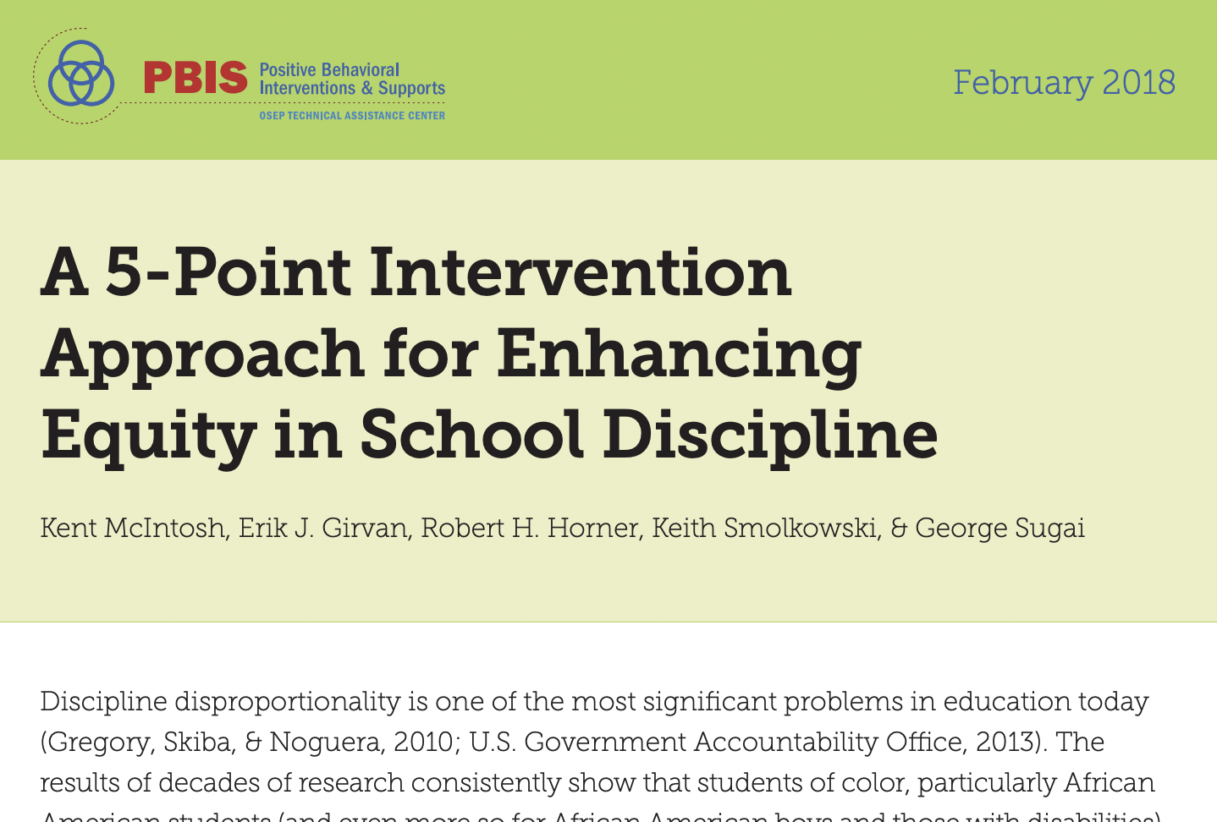
Resources for Starting
& Updating Your LEA
Equity Efforts
A 5-Point Intervention Approach for Enhancing Equity in School Discipline (2018)
PBIS Cultural Responsiveness Field Guide: Resources for Trainers and Coaches
https://www.delawarepbs.org/what-educators-can-do/

Slide 11
Intro to ISLA:
Inclusive Skill-building
Learning Approach
Rhonda Nese (University of Oregon) and her team are helping middle schools replace harmful exclusionary discipline practices with instructional and restorative alternatives to improve educator practices, student social and behavioral problem-solving, and student-teacher relationships.
A Tier I Universal Model
https://www.neselab.org/isla/

Slide 12
ISLA
Positive Classroom Behavior Supports (PCBS)
Positive Student-Staff Relationship Strategies
Behavior Matrix Expectations and Routines (including Taking Breaks)
Trauma-Informed Practices & Restorative Practices
Connections to Existing
Tier 1 Interventions

Slide 13
ISLA
ISLA Videos for Educators
ISLA Overview
Building and Strengthening Relationships
Responding to Behavior
Break System
Out of Class Supports (ISLA Process)
Orientation
Videos
https://www.neselab.org/isla/

Slide 14
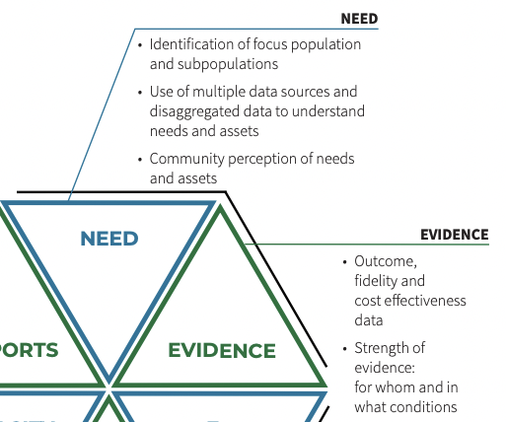
Hexagon Tool Connections:
Overall & Disaggregated
SDIP data
ODR data
Indicator 4 data
Middle school, includes EBPs and OSEP: Promising Practices for Improving the Middle to High School Transition for Students with Emotional and Behavioral Disorders

Slide 15
Discussion:
Do we want to
explore and/or
take any next steps?
Possible options:
Dig deeper during Networking or Cadre?
Explore on your own?
Other ideas?

Slide 16
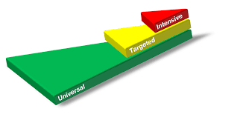
Professional Learning & Coaching Resources - Part 1
Fall 2022 Recap

Slide 17
October Cadre Meeting - Reminder
Strategies for De-escalating Student Behavior in the Classroom: This 2022 practice brief provides practical, research-based strategies educators can use to de-escalate challenging student behavior in the classroom. Despite the development of supportive, safe, and predictable school environments, students may, at times, become agitated, and their behavior may escalate to unsafe levels. With some advance planning, educators can reduce reliance on reactive strategies, such as punitive or exclusionary practices (e.g., restraint, seclusion, suspension, expulsion) in favor of safer, more instructive, and inclusive approaches.
"Whether working with students who experience low level or more intense behaviors, this practice brief can be a resource to help teachers feel better equipped to work through the de-escalation process.”

Slide 18
Tier 3 Networking
For: MTSS Coaches, Tier 3 FBA/BIP facilitators and team members, & interested educators and leaders.
Time: 9:00-10:30
Network Session #1- 11/15/2022
Mapping out a Continuum of Function-Based Tier 3 Practices
Network Session #2 - 1/17/2023
T3 Data-Based Decision Making at the Systems and Student-Level
Network Session #3 - 3/21/2023
Supporting Students with Autism Spectrum Disorders through Positive Behavioral Interventions in the General Education Classroom

Slide 19
Tier 3 Networking - Session 1 Key Topics
Tier 3 practice foundations
3 conversation starters for building a continuum of tier 3 supports
Avoid a one size fits all approach
See: Determining Intensity of FBA/BIP Process Handout
Address the classroom
Use an integrated approach (when it makes sense)
Check out resources from this event at: www.delawarepbs.org/tier-3-networking/

Slide 20
MTSS-SEB Coaches Networking - 11/17/2022
Center on PBIS — Supporting and Responding to Students’ Social, Emotional, and Behavioral Needs: Evidence-Based Practices for Educators –This Center on PBIS practice guide summarizes evidence-based, positive, and proactive practices that support and respond to students’ social, emotional, and behavioral (SEB) needs in classrooms and similar teaching and learning environments (e.g., small-group activity).
DE-PBS Update: Supporting and Responding to Students' SEB Needs-- Self-assessment data entry template. Excel tool template to track status and priority data for implementation of school practices in supporting and responding to students' social, emotional, and behavioral needs.

Slide 21
Tier 2 Networking Series
For: MTSS Coaches, Tier 2 team leaders and members, & interested educators & leaders.
When: Tuesdays afterschool 3:00-4:30 pm
Network Session #1- Dec. 13
Mapping your Tier 2 Staff and Interventions to Ensure Strong MTSS Systems and Positive Student Outcomes at the Targeted Level
Network Session #2 - Feb. 21
Including Critical Features for Success in Your Tier 2 interventions
Network Session #3 - Apr. 25
Data Tools to Gauge Student Progress and Performance at the Tier 2 level

Slide 22
Tier 2 Networking - Session 1 Highlights
Materials @ Tier 2 Website - https://www.delawarepbs.org/forms-and-tools/tier-2-targeted-tools/
Networking PPT
Related assessment mapping tools
Teaming and skills represented on related teams
System team membership (1 tool)
Tier 2 Intervention level staffing (2 tools)
Interventions (1 tool)
Check-In/Check-Out Resources Reminder

Slide 23
Professional Learning & Coaching - Part 2
Looking ahead in 2023

Slide 24
MTSS-SEB Coaches Networking - 1/19/2023
Registration info coming soon: 1/19/23 – 10-12 via Zoom
Audience: District MTSS-SEB coaches & thought partners, Tier 1 & 2 leaders and/or members, Family Liaisons

Slide 25
See you at the Secondary Schools Networking Session!
1/26/2023
2:30-4:30 on Zoom
Audience: District MTSS-SEB coaches & secondary school Tier 1 teams/members

Slide 26
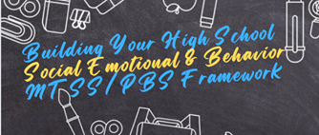
How to Connect Even More with the
Secondary PBIS Community!
Online but Live Monthly:
National APBS High School Think Tank
Interactive networking convos facilitated by the APBS High School Network
Next one: 1/20/23 12:30-1:30 EST (you do not need to attend all sessions)
Online and On Tap Anytime:
DE-PBS Secondary Forum webpage & Center on PBIS High School website
Facebook group HS Network for Association for PBS
View/post high school MTSS/PBS resources and success stories
Get updates via Google survey

Slide 27
Universal SEB Screening - 2/14/2023
Upcoming professional learning:
Universal SEB Screening and the Critical Role of the Administrator
2/14/2023 (afternoon; 2 hours)
Co-presenter, Felicia Kaas from Cape Henlopen School District
Reminders:
Universal SEB Screening Top Ten Questions Webinar
Universal SEB Screening Webinar Series (1-4)
Includes an associated Installation Action Plan
To DO:
Update Universal Screeners in Delaware Resource

Slide 28
Tier 1 MTSS/PBS Team Training - Early March 2023
Audience: Teams and/or new members to existing teams
March 2 OR March 9, 2023 (to be finalized)
Full day
Support Readiness
Plan with administration; Administrator team buy-in is key!
Discuss team structure
Provide overview of MTSS & Tier 1 efforts to build understanding

Slide 29
Tier 3 Practices Workshop - Early May 2023
Audience: Those working to develop or implement positive behavioral interventions for individual students
Early May 2023 (to be finalized)
½ day
Topics include:
Tier 3 practices defined
ABCs of behavior
An overview of prevent, teach, and respond practices
Strategies to match practices to student needs to support IEP and BIP development

Slide 30
Northeast PBIS Leadership Forum
May 18-19, 2023 - IN PERSON!
Mystic, CT
Keynote Speakers - Dr. Kurt Hatch (Univ. of Washington) and Dr. Sara Whitcomb (UMass Amherst)
Request for proposals now open
Submission deadline is Friday, January 6, 2023

Slide 31
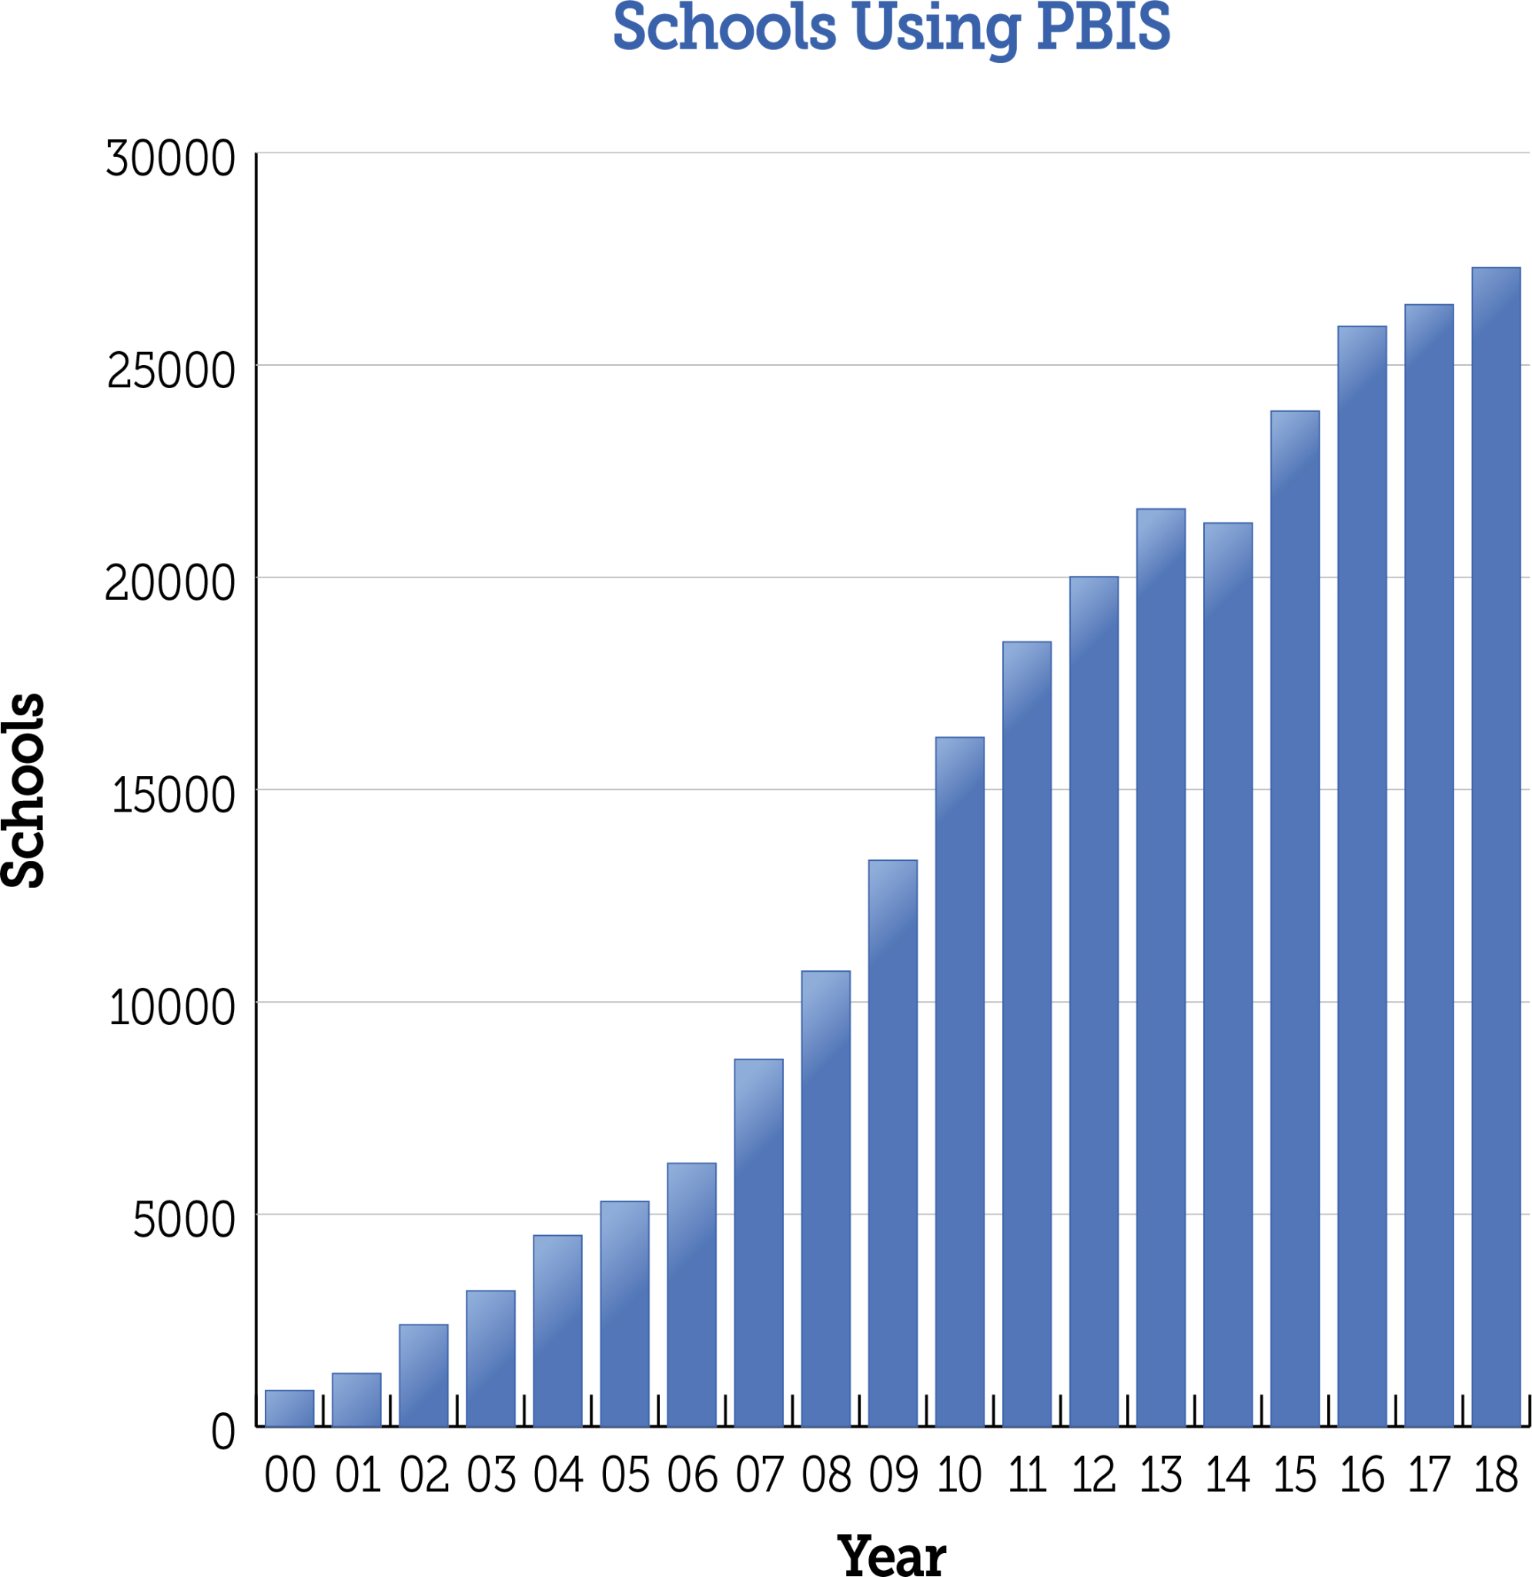
Data

Slide 32
Discipline Data Reporting Tool (DDRT)
2022-23 Templates available on website
NEW: Google sheets versions now available
Submissions are 2x per year to district coach and project. January 13th and June 16th
Reminder will be shared in the new year

Slide 33
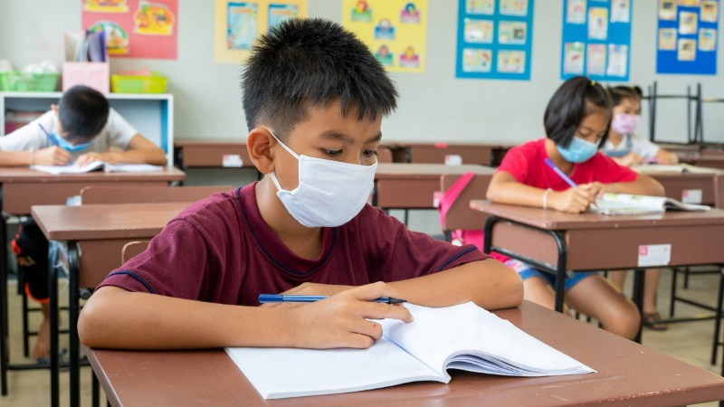
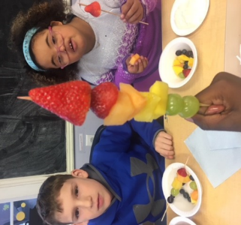
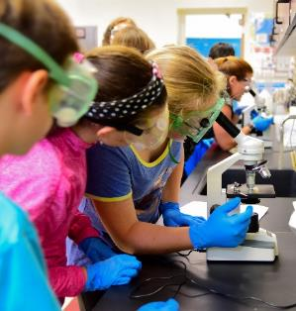
LEA MTSS Survey

Slide 34
LEA MTSS Survey
MTSS Survey given to district leaders at Communication and Collaboration Network (CCN)
LEAs asked to complete survey with an integrated team
academic and non-academic staff
district and school level
Survey due by January CCN
Teams (2-3 members/LEA) will do a MTSS related activity in January CCN Meeting

Slide 35
SSSIP Grant Opportunity - Cohort 2 Call for proposals
The Delaware Department of Education (DDOE) is seeking applications for a grant opportunity for LEA and/or school projects related to developing or improving a safe and supportive school environment that improves educational outcomes for students.
Round one awardees for the Safe and Supportive School Improvement Practices Grant are now posted on the DDOE Bid site!
Round 2 RFA is posted and will remain open until Dec. 19, 2022. LEAs that were not awarded in Round 1 are eligible to apply for Round 2.
See RFA URL for all details.

Slide 36
SSSIP Grant purposes include one or more of the following…
· Provide opportunity for LEA team or school team led- projects/proposals that support the establishment/implementation of their social, emotional and behavioral wellbeing supports within a Multi-tiered System of Support (MTSS).
· Provide opportunity for projects/proposals around student supports and dramatically improve the school culture and climate and corresponding metrics (absences, office referrals, school climate survey, etc.) through an inclusive and equitable approach.
· Provide opportunity to build educator capacity on effectively supporting and responding to a full range of student and educator wellbeing needs.
· Provide opportunity for LEA and/or school teams to improve/develop discipline practices and procedures that incorporate non-exclusionary and restorative practices.
· Provide opportunity for projects/proposals around student voice and choice that allow for policies, practices, and/or procedure to be enacted/revised that foster a safe and supportive environment where students have the access and opportunity to share their thoughts, feelings, and opinions.

Slide 37
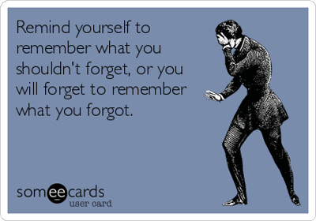
Reminders

Slide 38
Coaching Activities Calendar
Fall | Systems: | Hold scheduled Team Leader meetings (bi-monthly, quarterly, etc.) with agenda influenced by ongoing goals shared on page 1.
 | Practice: | Attend MTSS meetings and provide coaching feedback using Team Observation and/or ask Team Leaders to submit monthly agendas and minutes to preview & provide feedback Send reminder regarding DSCS enrollment based on DE-PBS Project timeline
 | Data: | Create and share a data collection plan for the year which includes the types of data (DDRT, DSCS, TFI) and collection schedule Send DDRT spreadsheet and instructions to Tier 1 PBS/MTSS Team Leaders Monitor DDRT submissions and identify trends to discuss at Team Leader Meetings; problem-solve with schools not yet utilizing DDRT.

Slide 39
Coaching Activities Calendar
Winter | Systems: | Hold scheduled Team Leader meetings (bi-monthly, quarterly, etc.)
 | Practice: | Send mid-year PBS/MTSS updates, success stories, and/or gratitude
 | Data: | Send reminder of school team’s DDRT to be submitted to DE-PBS Project by January 13, 2023

Slide 40
2023 Whole Child CoP Opportunity
Register for PDMS: 30944
Questions? Contact Teri Lawler
teri.lawler@doe.k12.de.us

Slide 41
Cadre
December 15, 2022
February 16, 2023
April 20, 2023
Networking
November 17, 2022
January 19, 2023
March 16, 2023
May - TBD

Slide 42
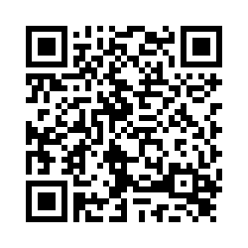
Thank you for coming!
Please take a few minutes to fill out our participant survey!

