Slide 1
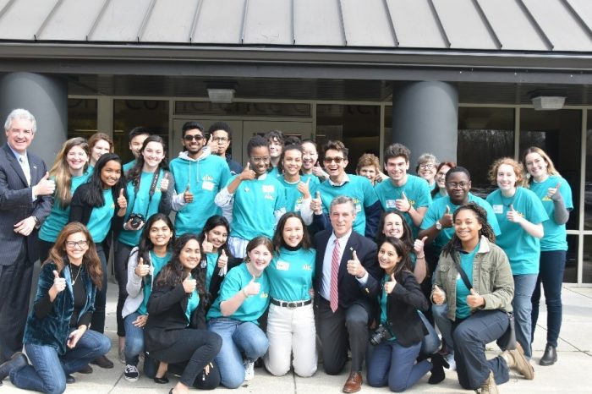
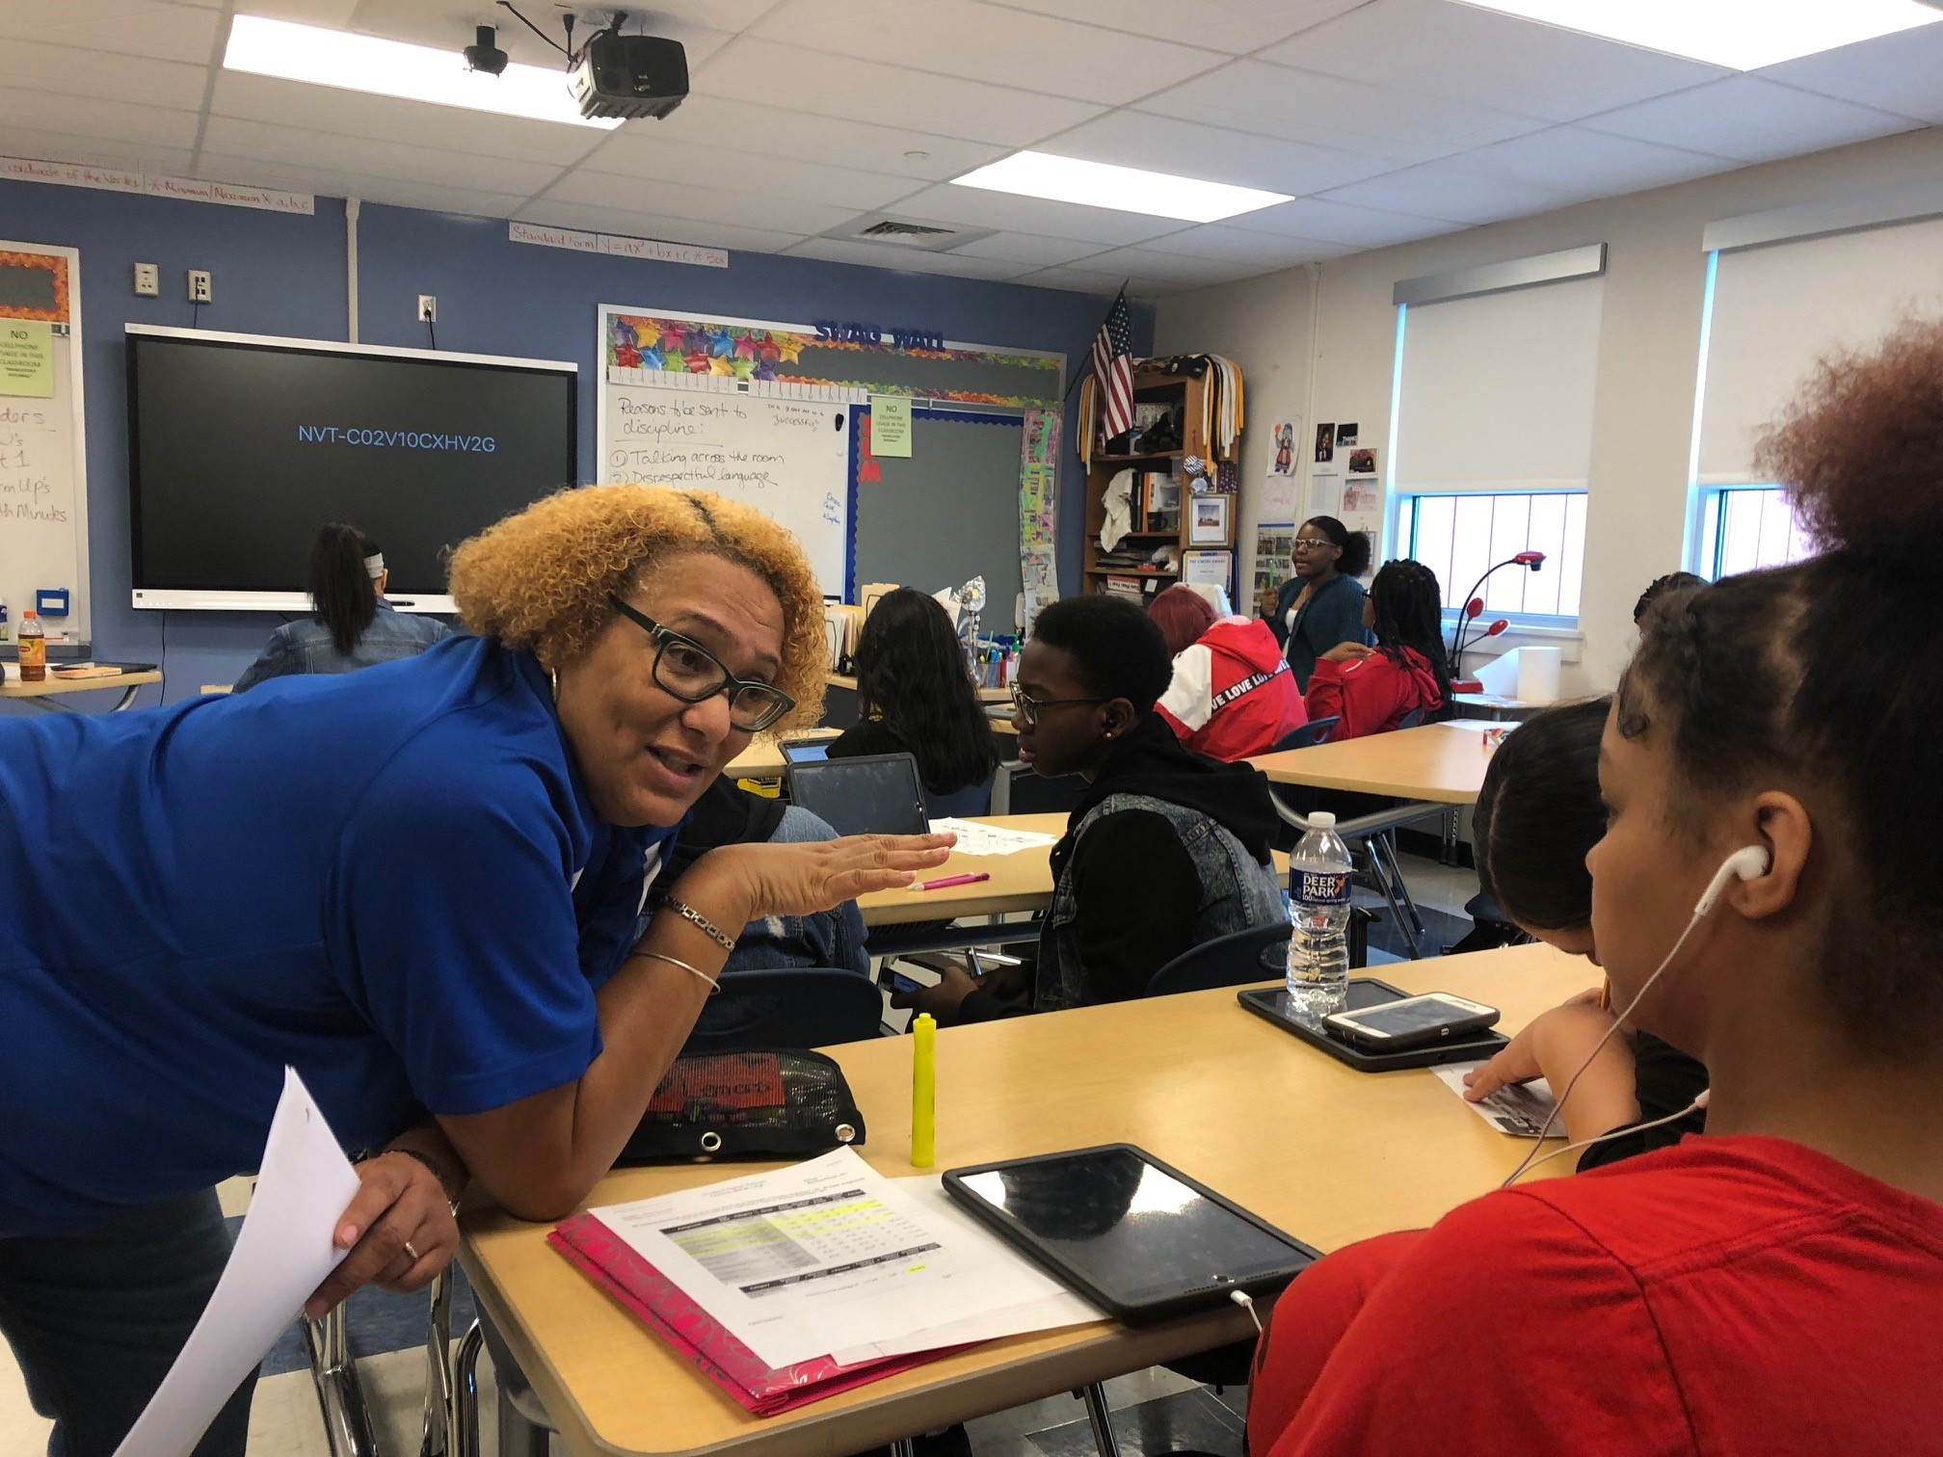
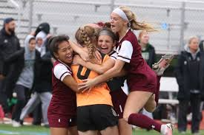
Secondary School Networking
for Successful
MTSS for SEB
January 26, 2023
DE-PBS Project

Slide 2
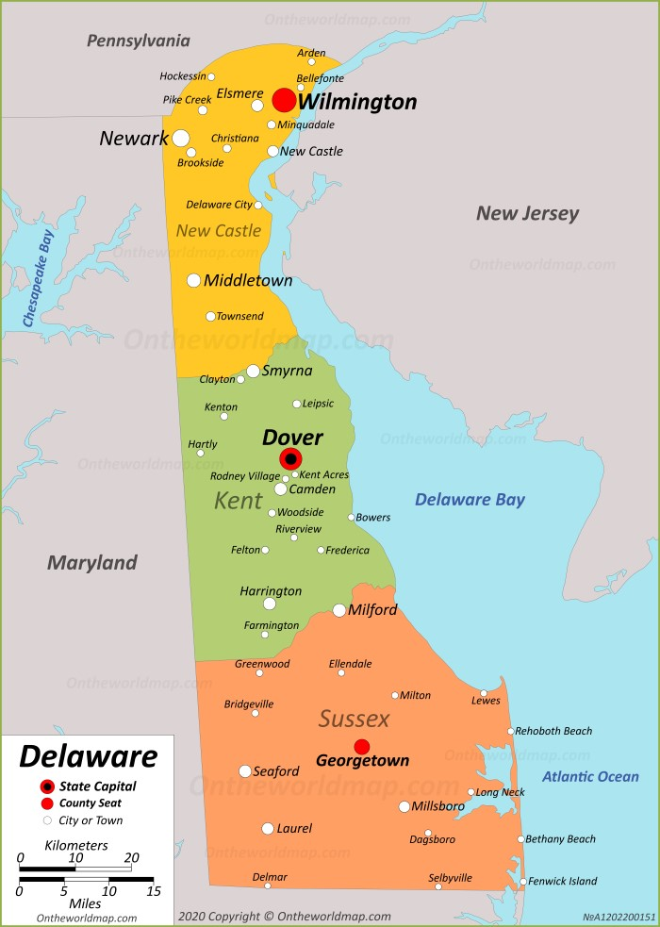
Hello!
Your school/district name.
Your role in regard to Tier 1 systems and interventions for behavior and SEL.

Slide 3
The DE-PBS Project serves as a technical assistance center for the Delaware DOE to actualize the vision to create safe and caring learning environments that promote the social-emotional and academic development of all children.
The statewide initiative is designed to build the knowledge and skills of Delaware educators in the concepts and evidence-based practices of Positive Behavior Support (PBS) as a Multi-tiered System of Support (MTSS).

Slide 4
As a community…
We are: | During this networking time, please:
ENGAGED | Share strategies you have used and lessons learned Ask questions Keep in touch after this event
REFLECTIVE | Compare the ideas shared to your current context and experiences Assess your current school practices & determine equity of access to interventions and cultural relevance to students
STRATEGIC | Identify next steps Use & share resources provided Take care of personal needs

Slide 5
Registration Survey Results
What do you hope to get out of attending this networking session?
Overall strategies and ideas | 5
School examples | 2
SEL Curriculum - mechanics and buy-in | 2
Acknowledgement/Recognition | 2
Building buy-In | 1
Community feel to a school | 1
New strategies (in general) | 1
Regaining momentum | 1
Team member functions/roles - including administrator | 1
Resource bank for high/leverage practices | 1

Slide 6
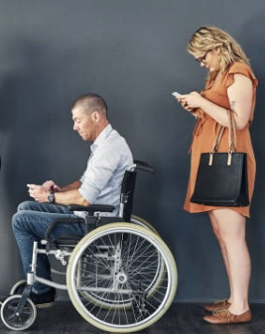
Our Working Networking Agenda
“So Brief” overview of PBIS foundations
“Go To” implementation guides
“Hmm” contextual influences
“Hey There” McKean presentation
“Take a Look” resources

Slide 7
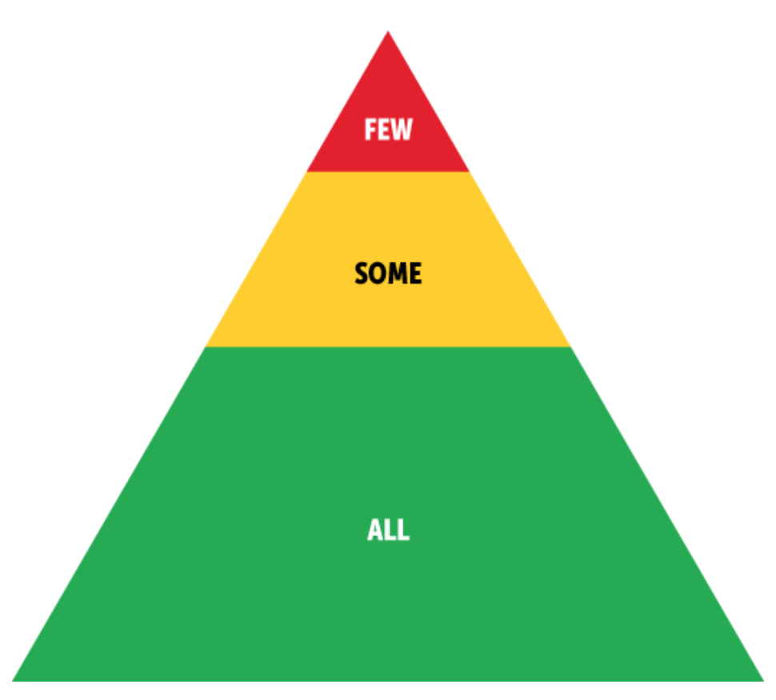
Tiered PBIS Framework
Foundations across ALL 3 tiers include:
A shared vision for a positive school social culture
A representative leadership team that meets regularly and shares expertise in coaching, social, emotional, behavioral, academic, equity, mental health, physical health, wellness, and trauma
Families are actively engaged‍
A supportive and involved school administration
Ongoing access to professional development for preparing all staff to implement each tier of PBIS
Systematic collection of screening, progress-monitoring, outcome, and fidelity data
Ongoing use of data for decision making
Disaggregating data to examine equity among student subgroups
Center on PBIS (2022). Positive Behavioral Interventions & Supports [Website]. www.pbis.org.

Slide 8
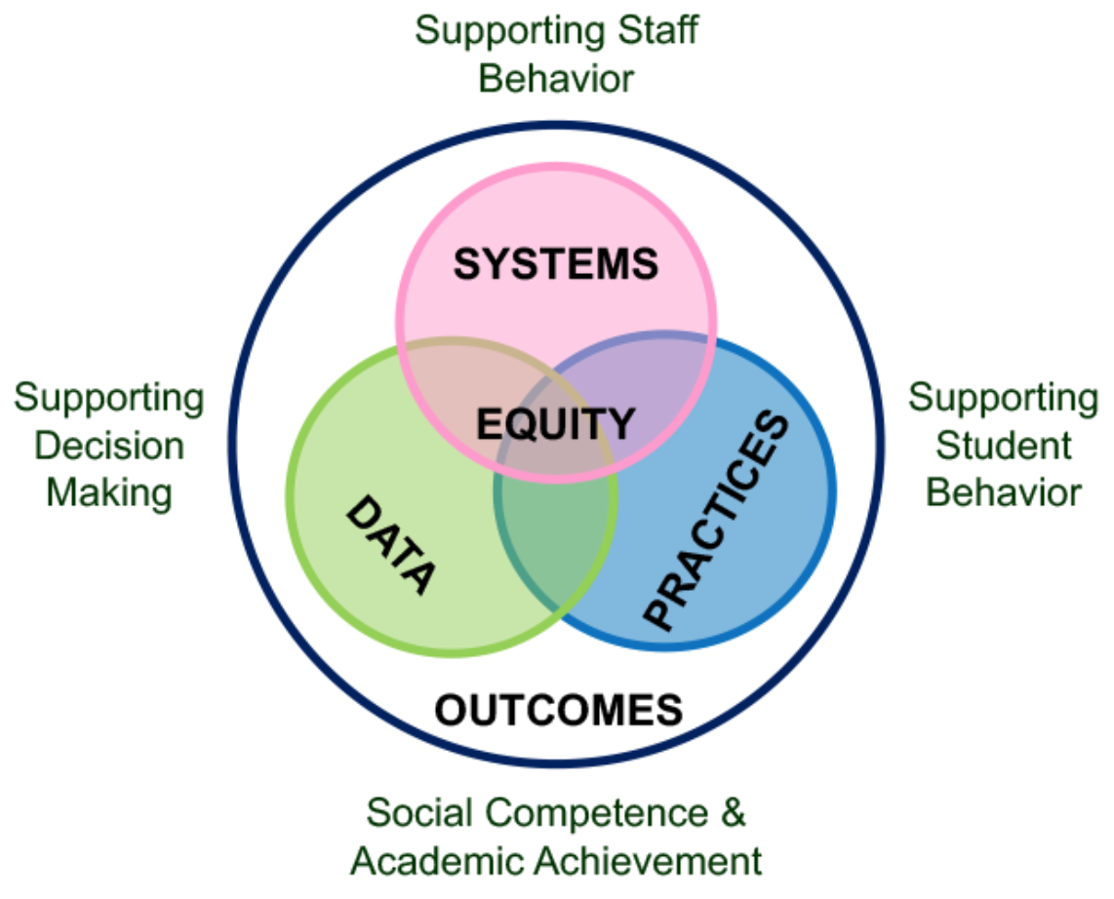
5 Elements
PBIS emphasizes five interrelated elements: equity, systems, data, practices, and outcomes.
Equity
When you implement PBIS with fidelity, it fits seamlessly within your local context. To do that requires a focus on aspects of culture and equity. Centering equity means supporting educators’ roles in implementation, adapting practices to meet students’ individual needs, and disaggregating data by student group to ensure success for everyone.
As you think about equity in your PBIS implementation, ask yourself: How can we enhance the experiences and outcomes of each educator and student?
Center on PBIS (2022). Positive Behavioral Interventions & Supports [Website]. www.pbis.org.

Slide 9
Tiered PBIS Framework: Tier 1 Universal, Primary Prevention (All)
Tier 1 systems, data, and practices support everyone, across all school settings. They establish a foundation for positive and proactive support. Tier 1 support is robust, differentiated, and enables most (80% or more) students to experience success. Tier 1 practices include:
Collaborating with students, families, and educators to define positive school/program-wide expectations and prioritize appropriate social, emotional, and behavioral skills
Aligning classroom expectations with school/program-wide expectations
Explicitly teaching expectations and skills to set all students up for success
Encouraging and acknowledging expected behavior
Preventing and responding to unwanted behavior in a respectful, instructional manner
Fostering school/program-family partnerships
Center on PBIS (2022). Positive Behavioral Interventions & Supports [Website]. www.pbis.org.

Slide 10
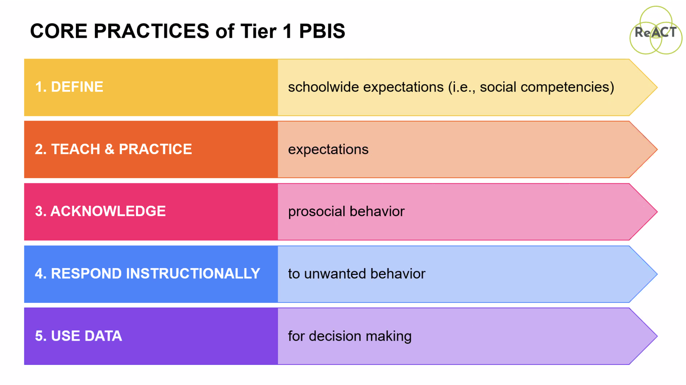

Slide 11
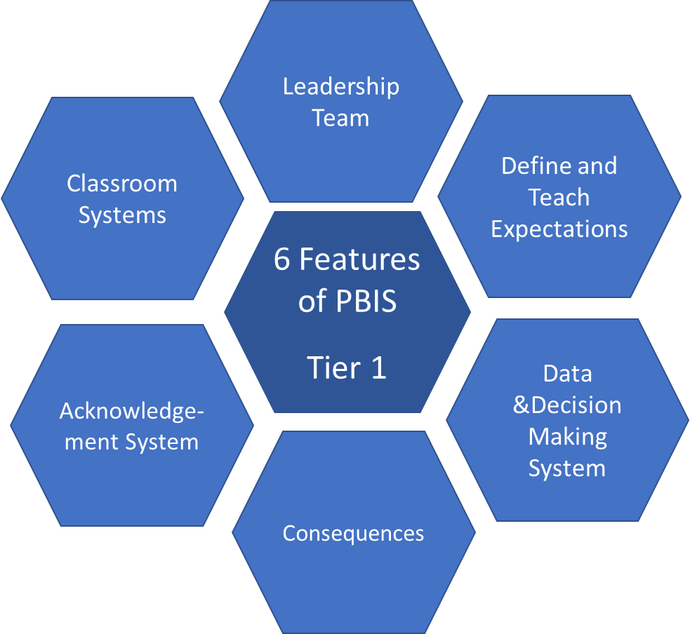
Tier I PBIS Core
Features
Adapted from: 2022 Leadership Forum: Patti Hershfeldt, Mimi McGrath Kato (Researchers) & Caitlin Peterson & Brian Ruehle, Anne Arundel County Public Schools (MD); Michael Calderone & Melissa Dunne, School District of Philadelphia (PA)

Slide 12
Leadership Team
Classroom Systems
Define and Teach Expectations
6 Features of PBIS
Tier 1
Acknowledge- ment System
Data & Decision Making
System
Consequences
Adapted from: 2022 Leadership Forum: Patti Hershfeldt, Mimi McGrath Kato (Researchers) & Caitlin Peterson & Brian Ruehle, Anne Arundel County Public Schools (MD); Michael Calderone & Melissa Dunne, School District of Philadelphia (PA)

Slide 13
PBIS in High Schools
School Engagement
and Success
•Historically slower adoption than in elementary schools
– Numbers of schools
– Time needed to reach fidelity
•Addresses the need for attention to braiding academics and SEB supports to meet contextual needs
•The PBIS framework can also promote school completion, facilitate the development of College and Career Readiness skills.

Slide 14
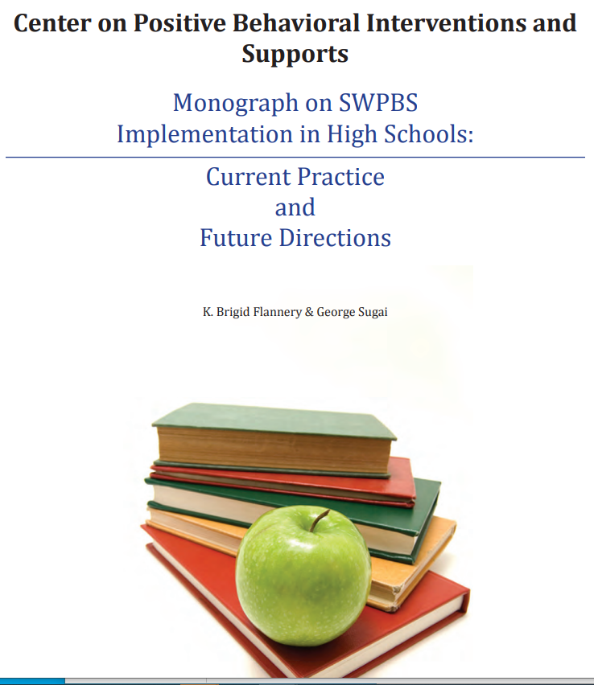
Inside:
Chapter 1: Introduction
Chapter 2: Administrator Roles and Functions
Chapter 3: Establishing and Maintaining Staff Participation
Chapter 4: Connecting SWPBIS supports to the Academic Curriculum
Chapter 5: Data-Based Decision Making
Chapter 6: Secondary and Tertiary Tier Supports
Includes 12 school summaries (p.147-180)

Slide 15
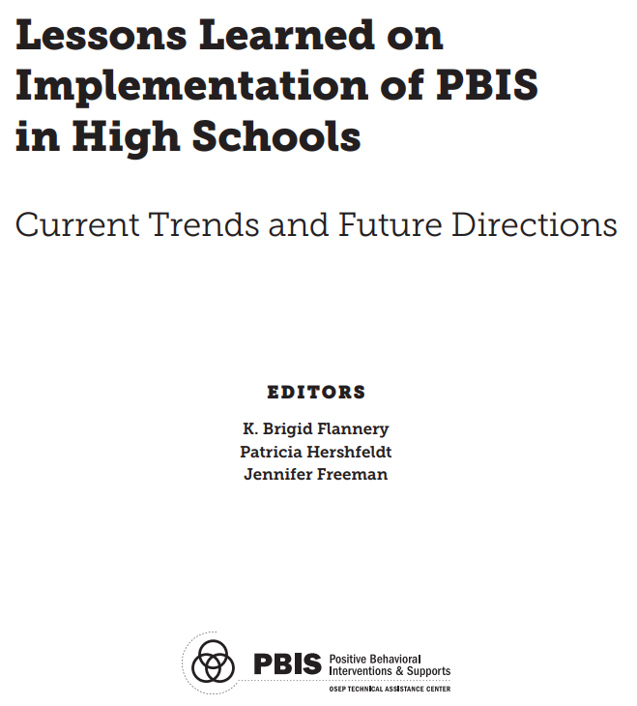
Inside:
Chapter 1: Introduction
Chapter 2: Context & Foundational Systems
Chapter 3: District Supports
Chapter 4: Coaching
Chapter 5: CCR and PBIS
Chapter 6: Freshman Supports
Chapter 7: Student Voice
Includes Ladder of Student Involvement
Chapter 8: Safe & Supportive Environments

Slide 16
Additional Resources to Extend Today’s Content
Center on PBIS – High School PBIS
https://www.pbis.org/topics/high-school-pbis
1-hour 2021 video - Lombardi, Kern, and Freeman
DE-PBS Secondary Forum webpage
https://www.delawarepbs.org/secondary-forum/
APBS Think Tank – Monthly 12:30-1:30 EST
https://odu.zoom.us/j/91955778458
March 17
April 21
May 18
HS APBS Mailing List
https://bit.ly/3QKmYKy
FB: High School Network for Association for Positive Behavior Support
Continue to build your knowledge through community

Slide 17
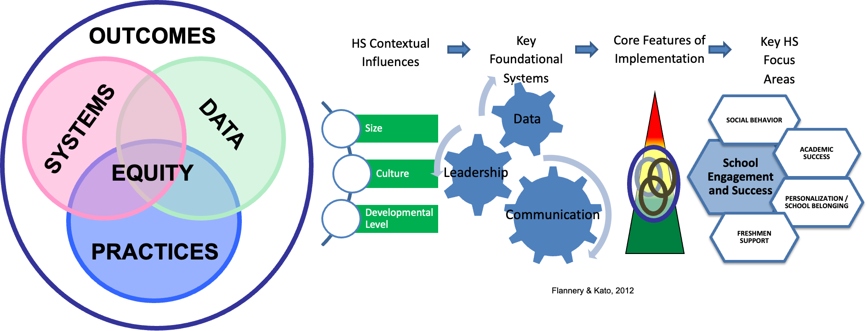

Slide 18
Implementation Barrier and Myths
Size
The school is too big to go school-wide, we’ll just implement with freshman
Having just one administrator know about PBIS is sufficient
Culture
My job is to teach academics
I shouldn’t have to teach something they should already know
I only need to work within my department or with my designated administrator
Developmental Level
These practices are not effective with adolescents
PBIS doesn’t “work” in high schools
Will it work here?
Why?
How?

Slide 19
Contextual Influence | Leadership | Communication | Data
Size | How to we ensure that there is good representation of all staff and faculty on the leadership team? Who are the right administrative team members to be involved with PBIS implementation? Who should be the administrative representative on the Leadership Team? How do decisions get made in an efficient manner and in a way that includes the entire Administrative Team? | How do we ensure all leadership (principals, deans, department heads) understand and can communicate to their constituents? Who will take what role in the communication? When are key times to communicate? What are the standard communication structures? Will they work to communicate with all groups of students? Faculty? Staff? Community? How does the building layout impact communication for this practice/system? Have we identified who needs to know/be involved? | What data will we have? Need? How will we manage the large amount of data? What are your data guidelines (e.g., number of students? NUmber of ODRs?)

Slide 20
Contextual Variables | Leadership | Communication | Data
Organizational Culture | What role can leadership play in promoting the beliefs/values? How can leadership the stage for how problem solving takes place or how decisions are made? | What are the values/beliefs of our school/district/community? How do these support/hinder the practice/system? What needs to be communicated to bridge between current beliefs/values? What examples/language can be used? | What information (data) is available to support chance in beliefs? Practices?

Slide 21
Contextual Variables | Leadership | Communication | Data
Developmental Age of Students | What authentic role do students have in the leadership of this? Have we sought student input in the design and roll out of procedures? | What role can the students play in development or implementation or problem solving? How is it best to communicate about the practice/system with the students? | What role can the students play in the use of data for decision-making? Can students be involved to inform leadership team about current ‘situations’ in the building/community that might be impacting behaviors?

Slide 22
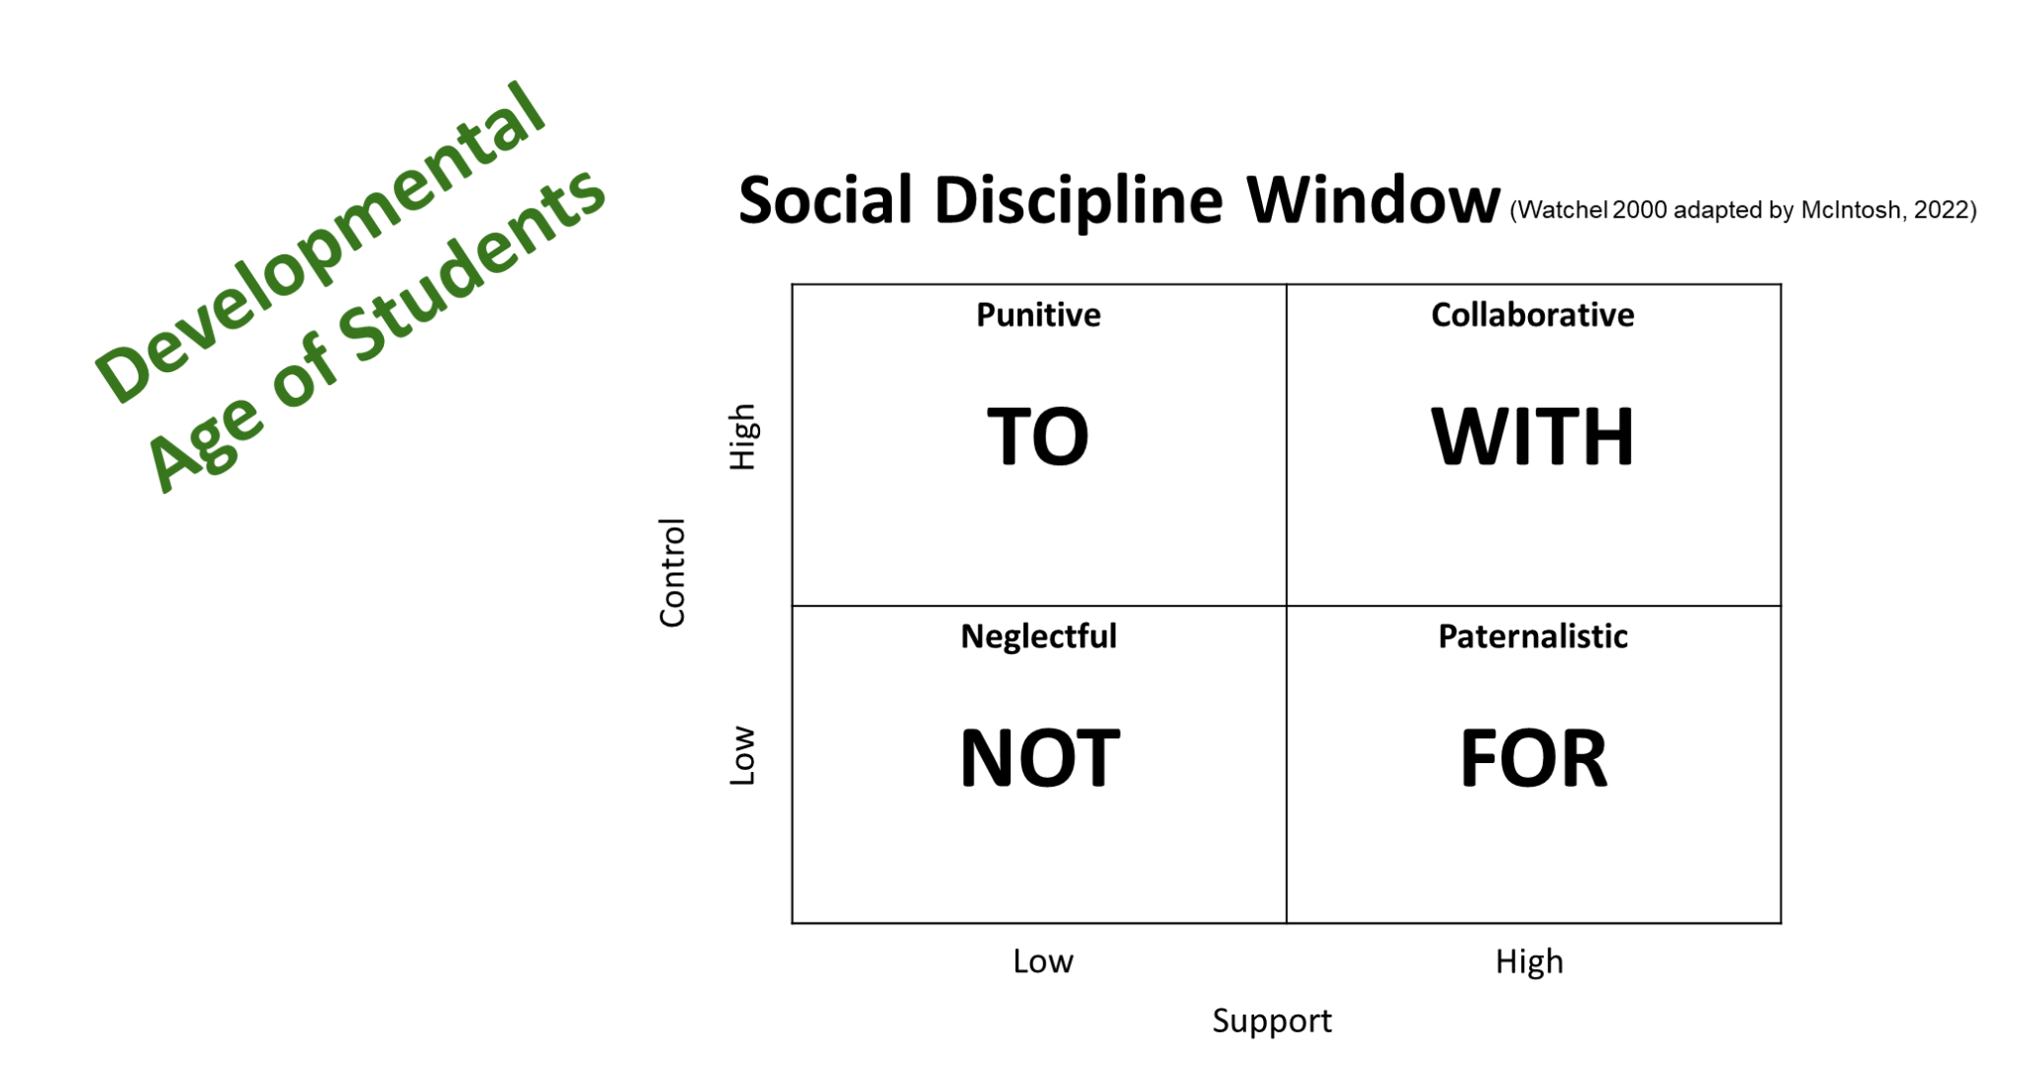

Slide 23
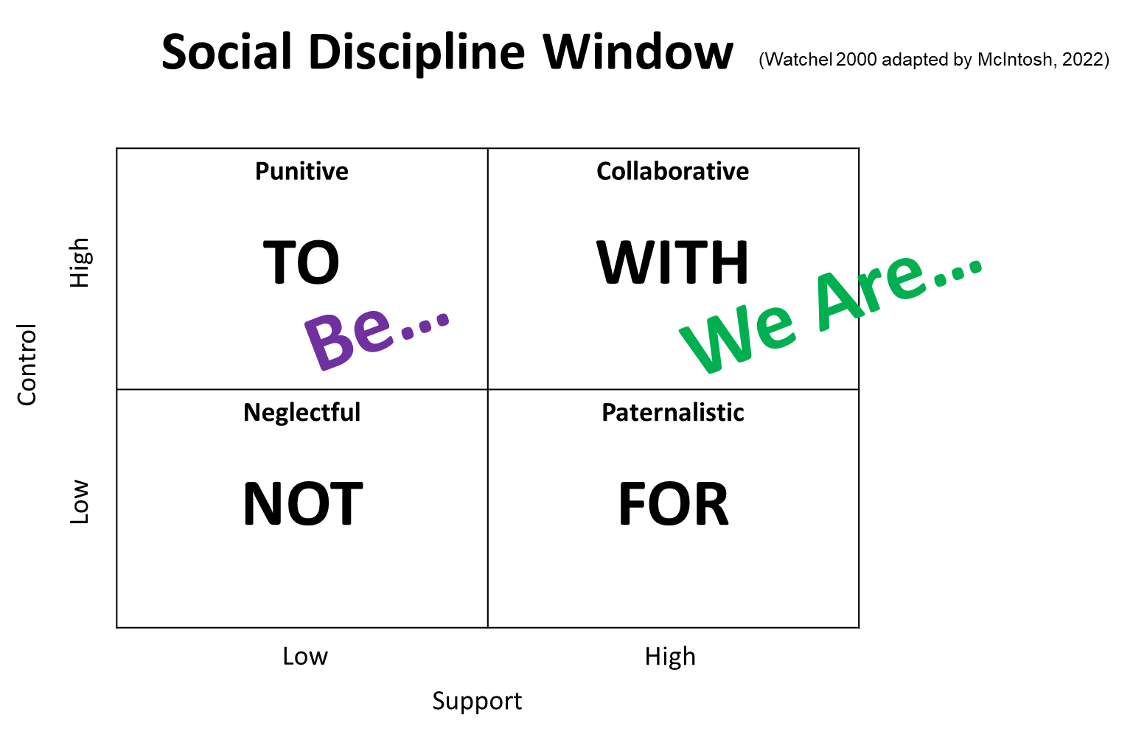

Slide 24
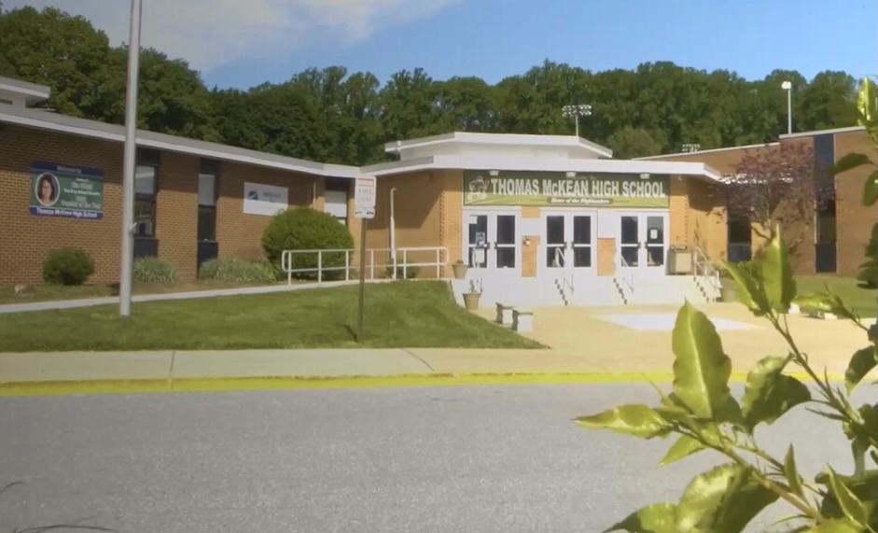
Jess Kradjel McKean High School
900+ students
RCCSD
PBS - Tier 1 6+ years

Slide 25
What we are most proud of
Lessons Learned/Learning
Future Directions
jessica.kradjel@redclay.k12.de.us

Slide 26
Big Picture Recommendations for Implementation
• Keep doing what already works
• Implement practices that are evidence based
• Always look for the smallest change that will produce the largest effect
• Define what you will STOP doing before adding something new
• Be sure you have a solid system for monitoring fidelity and outcomes
2022 National PBIS Leadership Forum
Patti Hershfeldt, Mimi McGrath Kato (Researchers) & Caitlin Peterson & Brian Ruehle, Anne Arundel County Public Schools (MD); Michael Calderone & Melissa Dunne, School District of Philadelphia (PA)

Slide 27
Additional Related Resources
Student Voice
High School PBIS Implementation: Student Voice
Other ways student can be involved in core practices
Practices - Matrix Development: Sample HS matrix, Personal Matrix Mini Module
Data - Student review/gallery walk of data and idea generation
Systems - Building a team at Somersworth High School (SHS) case study, Monograph p.51
SEL
Searchable CASEL Program Guide
Embedding SEL in High School Classrooms
Scheduling the magic of SEL instruction
Acknowledgement Systems
High School Acknowledgement Systems
Free Be+ App
Roles and responsibilities: Look at the data
Using Outcome Data to Implement Multi-tiered Behavior Support

Slide 28
Additional Related Resources
Fidelity in High Schools:
PBIS Brief: Fidelity of SW-PBIS in High Schools
Tiered Fidelity Inventory - Tier 1
Integration of Restorative Practices
PBIS Forum 2020: Integrating Restorative Practices into Multi-tiered Systems of Social Emotional Behavioral Support
Advanced Tiers at the HS Level
Advanced Tiers in High School: Lessons Learned from Initial Implementation
•High School Staff Buy in
High School PBIS Implementation – Staff Buy-In

Slide 29
(Lombardi and Freeman, 2021)

Slide 30
Worth the reminder:
Center on PBIS – High School PBIS
https://www.pbis.org/topics/high-school-pbis
1-hour 2021 video - Lombardi, Kern, and Freeman
DE-PBS Secondary Forum webpage
https://www.delawarepbs.org/secondary-forum/
APBS Think Tank – Monthly 12:30-1:30 EST
https://odu.zoom.us/j/91955778458
March 17
April 21
May 18
HS APBS Mailing List
https://bit.ly/3QKmYKy
Facebook: High School Network for Association for Positive Behavior Support
Sample Implementation Guide: Jefferson County, KY
Strength in Community

Slide 31
Upcoming DE-PBS Project Events
Tier 2
DE-PBS Tier 2 Networking: Including Critical Features for Success in Your Tier 2 Interventions
Date: February 23 from 3:00-4:30 pm
Register at https://delaware.ca1.qualtrics.com/jfe/form/SV_08OJYJJfBWqcNE2
Tier 3
DE-PBS Tier 3 Networking with Special Guest Sarah Mallory: Supporting Students with Autism Spectrum Disorders through Positive Behavioral Interventions in the General Education Classroom
Date: 3/21 from 9:00-10:30 am
Register at https://delaware.ca1.qualtrics.com/jfe/form/SV_41IzewLTqjlMM06

Slide 32
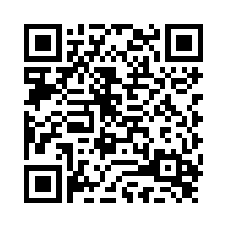
Next Steps
What is something you are excited about?
What is one action you plan to take?
Thank you
& Please Keep In Touch!
mpell@udel.edu

Slide 33
References
Center on PBIS (2022). Positive Behavioral Interventions & Supports [Website]. www.pbis.org.
Flannery, K. B. & Sugai, G. (2009). Introduction to the monograph on high school SWPBS implementation. In B. Flannery & G. Sugai (Eds.), SWPBS implementation in high schools: Current practice and future directions. (pp 7-22). University of Oregon. Retrieved from https://global-uploads.webflow.com/5d3725188825e071f1670246/5d72cab0a69a1e7b69d0a0ea_highschoolmonograph2009.pdf
Flannery, K. B., Hershfeldt, P., & Freeman J. (2018). Lessons Learned on Implementation of PBIS in High Schools: Current Trends and Future Directions. Center for Positive Behavioral Interventions and Supports (funded by the Office of Special Education Programs, U.S. Department of Education). Eugene, Oregon: University of Oregon Press. Retrieved from https://global-uploads.webflow.com/5d3725188825e071f1670246/5d797b10e5f68d42c677324d_monograph%20-%20pbis%20in%20high%20schools.pdf
Hershfeldt, P., McGrath-Kato, M., Peterson, C., Ruehle, B., Calderone, M., & Dunne, M. (2022, October 27-28). “5F Getting it started in high schools” [Presentation, PowerPoint slides]. National PBIS Leadership Forum, Chicago, IL, United States. https://drive.google.com/file/d/10UofJ2rZDMoA4OkboEswkom20LfzIOEn/view
Lombardi, A., Kern, L., & Freeman, J. (2021, June 21). High school implementation: Supporting college and career readiness through PBIS [Webinar, PowerPoint slides]. Center on Positive Behavior Interventions & Supports. https://www.pbis.org/video/high-school-implementation-supporting-college-and-career-readiness-through-pbis
McIntosh, K. (2022, December 1). Implementing PBIS with a Racial Equity Mindset [Symposium]. Social Emotional Behavioral Middle & High School Symposium, Virtual.
McIntosh, K. (n.d.). BEST/VT mtss summer institute strand h: Centering equity to promote social/emotional/behavioral success [PowerPoint slides]. Center on Positive Behavioral Interventions & Supports. https://www.pbisvermont.org/wp-content/uploads/2018/06/VTmtss-Equity-Strand-2021-06-22.pdf

