Slide 1
MTSS-SEB Coaches Networking
January 19, 2023
FAMILY ENGAGEMENT
WORKING TOGEHTER FOR STUDENT SUCCESS

Slide 2
The DE-PBS Project serves as a technical assistance center for the Delaware DOE to actualize the vision to create safe and caring learning environments that promote the social-emotional and academic development of all children.
The statewide initiative is designed to build the knowledge and skills of Delaware educators in the concepts and evidence-based practices of Positive Behavior Support (PBS) as a Multi-tiered System of Support (MTSS).

Slide 3
Meeting Expectations
We are... | Virtual Meetings
ENGAGED | Unmute yourself or use chat box to ask questions Participate in chat prompts, polls and breakout rooms Use video when possible, especially when speaking
REFLECTIVE | Share questions you have for full group Note follow up questions for PBS team and/or individuals Focus on problem solving around areas of concern
SUPPORTIVE | Share successes, ideas, useful resources Listen with openness and understanding; assume good intentions Attend to your own needs

Slide 4
MTSS-SEB Coach Networking Purpose & Today’s Agenda
Overall Goals
...to create space and time for fellow coaches & educators to connect & collaborate around key topics of particular interest and need
...for district MTSS coaches to share best SEB practices, ask questions, gain support from one another
...for hearing diverse voices from across the state.
Agenda Topics
Whole Child/PBIS
Domains of family engagement
Multi-tiered approach with families
Elements for partnering with families

Slide 5
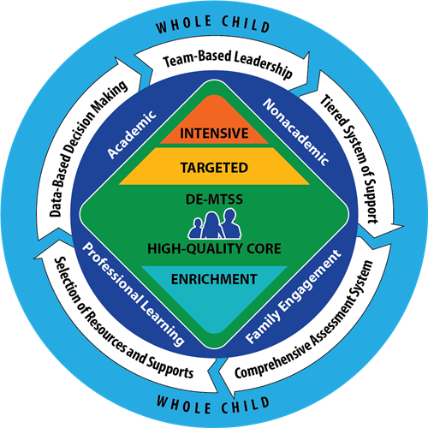
Regulation 508 - DE-MTSS
MTSS Whole Child Infographic
Copyright ©2020 Delaware Department of Education. All rights reserved
DDOE https://www.doe.k12.de.us/domain/613 :[website ]2022

Slide 6
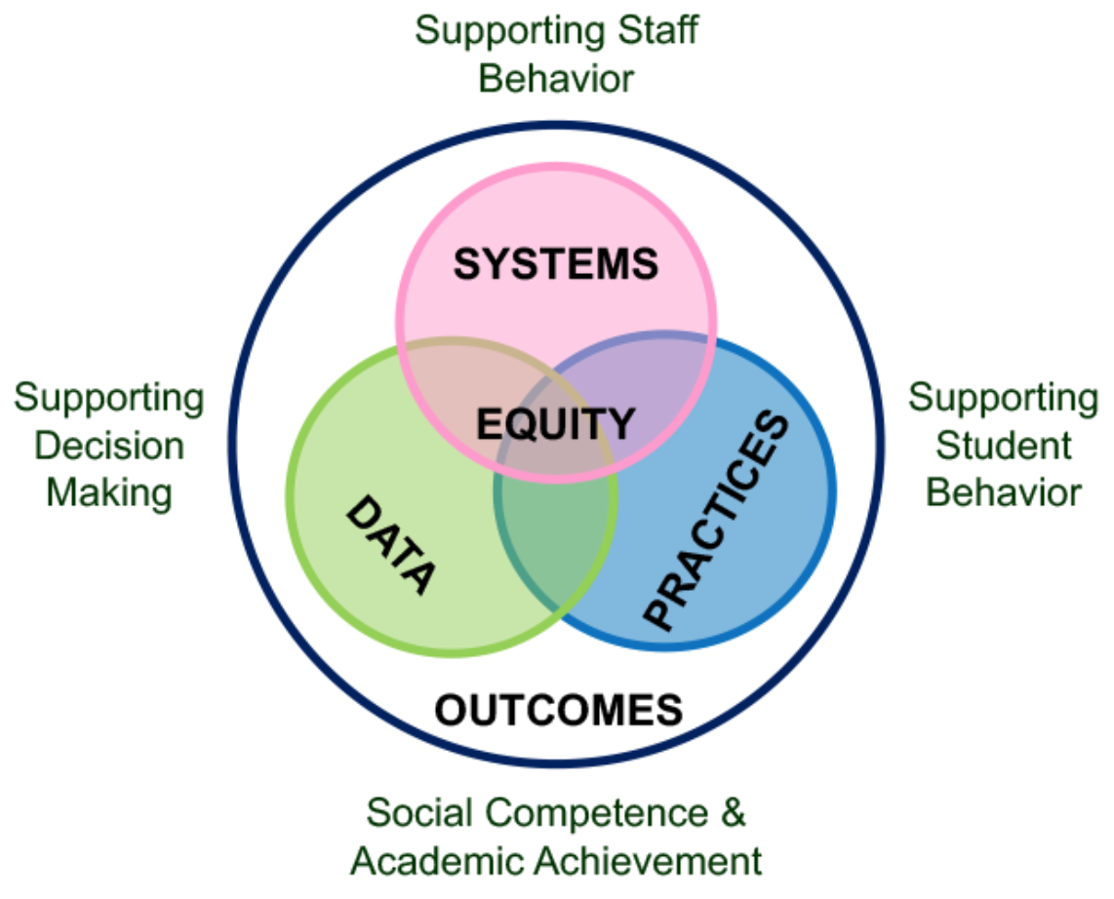
5 Elements
PBIS emphasizes five interrelated elements: equity, systems, data, practices, and outcomes.
Outcomes
The ultimate goal of implementing PBIS data, systems, and practices is to improve outcomes. Families, students, and educators set goals and work together to achieve them. In PBIS, outcomes might include behavioral, social, emotional, and academic growth; positive school climate; or fewer office discipline referrals.
As you think about the outcomes you want to achieve, ask yourself: What is important to each of our communities?
Center on PBIS (2022). Positive Behavioral Interventions & Supports [Website]. www.pbis.org.

Slide 7
What Is the Family Role in PBIS?
Including families in PBIS implementation means families and school personnel work together and share in the responsibility of making educational decisions and improving student outcomes.
Through effective family engagement, families and schools work together to create the conditions and practices which allow for ongoing collaboration, coordination and partnerships.
Center on PBIS (2022). Positive Behavioral Interventions & Supports [Website]. www.pbis.org/topics/family

Slide 8
A Thinking Prompt

Slide 9
Six Domains of Family Engagement
Leadership
Data-Based Goals & Outcomes
Positive Relationships
Multi-Tiered Approach
Empowering
Collaborative Problem Solving
Minch, D., Vatland, C., Winneker, A., Gaunt, B., Williams, H. (2015). School-level Family and Community Engagement in MTSS Innovation Configuration. Florida’s Positive Behavior Support Project. http://flpbs.fmhi.usf.edu.

Slide 10
Descriptions and Key Practices
6 Domains
Self- Assessment Tool
Minch, D., Vatland, C., Winneker, A., Gaunt, B., Williams, H. (2015). School-level Family and Community Engagement in MTSS Innovation Configuration. Florida’s Positive Behavior Support Project. http://flpbs.fmhi.usf.edu.

Slide 11
Reflection
5 Minutes

Slide 12
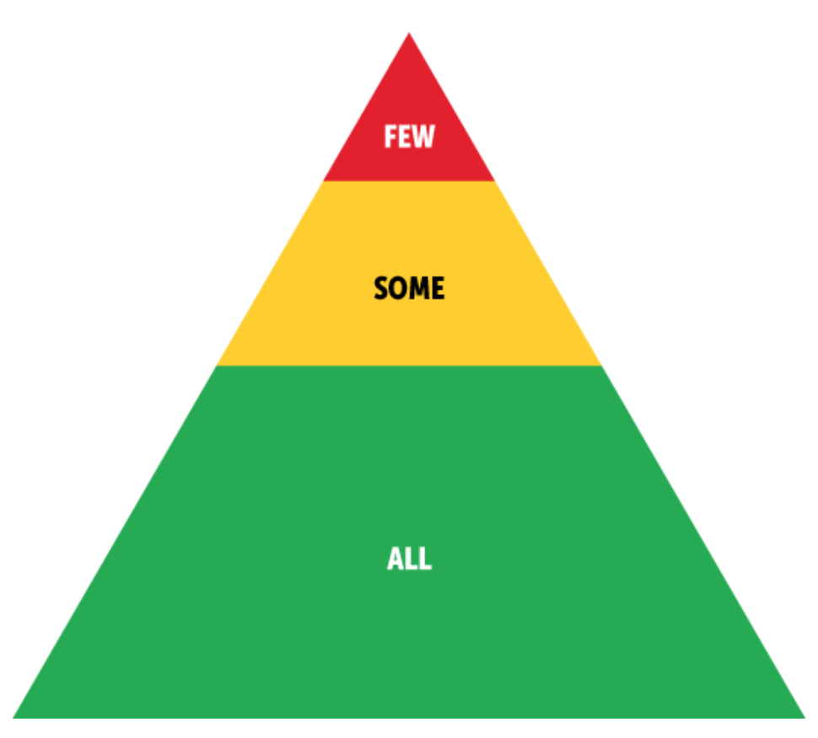
Flashback - Academic Example

Slide 13
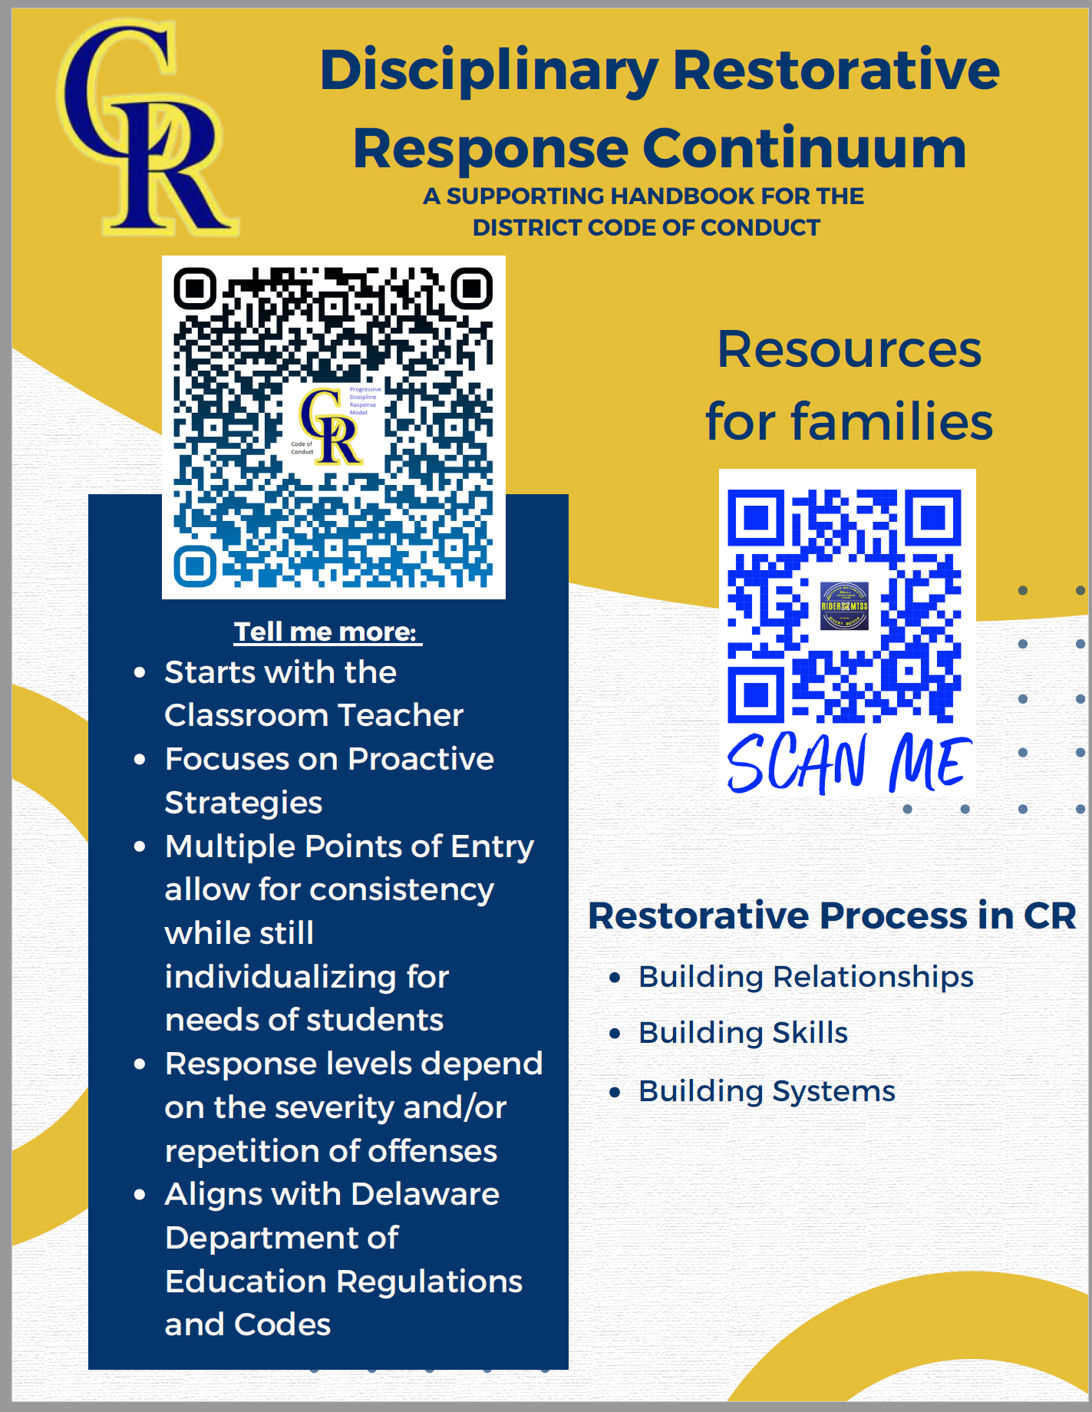
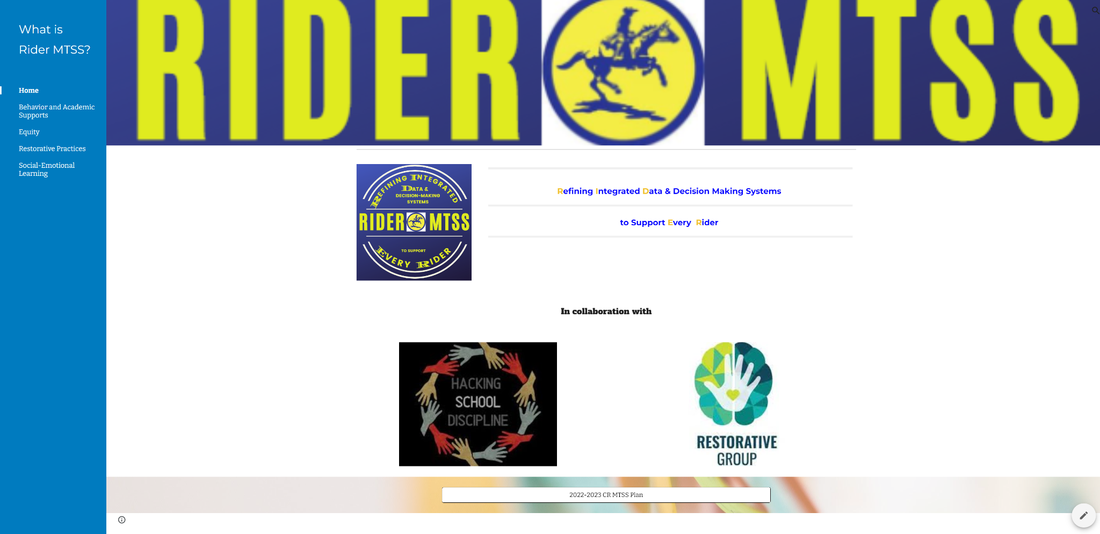
Family Engagement: Districtwide MTSS

Slide 14
Family Engagement: Districtwide MTSS

Slide 15
Multi-Tiered Approach
Equitable Family School Collaboration Video

Slide 16
What are School-wide Expectations & Teaching Matrices?
How do these relate to family engagement?
Expectations:
3 – 5 positively stated actions or terms
Simple, broadly stated, easy to remember & age appropriate
Serve as umbrella for more specific actions
Teaching Matrix:
Defines the expected behaviors for specific settings:
State definitions positively with few words
Show what the behavior “looks like”
Creates “Curriculum” to guide teaching of expected behaviors across settings (e.g., school, extracurriculars, HOME)
Enhances communication among staff, students and parents/community.

Slide 17
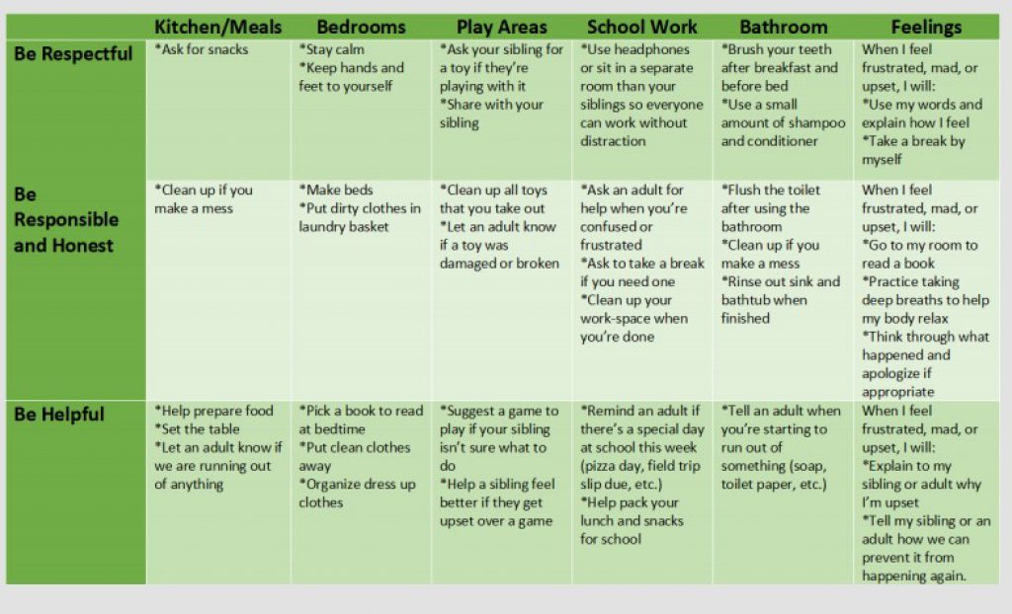
Home Matrix
Support positive behaviors at home blog

Slide 18
Foundational Elements of Families in PBIS
The basic elements of partnering with families include:
Building positive relationships
Engaging in two-way communication
Ensuring equitable family representation
Making meaningful data-driven decision
Center on PBIS (2022). Positive Behavioral Interventions & Supports [Website]. www.pbis.org/topics/family

Slide 19
Break out rooms - 10 minutes
Building a foundation activity
Multi-Tiered System of Support | Building positive relationships | Two way Communication | Equitable family representation | Data driven decision
Tier 3
Tier 2
Tier 1

Slide 20
We Have Everything We Need
Working together in an Interconnected Framework System using Positive Behavior Interventions and Supports in a Multi-Tiered approach.

Slide 21
Suggestions For Moving Forward
Identify the team members responsible for family engagement.
Complete the FACE school level assessment tool.
Add a family voice to existing teams.
Concentrate on one practice for the remainder of the year.
Begin to think about strategic planning for next year.

Slide 22
Sharing the Mindshift
Books & Resource to share
Embracing A New Normal
Written by Dr. Karen Mapp & Eyal Bergman

Slide 23
2023 Whole Child CoP Opportunity
Register for PDMS: 30944
Next Session Feb. 16th
Questions? Contact Teri Lawler
teri.lawler@doe.k12.de.us

Slide 24
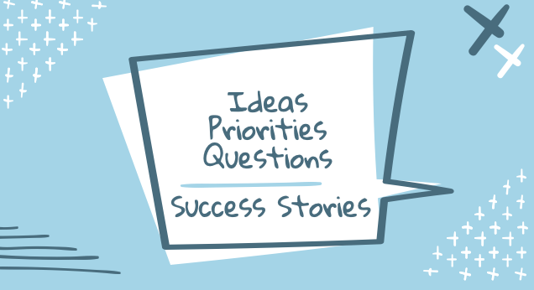
See you at the Secondary Schools Networking Session!
1/26/2023
2:30-4:30 on Zoom
Audience: District MTSS-SEB coaches & secondary school Tier 1 teams/members

Slide 25
Tier 2 Networking Series
For: MTSS Coaches, Tier 2 team leaders and members, & interested educators & leaders.
When: Tuesdays afterschool 3:00-4:30 pm
Network Session #1- Dec. 13
Mapping your Tier 2 Staff and Interventions to Ensure Strong MTSS Systems and Positive Student Outcomes at the Targeted Level
Network Session #2 - Feb. 23
Including Critical Features for Success in Your Tier 2 interventions
Network Session #3 - Apr. 27
Data Tools to Gauge Student Progress and Performance at the Tier 2 level

Slide 26
Tier 3 Networking
For: MTSS Coaches, Tier 3 FBA/BIP facilitators and team members, & interested educators and leaders.
Time: 9:00-10:30
Network Session #1- 11/15/2022
Mapping out a Continuum of Function-Based Tier 3 Practices
Network Session #2 - 1/17/2023
T3 Data Systems for Student and School-Level Problem Solving
Network Session #3 - 3/21/2023
Supporting Students with Autism Spectrum Disorders through Positive Behavioral Interventions in the General Education Classroom

Slide 27
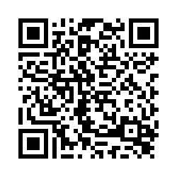
Thank you
Please let us know what you thought of this MTSS-SEB Networking Session

Slide 28
References
Building capacity for family engagement. Harvard Graduate School of Education. (n.d.). Retrieved from https://www.gse.harvard.edu/news/uk/14/11/building-capacity-family-engagement
Center on PBIS: Resource: Aligning and integrating family engagement in positive behavioral interventions and supports (PBIS): Concepts and strategies for families and schools in key contexts. Center on PBIS | Resource: Aligning and Integrating Family Engagement in Positive Behavioral Interventions and Supports (PBIS): Concepts and Strategies for Families and Schools in Key Contexts. (n.d.). Retrieved from https://www.pbis.org/resource/aligning-and-integrating-family-engagement-in-pbis
Center on PBIS: Resource: Enhancing family-school collaboration with diverse families. Center on PBIS | Resource: Enhancing Family-School Collaboration with Diverse Families. (n.d.). Retrieved from https://www.pbis.org/resource/enhancing-family-school-collaboration-with-diverse-families
Center on PBIS: Resource: Family plan for positive behavior at home. Center on PBIS | Resource: Family Plan for Positive Behavior at Home. (n.d.). Retrieved from https://www.pbis.org/resource/family-plan-for-positive-behavior-at-home
Center on PBIS: Resource: Obtaining stakeholder feedback to improve the middle to high school transition. Center on PBIS | Resource: Obtaining Stakeholder Feedback to Improve the Middle to High School Transition. (n.d.). Retrieved from https://www.pbis.org/resource/obtaining-stakeholder-feedback-to-improve-the-middle-to-high-school-transition
Center on PBIS: Video: Family and community engagement (SCTG Webinar). Center on PBIS | Video: Family and Community Engagement (SCTG Webinar). (n.d.). Retrieved from https://www.pbis.org/video/family-and-community-engagement-sctg-webinar

Slide 29
References
Center on PBIS: Video: [session H1] PBIS forum 2020: Equitable Family-School Collaboration in PBIS. Center on PBIS | Video: [Session H1] PBIS Forum 2020: Equitable Family-School Collaboration in PBIS. (n.d.). Retrieved from https://www.pbis.org/video/session-h1-pbis-forum-2020-equitable-family-school-collaboration-in-pbis
DBest practices and tips for working with families on check-in check-out ... Delaware Positive Behavior Supports. (n.d.). Retrieved from https://www.delawarepbs.org/wp-content/uploads/2022/03/Best-Practices-Tips-for-Working-with-Families-on-CICO-2022.pdf
Delaware MTSS / delaware MTSS implementation & resources. / Delaware MTSS Implementation & Resources. (n.d.). Retrieved from https://www.doe.k12.de.us/domain/613
Dr. Barbara Boone. Ohio's Statewide Family Engagement Center. (2022, September 2). Retrieved from https://ohiofamiliesengage.osu.edu/dr-barbara-boone
Family. Center on PBIS. (n.d.). Retrieved from https://www.pbis.org/topics/family
Google. (n.d.). Google drive: Sign-in. Retrieved from https://drive.google.com/file/d/1uFGasP_hYRnzeFawGZQG9ykRd_XU6-2W/view?usp=sharing
Google. (n.d.). Google drive: Sign-in. Retrieved from https://drive.google.com/file/d/1yaJb8ZvZZfd_a8nTeMA9pztdvPQy30na/view?usp=sharing
Google. (n.d.). Google slides: Sign-in. Retrieved from https://docs.google.com/presentation/d/1C_5XrzvcGLlvbwSX2mU1AVckjs6rFgb_jaoYBBctgI8/edit?usp=sharing
Multi-tiered approach to family engagement. Ohio's Statewide Family Engagement Center. (2022, November 30). Retrieved from https://ohiofamiliesengage.osu.edu/multi-tiered-approach-to-family-engagement
Multi-tiered systems of support for family engagement. YouTube. (2021, February 25). Retrieved from https://youtu.be/_3-7Uybb8sg
YouTube. (2021, May 19). De MTSS Overview Video. YouTube. Retrieved from https://www.youtube.com/watch?v=D320bOETKVE&t=8s

