Slide 1
to MTSS Tier 2 Networking Session #3:
Data tools to gauge student progress & performance at Tier 2
Data tools to gauge student progress & performance at Tier 2
April 27, 2023- DE-PBS Project
For more info: mpell@udel.edu

Slide 2
The DE-PBS Project serves as a technical assistance center for the Delaware DOE to actualize the vision to create safe and caring learning environments that promote the social-emotional and academic development of all children.
The statewide initiative is designed to build the knowledge and skills of Delaware educators in the concepts and evidence-based practices of Positive Behavior Support (PBS) as a Multi-tiered System of Support (MTSS).

Slide 3
Topics of Discussion for Today
Timeframes for progress monitoring
IN/ON/OUT criteria for Tier 2 Interventions
Tools including Behavior Rating Scales
Progress Monitoring Your Tier 2 Interventions Overall
https://storyset.com/people

Slide 4
Expectations for our time together
We are… | During this networking time, please…
ENGAGED | Share effective strategies, ideas, tools you have used Ask questions (aloud or chat works!)
REFLECTIVE | Compare the ideas shared to your current context & experiences Assess your current school practices & determine equity of access to interventions and cultural relevance to students
STRATEGIC | Use forms and tools provided Identify next steps Take care of personal needs

Slide 5
Internal Weather Check
A. Little Cloudy
C. Electrified
B. Sunny
E. Chilly
F. Drenched
D. Blowing Around

Slide 6
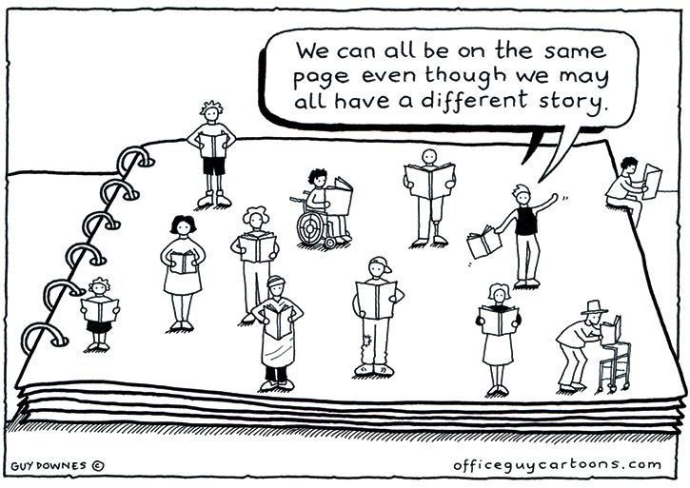

Slide 7
Within the Tier 2 intervention group setting & the classroom:
Educators:
…[reinforce] prevention when they increase structure, re-teach routines increase connections, target prompts and supervision, and implement targeted antecedent manipulations.
…explicitly teach targeted SEB skills and connect targeted instruction to tier 1 norms or expectations.
…target how they respond; they increase specific positive and supportive feedback, enhance continuum of recognition strategies, and enhance strategies to decrease SEB challenges.
(Adapted from Multi-Tiered System of Supports (MTSS) in the Classroom (2021)

Slide 8
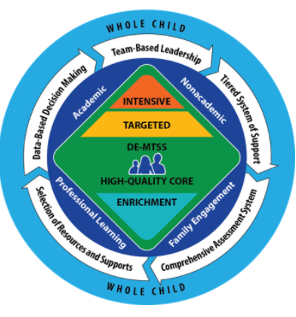
Definitions of Tier 2 Practices…
From DE-MTSS Implementation Guide:
Tier 2 interventions and supports are for students who continue to struggle after receiving high-quality Tier 1 instruction. Tier 2 interventions and supports are targeted to students’ needs and provide greater intensity (e.g., smaller group size, more practice opportunities) than Tier 1. Tier 2 supports are research based and delivered with fidelity. If a student’s performance improves, the student may no longer require Tier 2 interventions and supports.

Slide 9
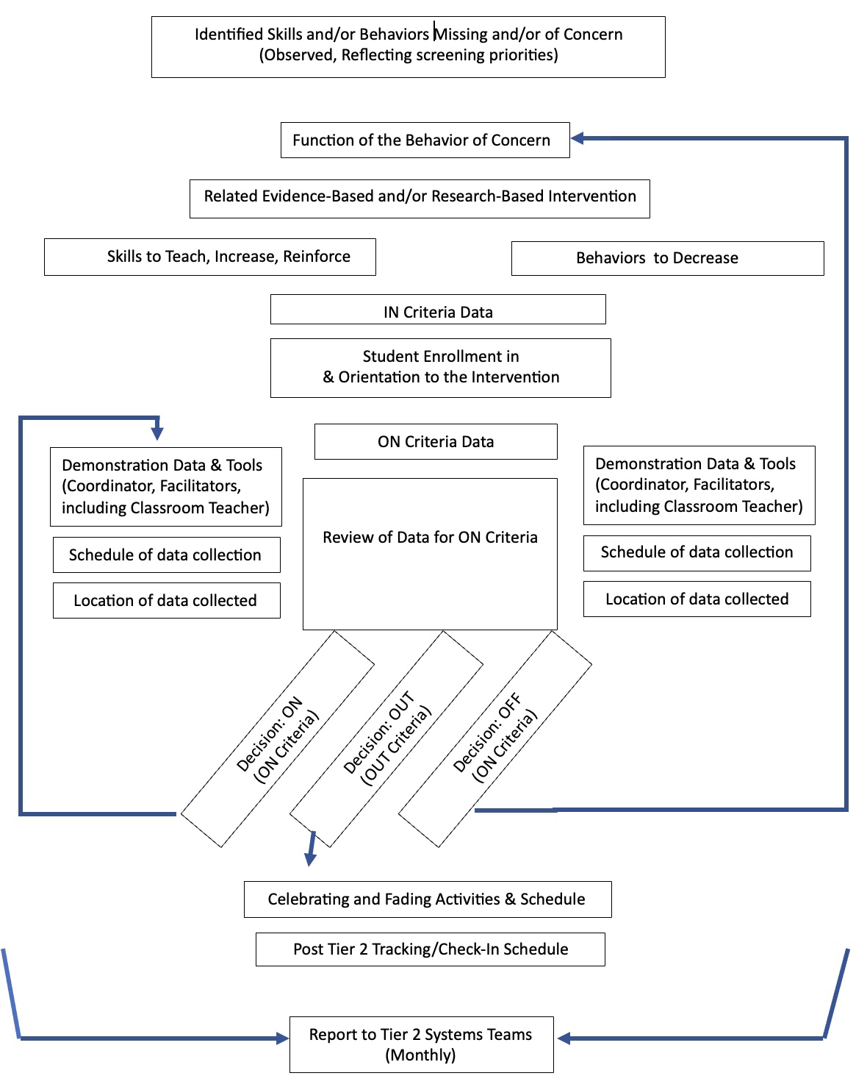
Tier 2
A Big Picture

Slide 10
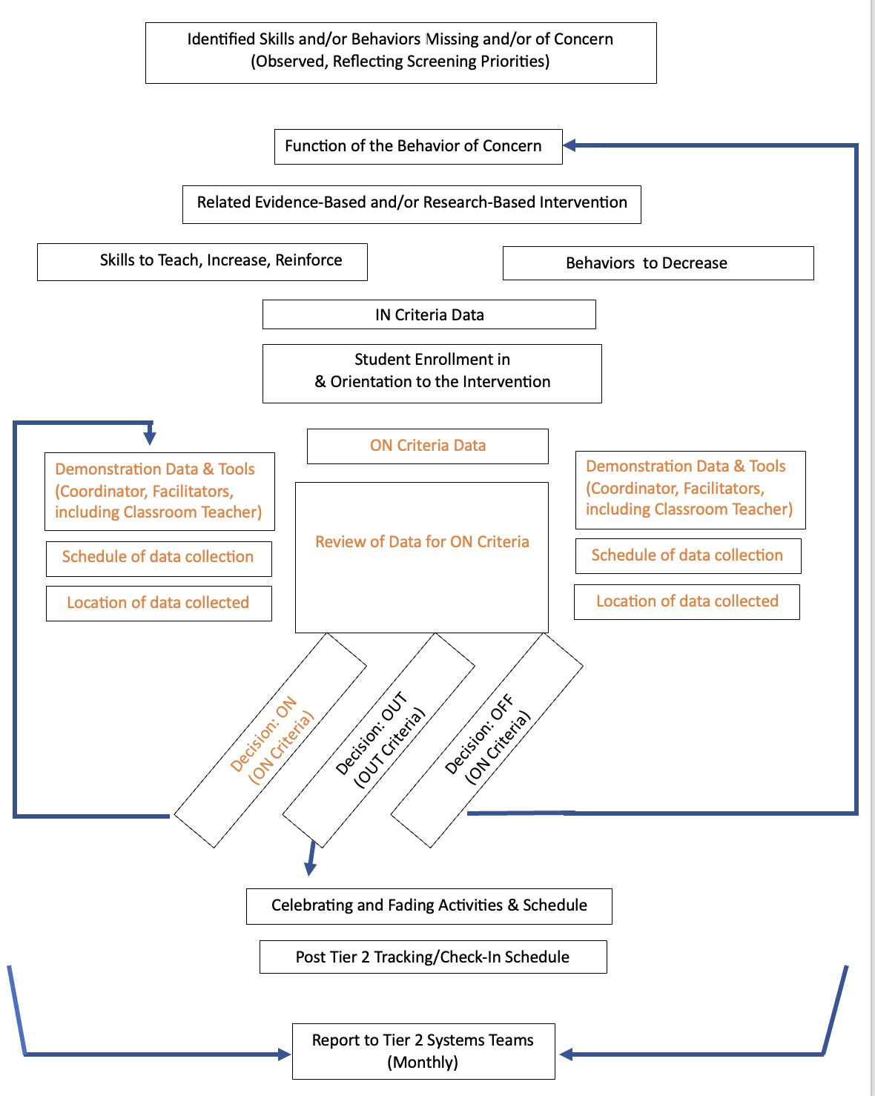
Tier 2
A Big Picture
Where Student-Level Progress Monitoring Is Key

Slide 11
Initial considerations for data collection
How often will data be collected?
Who will be collecting the data?
In what contexts will data be collected?
At what times will data be collected?
When will the data be inputted to allow for evaluation?
Direct Behavior Rating Overview (Maggin, National Center on Intensive Intervention)

Slide 12
Topics of Discussion for Today
Timeframes for progress monitoring
IN/ON/OUT criteria for Tier 2 Interventions
Tools including Behavior Rating Scales
Progress Monitoring Your Tier 2 Interventions Overall
https://storyset.com/people

Slide 13
Timeframes for progress monitoring
https://storyset.com/people

Slide 14
Tier 2 Timeframes…The Regulations
6.1.2 Tier 2 - Interventions shall be designed to be delivered in the student’s primary, scheduled education setting, by the student’s teacher or teachers, but may be delivered in other or additional settings or by other trained staff as appropriate to the specific intervention.
6.1.2.1 After no more than six to eight school weeks of Tier 2 intervention...the problem-solving team shall conduct a review of the plan …to determine whether additional assessments…are required, and whether changes to Tier 2 academic or non-academic methods are required; or the student should be provided Tier 3 intervention.

Slide 15
Tier 2 progress monitoring- Using Data For Decision Making.pdf
DR. ALLISON BRUHN, UNIVERSITY OF IOWA
DR. SARA MCDANIEL, UNIVERSITY OF ALABAMA

Slide 16
Tier 2 Timeframes…Within Your Interventions
What are the time frames that you currently have in place for Tier 2 interventions and how are folks keeping track of them?
What are your prescribed lengths of the interventions?
What, if any, weekly and/or mid-point check-ins do you have? Are there other check-in schedules being used?
How do these check-ins correspond to existing problem- solving meeting schedules?

Slide 17
IN/ON/OUT Criteria
https://storyset.com/people

Slide 18
Tier 2 INTERVENTIONS Asset Mapping (from Sessions #1 & 2)
Current Tier 2 Interventions | Skills Taught (Addressing Externalizing, Internalizing, a/o General Needs), Skills Being R+ | Coordinator | When/ Where
INTERVENTION NAME HERE | DESCRIPTION FILLED IN HERE | NAME HERE | SCHEDULE HERE
IN | [identify related screening data, consider ABC data, consider staff/student/family referral information]
ON | [identify what it looks like if the student is “on progress” with the skills being taught, reinforced]
OUT | [identify when a student graduates from this intervention, also identify when the student should be referred for review for a different intervention]

Slide 19
Current Tier 2 Interventions | Skills Taught (Addressing Externalizing, Internalizing, a/o General Needs), Skills Being R+ | Coordinator | When/ Where
Check In - Check Out | Description Filled in Here | Name Here | Schedule Here
IN | Frequent low-level behavior problems (e.g. attendance, across settings. Teacher/parent recommendation(s) during grade-level meeting AND/OR more than 3 ODRs in a one-month period. Student seeks attention.
ON | Student receives 70% or higher on signed Daily Progress Report (DPR) during the week.
OUT | Student receives 70% of higher on signed DPR for 5 days in a row and has no new ODRs. Classroom teacher/school counselor provides recommendation to graduate.

Slide 20
Current Tier 2 Interventions | Skills Taught (Addressing Externalizing, Internalizing, a/o General Needs), Skills Being R+ | Coordinator | When/ Where
Self-Esteem Group | Description Filled in Here | Name Here | Schedule Here
IN | Teacher recommendation, score of 15 or less on the Rosenberg Self- Esteem Scale
ON | teacher reporting more participation in class/their abilities, student creating secure relationships, accepting praise, more self praise/less self deprecation
OUT | score of 18 or higher on the Rosenberg Self-Esteem Scale,

Slide 21
Current Tier 2 Interventions | Skills Taught (Addressing Externalizing, Internalizing, a/o General Needs), Skills Being R+ | Coordinator | When/ Where
Mentoring | [Description Filled in Here] | [Name Here] | [Schedule Here]
IN | referred by staff as needing support with managing behavior and relationship building
ON | demonstrating positive behaviors as noted in classroom/teacher observations, point card, daily progress, etc.
OUT | decreased behavior referrals, and adequate progress as determined by staff

Slide 22
IN/ON/OUT Criteria
How have you aligned your data tools to your intervention criteria?
Are the tools needed for your criteria readily available to use?
How did you train folks to use the tools?
How are you keeping the data collected through these tools?

Slide 23
Tools including Behavior Rating Scales
https://storyset.com/people

Slide 24
The 3 Basic Types of Data Collection Tools
– Direct Behavior Ratings
– Direct Observation
– Intervention-Based Measures
Initial considerations
How often will data be collected?
Who will be collecting the data?
In what contexts will data be collected?
At what times will data be collected?
When will the data be inputted to allow for evaluation?
Tier 2 progress monitoring- Using Data For Decision Making.pdf (Bruhn & McDaniel)
Direct Behavior Rating Overview (Maggin, National Center on Intensive Intervention)

Slide 25
Direct Behavior Ratings
Involves teachers rating a student’s behavior on 0-10 scale
– Direct
• Ratings recorded immediately at end of observation session
– Behavior
• Behavior is specific and operationally defined
– Rating
• Ratings are conducted repeatedly and follow a 0-10 scale
Tier 2 progress monitoring- Using Data For Decision Making.pdf (Bruhn & McDaniel)

Slide 26
Direct Behavior Rating Scales
Why use DBR?
DBR involves rating of behavior following a specified observation period, and then sharing of that information to inform decisions. DBR offers many options to link connections across assessment, intervention, and communication uses. DBR provides a simple and inexpensive option for frequent feedback about important behaviors, facilitating communication among students, parents, and educators. Most importantly, DBR is evidence-based!
DBR is flexible for use across assessment, communication, and intervention purposes
DBR is efficient as ratings are simple and quick to complete
DBR is repeatable for use in progress monitoring assessment
DBR is defensible given increasing evidence of technical adequacy screening and progress monitoring assessment\
Excerpts from https://dbr.education.uconn.edu/

Slide 27
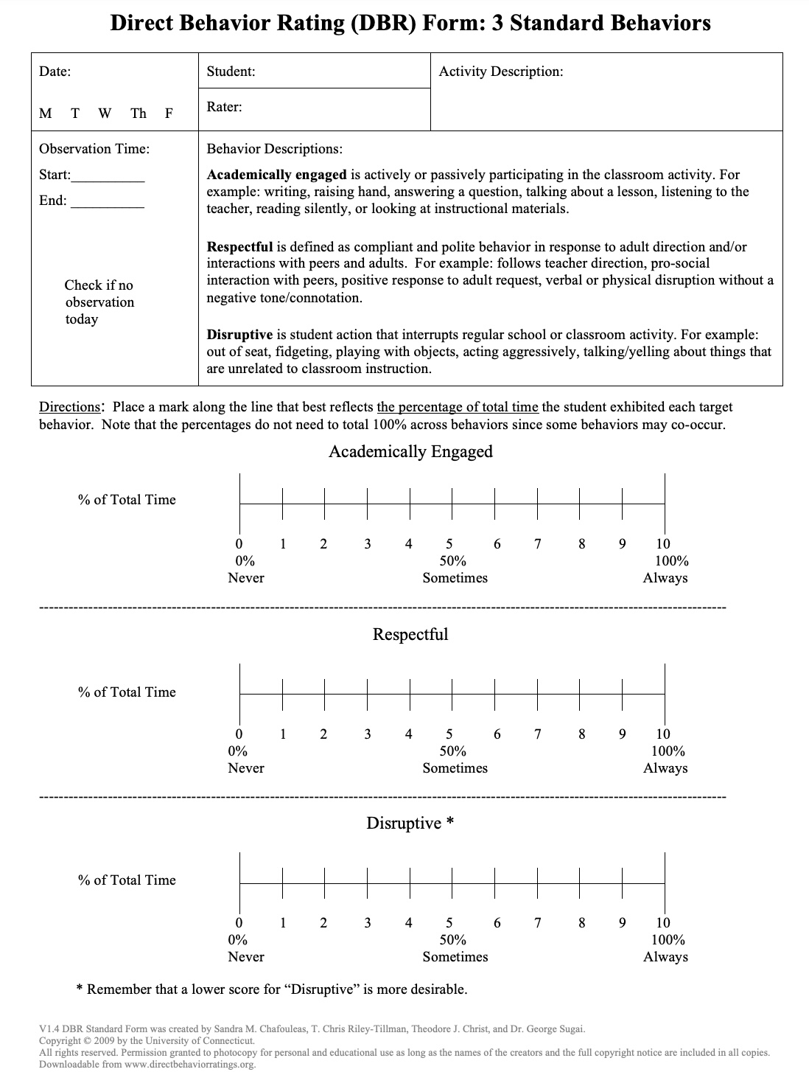
Example:
https://dbr.education.uconn.edu/wp-content/uploads/sites/916/2015/08/DBR-Standard-Form-with-3-Standard-Behaviors.pdf

Slide 28
Direct Behavior Rating Scales
Steps for implementation:
1. Identify the behaviors you want to monitor.
2. Define the behaviors with examples and nonexamples
3. Identify the time period or instructional activity for observation
4. Immediately following observation period, complete the rating
5. Graph the rating daily
Tier 2 progress monitoring- Using Data For Decision Making.pdf (Bruhn & McDaniel)

Slide 29
Direct Behavior Ratings
How have you taught and encouraged others to use DBRs?
Are there certain folks who are best at creating them?
How can you support the saving and sharing of sample DBRs?

Slide 30
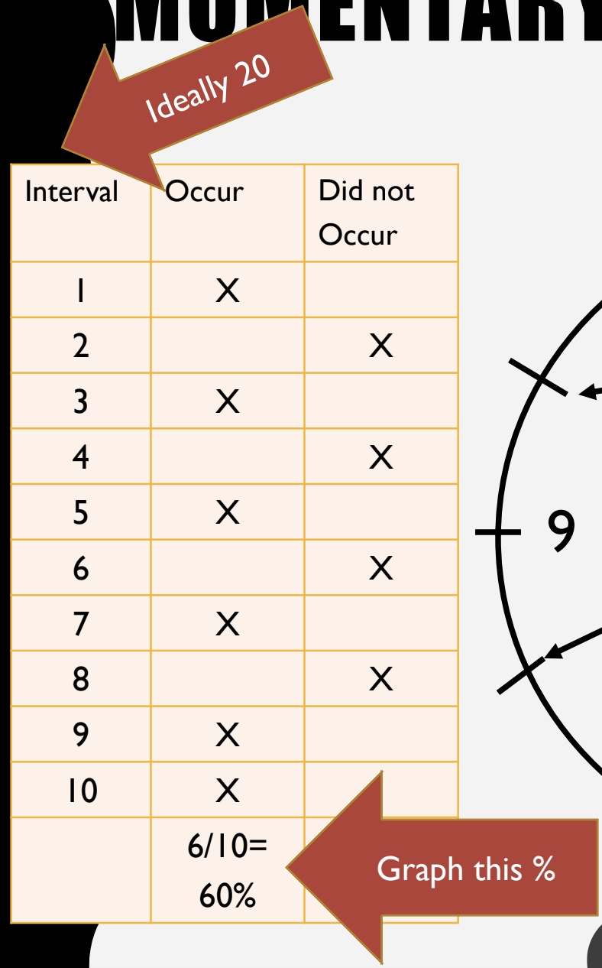
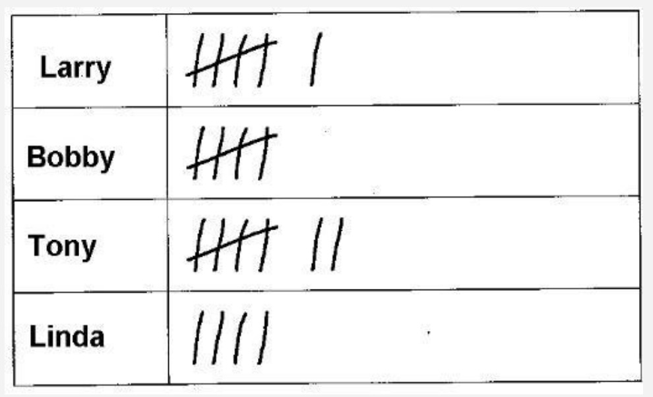
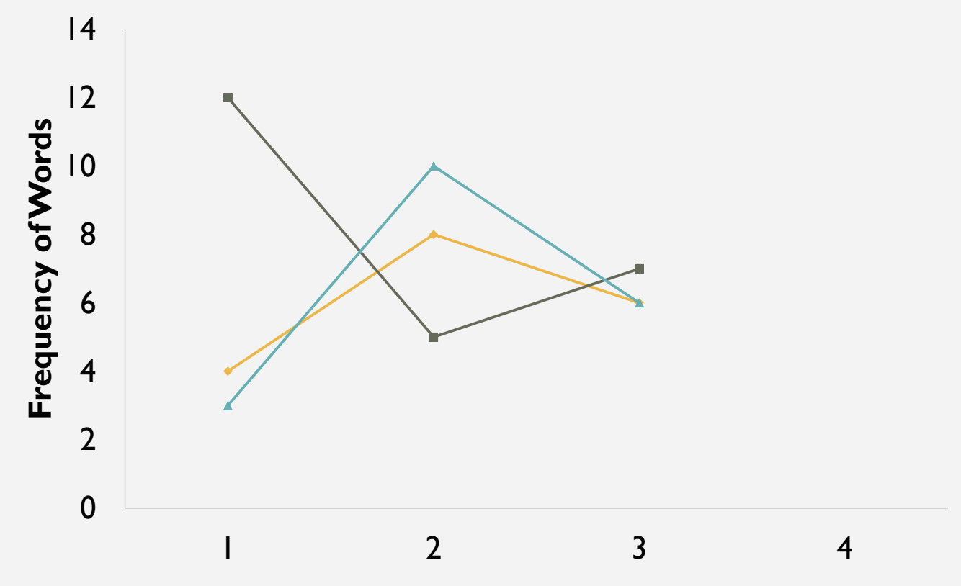
Direct Observation
Direct measure of student behavior in real time (i.e., recording behavior as it occurs in the setting of concern)
Momentary Time Sampling
Frequency Counts
Tier 2 progress monitoring- Using Data For Decision Making.pdf (Bruhn & McDaniel)

Slide 31
Direct Observation
Implementation Steps:
1. Identify the behavior you want to measure
2. Define behavior with examples and non-examples
3. Determine the method of measurement:
a. Is it a low-frequency, discrete behavior? = Frequency Count
b. Is it a high-frequency, discrete behavior? = Time Sampling
c. Is it a continuous behavior? = Time Sampling
4. Create observation form and determine session length
5. Collect data
6. Calculate (e.g., convert frequency to rate, or determine % of intervals behavior occurred)
7. Graph data
Tier 2 progress monitoring- Using Data For Decision Making.pdf (Bruhn & McDaniel)

Slide 32
Direct Observations
How have you taught and encouraged others to use Direct Observations?
Are there certain folks who are best at creating them?
How can you support the saving of sample direct observation tools?

Slide 33
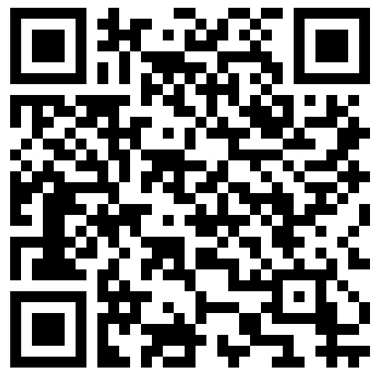
Intervention Based Measures
Data that are collected within the intervention.
Example: CICO
see DE–PBS Project CICO: Check-In/Check-Out Module)
Including:
CICO Daily Progress Report Data Tracking Tool
CICO DPR Data Tracking Tool – User Guide:

Slide 34
Intervention Based Measures
How have you taught and encouraged others to use Intervention Based Measures?
Do you look for the quality of measures provided when exploring a new intervention? (Hexagon thinking)

Slide 35
Progress monitoring your Tier 2 Interventions Overall
https://storyset.com/people

Slide 36
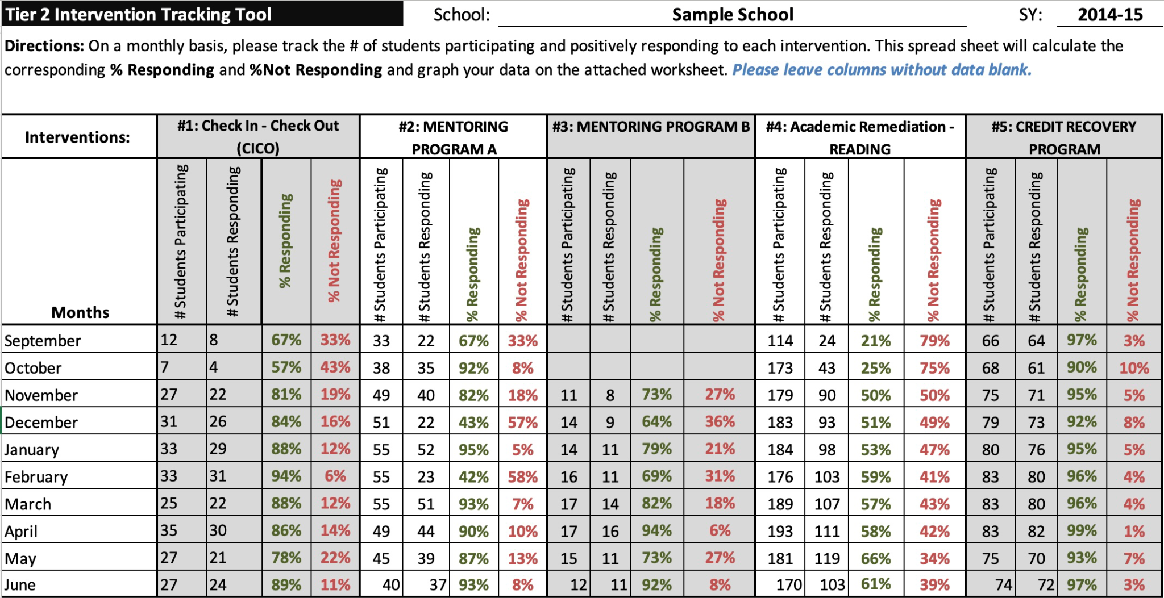
Tools for tracking proportions:
Tier 2 Intervention Tracker - Aggregate

Slide 37
Tier 2 Intervention Tracker - Tab 2

Slide 38
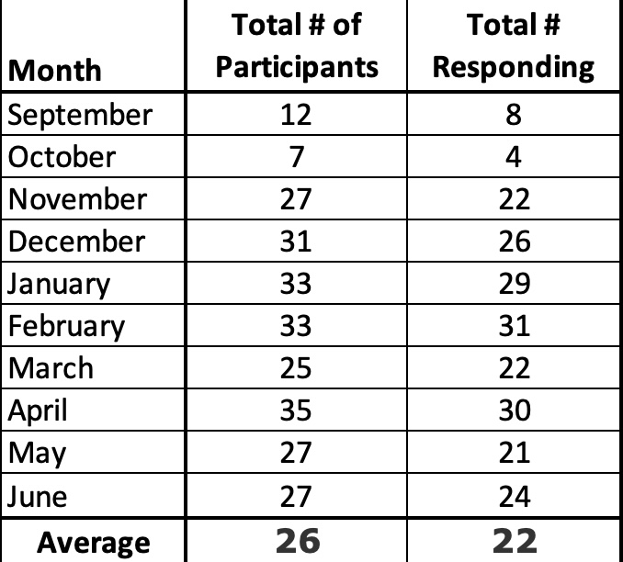
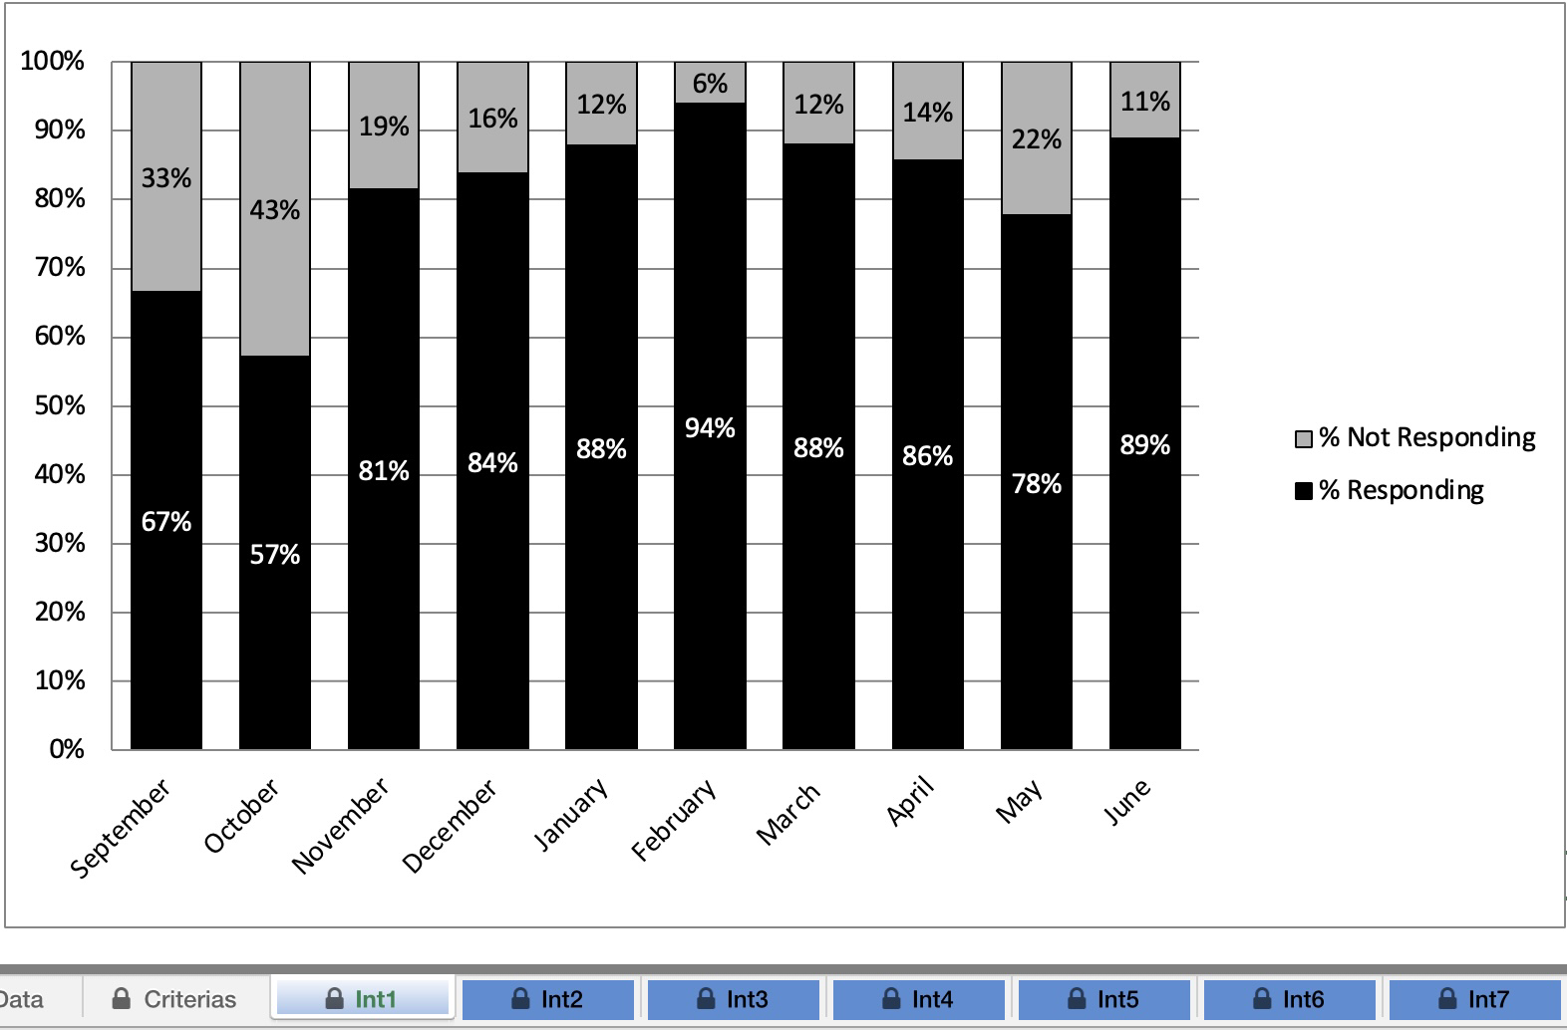
Tier 2 Intervention Tracker - “Int” tabs

Slide 39
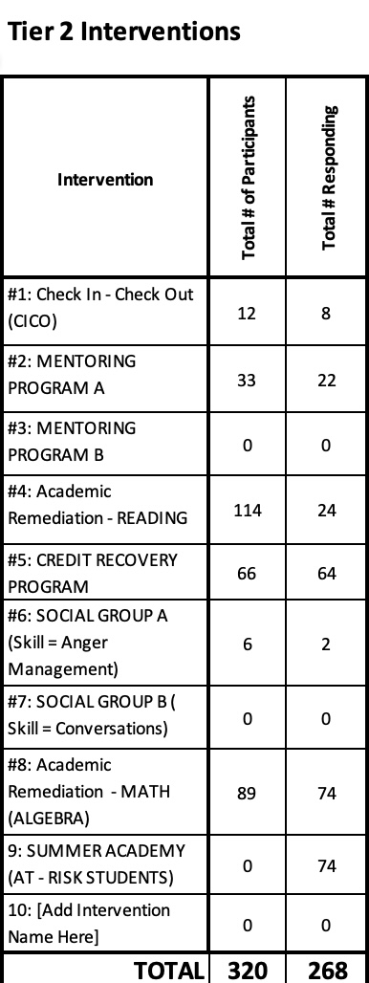
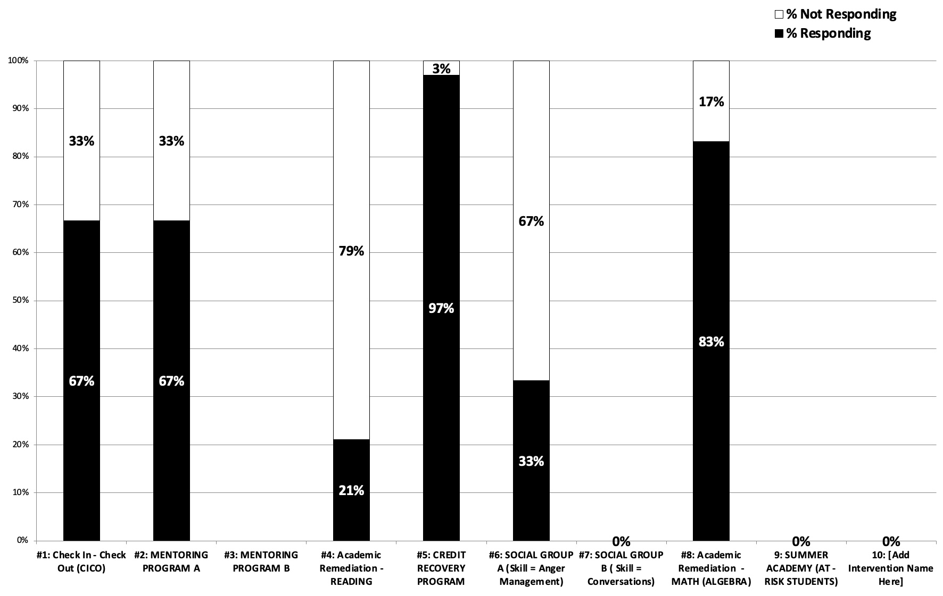
Tier 2 Intervention Tracker - Month tabs

Slide 40
Tools for tracking proportions:
Tier 2 Intervention Tracker - Disaggregate

Slide 41
Tools for tracking proportions:
Tier 2 Intervention Tracker - Disaggregate

Slide 42
Tier 2 Intervention Tracker - Tab 2

Slide 43
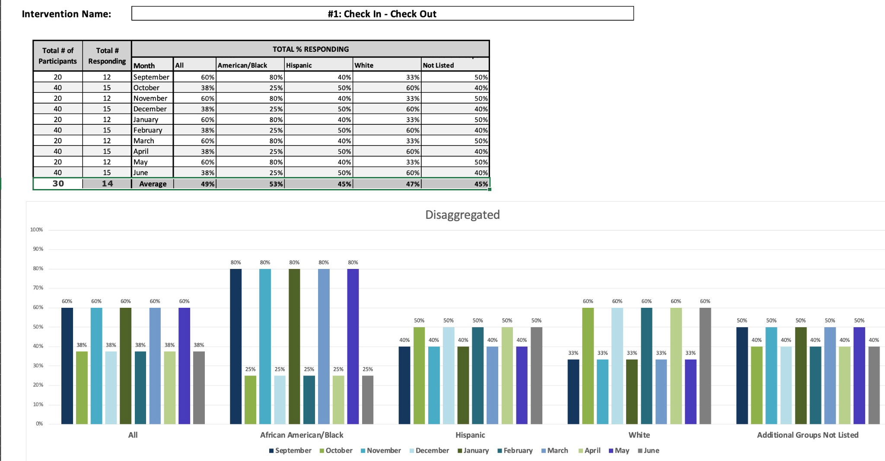
Tier 2 Intervention Tracker - “Int” tabs

Slide 44
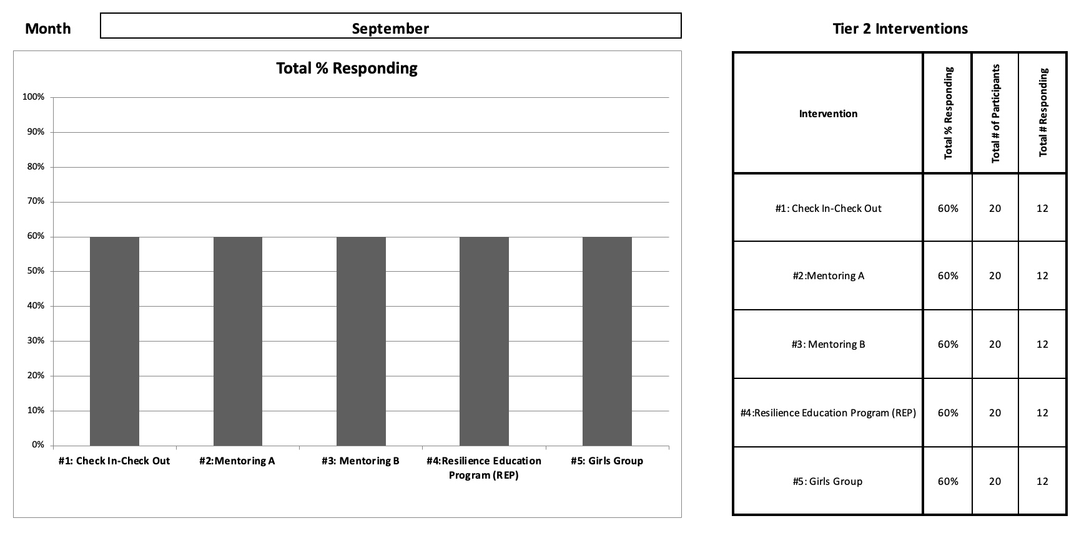
Tier 2 Intervention Tracker - Month tabs (are aggregate)

Slide 45
Tier 2 Interventions Overall
How are you capturing the best “big picture” progress-monitoring snapshot of your current interventions?
Who has access to this snapshot and why?
How might the sustainability of your programming being impacted by your snapshot(s)?
https://storyset.com/people

Slide 46
Take a fresh look at your interventions anytime…
https://www.pbis.org/resource/tfi
Tier 2 EVALUATION section (pgs.15-16)

Slide 47
Critical Features
2.10 Level of Use:
Team follows written process to track proportion of students participating in Tier 2 supports, and access is proportionate.
Team defines criteria and tracks proportion, with at least 5% of students receiving Tier 2 supports

Slide 48
Critical Features
2.10 Level of Use:
Team follows written process to track proportion of students participating in Tier 2 supports, and access is proportionate.
Team defines criteria and tracks proportion, with at least 5% of students receiving Tier 2 supports

Slide 49
Critical Features
2.11. Student Performance Data
Tier 2 team tracks proportion of students experiencing success (% of participating students being successful) and uses Tier 2 intervention outcomes data and decision rules for progress monitoring and modification.
Student data (% of students being successful) monitored and used at least monthly, with data decision rules established to alter (e.g., intensify or fade) support, and shared with stakeholders

Slide 50
Critical Features
2.12. Fidelity Data:
Tier 2 team has a protocol for ongoing review of fidelity for each Tier 2 practice.
Periodic, direct assessments of fidelity collected by Tier 2 team for all Tier 2 interventions

Slide 51
Coming Soon…
Jennifer Freeman (2022)

Slide 52
Even more specificity…
Jennifer Freeman (2022)

Slide 53
What is 1 implementation idea or tool
that you want to explore more?
https://storyset.com/people

Slide 54
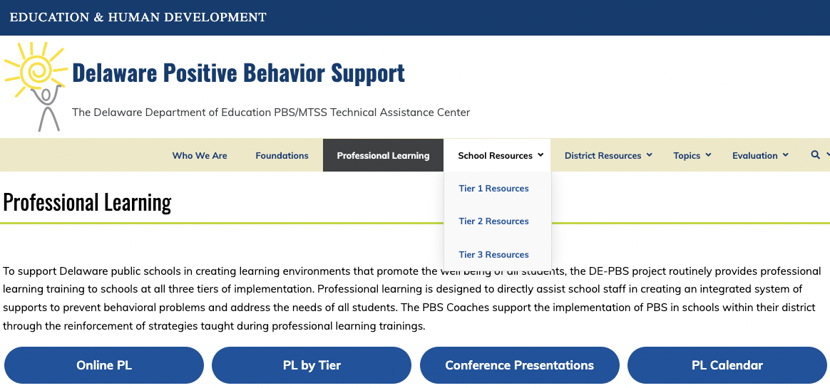
PL Resources for All Tiers

Slide 55
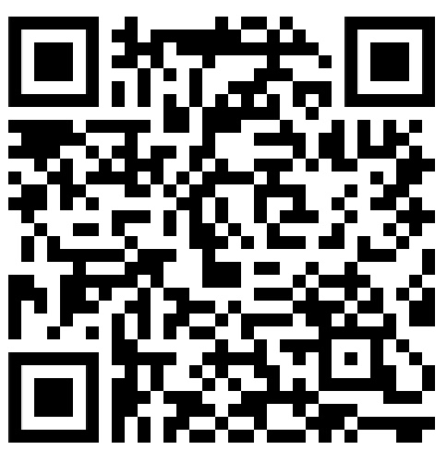
Your feedback makes our work better and brighter.
Thank you for completing our feedback survey
and best wishes for these final weeks of school!

Slide 56
Extra “If Time” Slides

Slide 57
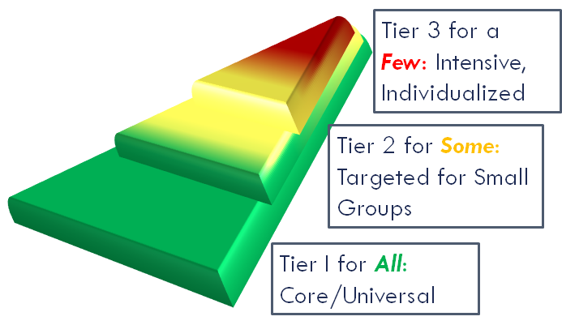
Quick Reminder: The MTSS layers build, they do not
divide and separate efforts
to support students, families, and staff.

Slide 58
…and we use the same problem solving process at ALL 3 Tiers!
Problem identification
Evaluate the response
Problem analysis
Develop and Implement a Plan
Adapted from Gaunt, 2022 (APBS Conference Workshop)

Slide 59
Tier 2 SYSTEMS Teams
& COORDINATORS & Facilitators for Tier 2 INTERVENTIONS
Tier 1 Interventions/
Team
Universal Screening
Efforts/
Related Team(s)
Classroom Teachers
Outside Agency Providers
Tier 3 Interventions
/
Team(s)
Reintegration
Efforts/
Related Team(s)

