Slide 1
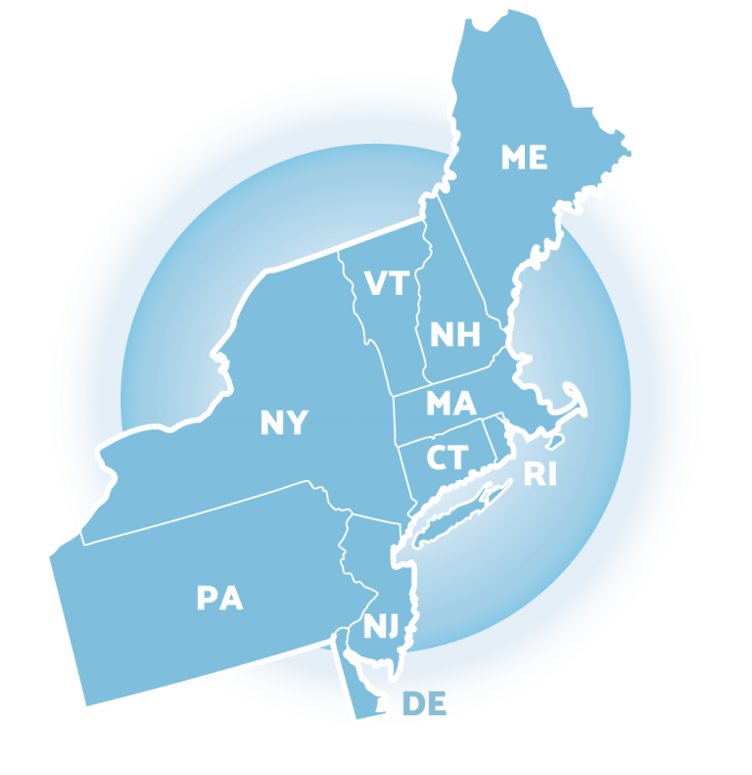
Moving from Exploration to Implementation of a Universal SEB Screener
Dr. Jocelyn Brown and Sonia Songui, Capital School District
Christina MacKerchar, Colonial School District
Niki Kendall, DE-PBS Project
Northeast
PBIS Network
Leadership Forum
MAY 17-18, 2023

Slide 2
Access Conference Program and Session Materials at NEPBIS.org
NEPBIS LEADERSHIP FORUM

Slide 3
Connection of the Presentation Topic to TFI 3.0 Item(s):
CLASSROOM IMPLEMENTATION OF PBIS
1.9 Schoolwide Practices used in Classrooms: Educators implement foundational Tier 1 practices (explicitly teach, prompt, and review schoolwide expectations as described in 1.4; implement school wide acknowledgements as described in 1.5; and respond to challenging behavior as described in 1.7) across all classroom locations and routines and integrate these supports within all academic and SEB instruction in a culturally responsive manner.
1.10 Classroom Practices: Educators consistently and equitably implement positive and proactive classroom practices--including building relationships with students; developing a safe environment; prompting predictable routines and expected behavior; actively providing OTRs, active supervision, and specific feedback (i.e., specific praise and supportive corrections); and ensuring a high ratio (≥ 5:1) of positive to corrective feedback.

Slide 4
Session Objectives
At the end of the session participants will:
Understand screening within the context of MTSS
Understand how to utilize the principles of implementation science to identify and implement a tool that fills a gap in their district’s screening process.
Understand the importance of an SEB screening evaluation process to ensure adherence to fidelity measures
Learn how to build district-wide capacity and sustainability following a small universal screening pilot

Slide 5
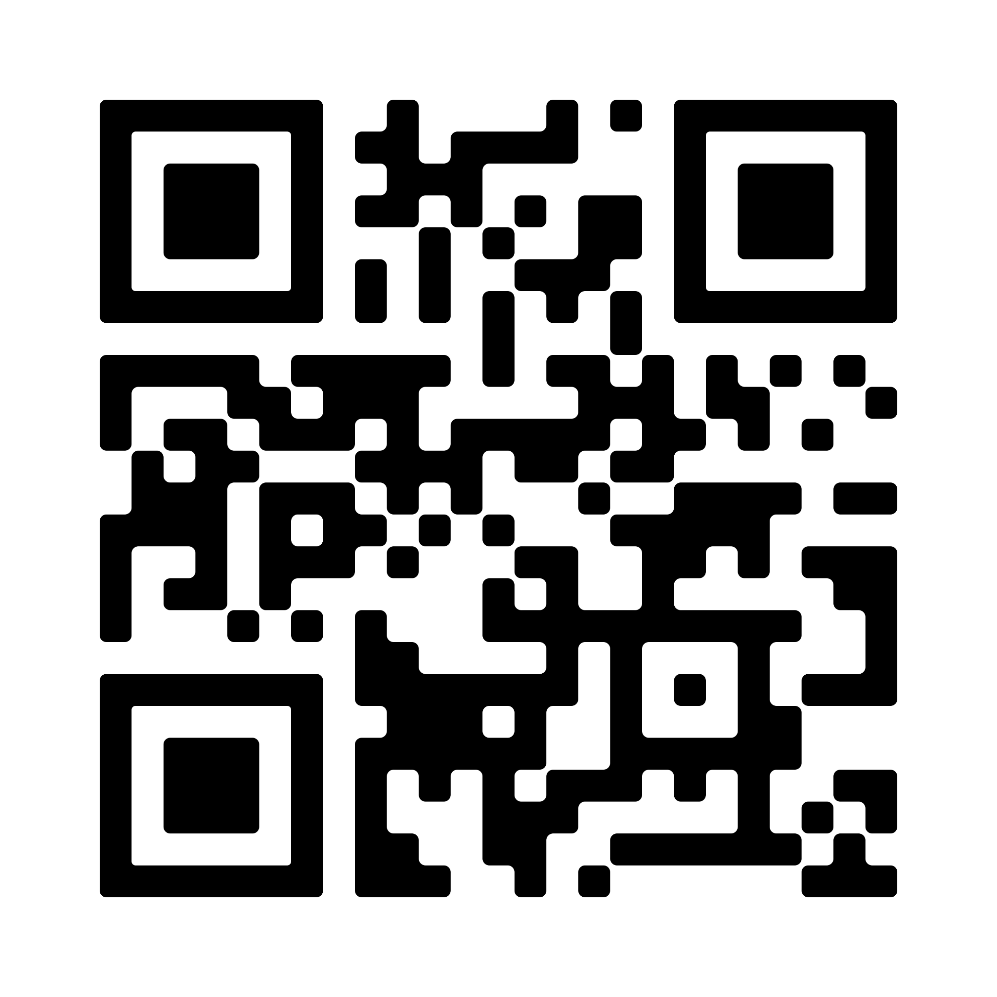
Session Materials
Scan here to access presentation slides and additional resources:

Slide 6
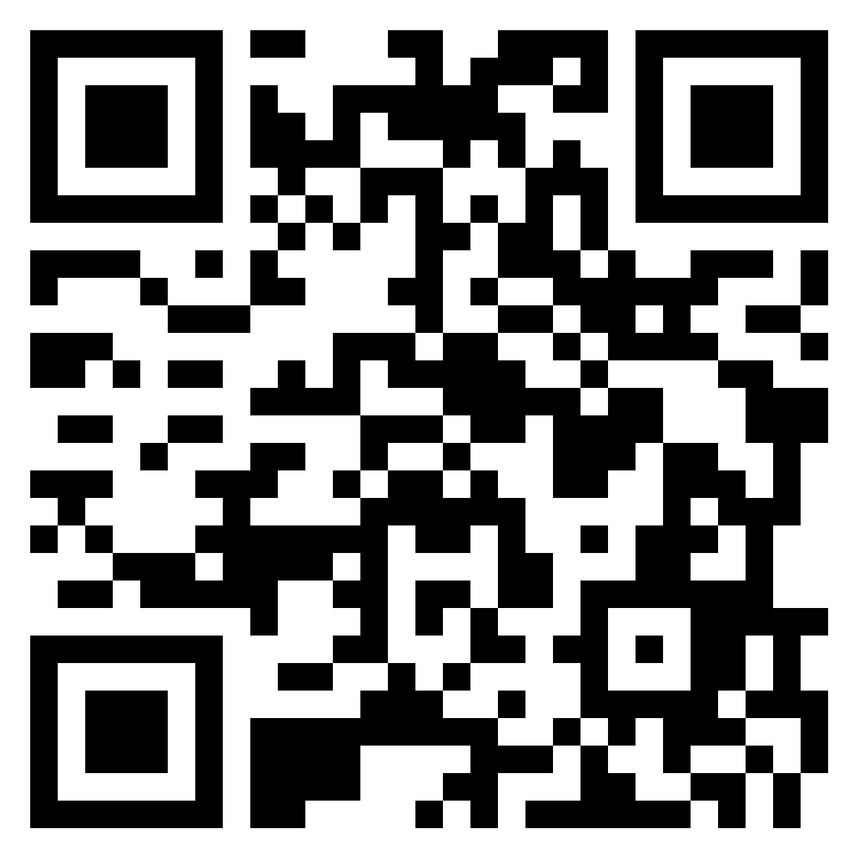
Session Questions?
Scan here to add to our padlet for our
Q & A at the end:

Slide 7
Delaware PBS Project
The DE-PBS Project serves as a technical assistance center for the Delaware DOE to actualize the vision to create safe and caring learning environments that promote the social-emotional and academic development of all children.
The statewide initiative is designed to build the knowledge and skills of Delaware educators in the concepts and evidence-based practices of Positive Behavior Support (PBS) as a Multi-tiered System of Support (MTSS).
https://www.delawarepbs.org/universal-screening/

Slide 8
Project DelAWARE
Project DelAWARE is a collaborative effort between the Department of Education (DOE), The Division of Prevention and Behavioral Health Services (DPBHS), the UD Center for Disabilities Studies (CDS), the Delaware PBS Project, the UD Center for Drug and Health Studies (CDHS), and three local school districts – Capital School District, Colonial School District, and Indian River School District. Funding for the project is provided through a 5 year federal SAMHSA (Substance Abuse and Mental Health Services Administration) grant.
The overarching purpose of Project DelAWARE is to implement evidence-based mental health services in school settings within the context of the Multi-Tiered System of Support (MTSS) in order to promote wellness and resilience for school-age youth and to improve access to mental health services.
WE ARE IN THE LAST YEAR OF GRANT IMPLEMENTATION

Slide 9
Project DelAWARE Goals:
Goal 1: School staff will recognize the principles of MTSS and will understand the referral process to access mental health services for students.
Goal 4: Each school will implement a mental health screening process for students and provide mental health services that are evidence-based and proven effective.

Slide 10
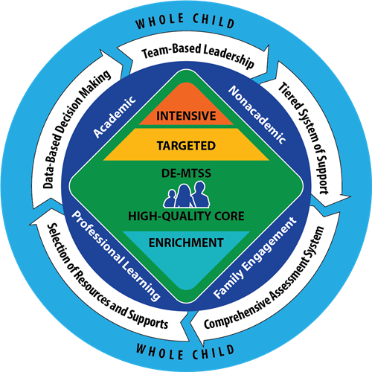
Delaware MTSS and SEB Screening
DE MTSS Regulations require schools to implement a multi-level prevention system that includes high quality universal supports to all students.
Student response to these supports are monitored by a universal screening process, which enables teams to proactively identify (and address) needs at the school, grade, class, or student level.

Slide 11
So, what is the universal screening process?
Tier 1 core instruction delivered with fidelity to all students​
Multiple gating procedure to determine when student support is needed
First stage is universal screening to identify students who may need additional supports​
Second stage (within two weeks) is data analysis to confirm there are specific areas of need for Tier 2 supports​ (based on results identified students matched to supports​)
If 20% of students in a classroom are not meeting a benchmark consider the need for additional classroom, instructional and systems level supports and strategies​

Slide 12
A Comprehensive Universal Screening Process
Universal SEB Screening Tool | Teacher/Caregiver/Student Referrals | Early Warning Indicators (grades, attendance, behavior referrals)
Collected/Reviewed 2 or 3 times per year | On-going review | Quarterly/On-going review
Data informs all tiers of supports
Tier 1 | Tier 2 | Tier 3
Inform universal prevention efforts (e.g. lessons to create/revise/revisit) | Collect or review additional data to understand student needs. Match students to existing interventions based on data based decision rules (problem solving conversations) Inform the development of new group interventions (systems conversations) | Collect additional data to understand student needs and identify appropriate supports (e.g. risk assessment, secondary screening tool, FBA, observations, interviews)

Slide 13
Stages of Implementation (Fixsen et al., 2005)
Stage | Implementation Activities
Exploration (select) | Develop a leadership team responsible for implementation, with a shared understanding and vision for SEB screening Complete tool selection process
Installation (prepare) | Determine readiness criteria for pilot sites Create district protocols for pilot sites (e.g., consent, introducing the screener) Organize/prepare school team(s) to follow protocols for screener use
Initial Implementation (start small) | Coach school team(s) through screener administration and follow up Evaluate effectiveness of district protocols and screener Make adjustments and expand to other implementation sites
Full Implementation (way of work) | Routine coaching and professional learning Routine use of screener data for decision making across all levels
Sustainability (adjust) | Make ongoing adjustments to sustain implementation and positive outcomes

Slide 14
Capital School District
Located in Dover, Delaware (State Capital)
12 Schools
6,278 Students in grades Pk-12
Minority Enrollment: 71%
Students with Disabilities: 23%
ELA Proficiency: 33%
Math Proficiency: 33%
Graduation Rate: 84%

Slide 15
Exploration
Exploration

Slide 16
Assemble a Team
District Level Team:
District Administrators
SAMHSA Project Aware Team
SAMHSA Technical Assistance Support Partners
School Level Team:
School Administrator(s)
School staff with knowledge and training in mental health
School-based community providers
Students, family members, community members (as appropriate)

Slide 17
Role of the Team
Planning the screening process
Administering screening measures
Reviewing data to identify students at imminent risk
Coordinating follow up supports as needed

Slide 18
Review Data to Clarify Needs1
Questions to consider:
What data do we have access to?
What data do we need?
What do we know?
What don’t we know?
What groups do we want to know more about?
Data Sources:
Attendance
Office Discipline Referrals (ODRs)
Grades/GPA
Nurse Visits
Counselor Visits
Referrals (Teacher/Caregiver)

Slide 19
Cultural Considerations
Complex stress related to poverty, immigration, and language barriers
Cultural beliefs about mental health and how concerns should be addressed
Access or barriers to services for historically marginalized groups
Preferred assessment processes
Accessibility to culturally and linguistically diverse populations
Tool’s predictive effectiveness for the school’s target population

Slide 20
Establishing Shared goals
Clarify goals of Screening
Cultural considerations
Strength based
Internalizing

Slide 21
Buy-In
Provide information and gather feedback from several groups at various points regarding:
Benefits of Screening
Communicate screening process and procedures (implementation, scoring, referral process)
Challenges and Concerns related to screening
Consent and privacy considerations
Solicit volunteers

Slide 22
Readiness
Readiness

Slide 23
SEB Screener Selection
Population
Feasibility and Usability
Time
Psychometric Evidence

Slide 24
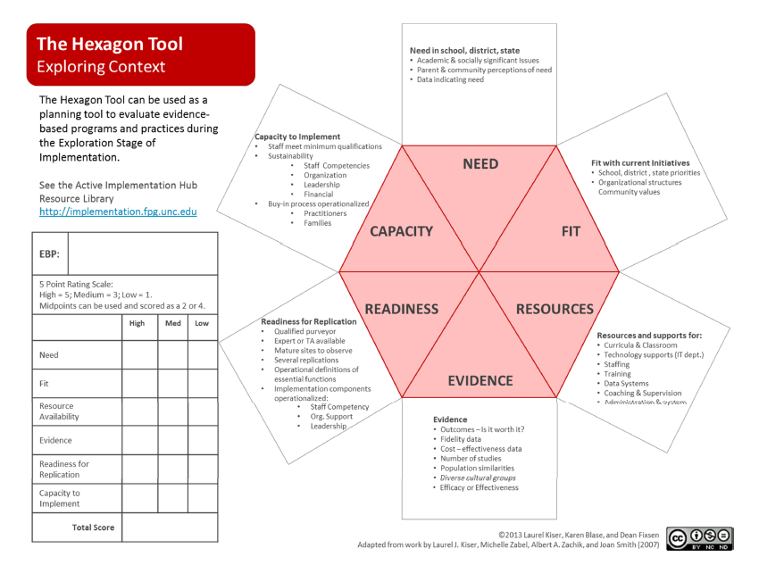
The Hexagon Tool
Notes:
Broad factors to consider when doing early stage exploration of Evidence‐Based Practices
(EBP)/Evidence Informed Innovations (EII) include:
Needs of students; how well the program or practice might meet identified needs.
Fit with current initiatives, priorities, structures and supports, and parent/community
Values.
Resource Availability for training, staffing, technology supports, curricula, data systems
and administration.
Evidence indicating the outcomes that might be expected if the program or practices
are implemented well.
Readiness for Replication of the program, including expert assistance available, number
of replications accomplished, exemplars available for observation, and how well the
program is operationalized
Capacity to Implement as intended and to sustain and improve implementation over
Time.
Modified tool specific to screening shared in resource folder

Slide 25
Adoption

Slide 26
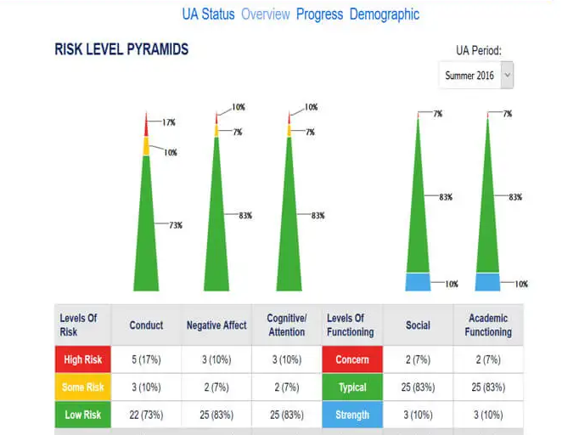
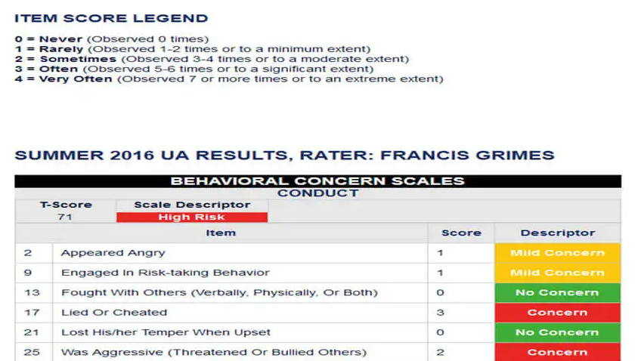
BIMAS

Slide 27
Training
Training screeners in the use of the tool
How to use data
Preparing students and families

Slide 28
Determining Target Group and Timing
Who should we screen?
When and how often should we screen?

Slide 29
Determine Choice of Informant
Consider who is able to provide the most valuable data
Student
Teacher
Parent

Slide 30
Student Assent
Gain students’ voluntary assent for participation in screening
Provide education so that students can make an informed decision
Communicate that there is not disciplinary or academic consequences for choosing not to participate

Slide 31
Type of Consent: Active vs. Passive
Type | Definition | Strengths | Limitations
Active Consent | Student may only participate with written parental consent | Ensures consent is informed Often aligns with district protocols Establishes trust between schools and families | May prevent access to minority or marginalized students Overall participation decreases
Passive Consent | Parent or guardian’s nonon response serves as consent | Allows access to greatest number of students (on average 79%-100%) | Gate 2 screening requires active consent
National Center for School Mental Health

Slide 32
Team Reflection

Slide 33
Team Reflection
Ensure teams are prepared for process by building capacity, expertise and fluency with tool and the use of data to inform decision making.
It’s imperative to set data rules so teams are ready to respond to screening results.
A universal screener process should start “slow” or small as a safe approach. This allows the school to test out the procedures and gain valuable feedback.

Slide 34
Team Reflection
Allows the school to make critical changes to the screening process before scaling the program up.
Allows teams to understand how to plan and make decisions from the data collected through the screening instrument.

Slide 35
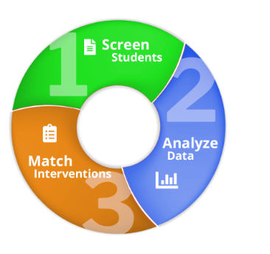
Analysis of Data
Determine reliability of data and address any concerns that may have impacted the validity of data:
Reliability: the degree that the chosen screener results in similar scores each time it is used.
Validity: the degree that the chosen screener measures what it is supposed to measure
False positives may be more desirable than false negatives with regard to screening

Slide 36
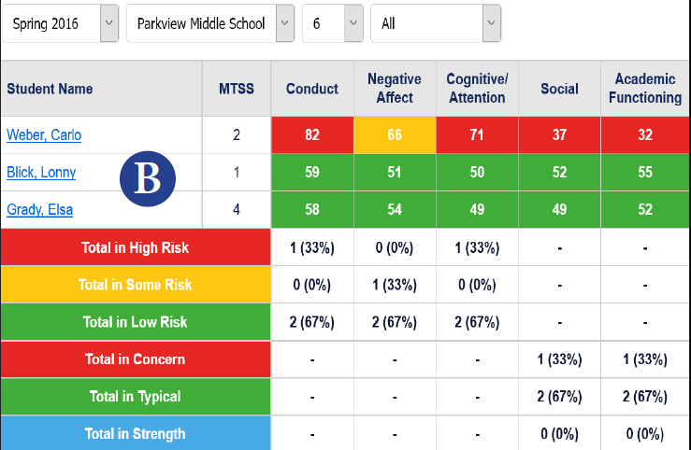
Response Plan Based upon Risk
High risk- same day
Moderate risk- within one week
Low risk- within a reasonable time frame as determined by team
Prepare crisis teams and local community mental health providers to be on call in advance of screening

Slide 37
Stakeholders

Slide 38
Stakeholder Feedback
Surveys
Focus Groups
Interviews

Slide 39
Communicating Findings with Stakeholders
Disseminate data amongst key stakeholders, including partners, teachers, students, administrators and/or district leaders.
Establish procedures for communicating concerns to families

Slide 40
Communicating with Families
Share concerns and screening results with parents/guardians.
Provide observations and concrete examples any additional supportive screening data.
Refrain from making judgments or assumptions about the parents/guardians’ decisions regarding treatments and/or services.
Provide current and accessible information about the student’s risk factors identified through screening
Provide information about local resources for the student and information about parent training and support groups
Substance Abuse and Mental Health Services Administration (SAMHSA)
Notes:
Families- letter with outcome of screener (Tier I)
Tier II and III- Tier II contacted families to invite students to participate in tier II interventions; Tier III- contacted individual families about school based mental health and community interventions (Project AWARE)

Slide 41
Communicating Positive Screen Results
(Tier II/Tier III) to Adolescents
Meet with the student individually in a private setting.
Reiterate the nature and intention of the screening tool.
Discuss range of results of screening (no risk, moderate risk, high risk) and potential reasons why students may fall in one category.
Explain the student’s individual screen results in an open, honest, and direct manner.
Reaffirm that screening is NOT a diagnosis of mental illness, but an indication of potential signs or risk factors.
Explain follow-up procedures for further assessment and supports. Substance Abuse and Mental Health Services Administration (SAMHSA)

Slide 42
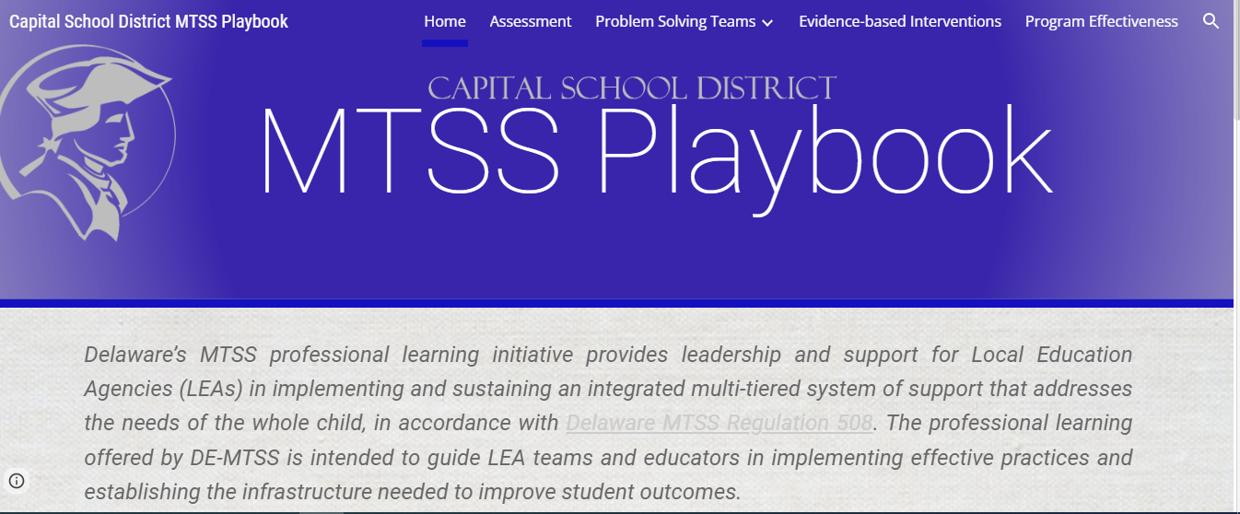
Capital School District’s MTSS Playbook

Slide 43
Intervention Matching
Taxonomy of Intervention Intensity
Review existing resources and capacity
Resource Mapping Activity- Making Caring Common
Capital School District Resource Map
Capital School District Tiered Intervention Chart

Slide 44
Progress Monitoring
Once students have been identified, problems targeted, interventions implemented, then progress monitoring begins.
Ongoing evaluation of the process, student progress with aligned interventions, identified students at risk who may require further assessment and tracking are crucial components.
Increased attention to assessing the extent of support being provided with fidelity and its effectiveness allows data based decision making to take place that may result in a change to interventions or termination supports.

Slide 45
Documentation

Slide 46
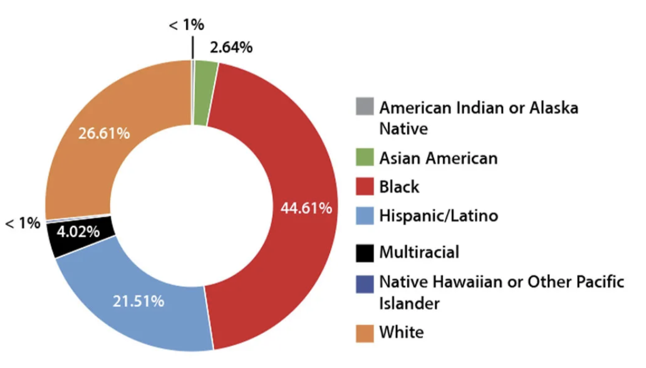
Colonial School District | New Castle, DE

Slide 47
Universal SEB Screening Goals
Use data to provide more targeted interventions to at-risk students
Analyze data to evaluate systems-level needs (school- and class-wide) at a Tier I level
Include a universal SEB screening tool as a part of our process

Slide 48
Getting Started
2019-2020
2020-2021
2021-2022
Gap analysis/resource mapping
--
Determined mySAEBRS (Social, Academic, and Emotional Behavior Risk Screener) would best meet our needs
High school received ongoing state- and district-level coaching through Project DelAWARE
--
Cross-sample of 9th grade students completed the SAEBRS
Larger 9th grade cohort
--
District decided to expand the SAEBRS pilot as a part of our universal screening process

Slide 49
Expanding the Pilot
Intentionally planned our expansion
Utilized multiple data sources to select 3rd and 6th grade for our pilot
Developed a proposal for a stipend position: a Universal Screening Coordinator for each of our schools
Planned coaching structure: monthly PLC

Slide 50
Preparing to Expand
Developed a brief manual: Assessing Readiness for a Universal SEB Screening Process to share with screening coordinators/administrators
MTSS
SEL
Universal Screening process
Universal Screening tool (SAEBRS)
Next steps

Slide 51
Pilot Selection
Guidance provided to PLC:
Pilot will look slightly different for each school depending on building size, teaming structures, etc. and that’s okay!
3rd grade: select two to four teachers who have been trained in Responsive Classroom or are open to implementing new strategies in their classrooms
6th grade: select a team/subject area with strong Tier 1 supports or are open to implementing new strategies

Slide 52
PLC Purpose
✔ Connect
✔ Assess
✔ Analyze
with colleagues across the district to support an effective MTSS framework in each building
readiness to implement a universal screener for social, emotional, and behavioral needs
data to more effectively support students through evidence-based, tiered interventions

Slide 53
PLC: Diving in
Set goal of piloting the SAEBRS during the winter benchmark period (January)
Universal Screening Coordinators passed training/content along to administrators and pilot teachers
Used evaluation survey at the end of each PLC to plan for the next

Slide 54
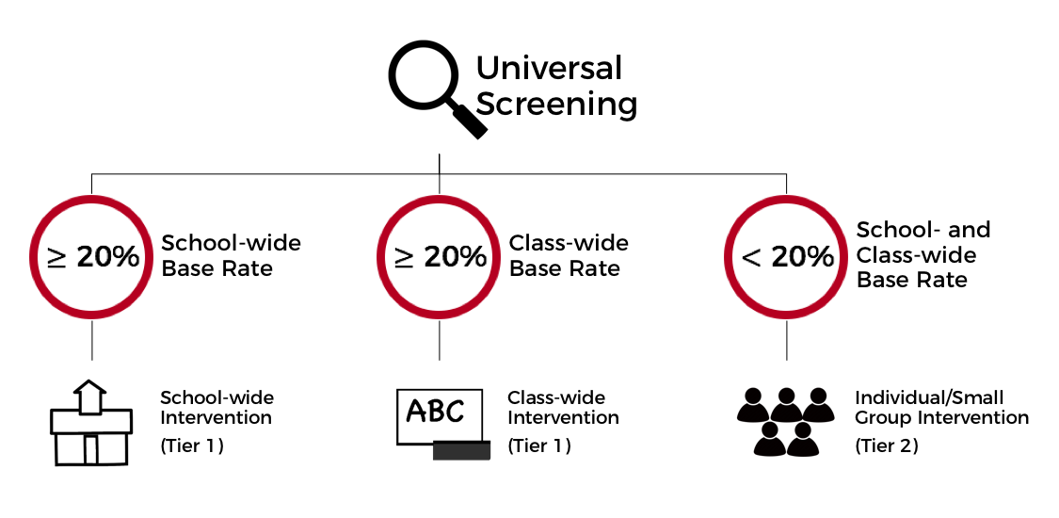
Coaching Focus: SEBA Model
See: Kilgus & Eklund, 2015

Slide 55
Coaching Focus: Tier 1
District SEL Coaches shared guidance documents on effective Tier 1 practices
When 20% or more of the students in a class demonstrate some or high-risk, consider the following whole-class interventions:
Focus on social-emotional skill building in Morning Meeting.
Reflect on social-emotional competencies during Closing Circle.
Revisit routines and procedures with Interactive Modeling lessons.
Connect frequently to class rules or norms through reinforcing and reminding language.
Use reminding language to prepare students for the social and emotional aspects of lessons.
Lead students in academic goal setting; revisit goals that were set earlier in the year to check on progress and provide support.
Role play situations that have proven tricky for students to navigate in the classroom.

Slide 56
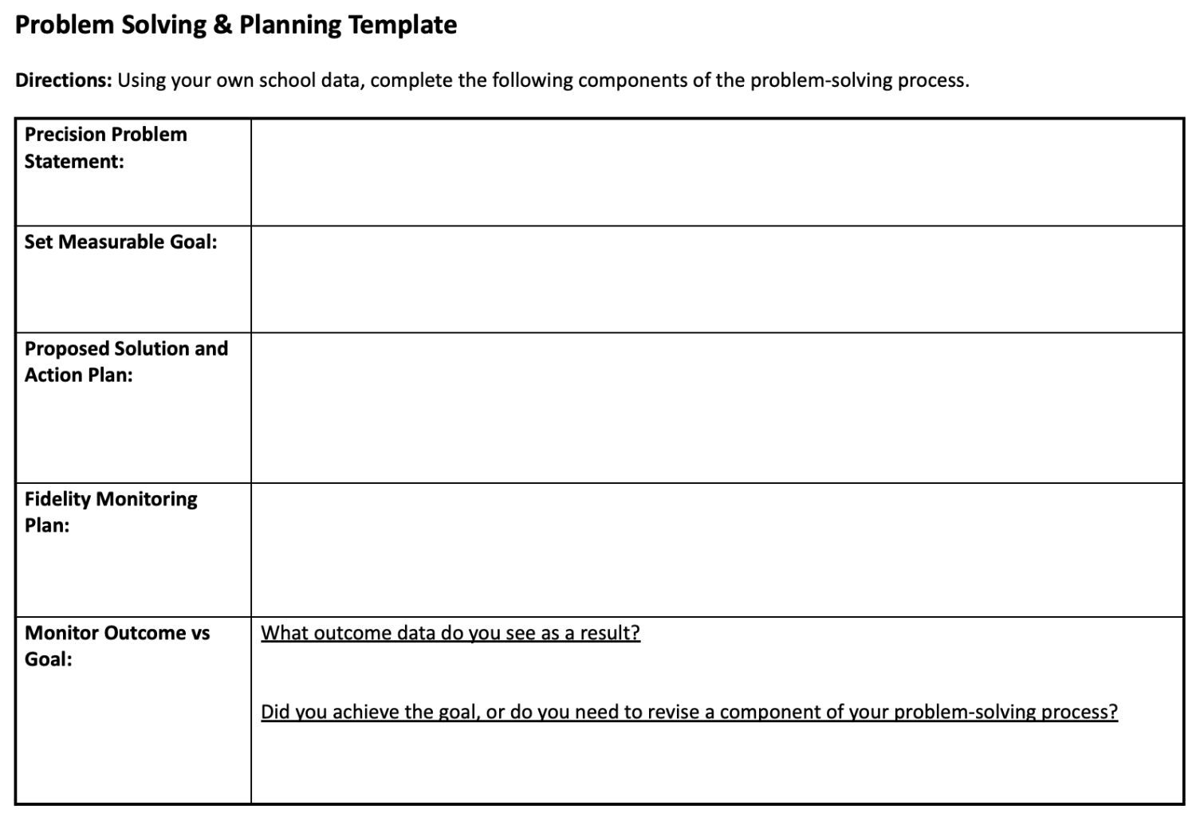
Coaching Focus: Tier 1
Analyze data: class/grade level trends
Utilize problem solving guide to identify areas of need, develop action plan, set measurable goals
Available on the DE-PBS Website

Slide 57
Coaching Focus: Tier 2
Intervention categories: skill building and relationship building
Intervention mapping
Take inventory of currently existing interventions
Develop/refine “in-on-out” rules to enhance data-based decision making
Continue this work with school-based teams

Slide 58
Tips for Success
Monthly PLCs
Develop a flexible scope and sequence for the year
Templates/spreadsheets
Screening windows added to assessment calendar
Community involvement: presented to school board
District-level coaching support

Slide 59
Q/A
Review any questions that were added to the padlet

Slide 60
Contact Us!
Capital School District Dr. Jocelyn Brown: jocelyn.brown@capital.k12.de.us
Sonia Songui, LPCMH: sonia.songui@capital.k12.de.us
Colonial School District
Christina MacKerchar, Ed.S., NCSP: christina.mackerchar@colonial.k12.de.us
DE-PBS Project
Niki Kendall: robertsn@udel.edu

Slide 61
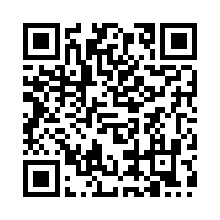
Session Evaluation
Your feedback is critical to future planning of this event. PLEASE take a moment to share your valuable insight!
THANK YOU!
https://bit.ly/NEPBISForum2023

