Slide 1
Tier 2 Disaggregated Data Workbook Tutorial
DE-PBS Project
Center for Disabilities Studies
Updated 7/20/2023
Notes:
Thank you for your interest in using the DE-PBS Tier 2 Intervention Tracking Workbook for Disaggregated Data. The following is a tutorial regarding how to use the Excel Workbook. Please send your questions, comments, and/or recommendations regarding this workbook to Megan Pell at mpell@udel.edu.

Slide 2
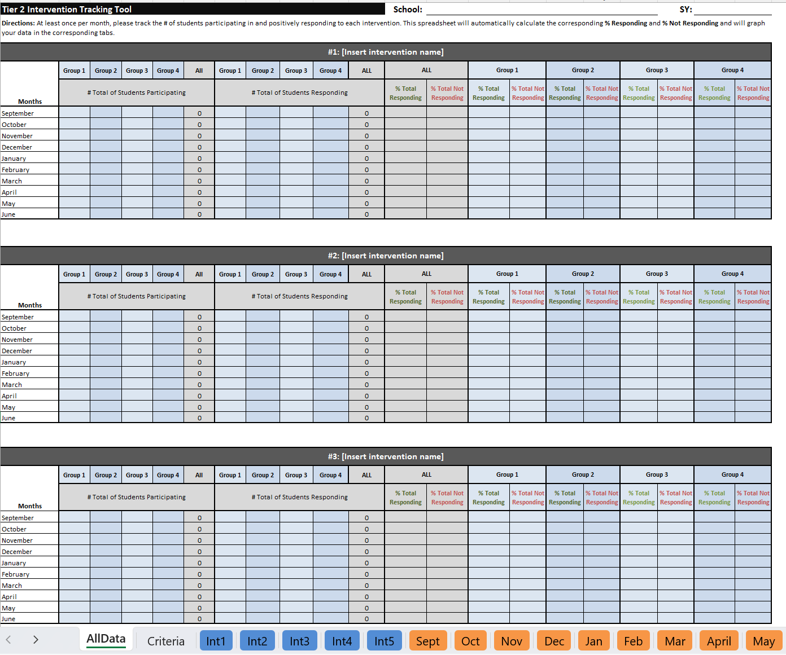
Why and How to Use This Workbook
Why use this workbook:
To help make important decision about your Tier 2 programming.
To help others understand the important and extent of your Tier 2 programming.
How to use this tool:
Please review this PowerPoint and update your data monthly in this Excel workbook!
Notes:
This workbook is based on the original DE-PBS Tier Intervention Tracking Workbook, which can also be found on our website.
The original workbook is intended to help schools do the following:
More regularly discuss SYSTEMS-related trends across their Tier 2 interventions (at least monthly is recommended).
More readily share information regarding the important and often extensive Tier 2 intervention efforts happening in the school (with staff, parents, school boards, and community)
This new workbook allows schools to examine intervention data per different subgroups of students (e.g., race/ethnicity, grade level, disability status, etc.) in order to identify discrepancies and trends/patterns.

Slide 3
A quick orientation to this tool… This is an Excel workbook, but you don’t need to be an Excel expert to use it!
You will just need to enter some numbers and text from your existing (and any new) Tier 2 intervention-related school activities into this workbook, and we’ll show you how and where!
Tip: You can copy and paste any tables and/or graphs from this workbook into other documents (like Word or PowerPoint).

Slide 4
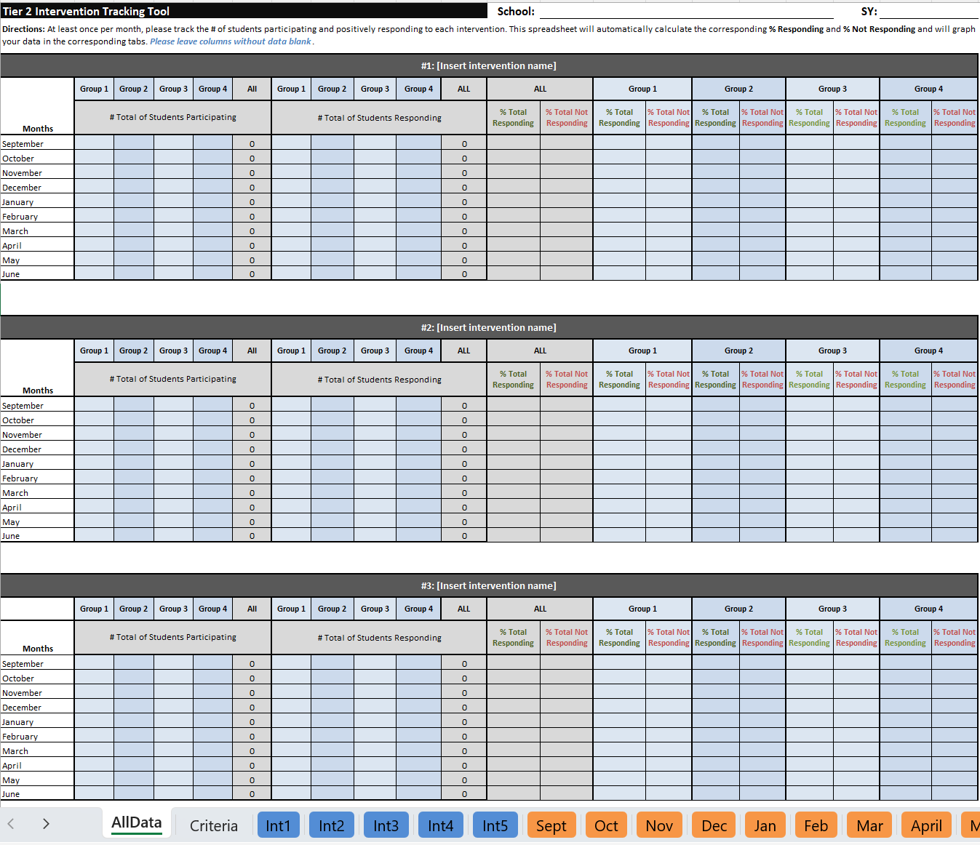
17 Tabs to Help Outline
Your Important Tier 2 Programming
Notes:
Please note:
There are 17 tabs included in this workbook. This may seem like a lot, but teams may not use all of them in a given month or year.

Slide 5
Certain cells within these 2 tabs will require you to manually enter data/info (but some cells are locked)
Notes:
Please note:
The first 2 tabs included in this workbook are the most important and will be discussed in detail later in this tutorial. These tabs require teams to manually enter intervention names, data, and/or criteria information. The data/information in these two tabs is linked to the other tabs in this Excel workbook, so some cells are locked to prevent changes that would interfere with proper functioning of the workbook.

Slide 6
The other 15 tabs are linked to the data/info you enter
(they will automatically generate graphs based on your data)
Notes:
Please note:
The other 15 tabs included in this workbook provide teams with professional-looking graphs and tables that are based on the data entered under the “AllData” tab. These tabs will be discussed in detail later in this tutorial.

Slide 7
Before using this workbook, you’ll need…
A list of your current Tier 2 interventions.
This workbook allows you to track 5 interventions simultaneously. If you have more than 5, consider using one workbook to track behavioral interventions and another to track academic interventions.
A monthly data collection method
This workbook allows your Tier 2 team to track the percentages of students per subgroup responding to those 5 interventions across each month of the SY (September-June). There can be up to 4 subgroups per intervention. We recommend that schools designate a facilitator for each intervention who can collect and report this data monthly to the team leader(s), who would then enter it into this workbook.
And (at least) the Responding criteria for each intervention
As soon as possible, it is recommended that your team determine the other decision rules (i.e., entrance [in] and exit [out] criteria) for each intervention. Interventions should be fluid and dynamic (and not holding pens for students).
Notes:
Please gather the information listed above in order to follow along with the steps in this tutorial.

Slide 8
Okay, now to start…
Please open the Excel file named:
“Tier 2 Intervention Tracking with Graphs - Disaggregated - ADD SCHOOL NAME”
and save the file on your computer by renaming it with your school name.
Notes:
To begin, download and open the Excel workbook by clicking on the link labeled “Tier 2 Intervention Tracking Tool – Disaggregated – BLANK” on the DE-PBS Project Tier 2 webpage: https://www.delawarepbs.org/forms-and-tools/tier-2-targeted-tools/
Save the file to your computer with your school name. Currently, this file is called “Tier 2 Intervention Tracking with Graphs - Disaggregated - ADD SCHOOL NAME”

Slide 9
Steps for Using the Workbook
Step 1
ADD school information
Step 2
ADD intervention information
Step 4
DOCUMENT decision criteria
Step 5
ENTER monthly data to automatically generate percentages of students responding and not responding
Step 6
LOOK FOR trends within and across interventions
Step 7
DISCUSS trends of concern
Step 3
ADD grouping information
Notes:
Here is an overview of the steps for using this workbook. Each step will be reviewed in detail in the following slides.

Slide 10
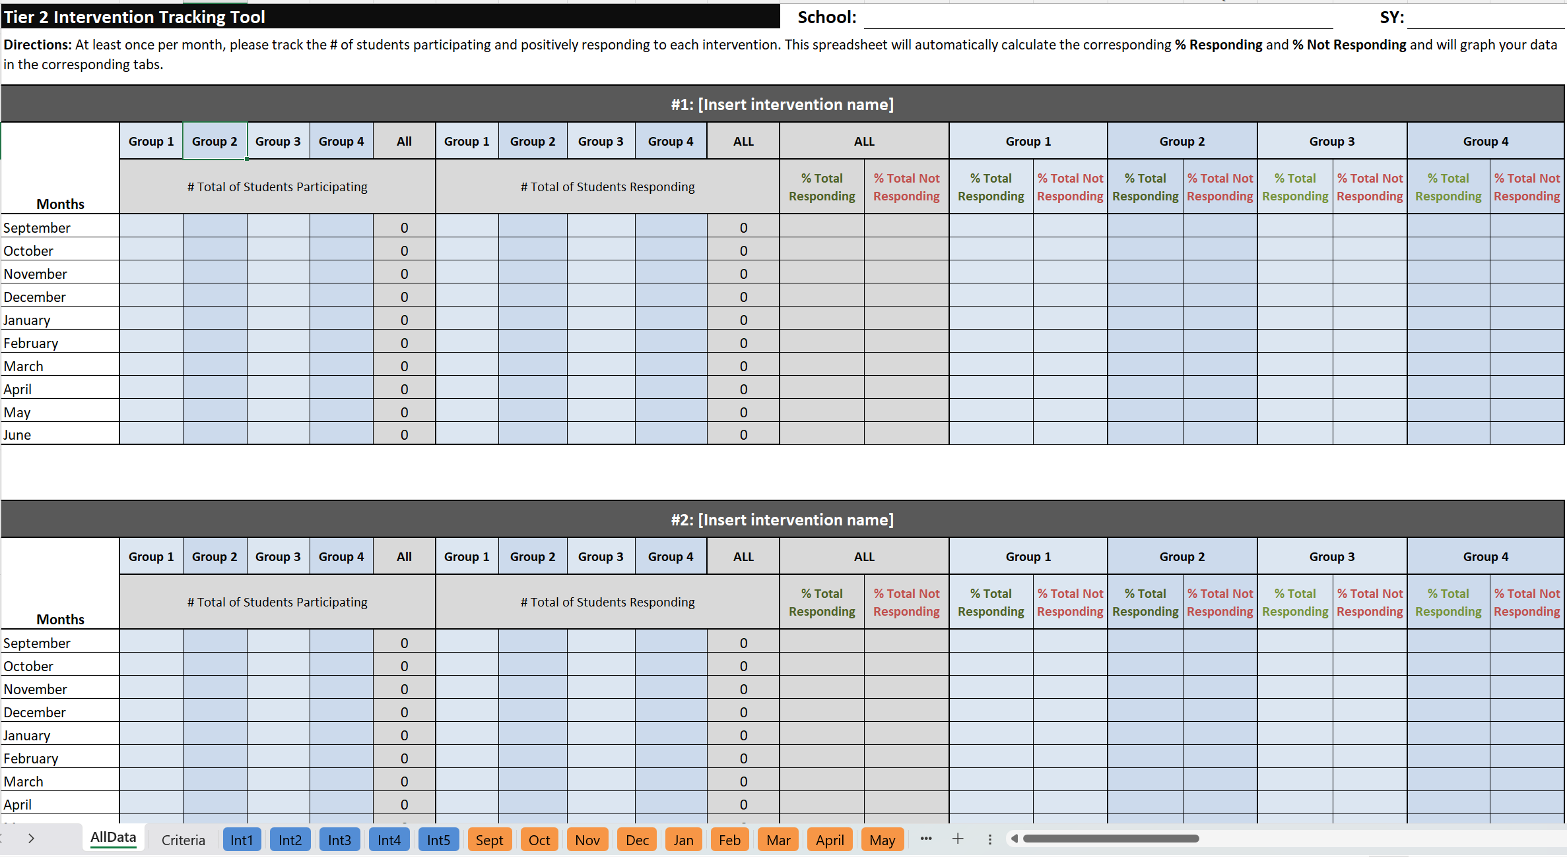
Step 1: Complete school information at the top of the “AllData” tab
Notes:
The first step is to add the school name and school year (SY) in the appropriate cells at the top of the “AllData” tab.

Slide 11
Step 2: Add intervention names to worksheet There is space for up to 5 interventions.
Special note: The intervention names you type in these boxes will automatically show up on all other worksheets that relate to that intervention in this workbook!
Notes:
Next, type in the name of each Tier 2 intervention that you would like to track. These intervention names will automatically populate in the appropriate areas throughout the rest of this workbook.
Tip: In order to reference interventions quickly in your team discussions, it can be helpful to keep the #s in each of these boxes (e.g., #1, #2, etc.)

Slide 12
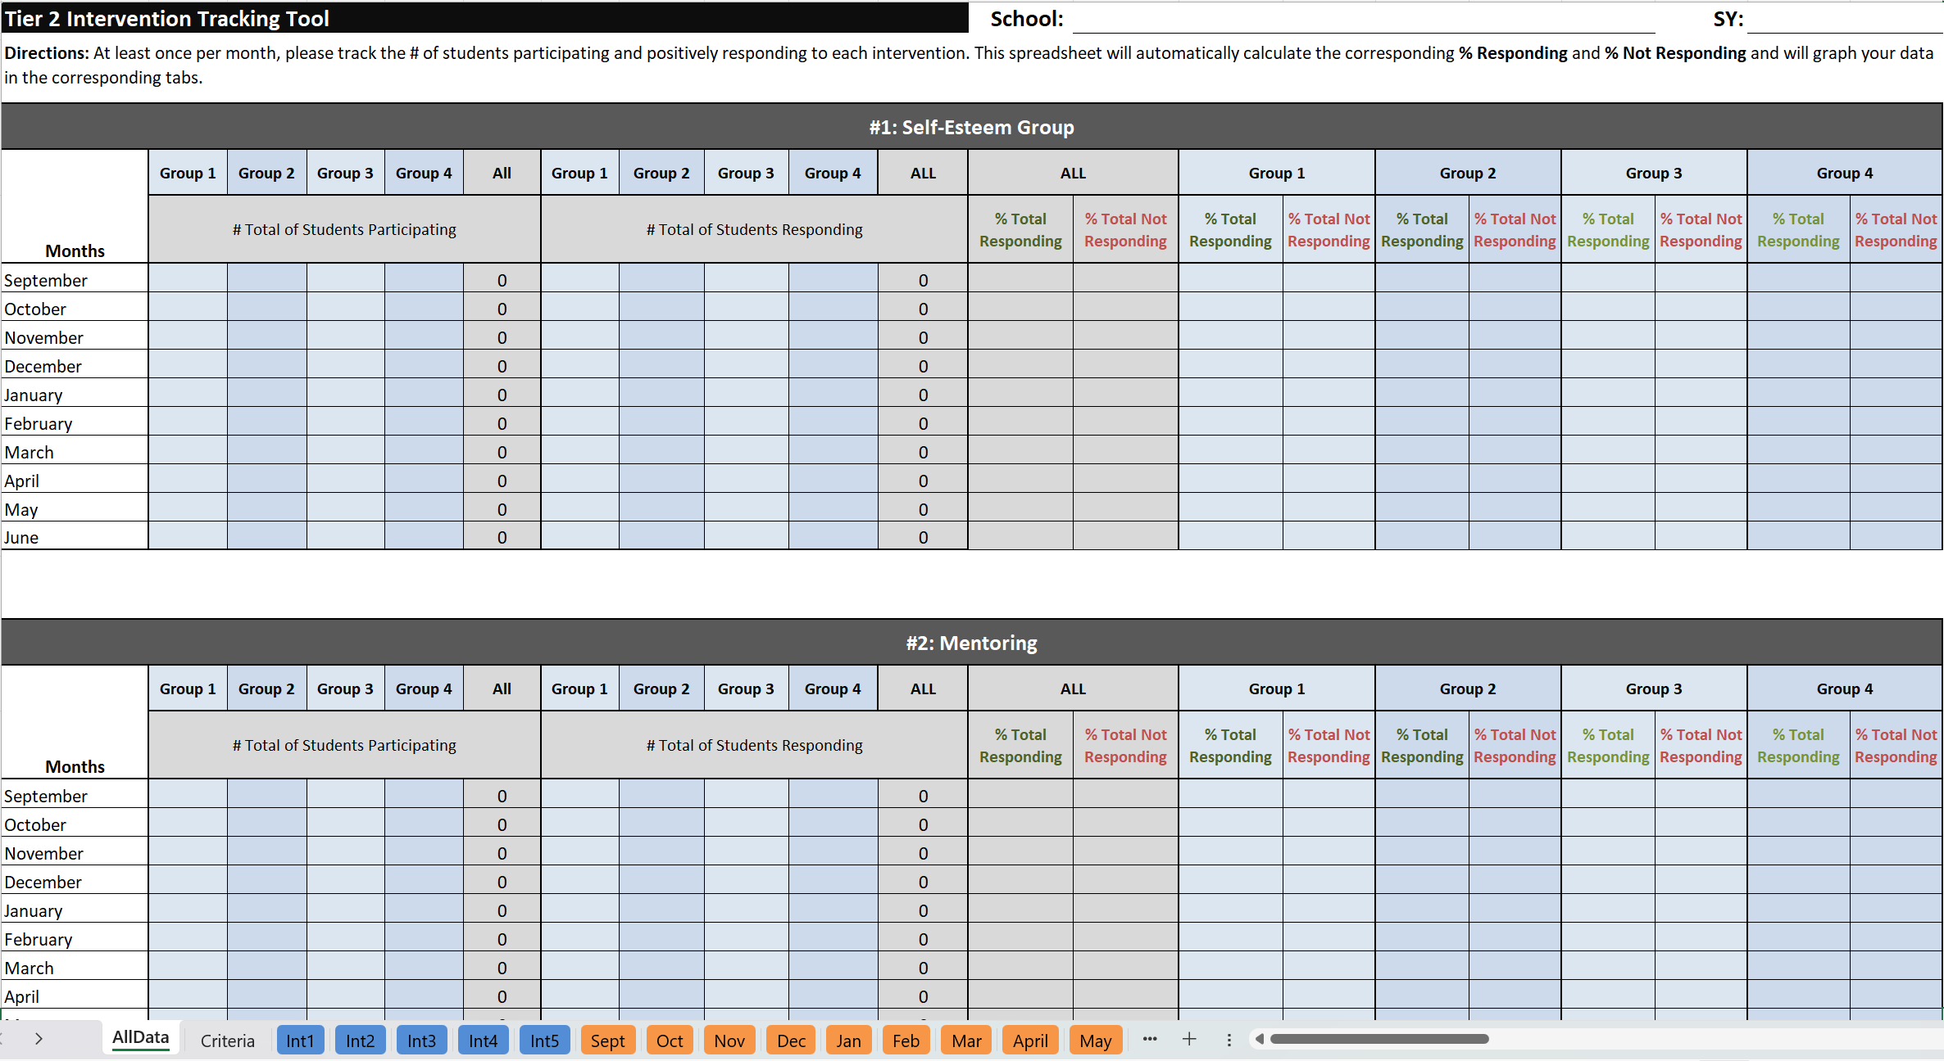
Step 2: EXAMPLE
Notes:
Here is an example of what the worksheet looks like with intervention names added.

Slide 13
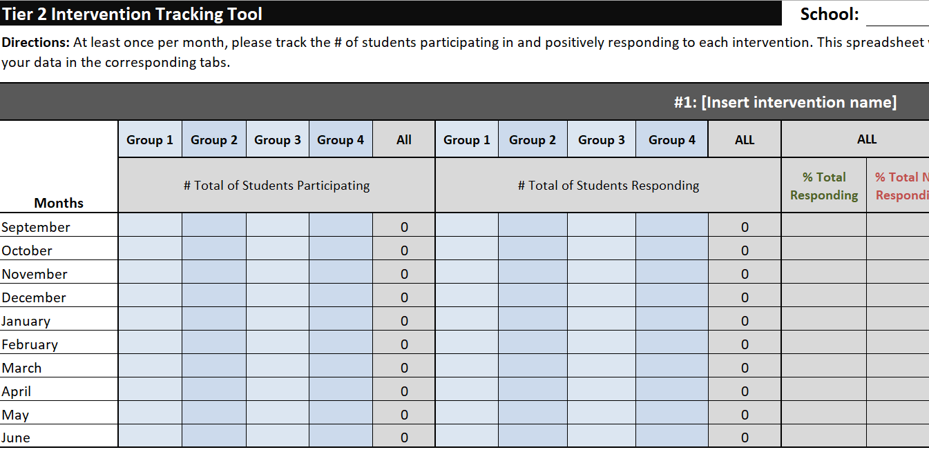
Step 3: Add group names to worksheet There is space for up to 4 student subgroups.
Special note: The group names you enter in these boxes will automatically show up throughout other tabs in this workbook!
Notes:
The third step is to add the names of the subgroups you would like to track. Just like with the intervention names, the group names that you enter will automatically populate in the appropriate locations throughout the rest of the workbook.

Slide 14
Step 3: EXAMPLES
Notes:
Here are some examples of what the worksheet looks like with subgroup names entered.

Slide 15
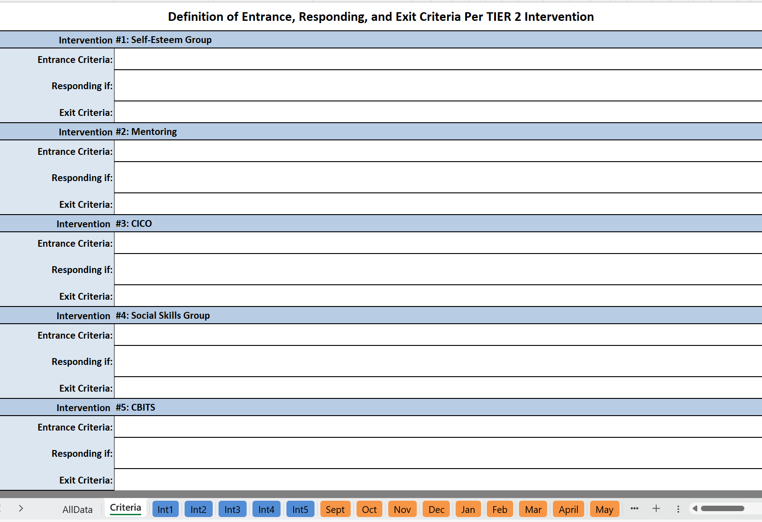
Step 4: Document Decision Criteria A. Select the second tab “Criteria” B. Define the entrance, responding, and exit criteria for each intervention (Interventions will self-populate based on the names entered on the “AllData” tab)
B
A
Notes:
The next step is to enter the decision criteria for each intervention being tracked. There are boxes for entrance criteria, responding criteria, and exit criteria. (See the next few slides for an explanation of what these terms mean and examples.)

Slide 16
What do we mean by decision criteria?
In Entrance Criteria | On Responding Criteria | Out Exit Criteria
Identify related screening data Consider ABC data Consider staff/student/family referral information | Identify what it looks like if the student is “on progress” with the skills being taught and reinforced | Identify when a student graduates from the intervention Identify when the student should be referred for review for a different intervention
Notes:
Decision criteria can be categorized into three areas: In (or Entrance Criteria), On (or Responding Criteria), and Out (or Exit Criteria).
In: To determine whether a student should receive an intervention, we can use information such as relevant screening data, ABC (antecedent-behavior-consequence) data, and information from the referral.
On: Responding Criteria represents what progress looks like. This helps us determine if the student is experiencing adequate growth in the intervention.
Out: Exit Criteria allow us to determine when a student is ready to exit the intervention, either due to successful goal completion or the need for a different intervention approach.

Slide 17
Decision Criteria Example 1: Self-Esteem Group
In Entrance Criteria | On Responding Criteria | Out Exit Criteria
Teacher recommendation Score of 15 or less on the Rosenberg Self- Esteem Scale | Teacher reporting more participation in class/their abilities Student creating secure relationships, accepting praise, more self praise/less self deprecation | Score of 18 or higher on the Rosenberg Self-Esteem Scale
Notes:
This table contains examples of decision criteria that could be used for a Self-Esteem Group intervention.

Slide 18
Decision Criteria Example 2: Mentoring
In Entrance Criteria | On Responding Criteria | Out Exit Criteria
Referred by staff as needing support with managing behavior and relationship building | Demonstrating positive behaviors as noted in classroom/teacher observations, point card, daily progress, etc. | Decreased behavior referrals Adequate progress as determined by staff
Notes:
This table contains examples of decision criteria that could be used for a Mentoring intervention.

Slide 19
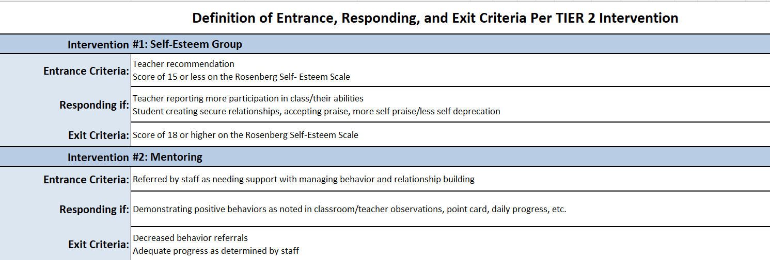
Step 4: EXAMPLE
TIP: To start a new line of text within the same cell,
press ALT + ENTER (Windows) or OPTION + RETURN (Mac)
Notes:
Here is what the worksheet looks like with these decision criteria entered in the “Criteria” tab.
Tip: Although Excel does not allow for bulleted/numbered lists, you can add additional lines of text within a single cell by placing your cursor at the end of the first line of text and then simultaneously pressing ALT and ENTER (on Windows) or OPTION and RETURN (on Mac).

Slide 20
Now that you have your basic intervention information saved…
…you can start adding your monthly data!

Slide 21
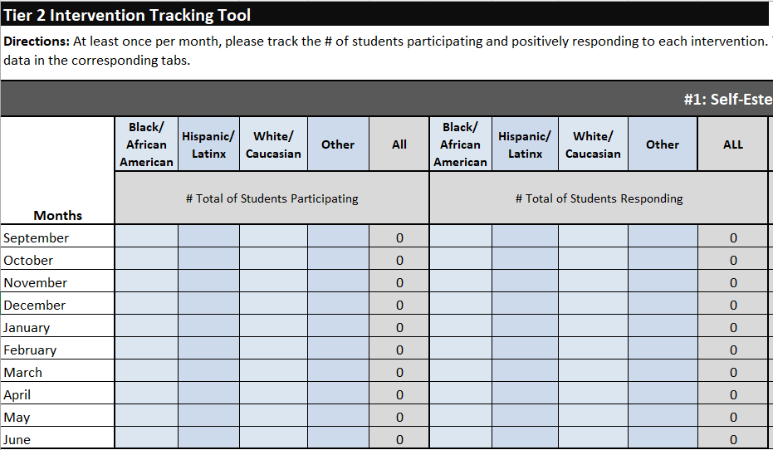
Step 5: Enter Monthly Data 1. the # of students per subgroup participating in each intervention 2. the # of students per subgroup responding to each intervention
1
2
Hint: Use the responding criteria identified in Step 4 to determine how many students are responding to the intervention.
Notes:
There are two types of monthly intervention data for you to enter for each intervention: (1) the total number of students per subgroup that are participating in the intervention and (2) the total number of students per subgroup that are responding to the intervention. You will use your responding criteria from Step 4 to determine if students are making progress in the intervention.

Slide 22
Step 5 (continued): The spreadsheet will automatically calculate: 3. the total # of students participating in each intervention 4. the total # of students responding to each intervention
3
4
Notes:
Once you have entered the monthly intervention data, the worksheet will automatically sum up the total number of students participating in and responding to the intervention each month.

Slide 23
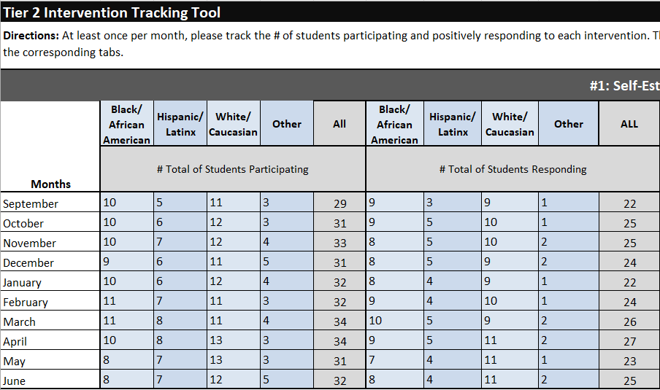
Step 5: EXAMPLE
Notes:
Here is an example of what the worksheet looks like with monthly intervention data entered.

Slide 24
Step 5 (cont.): The percentages of students (total and per subgroup) responding and not responding will automatically populate once the numbers are entered for each month.
Notes:
After you have entered in your monthly data, the worksheet will automatically calculate the percentages of students per subgroup who are responding vs. not responding to the intervention each month.

Slide 25
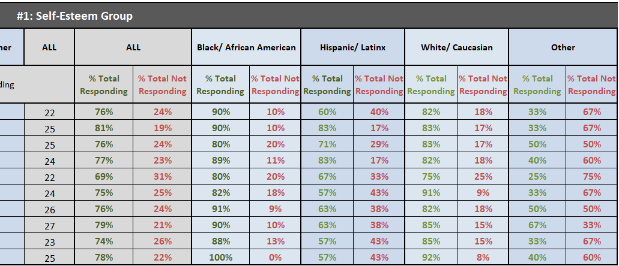
Step 5: EXAMPLE of generated data
Notes:
Here is an example of what the automatically-generated data looks like in the worksheet.

Slide 26
Step 6: Examine your percentages to determine how interventions are working for students:
Which interventions seem to be working (overall or for specific subgroups)?
(i.e., at least 70% of students are responding)
Which interventions don’t seem to be working (overall or for specific subgroups)?
(i.e., less than 70% of students are responding)
There are three methods for examining your data: Method 1 - Look at Tab 1 (to see all trends for all interventions) Method 2 - Look at tabs for each intervention (disaggregate) Method 3 - Look at tabs for each month (aggregate only)
Notes:
Now that you’ve entered your monthly data, the next step is to look at student response rates (in total and per subgroup) for each intervention to determine how the interventions are working. Generally, an intervention may be considered effective if at least 70% of students are responding positively to it.
There are three methods for analyzing your intervention data, each of which will be detailed in the following slides. The first two methods provide ways to look at both aggregate and disaggregate data. The third method provides aggregate data only.

Slide 27
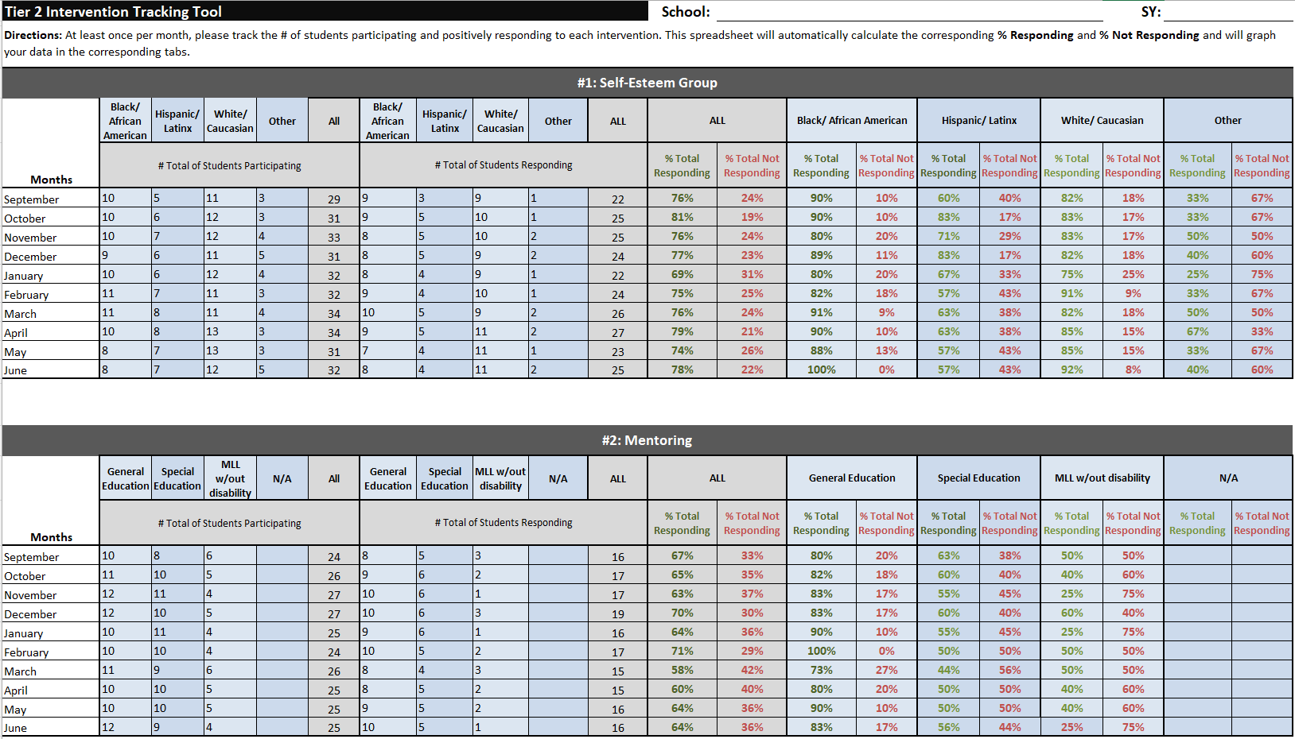
Method 1: Look at Tab 1 to see all trends for all interventions
Notes:
The first method of analyzing your data is to use Tab 1 to look for trends within and across interventions by examining the percentages of students (in total and per subgroup) who are responding and not responding to each intervention throughout each month of the school year.

Slide 28
Method 1: EXAMPLE #1
Intervention #1 appears to have worked OVERALL…
…but Intervention #2 does not appear to have worked as well OVERALL
Notes:
Looking at the data in Tab 1, we can easily compare rates of responding within and across interventions. This allows us to see that our Self-Esteem Group was successful overall (>70% of students responding); however, our Mentoring intervention was not as successful overall (<70% responding).

Slide 29
Method 1: EXAMPLE #2
Intervention #1 appears to have worked for Black/African American students…
…but not as well for Hispanic/Latinx and Other students
Notes:
We can also use Tab 1 to compare rates of responding across multiple student groups within the same intervention. Here we can see that the Self-Esteem Group was effective for Black/African American students, but it was not as effective for Hispanic/Latinx and Other students.

Slide 30
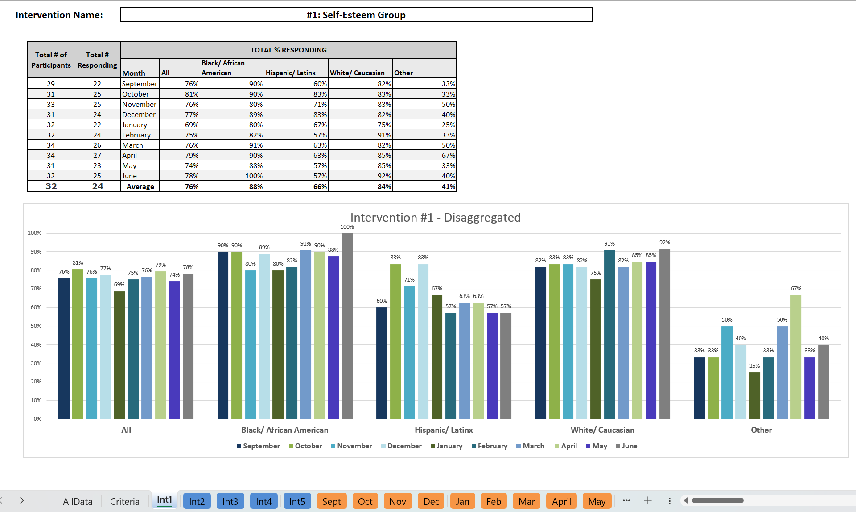
Method 2: Look at tabs for each intervention
Special Note: You cannot change the data within the graph worksheets (they are imported directly from the AllData worksheet).
The blue tabs in this workbook provide you with tables and graphs for each intervention across the SY.
They show the percentages of students responding to the intervention per month, both in total and broken down by subgroup.
Notes:
The next method for analyzing your data is to look at how students are responding to each intervention (per month and on average) using the blue (intervention) tabs. The tables and graphs on these tabs allow you to easily examine the percentages of students (in total and per subgroup) who are responding to the intervention throughout the school year.
Special Note: You cannot change the data in the graph worksheets (they are imported directly from the AllData worksheet), but you can format the look and size of the text in the accompanying table.

Slide 31
Method 2: EXAMPLE
OVERALL, the intervention appears to have worked…
…but not as well for Hispanic/Latinx and Other students
Notes:
When looking at the aggregate data only, it appears that our Self-Esteem Group was a success! However, a closer look at the disaggregated data reveals that the intervention was not working as well for Hispanic/Latinx and Other students.

Slide 32
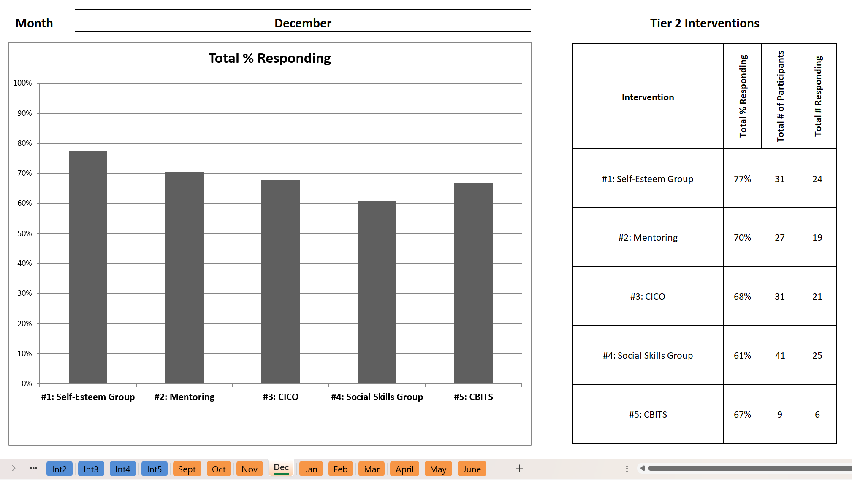
Method 3: Look at tabs for each month
Special Note: You cannot change the data within the graph worksheets (they are imported directly from the AllData worksheet).
The orange tabs in this workbook provide you with graphs of intervention data per month.
They show the percentages of ALL students responding to each intervention during that month.
Notes:
The third method for analyzing your data is to look at how students are responding to the interventions using the orange (monthly) tabs. The tables and graphs on these tabs allow you to easily examine the percentages of students (in total) who are responding to the intervention each month.
Special Note:
You cannot change the data in the graph worksheets (they are imported directly from the AllData worksheet) but you can format the look and size of the text in the accompanying table.

Slide 33
Method 3: EXAMPLE
In December, intervention #1 appears to have worked OVERALL…
…but Intervention #4 does not appear to have worked as well OVERALL in December
Notes:
Looking at the data for December, we can see that the Self-Esteem Group was successful overall, but our Social Skills Group was not as successful overall.

Slide 34
Step 7: For any interventions with low student response rates (less than 70%), ask WHY.
If an intervention is working for less than 70%
of ALL of your enrolled students:
You need to talk about the intervention system. Your discussion may include questions about intervention fidelity and/or retraining in the intervention.
Conversations about individual students’ lack of response should be addressed in a separate, problem-solving conversation.
Notes:
The final step is to reflect on any interventions that had less than 70% of students responding. It is critical to discuss and address reasons for a low response rate. The considerations above apply to interventions in which less than 70% of ALL students responded positively to the intervention.

Slide 35
Step 7: For any interventions with low student response rates (less than 70%), ask WHY.
If an intervention is working for less than 70%
of particular student groups:
You need to talk about the intervention itself. What is the fidelity of implementation across student groups? Which aspects may be contributing to the discrepancy in response rates?
You should also discuss the impact of possible implicit biases among staff delivering the intervention. It may be helpful to observe how staff is implementing the intervention with students from each of the subgroups.
You should review the research on the intervention. Was it shown to be effective for the same populations of students you are serving?
Notes:
The final step is to reflect on any interventions that had less than 70% of students responding. It is critical to discuss and address reasons for a low response rate. The considerations above apply to interventions in which less than 70% of PARTICULAR student groups responded positively to the intervention.

Slide 36
Tips for Printing Your Data
Printing is by the worksheet (e.g., AllData, Criteria, Int1, Int2, etc.)
You can adjust your print settings to print each page the way that best fits your discussions and/or sharing

Slide 37
Thank you for reviewing this tutorial! For more information about Targeted (Tier 2) programming and tools, please visit our website at delawarepbs.org
DE-PBS Project
Center for Disabilities Studies
Updated 7/20/23
Notes:
Thank you so much for checking out our tutorial for the Tier 2 Intervention Tracking Workbook for Disaggregated Data! If you have any questions, comments, and/or recommendations regarding this workbook, please send them to Megan Pell at mpell@udel.edu.

