Slide 1
Tier 2 Data Workbook Tutorial
DE-PBS Project
Center for Disabilities Studies
Updated 7/20/2023
Notes:
Thank you for your interest in using the DE-PBS Tier 2 Intervention Tracking Workbook. The following is a tutorial regarding how to use the Excel Workbook. Please send your questions, comments, and/or recommendations regarding this workbook to Megan Pell at mpell@udel.edu.
This workbook is intended to help schools do the following:
More regularly discuss SYSTEMS-related trends across their Tier 2 interventions (at least monthly is recommended).
More readily share information regarding the important and often extensive Tier 2 intervention efforts happening in the school (with staff, parents, school boards, and community)

Slide 2
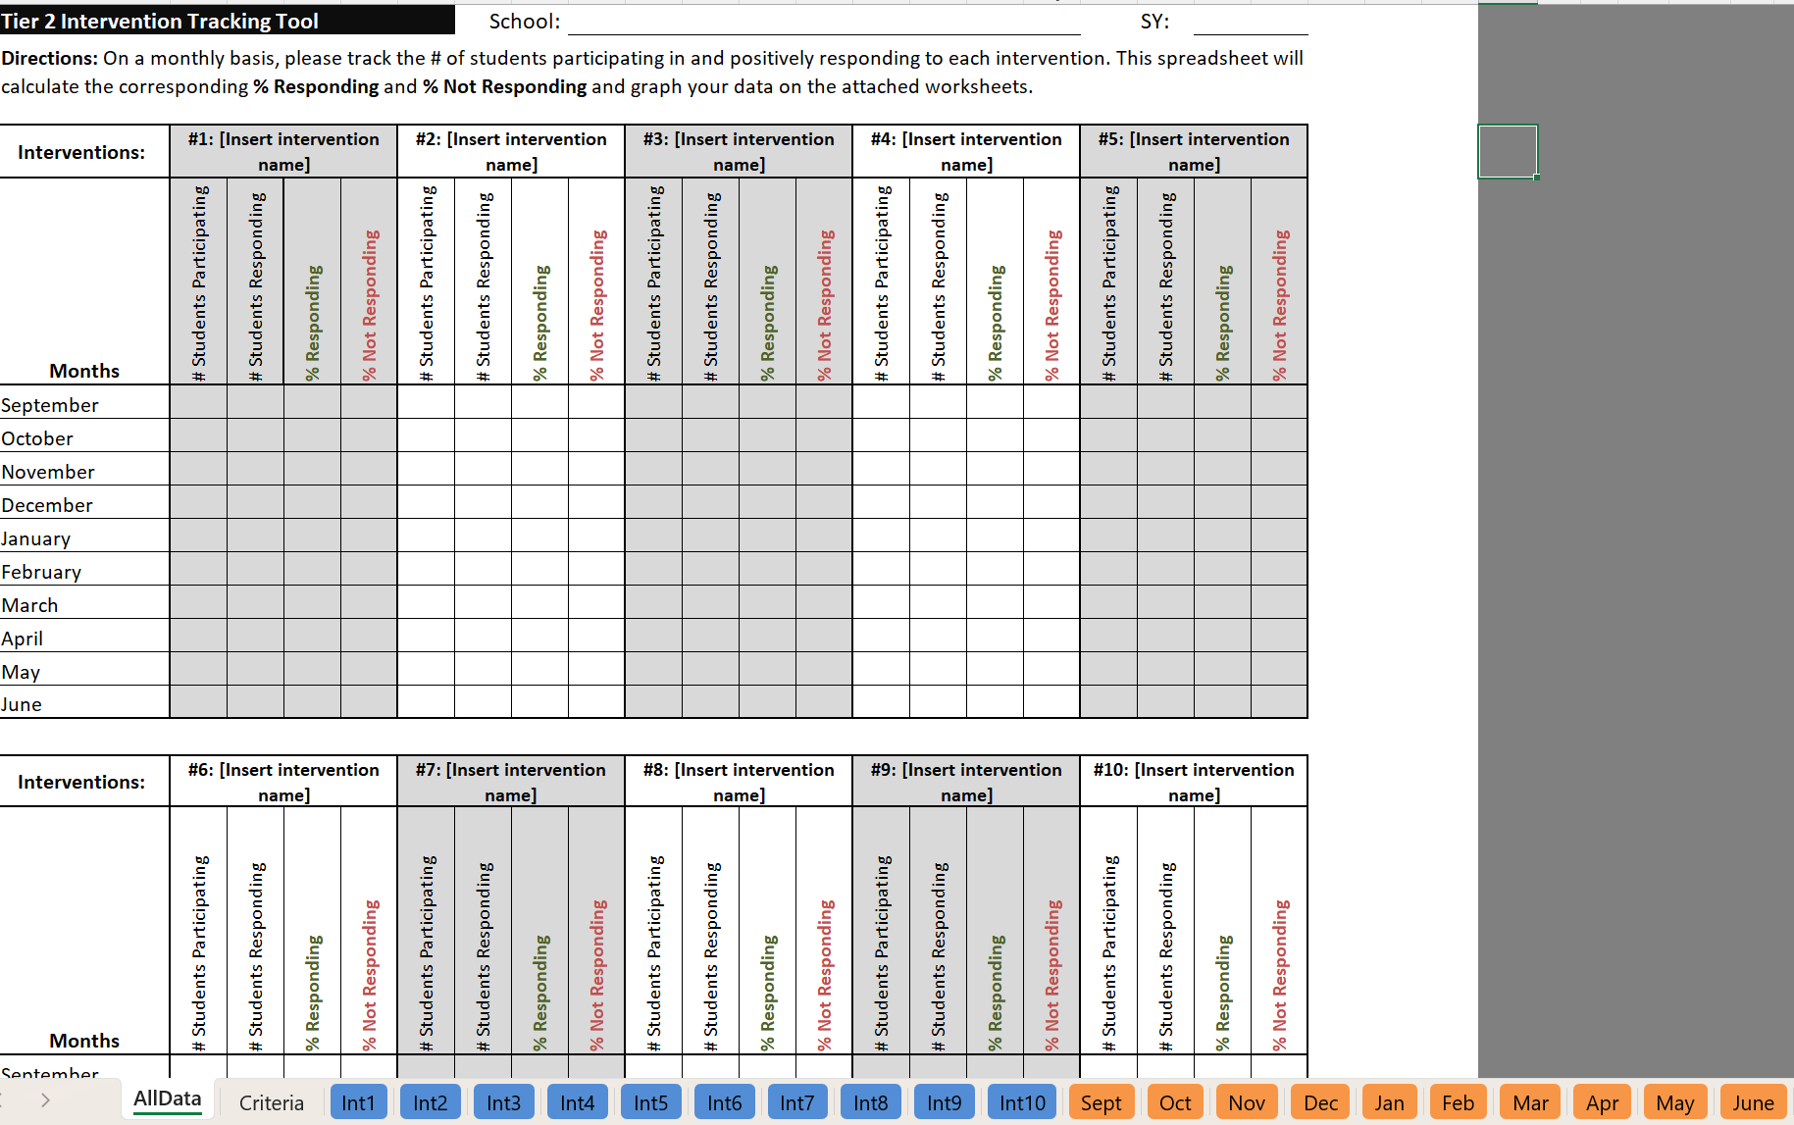
Why and how to use this workbook
Why use this workbook:
To help make important decision about your Tier 2 programming.
To help others understand the important and extent of your Tier 2 programming.
How to use this tool:
Please review this PowerPoint and update your data monthly in this Excel workbook!
Notes:
Thank you for your interest in using the DE-PBS Tier 2 Intervention Tracking Workbook. The following is a tutorial regarding how to use the Excel Workbook. Please send your questions, comments, and/or recommendations regarding this workbook to Megan Pell at mpell@udel.edu.
This workbook is intended to help schools do the following:
More regularly discuss SYSTEMS-related trends across their Tier 2 interventions (at least monthly is recommended).
More readily share information regarding the important and often extensive Tier 2 intervention efforts happening in the school (with staff, parents, school boards, and community)

Slide 3
A quick orientation to this tool… This is an Excel workbook, but you don’t need to be an Excel expert to use it!
You will just need to enter some numbers and some text from your existing (and any new) Tier 2 intervention-related school activities into this workbook, and we’ll show you how and where!
Tip: You can copy and paste any tables and/or graphs from this workbook into other documents (like Word or PowerPoint).

Slide 4
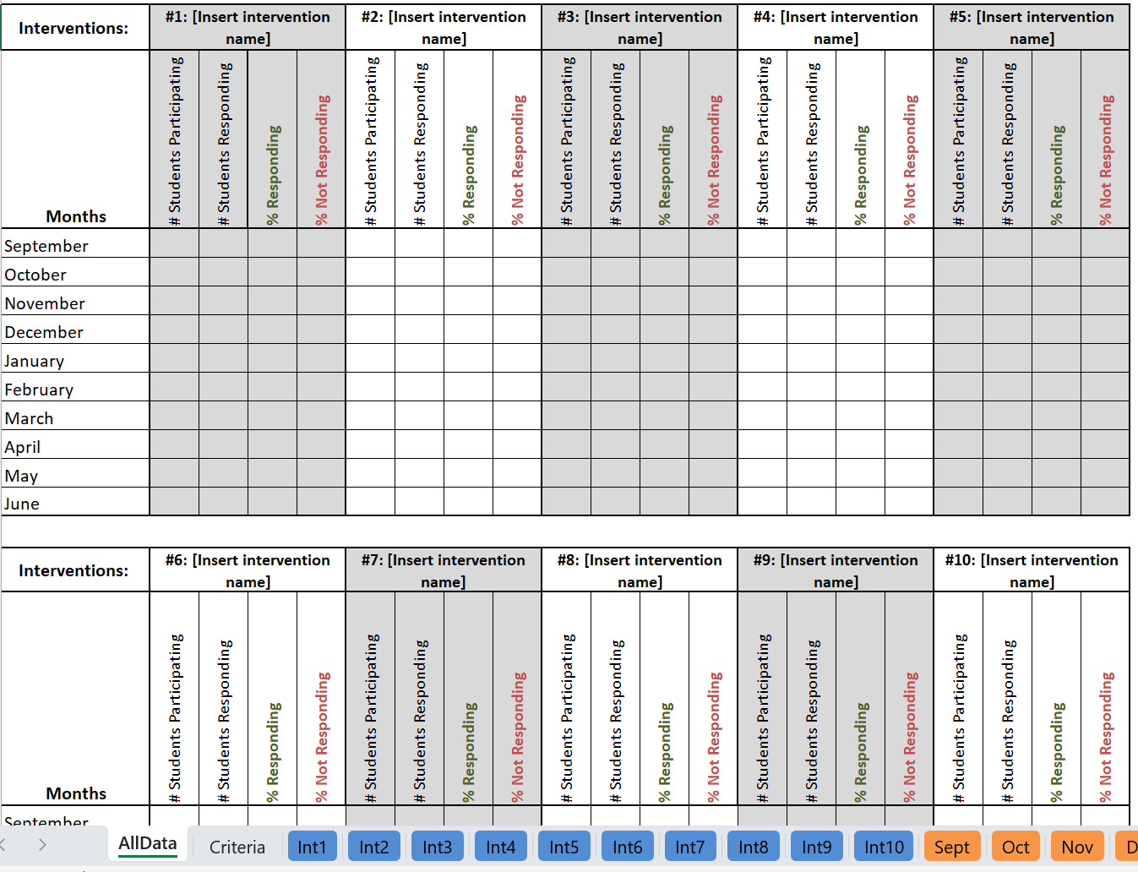
22 Tabs to Help Outline
Your Important Tier 2 Programming
Notes:
Please note:
There are 22 tabs included in this workbook. This may seem like a lot, but teams may not use all of them in a given month or year.

Slide 5
Certain cells within these 2 tabs will require you to manually enter data/info (but some cells are locked)
Notes:
Please note:
The first 2 tabs included in this workbook are the most important and will be discussed in detail later in this tutorial. These tabs require teams to manually enter intervention names, data, and/or criteria information. The data/information in these two tabs is linked to the other tabs in this Excel workbook, so some cells are locked to prevent changes that would interfere with proper functioning of the workbook.

Slide 6
The other 20 tabs are linked to the data/info you enter
(they will automatically generate graphs based on your data)
Notes:
Please note:
The other 20 tabs included in this workbook link to worksheets that provide teams with professional-looking graphs and tables that are based on the data entered under the “AllData” tab. These worksheets will be discussed in detail later in this tutorial.

Slide 7
Before using this workbook, you’ll need…
A list of your current Tier 2 interventions.
This workbook allows you to track 10 interventions simultaneously. If you have more than 10, consider using one workbook to track behavioral interventions and another to track academic interventions.
A monthly data collection method
This workbook allows your Tier 2 team to track the percentages of students responding to those 10 interventions across each month of the SY (September-June). We recommend that schools designate a facilitator for each intervention who can collect and report this data monthly to the team leader(s), who would then enter it into this workbook.
And (at least) the Responding criteria for each intervention
As soon as possible, it is recommended that your team determine the other decision rules (i.e., entrance [in] and exit [out] criteria) for each intervention, too. Interventions should be fluid and dynamic (and not holding pens for students).
Notes:
Please gather the information listed above in order to follow along with the steps in this tutorial.

Slide 8
Okay, now to start…
Please open the Excel file named:
“Tier 2 Intervention Tracking with Graphs ADD SCHOOL NAME”
and save the file on your computer by renaming it with your school name.
Notes:
To begin, download and open the Excel workbook by clicking on the link labeled “Tier 2 Intervention Tracking Tool – BLANK” on the DE-PBS Project Tier 2 webpage: https://www.delawarepbs.org/forms-and-tools/tier-2-targeted-tools/
Save the file to your computer with your school name. Currently, this file is called “Tier 2 Intervention Tracking with Graphs - ADD SCHOOL NAME”

Slide 9
Steps for Using the Workbook
Step 1
ADD school information
Step 2
ADD intervention information
Step 3
DOCUMENT decision criteria
Step 4
ENTER monthly data to automatically generate percentages of students responding and not responding
Step 5
LOOK FOR trends within and across interventions
Step 6
DISCUSS trends of concern
Notes:
Here is an overview of the steps for using this workbook. Each step will be reviewed in detail in the following slides.

Slide 10
Step 1: Complete school information at the top of the “AllData” tab
Notes:
The first step is to add the school name and school year (SY) in the appropriate cells at the top of the “AllData” tab.

Slide 11
Step 2: Add intervention names to worksheet There is space for up to 10 interventions.
Special note: The intervention name you type in these boxes will automatically show up on all other worksheets that relate to that intervention in this workbook!
Notes:
Next, type in the name of each Tier 2 intervention that you would like to track. These intervention names will automatically populate in the appropriate areas throughout the rest of this workbook.
Tip: In order to reference interventions quickly in your team discussions, it can be helpful to keep the #s in each of these boxes (e.g., #1, #2, etc.)

Slide 12
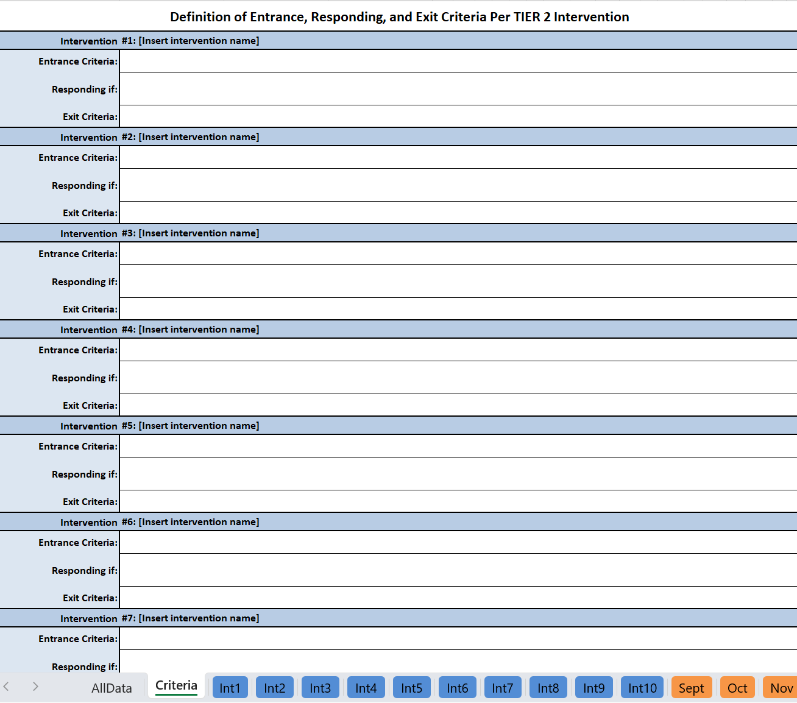
Step 3: Document Decision Criteria A. Select the second tab “Criteria” B. Define the entrance, responding, and exit criteria for each intervention (Interventions will self-populate based on the names entered on the “AllData” tab)
B
A
Notes:
The next step is to enter the decision criteria for each intervention being tracked. There are boxes for entrance criteria, responding criteria, and exit criteria. (See the next few slides for an explanation of what these terms mean and examples.)

Slide 13
What do we mean by decision criteria?
In Entrance Criteria | On Responding Criteria | Out Exit Criteria
Identify related screening data Consider ABC data Consider staff/student/family referral information | Identify what it looks like if the student is “on progress” with the skills being taught and reinforced | Identify when a student graduates from the intervention Identify when the student should be referred for review for a different intervention
Notes:
Decision criteria can be categorized into three areas: In (or Entrance Criteria), On (or Responding Criteria), and Out (or Exit Criteria).
In: To determine whether a student should receive an intervention, we can use information such as relevant screening data, ABC (antecedent-behavior-consequence) data, and information from the referral.
On: Responding Criteria represents what progress looks like. This helps us determine if the student is experiencing adequate growth in the intervention.
Out: Exit Criteria allow us to determine when a student is ready to exit the intervention, either due to successful goal completion or the need for a different intervention approach.

Slide 14
Decision Criteria Example 1: Self-Esteem Group
In Entrance Criteria | On Responding Criteria | Out Exit Criteria
Teacher recommendation Score of 15 or less on the Rosenberg Self- Esteem Scale | Teacher reporting more participation in class/their abilities Student creating secure relationships, accepting praise, more self praise/less self deprecation | Score of 18 or higher on the Rosenberg Self-Esteem Scale
Notes:
This table contains examples of decision criteria that could be used for a Self-Esteem Group intervention.

Slide 15
Decision Criteria Example 2: Mentoring
In Entrance Criteria | On Responding Criteria | Out Exit Criteria
Referred by staff as needing support with managing behavior and relationship building | Demonstrating positive behaviors as noted in classroom/teacher observations, point card, daily progress, etc. | Decreased behavior referrals Adequate progress as determined by staff
Notes:
This table contains examples of decision criteria that could be used for a Mentoring intervention.

Slide 16
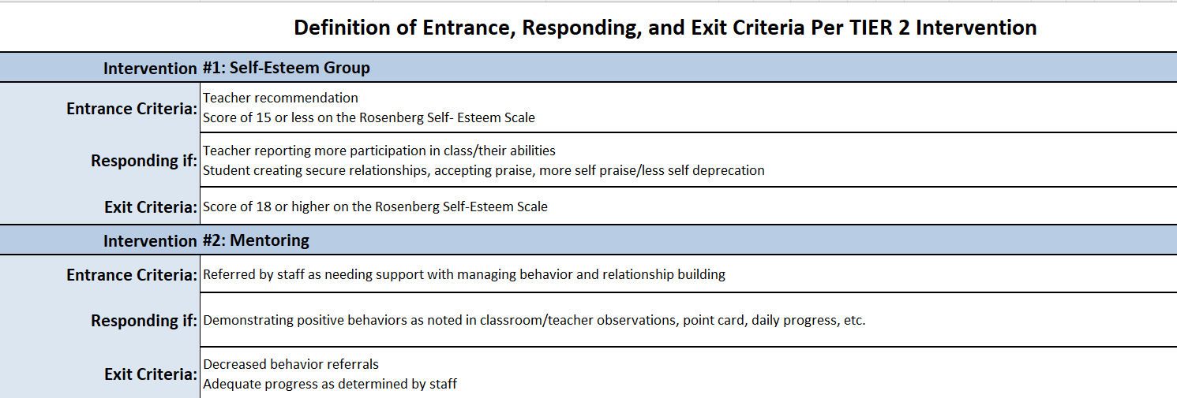
Step 3: EXAMPLE
TIP: To start a new line of text within the same cell,
press ALT + ENTER (Windows) or OPTION + RETURN (Mac)
Notes:
Here is what the worksheet looks like with these decision criteria entered in the “Criteria” tab.
Tip: Although Excel does not allow for bulleted/numbered lists, you can add additional lines of text within a single cell by placing your cursor at the end of the first line of text and then simultaneously pressing ALT and ENTER (on Windows) or OPTION and RETURN (on Mac).

Slide 17
Now that you have your basic intervention information saved…
…you can start adding your monthly data!

Slide 18
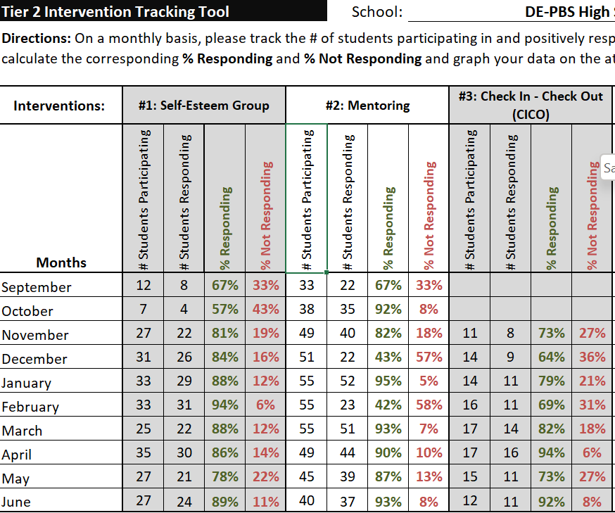
Step 4: Enter Monthly Data 1. the # of students participating in each intervention 2. the # of students responding to each intervention
1
2
Hint: Use the responding criteria identified in Step 4 to determine how many students are responding to the intervention.
Notes:
There are two types of monthly intervention data for you to enter for each intervention: (1) the total number of students participating in the intervention and (2) the total number of students responding to the intervention. You will use your responding criteria from Step 4 to determine if students are making progress in the intervention.

Slide 19
Step 4 (continued): The percentages of students responding and not responding will automatically populate once the numbers are entered for each month.
Notes:
After you have entered in your monthly data, the worksheet will automatically calculate the percentages of students per subgroup who are responding vs. not responding to the intervention each month.

Slide 20
Step 5: Examine your percentages to determine how interventions are working for students:
Which interventions seem to be working?
(i.e., at least 70% of students are responding)
Which interventions don’t seem to be working?
(i.e., less than 70% of students are responding)
There are three methods for examining your data: Method 1 - Look at percentages in Tab 1 Method 2 - Look at tabs for each intervention Method 3 - Look at tabs for each month
Notes:
Now that you’ve entered your monthly data, the next step is to look at student response rates for each intervention to determine how the interventions are working. Generally, an intervention may be considered effective if at least 70% of students are responding positively to it.
There are three methods for analyzing your intervention data, each of which will be detailed in the following slides.

Slide 21
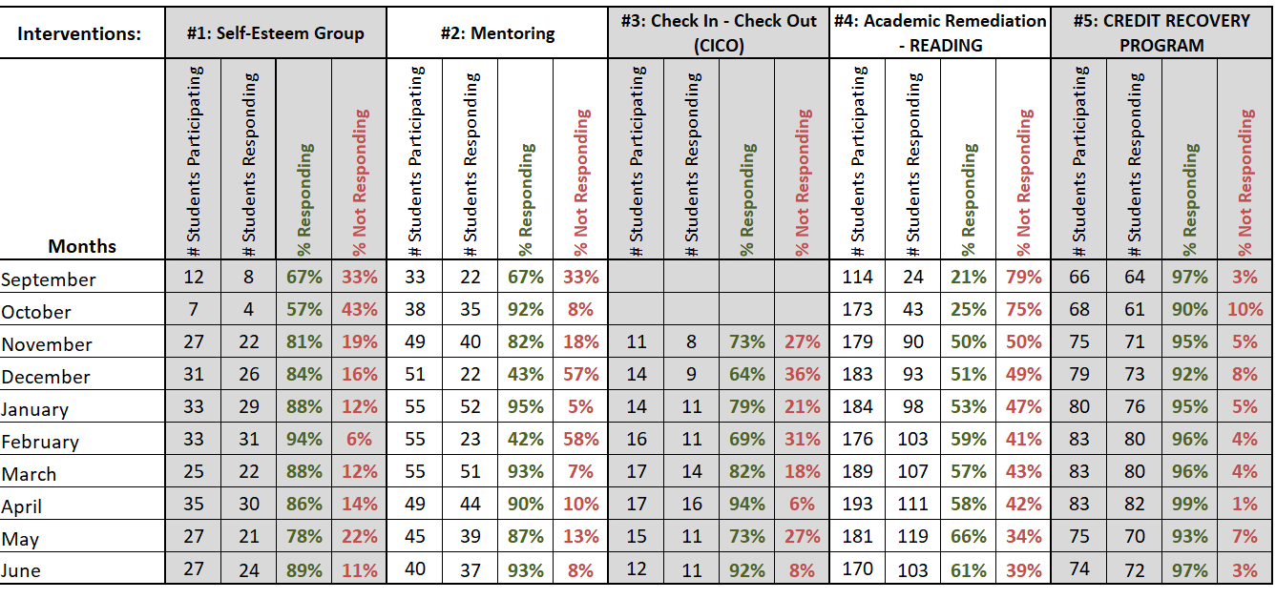
Method 1: Look at your percentages in Tab 1
Interventions #1, 2, 3, and 5 appear to have worked…
…but Intervention #4 does not appear to have worked as well
Notes:
The first method of analyzing your data is to use Tab 1 to look for trends across interventions by examining the percentages of students responding and not responding to each intervention throughout each month of the school year.
In the example above, we can see that our Self-Esteem Group, Mentoring, CICO, and Credit Recovery Program were effective (i.e., generally had >70% of students responding), whereas Academic Remediation was not as effective (<70% responding).

Slide 22
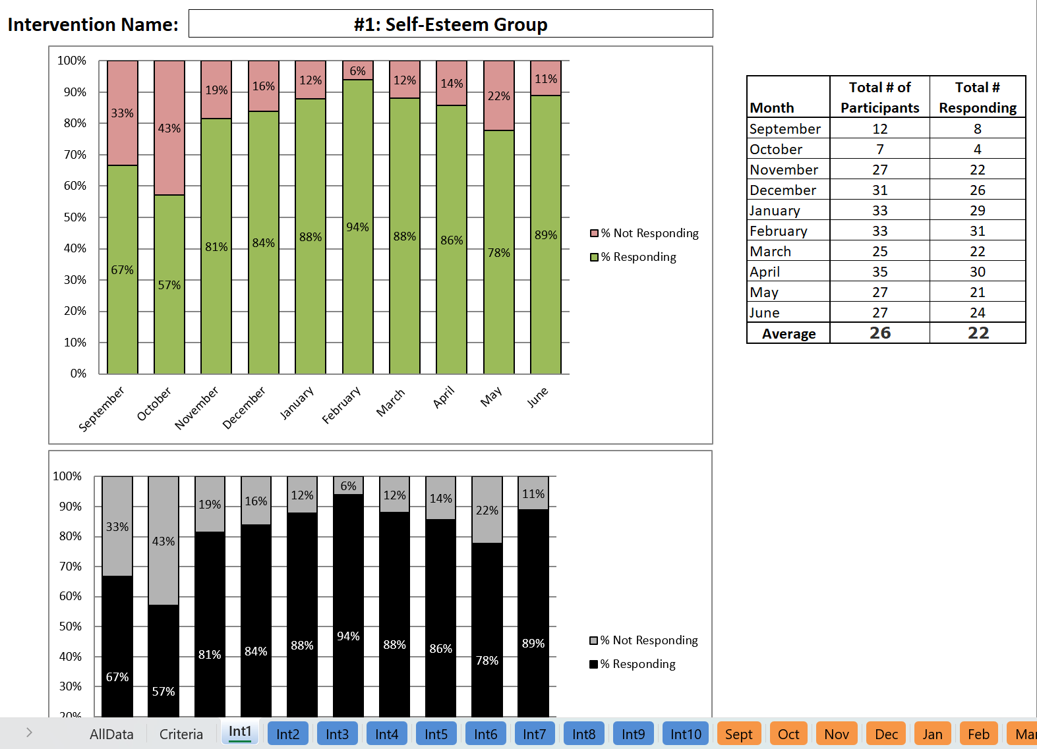
Method 2: Look at tabs for each intervention
Special Note: You cannot change the data within the graph worksheets (they are imported directly from the AllData worksheet).
The blue tabs in this workbook provide you with graphs for each intervention across the SY.
They show the percentages of students responding and not responding to the intervention per month.
Notes:
The next method for analyzing your data is to look at how students are responding to each intervention using the blue (intervention) tabs. The graphs on these tabs allow you to easily examine the percentages of students responding and not responding to the intervention throughout the school year. In addition, each intervention tab shows the same graph twice, once in color and once in black and white.
In the example above, we can see that more than 70% of students were responding to the Self-Esteem Group from November through June.
Special Note: You cannot change the data in the graph worksheets (they are imported directly from the AllData worksheet), but you can format the look and size of the text in the accompanying table.

Slide 23
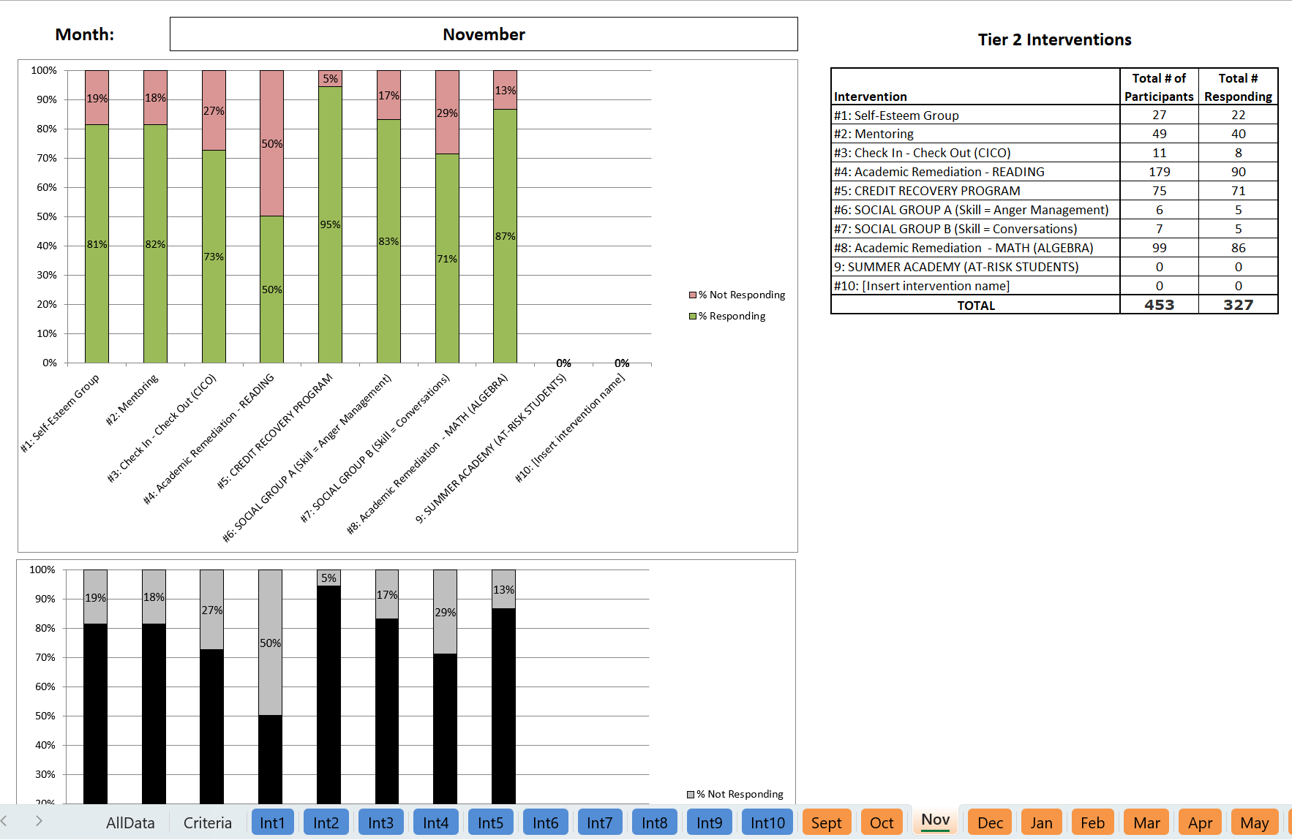
Method 3: Look at tabs for each month
Special Note: You cannot change the data within the graph worksheets (they are imported directly from the AllData worksheet).
The orange tabs in this workbook provide you with graphs of the interventions by month.
They show the percentages of students responding and not responding to all interventions per month.
Notes:
The third method for analyzing your data is to look at how students are responding to the interventions using the orange (monthly) tabs. The tables and graphs on these tabs allow you to easily examine the percentages of students (in total) who are responding to the intervention each month. In addition, the tabs for each month show the same graph twice, once in color and once in black and white.
In the example above, we can see that during November, more than 70% of students were responding to each intervention, except for Academic Remediation.
Special Note:
You cannot change the data in the graph worksheets (they are imported directly from the AllData worksheet) but you can format the look and size of the text in the accompanying table.

Slide 24
Step 6: For any interventions with low student response rates (less than 70%), ask WHY.
If an intervention is working for less than 70%
of your enrolled students:
You need to talk about the intervention system. Your discussion may include questions about intervention fidelity and/or retraining in the intervention.
Conversations about individual students’ lack of response should be addressed in a separate, problem-solving conversation.
Notes:
The final step is to reflect on any interventions that had less than 70% of students responding. It is critical to discuss and address reasons for a low response rate.

Slide 25
Tips for Printing Your Data
Printing is by the worksheet (e.g., AllData, Criteria, Int1, Int2, etc.)
You can adjust your print settings to print each page the way that best fits your discussions and/or sharing

Slide 26
Thank you for reviewing this tutorial! For more information about Targeted (Tier 2) programming and tools, please visit our website at delawarepbs.org
DE-PBS Project
Center for Disabilities Studies
Updated 7/20/23
Notes:
Thank you so much for checking out our Tier 2 Intervention Tracking Workbook tutorial! If you have any questions, comments, and/or recommendations regarding this workbook, please send them to Megan Pell at mpell@udel.edu.

