Slide 1
Tier 2 Data and Progress-Monitoring:
Tools & Networking
Data tools to gauge student progress & performance at Tier 2
July 27, 2023- DE-PBS Project
For more info: mpell@udel.edu

Slide 2
Intended Outcomes
Grow our collective advocacy and abilities \to gather and utilize data within the Tier 2 level of support for students SEL and behavior.
Use the time together to pose questions, engage in discussions, challenge ourselves and build networks around this topic.

Slide 3
The DE-PBS Project serves as a technical assistance center for the Delaware DOE to actualize the vision to create safe and caring learning environments that promote the social-emotional and academic development of all children.
The statewide initiative is designed to build the knowledge and skills of Delaware educators in the concepts and evidence-based practices of Positive Behavior Support (PBS) as a Multi-tiered System of Support (MTSS).

Slide 4
Meet our Team!
Directors, Coaches, Staff, and Graduate Assistants
Debby Boyer
UD/CDS
Co-Director
Sarah Hearn
Emily Consiglio
Niki Kendall
Alex Miller
Susan Veenema
DDOE
Co-Director
Megan Pell
Mark Miller
Valerie Brown
Kittie Rehrig
Brynn Fallah

Slide 5
Who Are You
&
Who Makes Your
Summer Brighter?

Slide 7
Today’s Guest Speakers
Cheryl Carey
School counselor - Showell ES
Stacey Falls
School psychologist - Talley MS
Emily Bain
Special education teacher - Lombardy ES

Slide 8
Topics of Discussion for Today
Tier 2 - Big Picture Reminders
Timeframes for progress monitoring
IN/ON/OUT criteria for Tier 2 Interventions
Data Collection Tools
Progress Monitoring Your Tier 2 Interventions Overall
https://storyset.com/people

Slide 9
Expectations for our time together
We are… | During this time together, please…
ENGAGED | Share effective strategies, ideas, tools you have used Ask questions (aloud or chat works!)
REFLECTIVE | Compare the ideas shared to your current context & experiences Assess your current school practices & determine equity of access to interventions and cultural relevance to students
STRATEGIC | Use forms and tools provided Identify next steps Take care of personal needs

Slide 10
The Tier 2 Big Picture

Slide 11
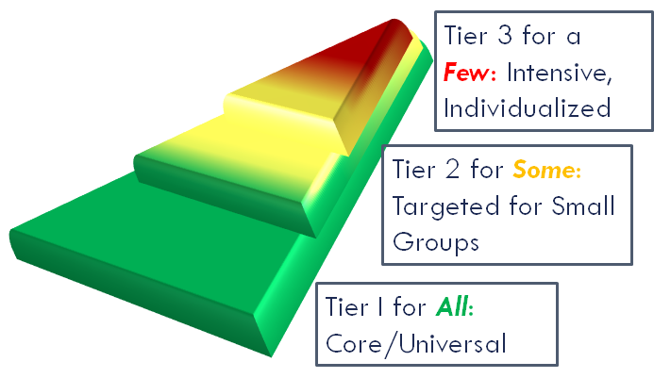
Quick Reminder: The MTSS layers build, they do not
divide and separate efforts
to support students, families, and staff.

Slide 12
…and we use the same problem solving process at ALL 3 Tiers!
Problem identification
Evaluate the response
Problem analysis
Develop and Implement a Plan
Adapted from Gaunt, 2022 (APBS Conference Workshop)

Slide 13
Within the Tier 2 intervention group setting & the classroom:
Educators:
…explicitly teach targeted SEB skills and connect targeted instruction to tier 1 norms or expectations.
…[reinforce] prevention when they increase structure, re-teach routines increase connections, target prompts and supervision, and implement targeted antecedent manipulations.
…target how they respond; they increase specific positive and supportive feedback, enhance continuum of recognition strategies, and enhance strategies to decrease SEB challenges.
(Adapted from Multi-Tiered System of Supports (MTSS) in the Classroom (2021)

Slide 14
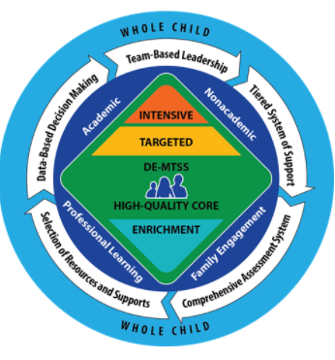
Definitions of Tier 2 Practices…
From DE-MTSS Implementation Guide:
Tier 2 interventions and supports are for students who continue to struggle after receiving high-quality Tier 1 instruction. Tier 2 interventions and supports are targeted to students’ needs and provide greater intensity (e.g., smaller group size, more practice opportunities) than Tier 1. Tier 2 supports are research based and delivered with fidelity. If a student’s performance improves, the student may no longer require Tier 2 interventions and supports.

Slide 15
Tier 2 Teaming: Creates & Maintains
Your Tier 2 Systems, Problem-Solving, and Interventions
Tier 1 Interventions
Universal Screening
Efforts
Outside Agency Providers
Tier 3 Interventions
Reintegration
Efforts

Slide 16
Cheryl Carey
Breakfast Club
(Homework Club)

Slide 17
The Breakfast (homework) Club
Tier 2 target group - students that had come up during MTSS meetings (academic concerns AND not completing homework) 4 third and 3 second graders
Time - during breakfast
Location - cafeteria (tables up front)
Coordinator - school counselor (breakfast duty)
Grade levels - 2nd, 3rd moved to involve all grades
Areas of focus - eventually -we covered it all
Supplies - pencils/erasers, timers, crayons, buddies

Slide 18
How Our Club Related
to Tier 1 Interventions
“Breakfast Club” evolved and eventually became known as HOMEWORK CLUB.
All students saw it as a safe place. Sometimes used just as a quick review before a spelling or vocabulary test. Sometimes used as math fact - sight word practice.
As a staff we had a lot of discussion about homework. We reviewed research (looking at data). Homework club lead to many successes (academically- social/emotionally- behaviorally) DATA showed this for all students. (not just those targeted)
Each team member brings different levels of expertise to IST/MTSS meetings. As the school counselor, I trust the academic integrity of our teachers. Homework club opened many eyes - a simple - no loss of “academic time” intervention was a win/win for so many. This lead to be a great reinforcement for all staff - the whole child perspective- thanks to the data collected during Tier 2 programming.

Slide 19
How Our Club Related
to Tier 3 Interventions
Weekly IST/MTSS meetings are imperative to review data collection and implications.
Important to mention that homework club met a need for many students (tier 1, tier 2 and tier 3) Homework philosophy was reinforced that much can be gained by practice, practice, practice (which is what elementary homework should consist of)
Data from homework club did reflect that consistent support of “practice, practice, practice”” for specific students at Tier 2 led to academic improvements. Data also showed improvements social/emotionally and behaviorally for students in all tiers.
Data from homework club also reflected that this intervention was not enough for all students. After review of data, it was determined that some students in this Tier 2 intervention could benefit from more support at the Tier 3 level.

Slide 20
In Conclusion
Data talks -
it is important to listen to what it is telling us about the student AND the intervention
Biggest take away -
Continue to be involved in conversations about students’ successes and challenges.
Use data to drive these conversations.
Look at the students’ data but also the overall data of the intervention.

Slide 21
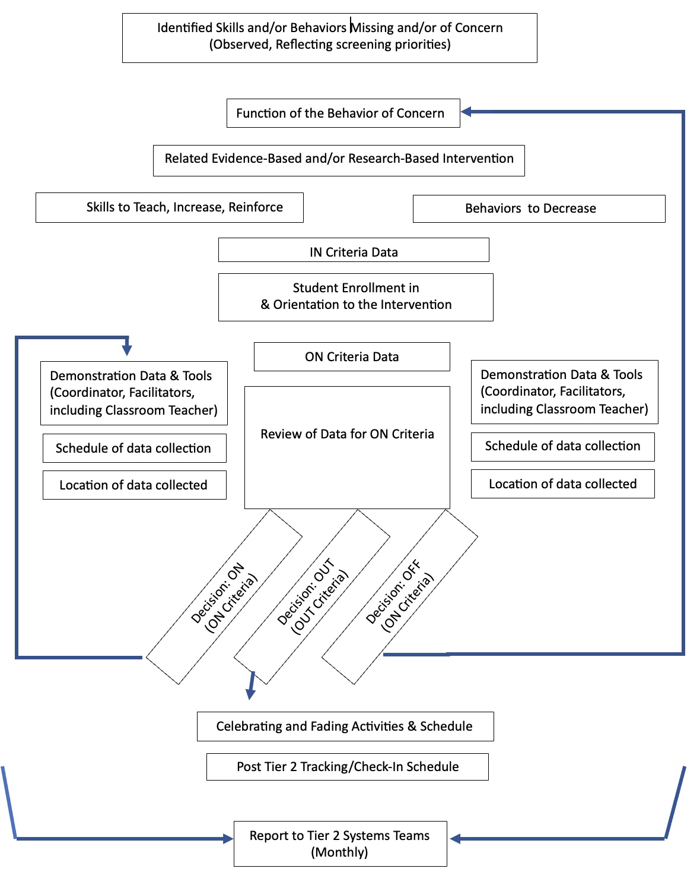
Tier 2 Teaming: Creates & Maintains
Your Tier 2 Systems, Problem-Solving, and Interventions

Slide 22
Teams Utilize Data-Informed Decision-Making Throughout

Slide 23
Systems Put Progress-
Monitoring in Action

Slide 24
Initial considerations for data collection
How often will data be collected?
Who will be collecting the data?
In what contexts will data be collected?
At what times will data be collected?
When will the data be inputted to allow for evaluation?
Direct Behavior Rating Overview (Maggin, National Center on Intensive Intervention)

Slide 25
Timeframes for progress monitoring
https://storyset.com/people

Slide 26
Tier 2 Timeframes…The Regulations
6.1.2 Tier 2 - Interventions shall be designed to be delivered in the student’s primary, scheduled education setting, by the student’s teacher or teachers, but may be delivered in other or additional settings or by other trained staff as appropriate to the specific intervention.
6.1.2.1 After no more than six to eight school weeks of Tier 2 intervention...the problem-solving team shall conduct a review of the plan …to determine whether additional assessments…are required, and whether changes to Tier 2 academic or non-academic methods are required; or the student should be provided Tier 3 intervention.

Slide 27
Tier 2 progress monitoring- Using Data For Decision Making.pdf
DR. ALLISON BRUHN, UNIVERSITY OF IOWA
DR. SARA MCDANIEL, UNIVERSITY OF ALABAMA

Slide 28
Tier 2 Timeframes…Within Your Interventions
What are the time frames that you currently have in place for Tier 2 interventions and how are folks keeping track of them?
What are your prescribed lengths of the interventions?
What, if any, weekly and/or mid-point check-ins do you have? Are there other check-in schedules being used?
How do these check-ins correspond to existing problem- solving meeting schedules?

Slide 29
IN/ON/OUT Criteria
https://storyset.com/people

Slide 30
IN/ON/OUT
Criteria
Protocols that teams use for determining:
Who should be put INto an intervention.
How ON target is a student progressing through the intervention as intended.
When is it time to fade, graduate, or pivot OUT of an intervention.

Slide 31
“Tier 2 Interventions Asset Map” - Delaware
Current Tier 2 Interventions | Skills Taught (Addressing Externalizing, Internalizing, a/o General Needs), Skills Being R+ | Coordinator | When/ Where
[INTERVENTION NAME HERE] | [Description] | [Name Here] | [Schedule Here]
IN | [Description]
ON | [Description]
OUT | [Description]

Slide 32
“Intervention Grid”
Michigan
Intervention | [Intervention Name]
Description | [Description] Function: [Description]
Entrance Criteria | [Description]
Permission | [Description]
Progress Monitoring Data | Student Data: [Description] Implementation Fidelity Data: [Description]
Decision Rules | Maintain: [Description] Fade: [Description] Alter: [Description]

Slide 33
Some notes about Tier 2 Interventions Asset Maps (or “Grids”)
Intervention | [Intervention Name]
Description | [Description] Function: [Description]
Entrance Criteria | [Description]
Permission | [Description]
Progress Monitoring Data | Student Data: [Description] Implementation Fidelity Data: [Description]
Decision Rules | Maintain: [Description] Fade: [Description] Alter: [Description]
Development and refinement is lead by the school Tier 2 team. Pre-set recommendations and context matters.
Criteria are developed using data, informed by curriculum recommendations and research.
Schools are starting to share asset maps.
Current Tier 2 Interventions | Skills Taught (Addressing Externalizing, Internalizing, a/o General Needs), Skills Being R+ | Coordinator | When/ Where
[INTERVENTION NAME HERE] | [Description] | [Name Here] | [Schedule Here]
IN | [Description]
ON | [Description]
OUT | [Description]

Slide 34
Actions to Ensure an Efficient, Effective, and Equitable Tier 2 System
(An Equitable Multi-Level System of Supports, Wisconsin RTI Center webinar from Michigan, 2021, 40 mins, Stephanie Dyer)

Slide 36
Tier 2 INTERVENTIONS Asset Map
Current Tier 2 Interventions | Skills Taught (Addressing Externalizing, Internalizing, a/o General Needs), Skills Being R+ | Coordinator | When/ Where
[INTERVENTION NAME HERE] | [Description] | [Name Here] | [Schedule Here]
IN | [Description]
ON | [Description]
OUT | [Description]

Slide 37
Tier 2 INTERVENTIONS Asset Map
Current Tier 2 Interventions | Skills Taught (Addressing Externalizing, Internalizing, a/o General Needs), Skills Being R+ | Coordinator | When/ Where
INTERVENTION NAME HERE | DESCRIPTION FILLED IN HERE | NAME HERE | SCHEDULE HERE
IN | [identify related screening data, consider ABC data, consider staff/student/family referral information]
ON
OUT

Slide 39
IN/ON/OUT Criteria - Activity Time!
Download “Practice with the Intervention Grid: Behavior”
https://www.wisconsinrticenter.org/resources/e2-intervention-grid-resource/

Slide 40
“Practice with the Intervention Grid: Behavior”
Matching 3 Students to 3 Available Interventions via Grids
Attendance Check-In
Check-In, Check-Out
Second Step: Grade Six (Double Dose)
Student 1: Della
Student 2: Leonard
Student 3: Xander

Slide 41
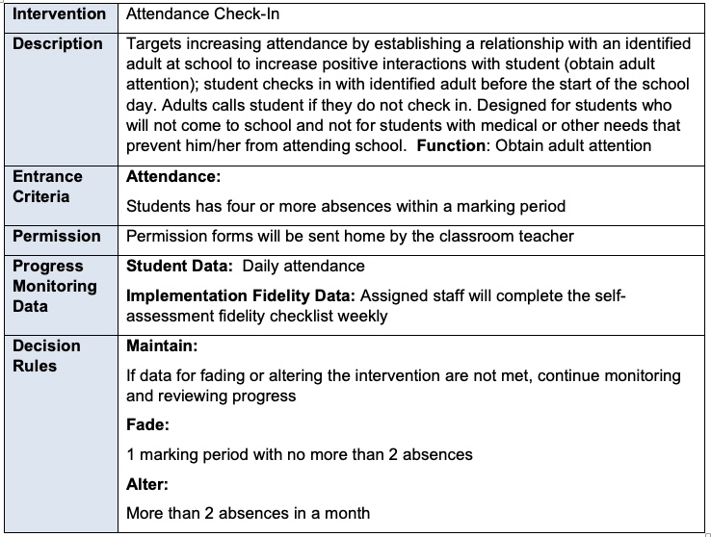
Example Grid:
Attendance Check-In

Slide 42
We do: “Practice with the Intervention Grid: Behavior”
Student 1: Della
Della is a third-grade student at Anywhere Elementary. During the Winter behavior screening, Della was identified as a student at moderate risk based on the behavior screener’s internalizing scale. In addition, Della has had three discipline referrals for disrespect in the last 6 weeks in a variety of settings. The perceived motivation for all of the referrals was adult attention.
Intervention Selection:
Rationale:
Attendance Check-In
Check-In, Check-Out
Second Step: Grade Six (Double Dose)
?

Slide 44
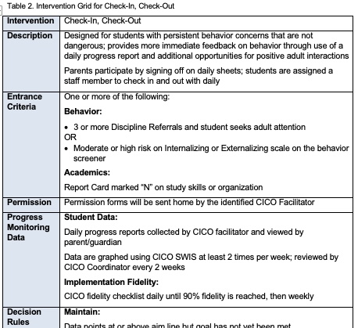
Student 1: Della

Slide 45
You do: “Practice with the Intervention Grid: Behavior”
INDEPENDENT BREAK-OUT
Student 2: Leonard
Student 3: Xander

Slide 46
Tier 2/3 MTSS
Talley Middle School

Slide 47
Tip 1: Strong Tier 1
Different Tier 1 and Tier 2/3 Leaders
Administrative Support
Monetary
Physical
PBIS Rewards Online System
School Store is a paid staff position
Creative reinforcers - School Snacks, Musical, Outside, Community Center
Advisory and Social Emotional Learning
Paid lesson writing, designated time
Adult Focus on Relationships
Restorative Practices
PD Focus
Staff Meetings - games, recognition

Slide 48
Tip 2: Identify Your Non-Negotiable Tier 2/3 Team
Talley’s Team
ALL Admin
Counselors (we have 3)
School Nurse
Social Worker/Behavioral Health Consultant
Building Special Education Coordinator
School Psychologist
Building Attendance Secretary
Grade Level Team Leaders Copied
Academic MTSS Copied

Slide 49
Tip 3: Meeting Format
Standing Meeting Time
Time Limit - 1 class period (About 40 Minutes)
Grade Level Meetings - School Counselors & Grade Level Admin are Liason
Review by Grade Level - Counselors & Admin Present
Different Expertise Valued
Minimal Time “Admiring the Problem”
Flexibility for Additional Meetings and/or Guest Speakers as Needed

Slide 50
Tip 4: Identifying Needs & Forming Intervention Groups
Understanding the Individual Student
Focus More on Individual Data than Group Data
Backwards Mapping
Through Quickly Reviewing Individual Student Needs We Develop Groups Needs
Case Studies
Take Lessons Learned to Quickly Apply to New Situations
Think Outside the Box
Use Unexpected Resources
Everyone Takes Ownership

Slide 51
Tip 5: Example Intervention Groups
Achievers Academy
Behavioral Health Consultant Tier 2
Behavioral Health Consultant Tier 3
Check In/Check Out
Check & Connect (Talley Version)
Girls Groups (6 Options)
Social Skills (Girls & Boys)
Stress Management
13 Total To Keep Track of = Easy to Monitor

Slide 52
Tip 7: Reward & Review
Build on Already Existing Tier 1 Reinforcers
(Don’t reinvent the wheel!)
If At First We Don’t Succeed…We Try Again
Lack of Progress is an Adult Problem Until We’ve Exhausted All Options
Solving the Problem is a Shared Responsibility
The Mindset is - We Want Students to Succeed

Slide 53
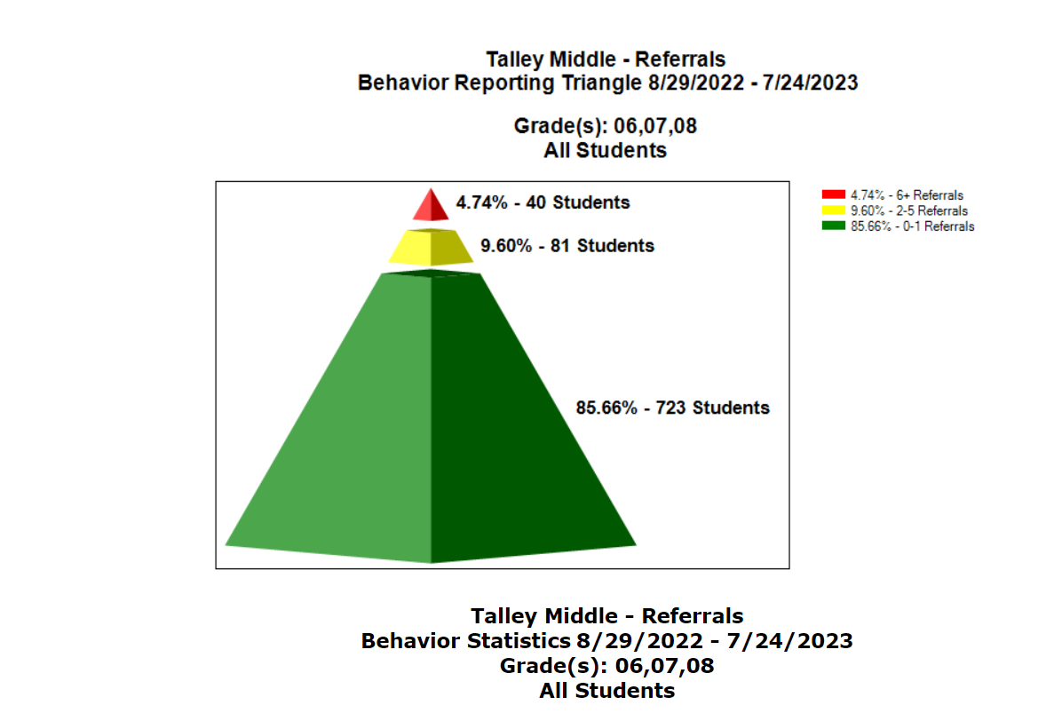

Slide 54
Questions???
Let’s Collab!
stacey.falls@bsd.k12.de.us

Slide 55
Tier 2 INTERVENTIONS Asset Map
Current Tier 2 Interventions | Skills Taught (Addressing Externalizing, Internalizing, a/o General Needs), Skills Being R+ | Coordinator | When/ Where
INTERVENTION NAME HERE | DESCRIPTION FILLED IN HERE | NAME HERE | SCHEDULE HERE
IN | [identify related screening data, consider ABC data, consider staff/student/family referral information]
ON | [identify what it looks like if the student is “on progress” with the skills being taught, reinforced]
OUT

Slide 56
“Intervention Grid”
Michigan
Intervention | [Intervention Name]
Description | [Description] Function: [Description]
Entrance Criteria | [Description]
Permission | [Description]
Progress Monitoring Data | Student Data: [Description] Implementation Fidelity Data: [Description]
Decision Rules | Maintain: [Description] Fade: [Description] Alter: [Description]

Slide 57
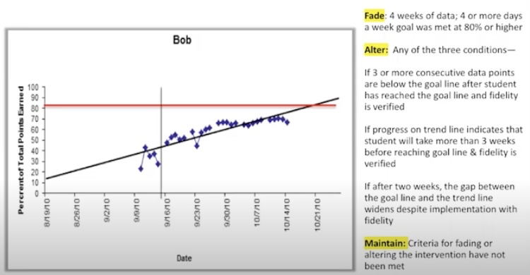

Slide 59
Current Tier 2 Interventions | Skills Taught (Addressing Externalizing, Internalizing, a/o General Needs), Skills Being R+ | Coordinator | When/ Where
Check In - Check Out | Description Filled in Here | Name Here | Schedule Here
IN | Frequent low-level behavior problems (e.g. attendance, across settings. Teacher/parent recommendation(s) during grade-level meeting AND/OR more than 3 ODRs in a one-month period. Student seeks attention.
ON | Student receives 70% or higher on signed Daily Progress Report (DPR) during the week.
OUT | Student receives 70% of higher on signed DPR for 5 days in a row and has no new ODRs. Classroom teacher/school counselor provides recommendation to graduate.

Slide 60
Current Tier 2 Interventions | Skills Taught (Addressing Externalizing, Internalizing, a/o General Needs), Skills Being R+ | Coordinator | When/ Where
Check In - Check Out | Description Filled in Here | Name Here | Schedule Here
IN | Frequent low-level behavior problems (e.g. attendance, across settings. Teacher/parent recommendation(s) during grade-level meeting AND/OR more than 3 ODRs in a one-month period. Student seeks attention.
ON | Student receives 70% or higher on signed Daily Progress Report (DPR) during the week.
OUT | Student receives 70% of higher on signed DPR for 5 days in a row and has no new ODRs. Classroom teacher/school counselor provides recommendation to graduate.
Maintain?
Fade?
Alter?

Slide 61
Current Tier 2 Interventions | Skills Taught (Addressing Externalizing, Internalizing, a/o General Needs), Skills Being R+ | Coordinator | When/ Where
Self-Esteem Group | Description Filled in Here | Name Here | Schedule Here
IN | Teacher recommendation, score of 15 or less on the Rosenberg Self- Esteem Scale
ON | Teacher reporting more participation in class/their abilities, student creating secure relationships, accepting praise, more self praise/less self deprecation
OUT | Score of 18 or higher on the Rosenberg Self-Esteem Scale,

Slide 62
Current Tier 2 Interventions | Skills Taught (Addressing Externalizing, Internalizing, a/o General Needs), Skills Being R+ | Coordinator | When/ Where
Self-Esteem Group | Description Filled in Here | Name Here | Schedule Here
IN | Teacher recommendation, score of 15 or less on the Rosenberg Self- Esteem Scale
ON | Teacher reporting more participation in class/their abilities, student creating secure relationships, accepting praise, more self praise/less self deprecation
OUT | Score of 18 or higher on the Rosenberg Self-Esteem Scale,
Maintain?
Fade?
Alter?

Slide 63
Let’s Take a Look Together
Current Tier 2 Interventions | Skills Taught (Addressing Externalizing, Internalizing, a/o General Needs), Skills Being R+ | Coordinator | When/ Where
Mentoring | Students meet with assigned adult mentor and they discuss positive SEL skills using the Skillstreaming curriculum. | Ms. Dashuan | 2x/week in the calm room
IN | Referred by staff as needing support with managing behavior and relationship building
ON | Demonstrating positive behaviors as noted in classroom/teacher observations, point card, daily progress, etc.
OUT | Decreased behavior referrals, and adequate progress as determined by staff

Slide 64
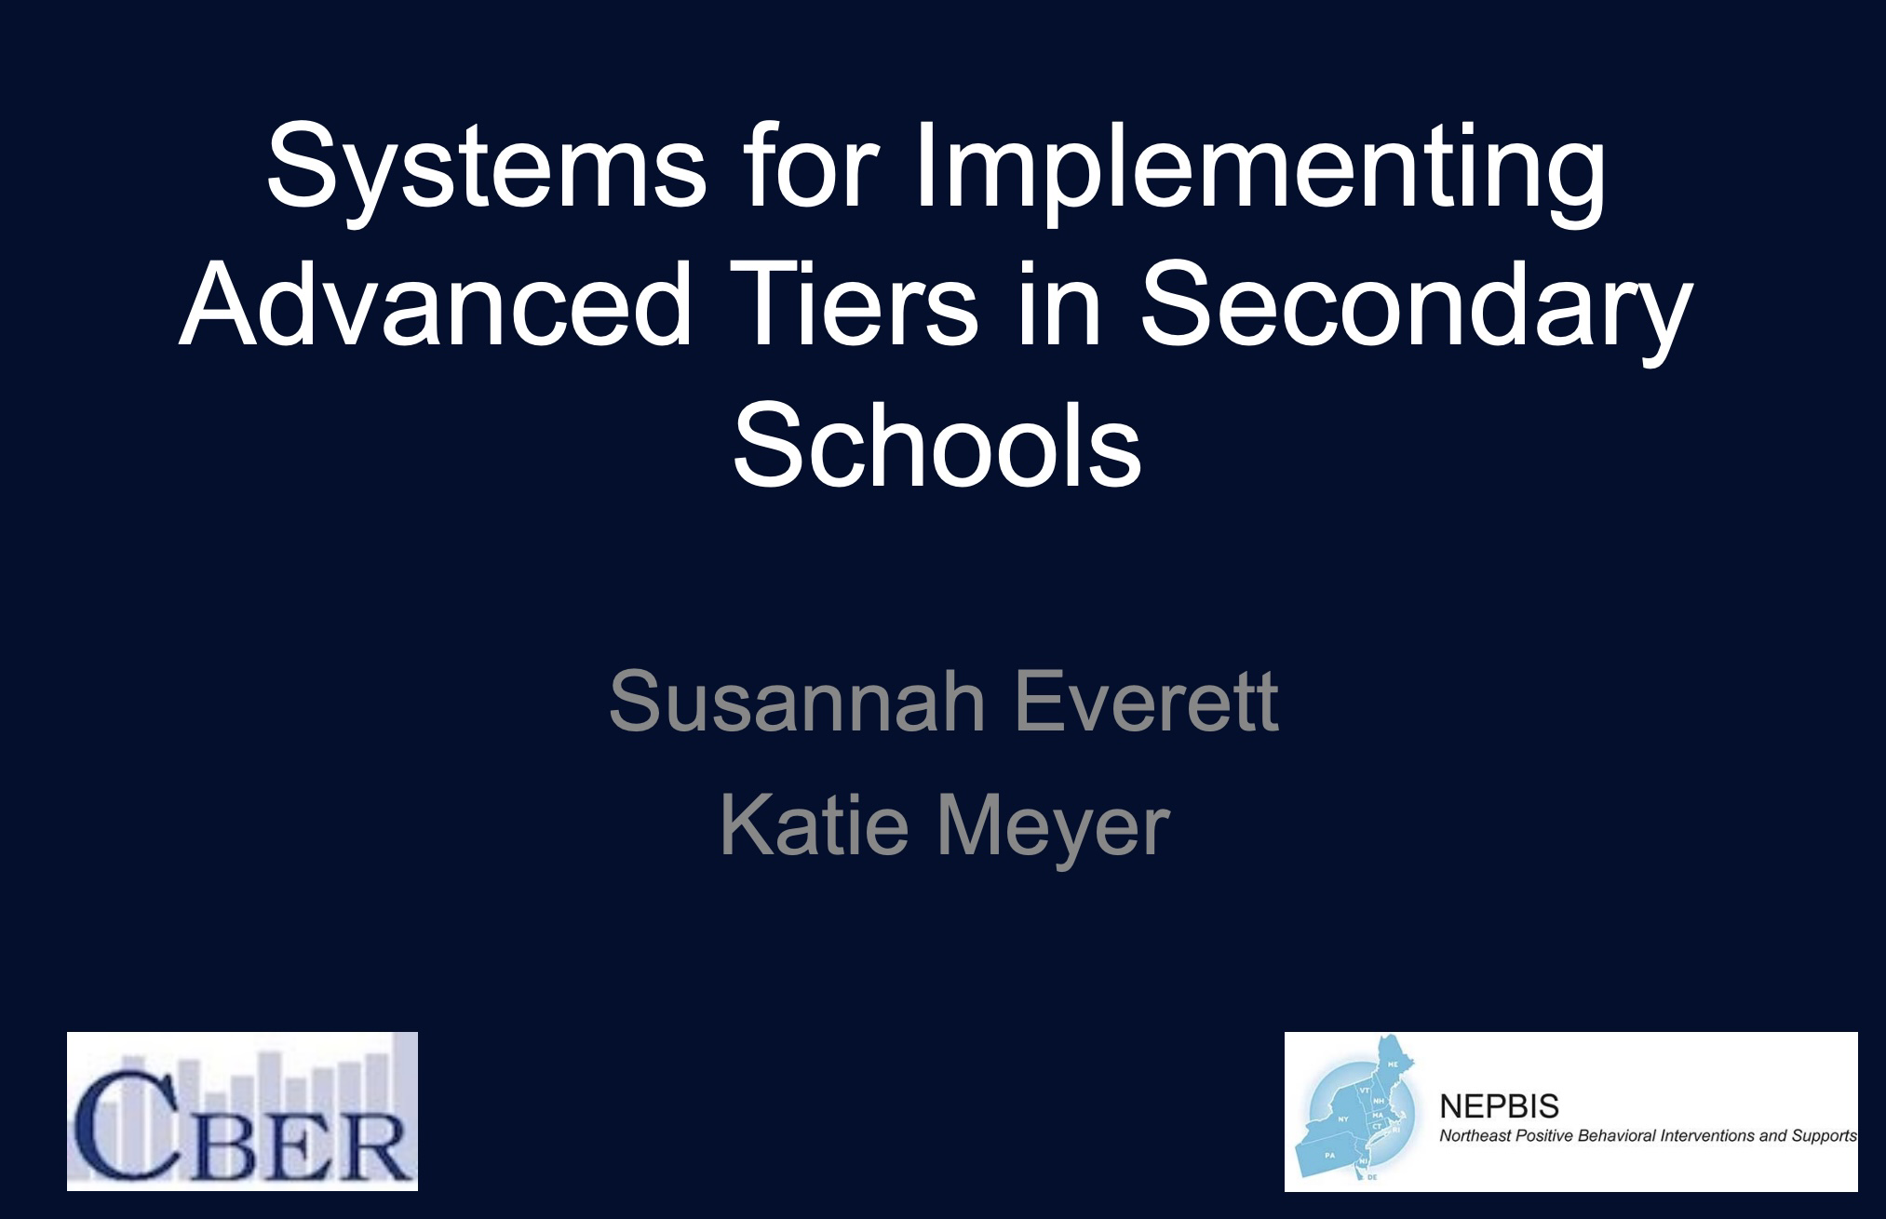
A Brief Overview Of Data-Based Decision-Making
A HS examples from Systems for Implementing Advanced Tiers in Secondary Schools
SCTG
2/9/22
~1hr

Slide 65
High School Example (SCTG, 2022)
Targeted Intervention Organizer
Example
Area of Concern
Target Intervention | Social Behavioral | Academic | Emotional | New Student | Description | Coordinator | Entry Criteria | Exit Criteria | Data Collected/Monitored
Check-in Check-out | X | X |  |  | • Students identified and enrolled within a week • Check-in and check-out daily with an adult at school • Regular feedback & reinforcement from teachers • Family component • Daily performance data used to evaluate progress | Susan | 4 or more ODRs in trimester 2 or more OSS in trimester | 4 weeks at >85% of points | Percent points towards daily goal ODR OSS (CICO-SWIS)
Check and Connect | X | X | X |  | • Students matched with mentor/monitor • Mentor monitors risk factors daily/weekly • Regular feedback and problem solving with mentor • Intensive intervention option if risk factors increase • Family component | Frank | 5+ absences in trimester 4+ tardies in trimester D or F in core | <2 absences in trimester 0 tardies in trimester C or better in core | Course grades Attendance/Tardies (Infinite Campus)
Homework Club |  | X |  |  | • Home partners assigned • Partners call each other to remind assignments are due • Homework support available after schools • Reinforcers for students/teams who show improvements | Marta | 3 or more missing assignments in trimester | No missing assignments | Course grades (Infinite Campus)

Slide 66
High School Example (SCTG, 2022)
Tier 2 Interventions at AHS
Intervention description | Student entry criteria | How students are referred | Contact
Academic Support Team (AST) Program designed for freshmen that follows them through graduation to prevent student drop out by building relationships and offering regular academic support. Students are enrolled in a shared humanities class for grades 9 & 10, and followed through grades 11 & 12. | Middle school teams identify rising 9th grade students at risk for drop out based on attendance, academics, and conduct (need to detail data-based decision making process). The AST reviews potential candidates and selects 15 students based on a rubric that considers student learning style and needs, group dynamics, and environment. | 8th grade teams refer AST team for consideration. | Social Studies Teacher: English Teacher: Dean: Adjustment Counselor:
Credit Recovery Program’s goal is to reduce the rate of failure for all students who have failed a course with 49% of higher by offering an online course and summer courses. Timeframe during school year: Need to add this Summer Credit Recovery is 3 weeks, 8am-12pm (2 hour classes). | Student who has failed a class with a 49% or higher Students are notified of eligibility for credit recovery on their report card | School Counselor review options and give students paperwork about the program and options for payment. Students (or parents of) who would like to do recovery reach out to their School Counselor. | School Counselor: Credit Recovery Coordinator:

Slide 67
Links between your IN/ON/OUT Criteria and data collection
How have you aligned your data tools to your intervention criteria?
Are the tools needed for your criteria readily available to use?
How did you train folks to use the tools?
How are you keeping the data collected through these tools?

Slide 68
Data Collection Tools
https://storyset.com/people

Slide 69
Data Collection Methods Should:
• measure skill(s) targeted by the intervention. The educator wants to know whether the student is improving a specific skill or behavior. The data-collection method is selected to track growth in that skill or behavior.
• be sensitive to short-term gains. Progress-monitoring should reveal in weeks—not months– whether the intervention is effective.
• yield a specific number value. The teacher selects progress-monitoring tool(s) that can be converted to numeric data—and charted.
(Jim Wright, Intervention Central, 2021)

Slide 70
Interventions should provide
additional time for learning and reinforcement
Pre-intervention
performance and/or perception data related to + skill(s) you will teach
Performance or perception data related to + skill(s) as they are being taught in the intervention
Post-intervention performance and/or perception data related to + skill(s) you will teach

Slide 71
The 3 Basic Types of Data Collection Tools
– Direct Behavior Ratings
– Direct Observation
– Intervention-Based Measures
Initial considerations
How often will data be collected?
Who will be collecting the data?
In what contexts will data be collected?
At what times will data be collected?
When will the data be inputted to allow for evaluation?
Tier 2 progress monitoring- Using Data For Decision Making.pdf (Bruhn & McDaniel)
Direct Behavior Rating Overview (Maggin, National Center on Intensive Intervention)

Slide 72
Gallaher ES Extension to the Intervention Grid
Tier 2 / 3 Intervention Responsibilities Coordination Chart
Intervention [Information & Criterias] | Point Person [Coordinator] | Person(s) Intervening [Facilitators] | Data Collection [Tools] | Data Entry [Dates/ Routines]

Slide 73
Direct Behavior Ratings
Involves teachers rating a student’s behavior on 0-10 scale
– Direct
• Ratings recorded immediately at end of observation session
– Behavior
• Behavior is specific and operationally defined
– Rating
• Ratings are conducted repeatedly and follow a 0-10 scale
Tier 2 progress monitoring- Using Data For Decision Making.pdf (Bruhn & McDaniel)

Slide 74
Tier 2 progress monitoring- Using Data For Decision Making.pdf (Bruhn & McDaniel)

Slide 75
Direct Behavior Rating Scales
Why use DBR?
DBR involves rating of behavior following a specified observation period, and then sharing of that information to inform decisions. DBR offers many options to link connections across assessment, intervention, and communication uses. DBR provides a simple and inexpensive option for frequent feedback about important behaviors, facilitating communication among students, parents, and educators. Most importantly, DBR is evidence-based!
DBR is flexible for use across assessment, communication, and intervention purposes
DBR is efficient as ratings are simple and quick to complete
DBR is repeatable for use in progress monitoring assessment
DBR is defensible given increasing evidence of technical adequacy screening and progress monitoring assessment\
Excerpts from https://dbr.education.uconn.edu/

Slide 76
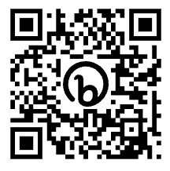
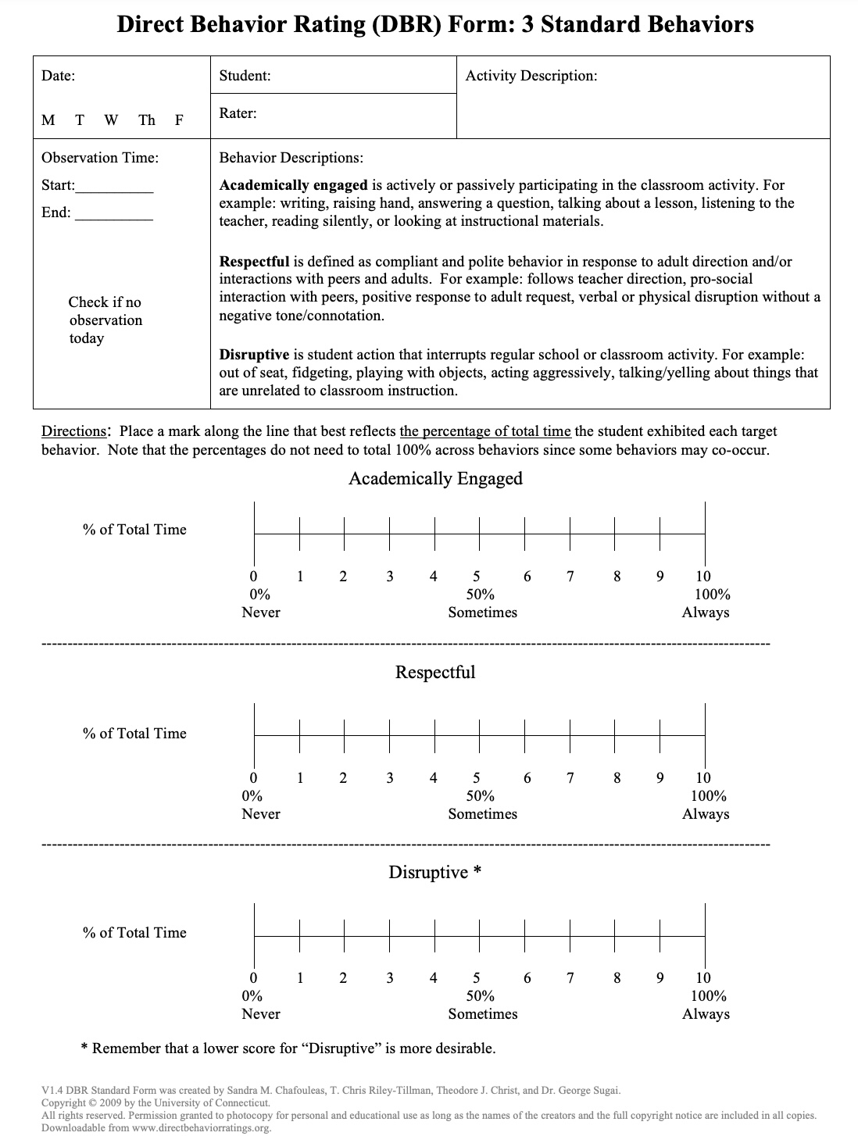
Example:
https://dbr.education.uconn.edu/wp-content/uploads/sites/916/2015/08/DBR-Standard-Form-with-3-Standard-Behaviors.pdf

Slide 77
Direct Behavior Rating Scales
Steps for implementation:
1. Identify the behaviors you want to monitor.
2. Define the behaviors with examples and nonexamples
3. Identify the time period or instructional activity for observation
4. Immediately following observation period, complete the rating
5. Graph the rating daily
Tier 2 progress monitoring- Using Data For Decision Making.pdf (Bruhn & McDaniel)

Slide 78
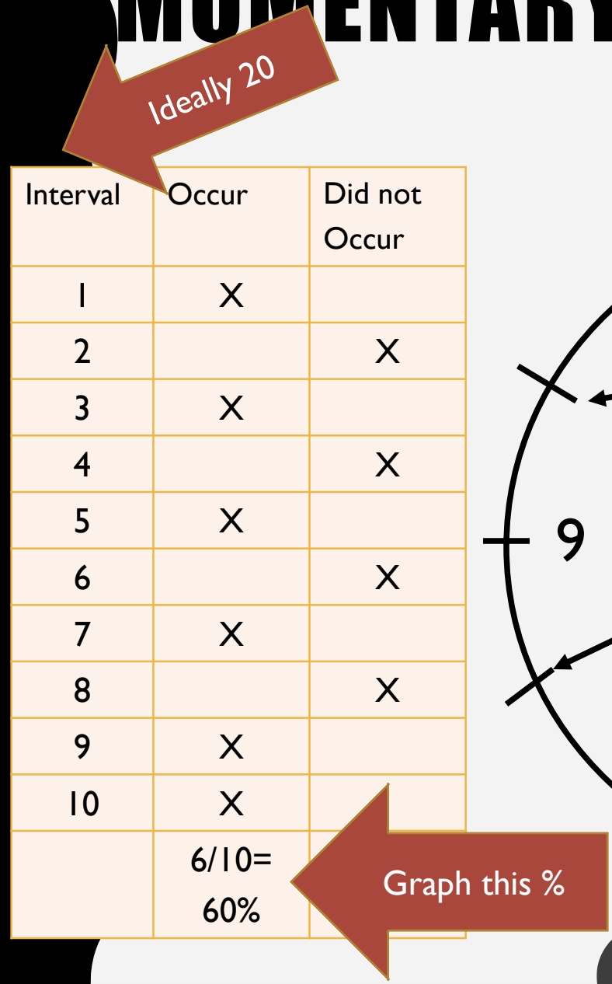
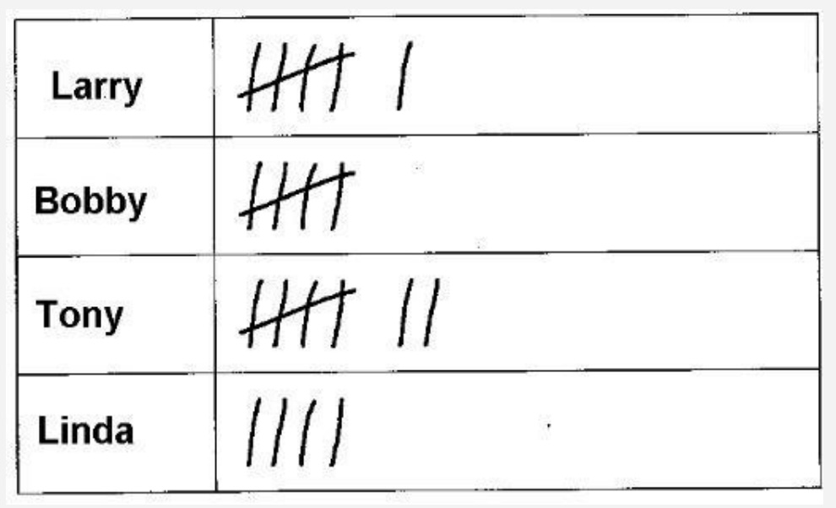
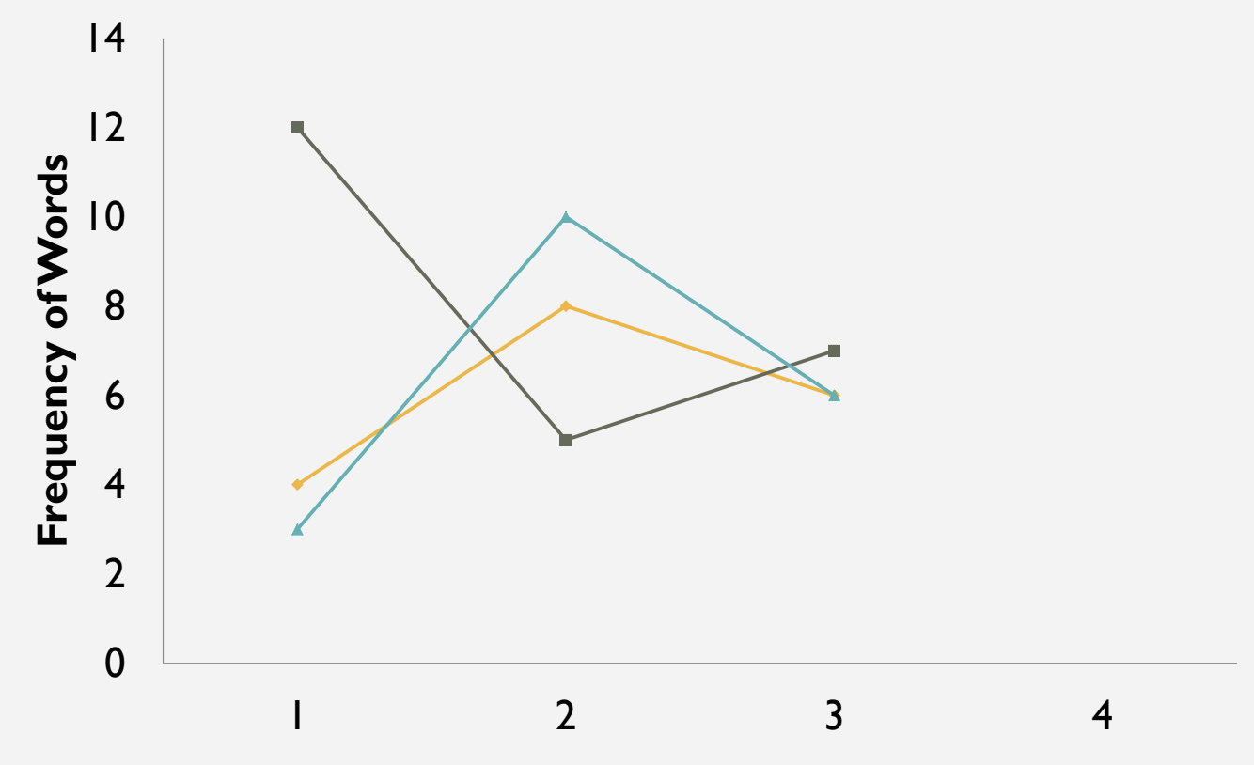
Direct Observation
Direct measure of student behavior in real time (i.e., recording behavior as it occurs in the setting of concern)
Momentary Time Sampling
Frequency Counts
Tier 2 progress monitoring- Using Data For Decision Making.pdf (Bruhn & McDaniel)

Slide 79
Direct Observation
Implementation Steps:
1. Identify the behavior you want to measure
2. Define behavior with examples and non-examples
3. Determine the method of measurement:
a. Is it a low-frequency, discrete behavior? = Frequency Count
b. Is it a high-frequency, discrete behavior? = Time Sampling
c. Is it a continuous behavior? = Time Sampling
4. Create observation form and determine session length
5. Collect data
6. Calculate (e.g., convert frequency to rate, or determine % of intervals behavior occurred)
7. Graph data
Tier 2 progress monitoring- Using Data For Decision Making.pdf (Bruhn & McDaniel)

Slide 80
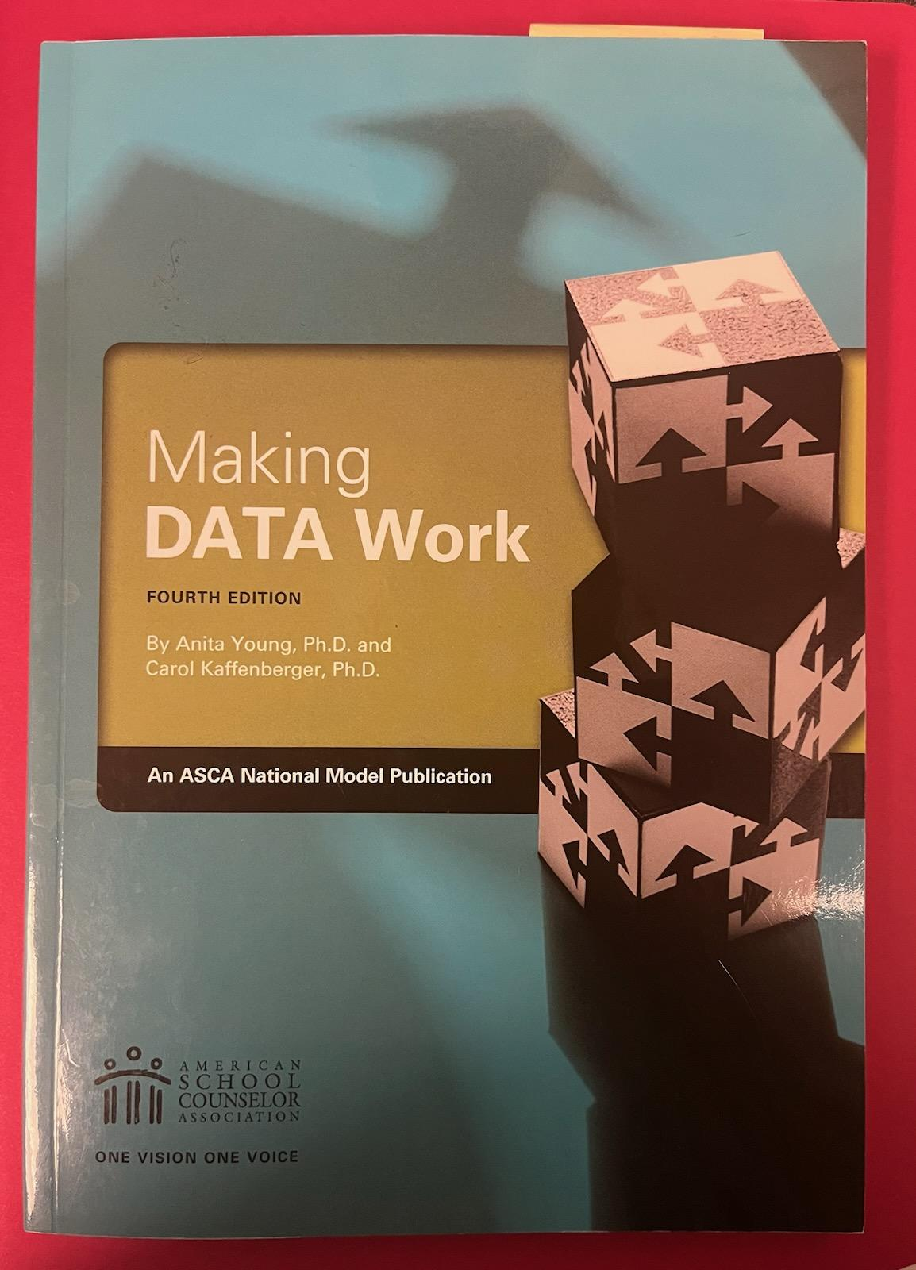
Making DATA Work
Sample Perception Data Surveys
Peer mediator training survey
Small-group counseling pre/post group survey
Needs assessment
Office Discipline Referrals (ODR) survey
Pre-/Post mindful math student survey and teacher survey
Pre-/Post ASCA mindsets and behaviors student and teacher survey
School bullying - student and faculty survey
Pre-/Post School resilience group counseling student survey
School engagement perception - Parent Success Survey and Student Success Survey
Study skills self-assessment survey
Pre-/Post information session surveys
(Young & Kaffenberger (2018) Chapter 6)

Slide 81
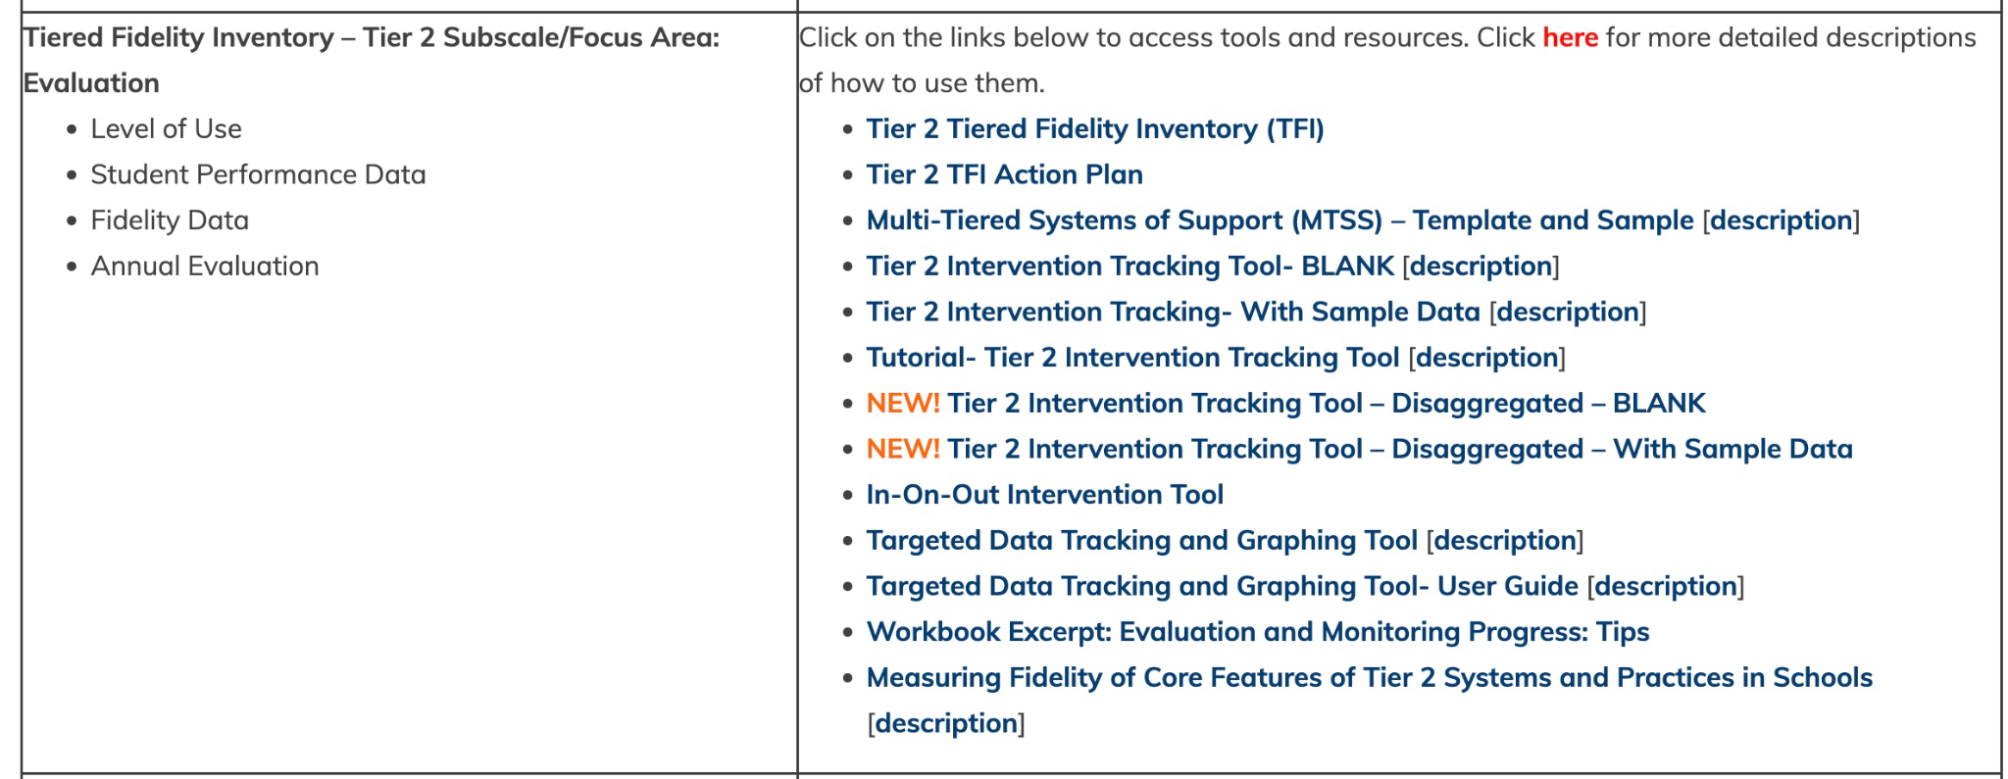
Progress Monitoring at the Student Level - Excel and Google Resource
https://www.delawarepbs.org/forms-and-tools/tier-2-targeted-tools/

Slide 82
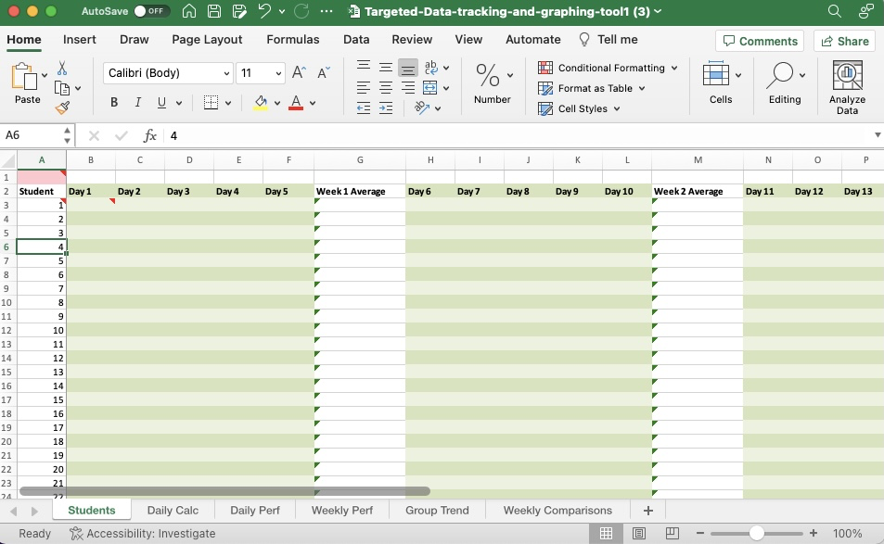
The targeted data tracking and graphing tool

Slide 83
On the Students tab - Interventions A (5 points daily)
Enter 1 students data - a student with a 5 point daily participation score from the intervention facilitator

Slide 84
Targeted Data Tracking and Graphing Tool
BREAK-OUT for PRACTICE
Please download the tool
& enter this sample data for 6 students

Slide 85
On the Daily Calc tab

Slide 86
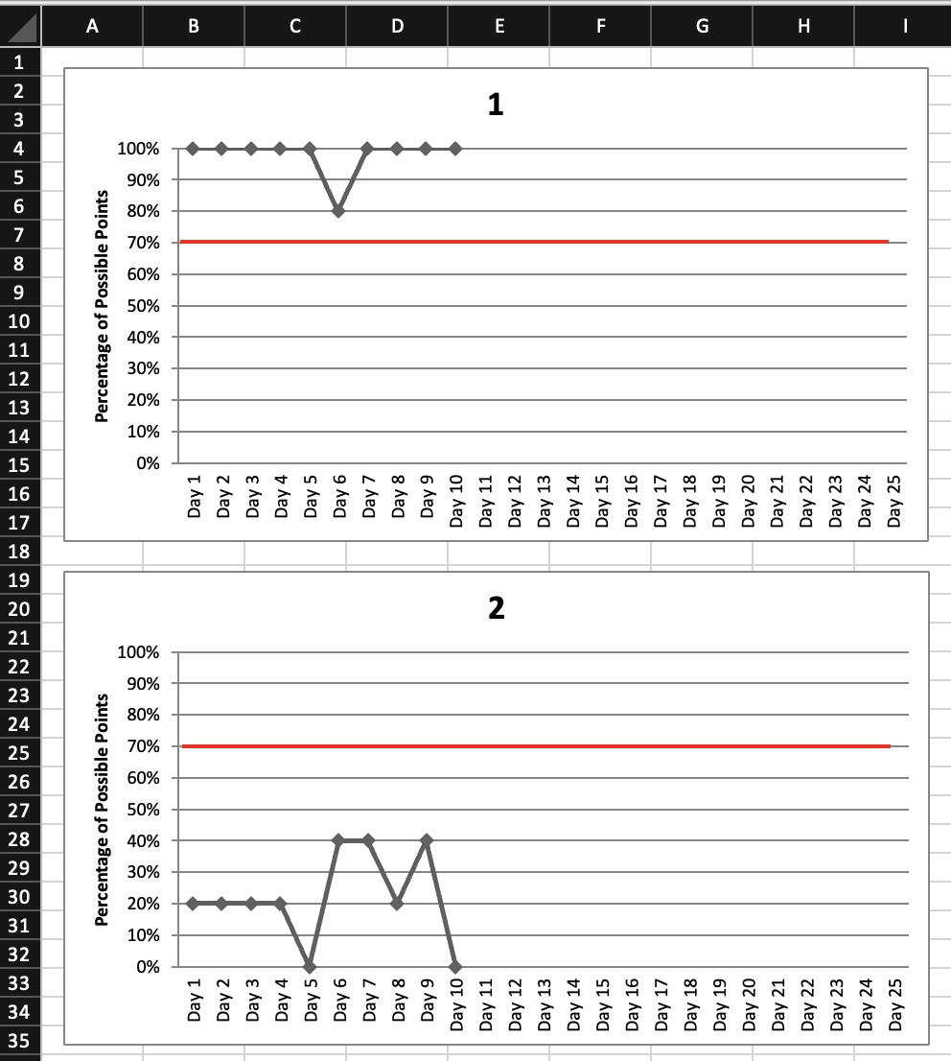
On the Daily Perf tab

Slide 87
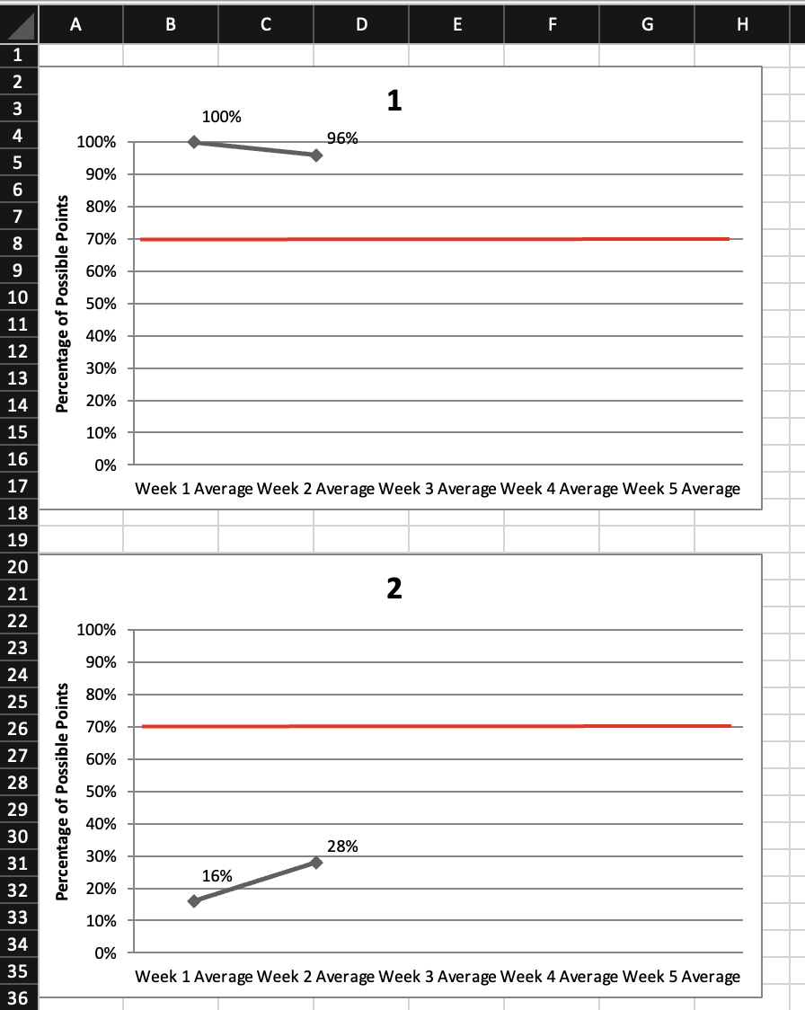
On the Weekly Perf tab

Slide 88
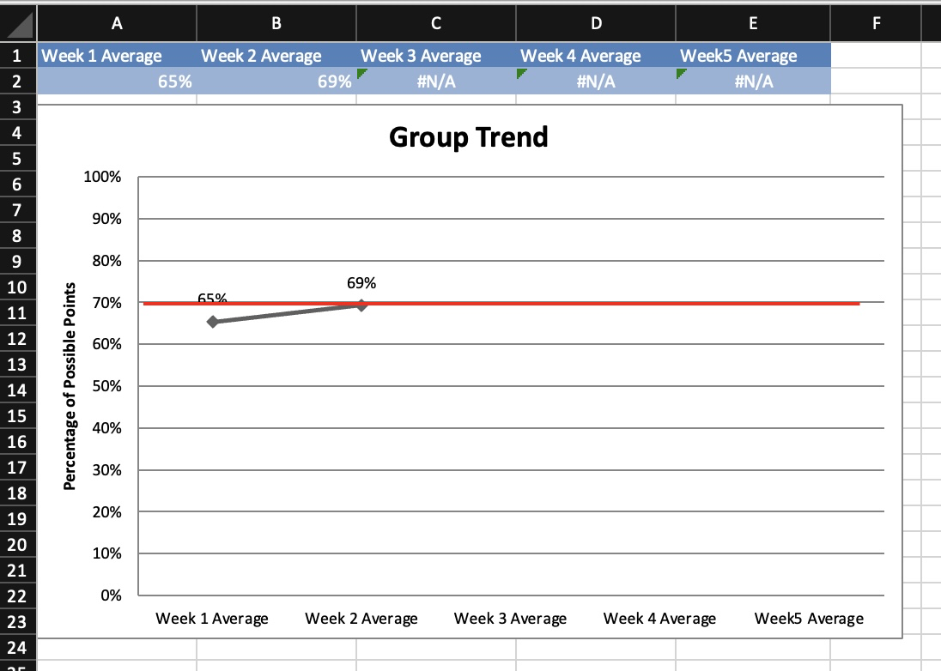
On the Group Trend tab

Slide 89
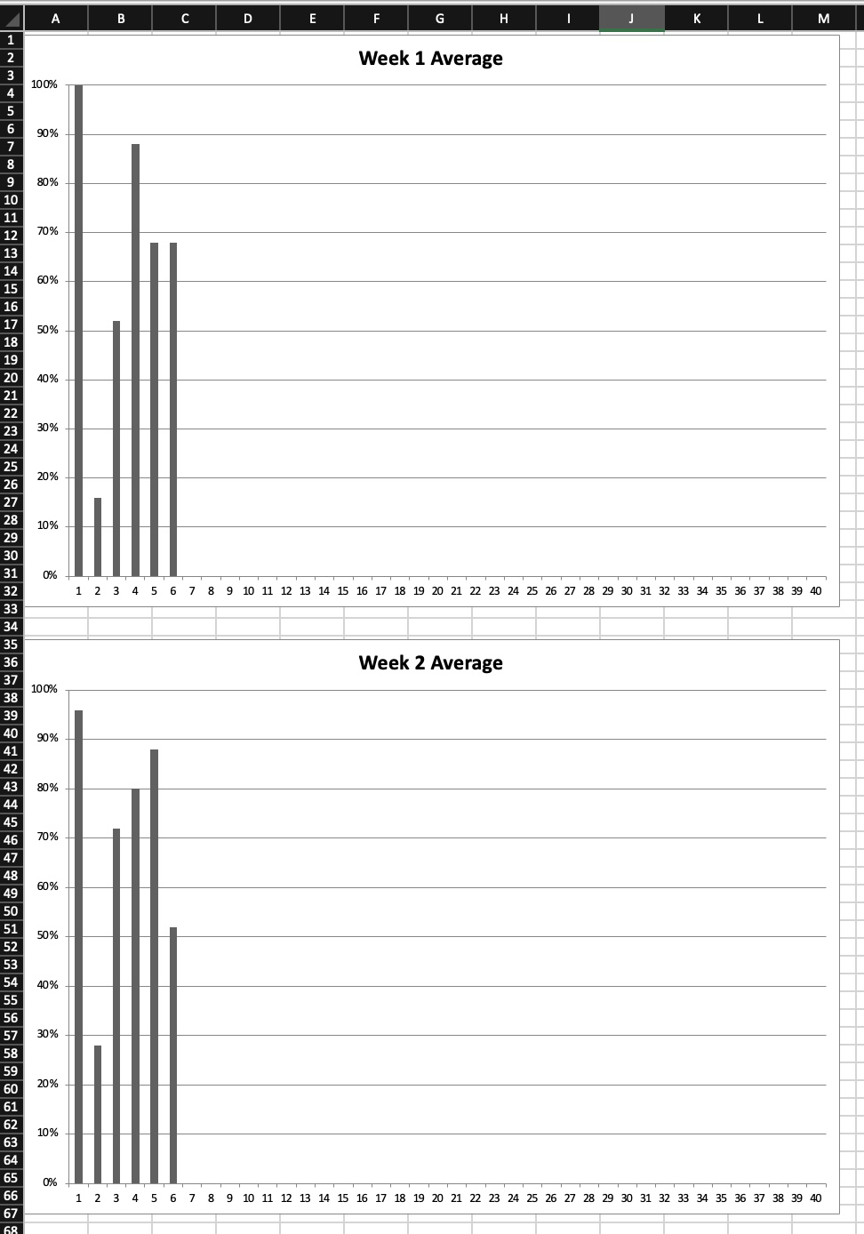
On the
Weekly
Comparisons
tab

Slide 90
Lombardy MTSS
Tiers 2 & 3

Slide 91
2022 Summer Planning Goal
-Develop a Tier 2 Check In/Out Program
- Develop protocols for students moving in and out of tiers 2 and 3
- Set up social/behavioral skills groups based on needs currently identified in the building
- Start students on a tier 2 or 3 intervention within the first 6 weeks who were already placed in a tier for behavior during the 2021-2022 sy

Slide 92
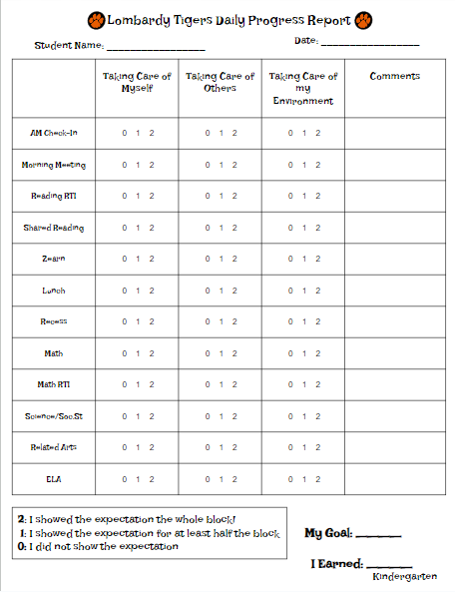
2022-2023
Main Focus
Tier 2 CICO Program
Students who were identified as needing tier 2 interventions for behavior with focuses on relationship deficits
12 Lombardy staff members volunteered to take the PBIS training on CICO systems to become CICO facilitators

Slide 93
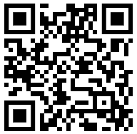
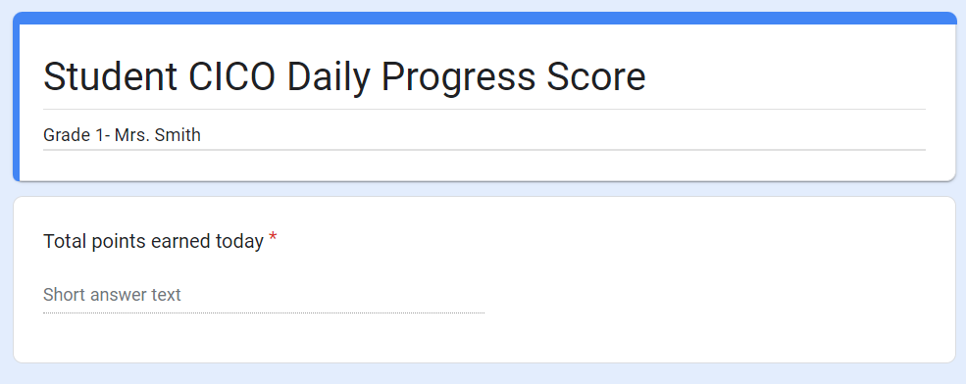
The Lombardy Spin on CICO
CICO facilitators were given folders with a cycle’s worth of charts
Taped to each folder was a QR code specific to that student
At the end of the day, facilitators would scan the QR code and enter the daily points earned into a Google form
The Google form is reviewed weekly by me
I enter the point values into DSC on a weekly basis
During end of cycle reviews the Google forms provided data specific to that cycle for me to chart for the team to review

Slide 94
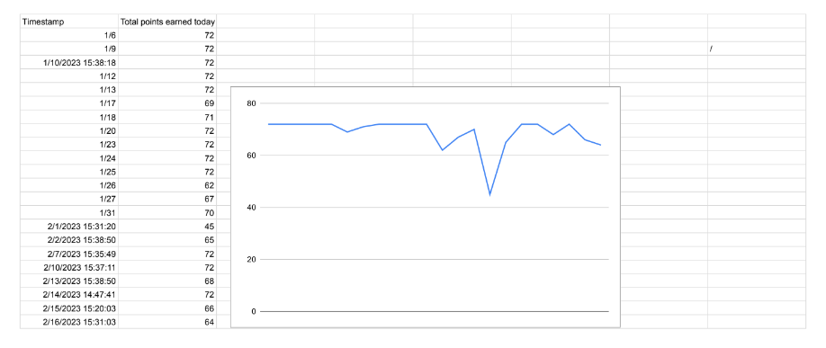
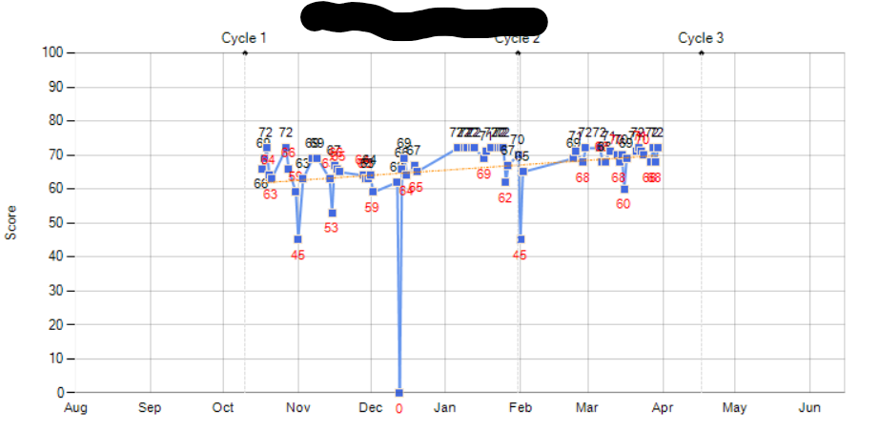

Slide 95
Staff Feedback After Using the QR Code System
It’s fast- it doesn’t feel like “one more thing”
It’s easy to input multiple dates at once if they forget one day
Although it timestamps entries, staff put the date in the Google form if the data points are for different days- I am able to tweak the timestamp on the spreadsheet
Allows staff to provide feedback on the student’s day without putting it on the chart
Some staff have shared details that may have impacted the student’s daily points (early dismissal, came in late, had a rough morning before school etc.)

Slide 96
Progress
Started with 7 students and 6 active CICO facilitators
Currently have 4 students and 3 active CICO facilitators
14 staff members have been trained as CICO facilitators
CICO charts have allowed staff to be flexible when students are transitioning to tier 1 strategic
Charts have continued to be used at the tier 1 level for students to track their progress and to allow families to see progress
Charts have provided behavior data for students who move to tier 3 personalized point cards, behavior plans, IEPs, or 504 plans

Slide 97
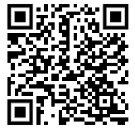
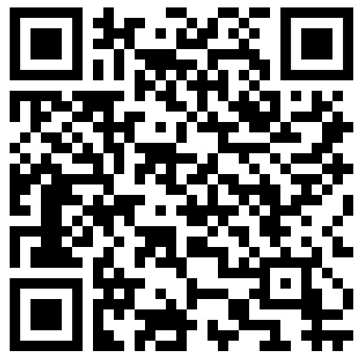
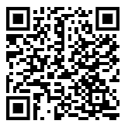
CICO Resources
MTSS Tier 2 Check-In/Check-Out (CICO): The Fundamentals and Tools
CICO: Check-In/Check-Out Module
CICO INITIATIVE Google Drive

Slide 98
Progress Monitoring Your Tier 2 Interventions Overall
https://storyset.com/people

Slide 99
Progress-Monitoring Happens at 2 Levels
Within Interventions
How are the students progressing?
Across Interventions (the Balcony View)
How are the interventions doing?

Slide 100
Tools to Help You See That Balcony View
Tier 2 Tracker - Aggregate Version
Excel format
Google Sheets format
Tutorial PPT
Tier 2 Tracker - Disaggregate Version
Excel format
Google Sheets format
Tutorial PPT
DE-PBS Project Tier 2 Resources webpage

Slide 101
Three Methods for Examining Your Data
Method 1 - Look at percentages in Tab 1 Method 2 - Look at tabs for each intervention Method 3 - Look at tabs for each month
Which interventions seem to be working?
(i.e., at least 70% of students responding)
Which interventions don’t seem to be working?
(i.e., less than 70% of students responding)

Slide 102
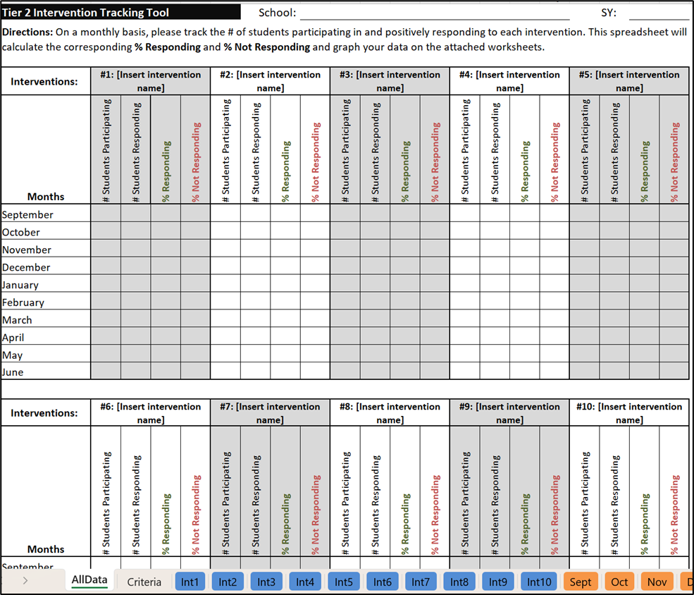
Tier 2 Intervention Tracker - Aggregate Version
Can track up to 10 interventions
Automatically calculates student response rates
Automatically graphs your data

Slide 103
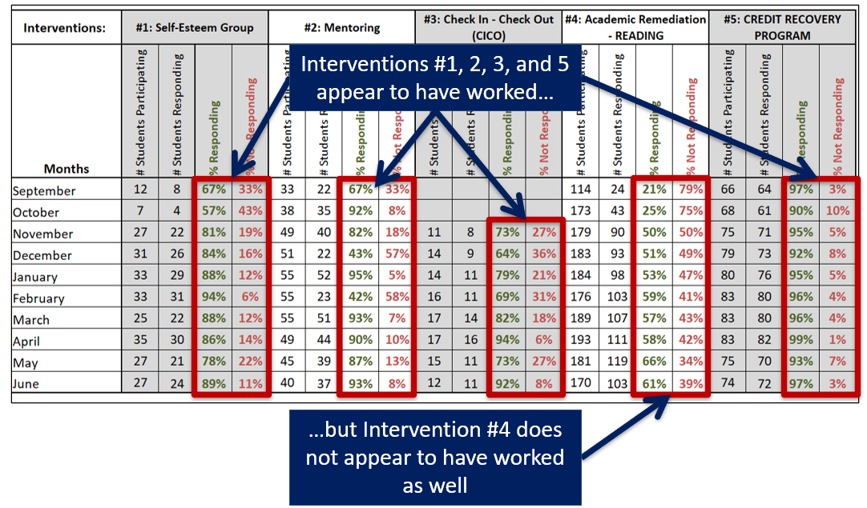
Aggregate View - Noticing Trends in Your Data

Slide 104
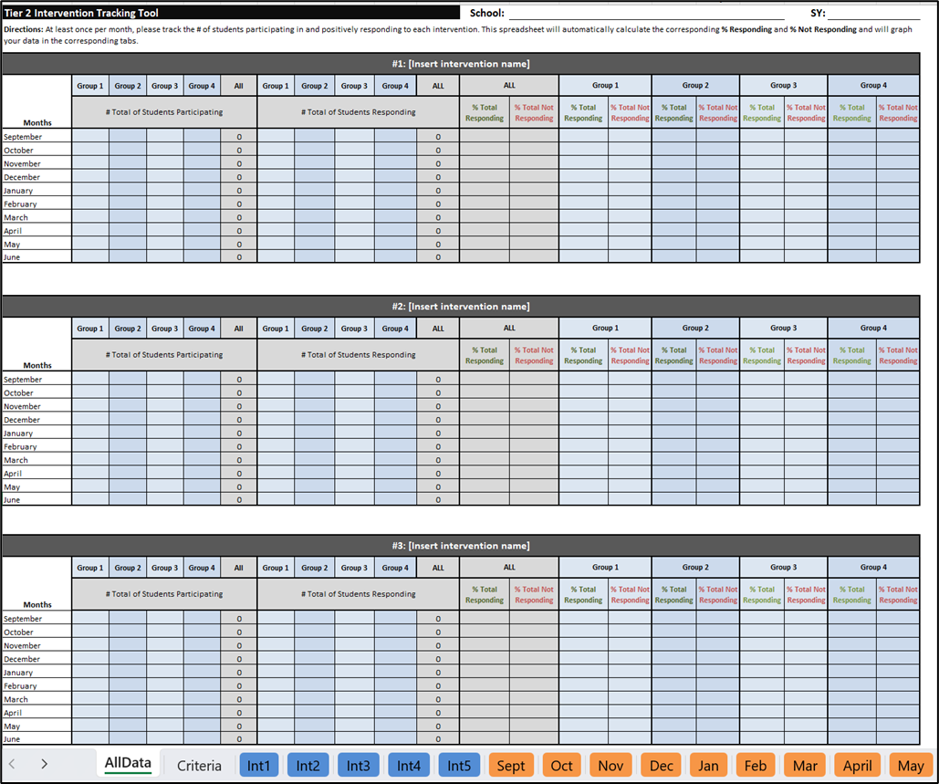
Tier 2 Intervention Tracker - Disaggregate Version
Examine trends and discrepancies across student subgroups
Can track up to 5 interventions, with up to 4 subgroups per intervention
Automatically calculates student response rates
Automatically graphs your data

Slide 105
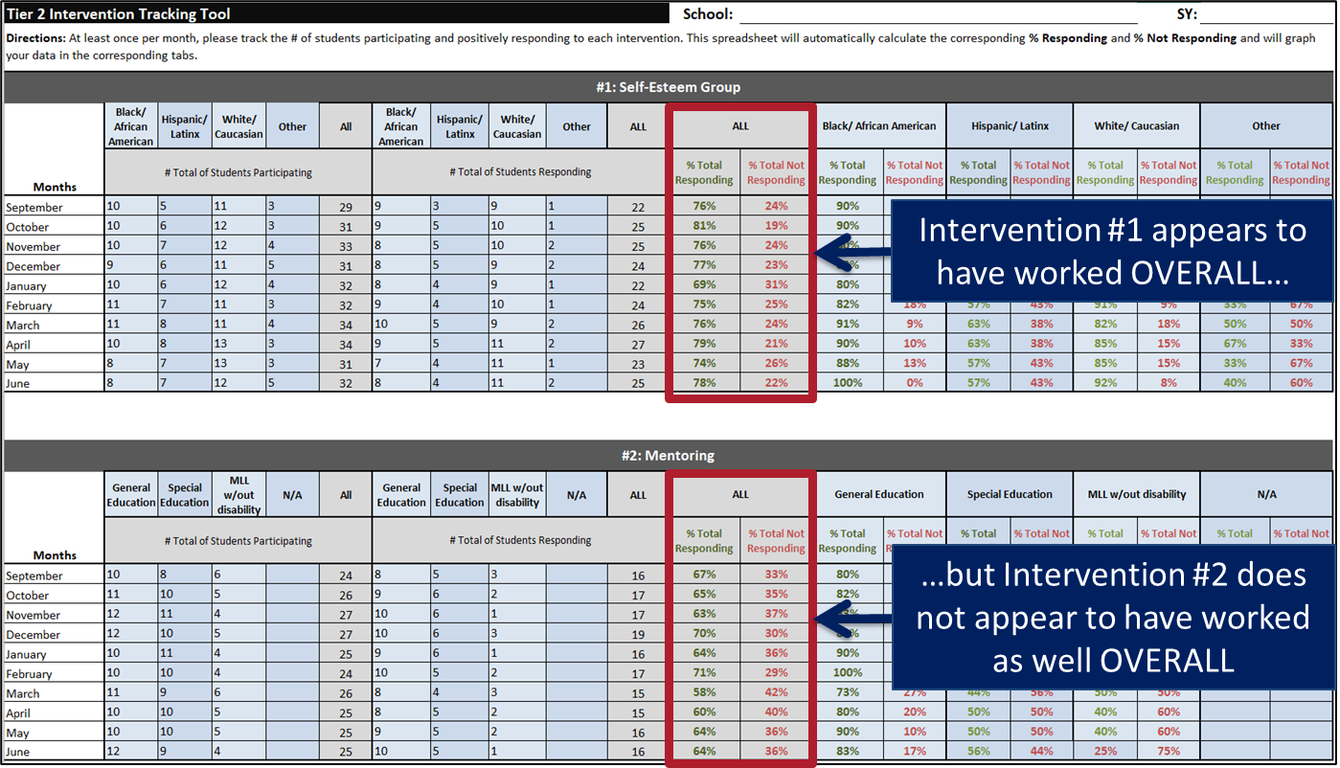
Disaggregate View - Noticing Trends Across Interventions

Slide 106
Disaggregate View - Noticing Trends Within Interventions

Slide 107
Disaggregate View - Intervention Graph

Slide 108
Looking at Sample Data…
WHAT DO YOU NOTICE - 10 MINS

Slide 109
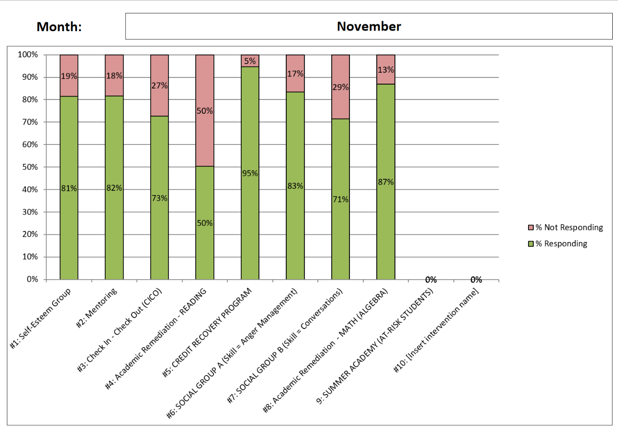
ACTIVITY: Aggregated Data - Monthly View
What do you notice?

Slide 110
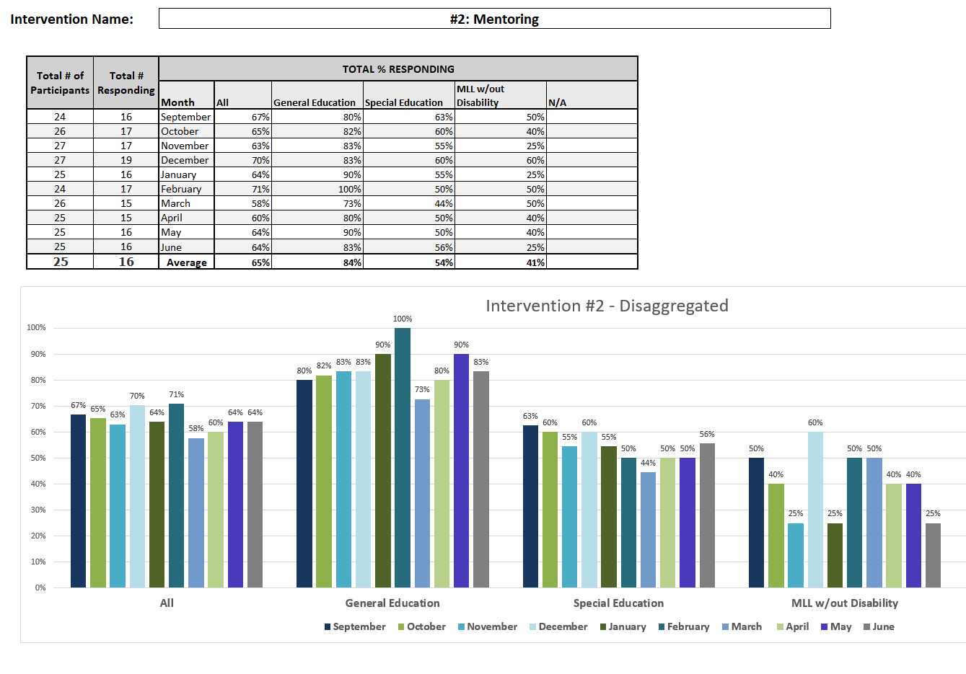
ACTIVITY: Disaggregated Data - Intervention View
What do you notice?

Slide 111
Reflecting on Your Data
Look for trends/ discrepancies in your data
Identify potential contributing factors*
Less than 70% of students responding?
*See tracker tutorial slides for reflection prompts and guidance!

Slide 112
Tier 2 is A Team Sport
https://storyset.com/people

Slide 113
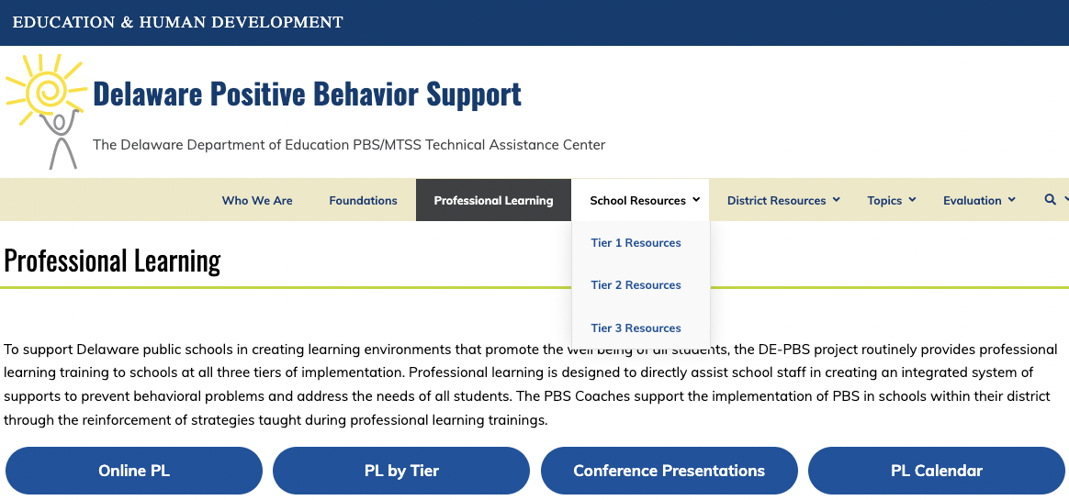
PL Resources for All Tiers

Slide 114
Routinely assess your Tier 2 system fidelity …

Slide 115
What is 1 implementation idea or tool
that you want to explore more?
https://storyset.com/people

Slide 116
Your feedback makes our work better and brighter.
Thank you for completing today’s feedback survey!

