Slide 1
Moving from Exploration to Implementation of a Universal SEB Screener
Sonia Songui, LPCMH; Capital School District
Christina MacKerchar, Ed.S., NCSP; Colonial School District
SEBW Conference
August 9, 2023
Notes:
Christina

Slide 2
Session Objectives
At the end of the session participants will:
Understand screening within the context of MTSS
Understand how to utilize the principles of implementation science to identify and implement a tool that fills a gap in their district’s screening process.
Understand the importance of an SEB screening evaluation process to ensure adherence to fidelity measures
Learn how to build district-wide capacity and sustainability following a small universal screening pilot
Notes:
Christina

Slide 3
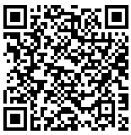
Session Materials
Scan here to access presentation slides and additional resources:
https://www.delawarepbs.org/2023-social-emotional-and-behavioral-wellbeing-conference/
Notes:
Christina
https://www.delawarepbs.org/2023-social-emotional-and-behavioral-wellbeing-conference/
Niki to add information for participants to access materials from session.
Colonial materials:
Tier 1 problem solving template: https://docs.google.com/document/d/17sJM-4fMKasZ6WNaGUFEqMA-hWSrjuiY/copy
Tier 2 intervention map template: https://docs.google.com/spreadsheets/d/1bcZOEbVA_QhXCksl_j9GQ-ADZZWFMqwXGWYUZjLeL2Q/copy
Universal Screening Coordinator roles and responsibilities: https://docs.google.com/document/d/1iv0aDYIVLkwJwcxMpv65uUMHadFgEFK1/copy
Book: Conducting Behavioral and Social-Emotional Assessments in MTSS: https://www.taylorfrancis.com/books/edit/10.4324/9780429355790/conducting-behavioral-social-emotional-assessments-mtss-nathaniel-von-der-embse-stephen-kilgus-katie-eklund
Capital Materials:
Taxonomy of Intervention Intensity
Relationship Mapping: Making Caring Common
Capital School District Relationship Mapping
Capital School District Tiered Interventions
Universal Screening Hexagon Tool (Niki)
SHAPE Screening Guide
School Mental Health Collaborative: Best Practices in Mental Health Screening
Screening for Behavioral Risk in Schools

Slide 4
Project DelAWARE is a collaborative effort between the Department of Education (DOE), The Division of Prevention and Behavioral Health Services (DPBHS), the UD Center for Disabilities Studies (CDS), the Delaware PBS Project, the UD Center for Drug and Health Studies (CDHS), and three local school districts – Capital School District, Colonial School District, and Indian River School District. Funding for the project is provided through a 5 year federal SAMHSA (Substance Abuse and Mental Health Services Administration) grant.
The overarching purpose of Project DelAWARE is to implement evidence-based mental health services in school settings within the context of the Multi-Tiered System of Support (MTSS) in order to promote wellness and resilience for school-age youth and to improve access to mental health services.
WE ARE IN THE LAST YEAR OF GRANT IMPLEMENTATION
Notes:
Sonia
DE-PBS supports the MTSS TA through the grant to partner LEAs
In effect Fall 2019

Slide 5
Project DelAWARE Goals:
Goal 1: School staff will recognize the principles of MTSS and will understand the referral process to access mental health services for students.
Goal 4: Each school will implement a mental health screening process for students and provide mental health services that are evidence-based and proven effective.
Notes:
Sonia

Slide 6
The DE-PBS Project serves as a technical assistance center for the Delaware DOE to actualize the vision to create safe and caring learning environments that promote the social-emotional and academic development of all children.
The statewide initiative is designed to build the knowledge and skills of Delaware educators in the concepts and evidence-based practices of Positive Behavior Support (PBS) as a Multi-tiered System of Support (MTSS).
https://www.delawarepbs.org/universal-screening/
Notes:
Sonia

Slide 7
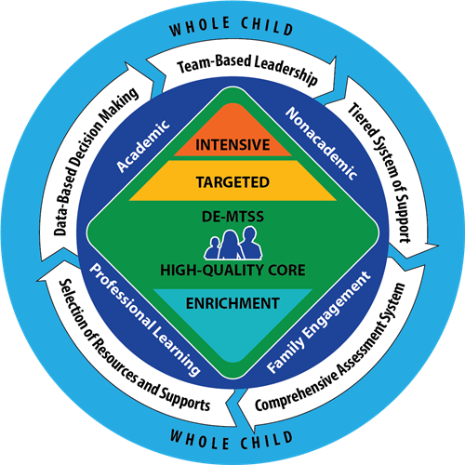
Delaware MTSS and SEB Screening
DE MTSS Regulations require schools to implement a multi-level prevention system that includes high quality universal supports to all students.
Student response to these supports are monitored by a universal screening process, which enables teams to proactively identify (and address) needs at the school, grade, class, or student level.
Notes:
Christina

Slide 8
So, what is the universal screening process?
Tier 1 core instruction delivered with fidelity to all students​
Multiple gating procedure to determine when student support is needed
First stage is universal screening to identify students who may need additional supports​
Second stage (within two weeks) is data analysis to confirm there are specific areas of need for Tier 2 supports​ (based on results, identified students matched to supports​)
If 20% of students in a classroom are not meeting a benchmark, consider the need for additional classroom, instructional and systems level supports and strategies​
Notes:
Christina
Reminder that tier 2 and 3 should be layered from an effective tier 1
Reminder that screener monitors student response to tier 1

Slide 9
A Comprehensive Universal Screening Process
Universal SEB Screening Tool | Teacher/Caregiver/Student Referrals | Early Warning Indicators (grades, attendance, behavior referrals)
Collected/Reviewed 2 or 3 times per year | On-going review | Quarterly/On-going review
Data informs all tiers of supports
Tier 1 | Tier 2 | Tier 3
Inform universal prevention efforts (e.g. lessons to create/revise/revisit) | Collect or review additional data to understand student needs. Match students to existing interventions based on data-based decision rules (problem solving conversations) Inform the development of new group interventions (systems conversations) | Collect additional data to understand student needs and identify appropriate supports (e.g. risk assessment, secondary screening tool, FBA, observations, interviews)
Notes:
Christina
Discussions at the State level raised lots of questions about defining universal screening as a practice; which resulted in a document that lays the groundwork in our State. Top Ten questions.
I will share this document but also point out these key items.
A comprehensive screening process identifies student needs, across the tiers of support, using multiple sources of information
Our focus is on adding a tool - that fills a gap in your existing procedures

Slide 10
Stages of Implementation (Fixsen et al., 2005)
Stage | Implementation Activities
Exploration (select) | Develop a leadership team responsible for implementation, with a shared understanding and vision for SEB screening Complete tool selection process
Installation (prepare) | Determine readiness criteria for pilot sites Create district protocols for pilot sites (e.g., consent, introducing the screener) Organize/prepare school team(s) to follow protocols for screener use
Initial Implementation (start small) | Coach school team(s) through screener administration and follow up Evaluate effectiveness of district protocols and screener Make adjustments and expand to other implementation sites
Full Implementation (way of work) | Routine coaching and professional learning Routine use of screener data for decision making across all levels
Sustainability (adjust) | Make ongoing adjustments to sustain implementation and positive outcomes
Notes:
Christina
You will hear from two of our three LEAs - Capital will focus on Exploration and installation
Colonial will focus on Installation and initial implementation
Add- adapted from kent mcintosh

Slide 11
Capital School District
Located in Dover, Delaware (State Capital)
12 Schools
6,278 Students in grades Pk-12
Minority Enrollment: 71%
Students with Disabilities: 23%
ELA Proficiency: 33%
Math Proficiency: 33%
Graduation Rate: 84%
Notes:
Sonia
Capital School district is located in Dover, Delaware. Dover is the capital of Delaware and is located in Kent county. It is the second largest city in the state, behind Wilmington Delaware. Our community is rich in history and diversity. It is home to Delaware State University, which is a historically Black university and houses an underground railroad route, which helped more than 3,000 slaves reach freedom in the 19th Century. Additionally, in Dover you will find the Dover International Speedway which hosts numerous Nascar events each year, Dover Air Force Base, which is home of the Department of Defense's largest aerial port and nearly 9,000 service members, civilians and families, and you will find a thriving Amish community.
As you can see, Dover Delaware is an extremely historic and diverse community that is comprised of a mix of uban, suburban and rural communities.
Capital School District serves over 6,000 students in grades Pre-K through 12 in 12 school buildings. We have 7 elementary schools, 2 middle schools, one for students in grades 5 and 6 and the other for students in grades 7 and 8, and one comprehensive high school. We have two specialized community schools which serve students throughout the county with special academic and behavioral needs in grades PreK-12.
Our student body is also extremely diverse. About 50 % of our students identify as Black, 29% identify as white, and 13 % identify as hispanic.
Due to our high rate of poverty, our district is a Title I district where all of our students are provided with free breakfast and lunch services.
About 23% our students receive special education services
About 33% of our students demonstrated proficiency on our state math and ela assessments, and our high school graduation rate is 84%

Slide 12
Exploration
Exploration

Slide 13
Assemble a Team
District Level Team:
District Administrators
SAMHSA Project Aware Team
SAMHSA Technical Assistance Support Partners
School Level Team:
School Administrator(s)
School staff with knowledge and training in mental health
School-based community providers
Students, family members, community members (as appropriate)
Notes:
You don't always need to create a whole new team for screening. Consider what groups already exist and are working on something related to health/mental health/academics that we can expand.
Community members such as interpreters, clergy, and community program staff can also be important for consultation and referral to programs that may be more accessible to to students and families.
School screening teams must include students and families and consider communication with students and family members in a culturally responsive way throughout the screening process, from garnering input to providing results and referrals for follow up.
Including students as critical team members helps to ensure cultural relevance for and support from students and families.
Consider..how does your school screen for academic performance? Are there people or process that could be included in mental health screening?
Who (staff, family, community members) had expressed interest in mental health, collecting and analyzing data, or systems-level change? Can they lead or be involved?
In many cases, a school psychologist or school mental health clinician may undertake the leadership role or divide the role according to given grade levels.

Slide 14
Role of the Team
Planning the screening process
Administering screening measures
Reviewing data to identify students at imminent risk
Coordinating follow up supports as needed

Slide 15
Review Data to Clarify Needs
Questions to consider:
What data do we have access to?
What data do we need?
What do we know?
What don’t we know?
What groups do we want to know more about?
Data Sources:
Attendance
Office Discipline Referrals (ODRs)
Grades/GPA
Nurse Visits
Counselor Visits
Referrals (Teacher/Caregiver)
Notes:
Important to examine existing data before making a determination to engage in screening.
Careful to understand that looking at ODRs will help in identifying students who are externalizing behavior problems (i.e. disruptive behavior, attention problems) than with other behavioral and mental health problems (concentration, anxiety, depression, adaptive skills,) The reliance on ODRs to identify at risk student place the focus primarily on students with externalizing behavior problems, passion over tidnes at risk for internalizing behavior concerns.
Additional data points are necessary to conduct more thorough school wide identification of students in need
What data do we have access to?
What data do we need?
What do you know?
What don’t you know?
What groups do we want to know more about

Slide 16
Cultural Considerations
Complex stress related to poverty, immigration, and language barriers
Cultural beliefs about mental health and how concerns should be addressed
Access or barriers to services for historically marginalized groups
Preferred assessment processes
Accessibility to culturally and linguistically diverse populations
Tool’s predictive effectiveness for the school’s target population
Notes:
Take into consideration cultural considerations:
It is important to understand cultural values and unique consideration of your school community when implementing school mental health screening and supports
Complex stress related to poverty, immigration, and language barriers
Cultural beliefs about mental health and how concerns should be addressed
Groups that have been historically marginalized an undeserved amy have difficulty accessing or receiving mental health care in a timely and appropriate manner
Across cultural groups, research indicates that families are more supportive of screening and assessment processes that take a strengths based approach
If a tool’s predictive effectiveness has not been fully researched fora school’s target population, the findings may not be as reliable or vaid as the finding for students from populations o which it has been normed and studied

Slide 17
Establishing Shared goals
Clarify goals of Screening
Cultural considerations
Strength based
Internalizing
Notes:
It is imperative to clarify the goals of screening prior to selecting screening tools or communication to those outside of the screening team about screening administration.

Slide 18
Buy-In
Provide information and gather feedback from several groups at various points regarding:
Benefits of Screening
Communicate screening process and procedures (implementation, scoring, referral process)
Challenges and Concerns related to screening
Consent and privacy considerations
Solicit volunteers
Notes:
Agenda item at staff and parent meetings: feedback can be elicited at regular staff meetings, back to school night, and PTa and other caregiver sponsor activities.
Screening teams should collaborate with school staff and community providers tos support screening at different stages of the process. For example, buy in and availability of school based mental health professionals need to be considered to allow for appropriately staffed administration and follow up support when needs are identified
Teachers and paraprofessionals can be critical to help with classroom administration
When coordinating follow up supports, ensure the recommended school based and community based programs have the capacity to receive new referrals in a timely manner.

Slide 19
Readiness
Readiness

Slide 20
SEB Screener Selection
Population
Feasibility and Usability
Time
Psychometric Evidence
Notes:
Review Existing Tools and select those that align with your goals
The Ohio PBIS Network (2016) has identified the following considerations to help schools select an appropriate screening tool.
Population
A screening instrument should always be chosen based on its relevance to the school’s demographics and characteristics.
Screeners must always be age-and developmentally appropriate.
Ideally, a screener should have been validated or normed on a sample similar to the population being evaluated.
Many student and contextual factors (e.g., gender, ethnicity, socioeconomic status, home language, parent involvement) have been shown to affect cut scores and overall prediction of risk status.
Feasibility and usability
It must be practical to universally administer the screener within the desired context, including clear instructions and examples of any difficult concepts.
The cost of the screener should not outweigh the benefits obtained as a result of the process.
Involved stakeholders (e.g., students, parents/guardians, teachers and administrators) should consider the screener to be acceptable and useful.
Time
Consider the amount of time to collect, score, enter, manage and analyze screener data, in addition to administration time.
Personnel time to train staff in the administration and completing the screening process is an additional consideration that may be more important than the physical cost of materials.
Psychometric evidence
Reliability: the degree that the chosen screener results in similar scores each time it is used.
Validity: the degree that the chosen screener measures what it is supposed to measure.
Screeners should have valid cut scores, which help reduce false positives and negatives and assure that students are receiving the services they need.
False positives may be more desirable than false negatives with regard to screening (e.g., it is better to catch too many students than too few).

Slide 21
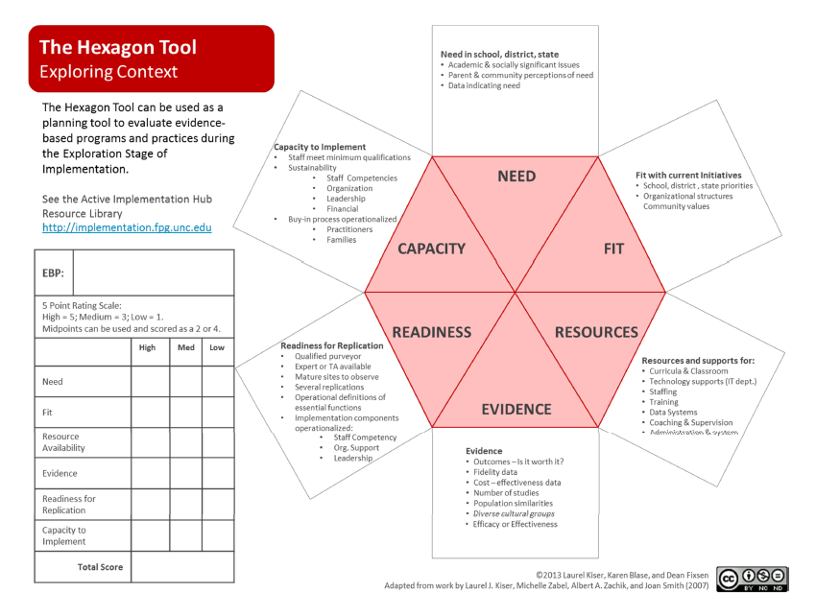
Notes:
Broad factors to consider when doing early stage exploration of Evidence‐Based Practices
(EBP)/Evidence Informed Innovations (EII) include:
Needs of students; how well the program or practice might meet identified needs.
Fit with current initiatives, priorities, structures and supports, and parent/community
Values.
Resource Availability for training, staffing, technology supports, curricula, data systems
and administration.
Evidence indicating the outcomes that might be expected if the program or practices
are implemented well.
Readiness for Replication of the program, including expert assistance available, number
of replications accomplished, exemplars available for observation, and how well the
program is operationalized
Capacity to Implement as intended and to sustain and improve implementation over
Time.
Modified tool specific to screening shared in resource folder

Slide 22
Adoption

Slide 23
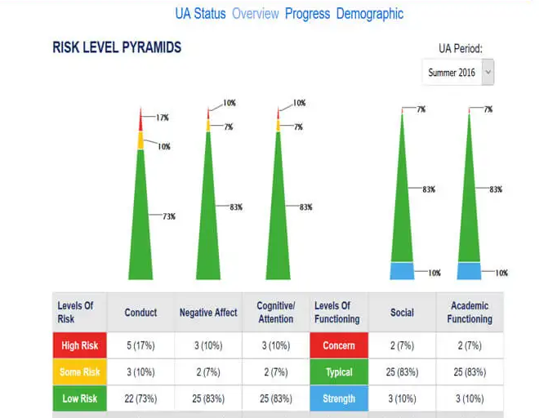
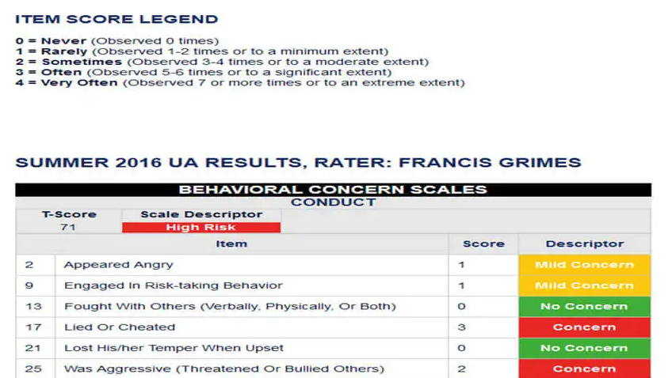
Notes:
We liked the access we had to support- responsive
Data was easy to interpret
Data was represented in multiple ways
Short time to administer
Technology was compatible with our existing SIS
Resources- sample letters, actual assessments were available
Progress monitoring
Looked at risk level and SEL indicators
Does ask the critical question

Slide 24
Training
Training screeners in the use of the tool
How to use data
Preparing students and families

Slide 25
Determining Target Group and Timing
Who should we screen?
When and how often should we screen?
Notes:
Start Slow or small
When to Screen
Decide how many time points you will screen- Delaware regs say 3 times per yea
If screening at the beginning of the school year, you may want to wait until 4-6 weeks for students and teachers to readjust- DE regs say 4-6 weeks
Mid year and end of year screening can help to assess progress and capture changes that occur through the year
When conducting end of year screening, be mindful that students switch will leaving for summer which can present challenges for timely intervention. Also, end of year data may not be valid for student when school starts in the fall
How will you ensure that data moves along with the student for longitudinal monitoring
Consult with teachers, admin and distinct calendar about best times to screen
Consider non-instructional times like advisory periods, homeroom
Who to Screen
Screening students during important transition grade levels
Targeting specific classes across grade levels that already present risk factors
Teacher referral
Pilot screening with select teachers
Program/Intervention evaluation
Infuse into existing screening opportunities (i.e. vision, dental, academic, school climate)

Slide 26
Determine Choice of Informant
Consider who is able to provide the most valuable data
Student
Teacher
Parent
Notes:
Consider who can provide the most relevant and valuable data to inform evidence based intervention
Student self support even in early grades can contribute to unique and valuable information that is distinct from teacher ratings
Teachers are most commonly used given their knowledge of normative student behavior and the extensive amount of time they spend with students. Teachers can provide valuable information regarding SEB functioning of the students (particularly K-5)
To increase accuracy and consistency of ratings amongst teachers, schools should provide pd and training to teacher prior to rating their students.
Parents also provide valuable insights into their own children’s seb functioning- particularly with younger children as parents can assess behaviors and emotions across various contexts and hae unique insight to values and norms outside of school .
As students get older they become more accurate informants of their own behavior and can reliably assess their own functioning. Self report can provide valuable information to guide subsequent intervention planning and increase overall student engagement into the interventions system.
Anxiety or depression may be easier or student to rate given the largely internalized nature of their concerns.
Self report data at the secondary level may be an important consideration given the increased prevalence of seb concerns in middle and high school
Important to provide family and youth voice and staff input to informe implementation of a seb support system.
Determine who will complete screener (student, caregiver, teacher)
Determine who will have access to the data

Slide 27
Student Assent
Gain students’ voluntary assent for participation in screening
Provide education so that students can make an informed decision
Communicate that there is not disciplinary or academic consequences for choosing not to participate
Notes:
Student assent is the willing agreement of a student to participate in an activity for which the purpose and process has been explained and any alternatives have been discussed..
Provide student voice

Slide 28
Type of Consent: Active vs. Passive
Type | Definition | Strengths | Limitations
Active Consent | Student may only participate with written parental consent | Ensures consent is informed Often aligns with district protocols Establishes trust between schools and families | May prevent access to minority or marginalized students Overall participation decreases
Passive Consent | Parent or guardian’s nonon response serves as consent | Allows access to greatest number of students (on average 79%-100%) | Gate 2 screening requires active consent
National Center for School Mental Health
Notes:
Screening teams must consider if they have the proper consents that explain how the data would be stored, who would have access, and how it would be used to include it in the data system.

Slide 29
Team Reflection
Notes:
After conducting the pilot, teams should meet to reflect upon the process and solicit feedback from staff, students and parents involved in the screening process
Develop a reasonable timeline of actions beginning with planned data review- administering the screener. Discuss grows and glows, identify things that went well, any concerns and things to improve process as well. Identify who will be responsible for share data from screening, how will data be used and response to any critical alerts that were ascertained in screening process.

Slide 30
Team Reflection
Ensure teams are prepared for process by building capacity, expertise and fluency with tool and the use of data to inform decision making.
It’s imperative to set data rules so teams are ready to respond to screening results.
A universal screener process should start “slow” or small as a safe approach. This allows the school to test out the procedures and gain valuable feedback.

Slide 31
Team Reflection
Allows the school to make critical changes to the screening process before scaling the program up.
Allows teams to understand how to plan and make decisions from the data collected through the screening instrument.

Slide 32
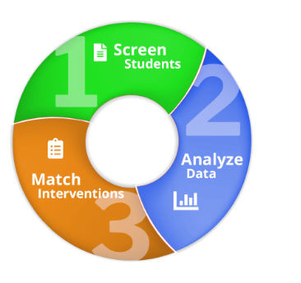
Analysis of Data
Determine reliability of data and address any concerns that may have impacted the validity of data:
Reliability: the degree that the chosen screener results in similar scores each time it is used.
Validity: the degree that the chosen screener measures what it is supposed to measure
False positives may be more desirable than false negatives with regard to screening
Notes:
After the pilot, gather feedback, troubleshoot, and assess feasibility for screening the whole school. Ensure that data is reliable and aligned youth with identified need to appropriate intervention. Discuss the possibility of scaling up target group to entire school. Is there enough resources to meet needs of the entire population?

Slide 33
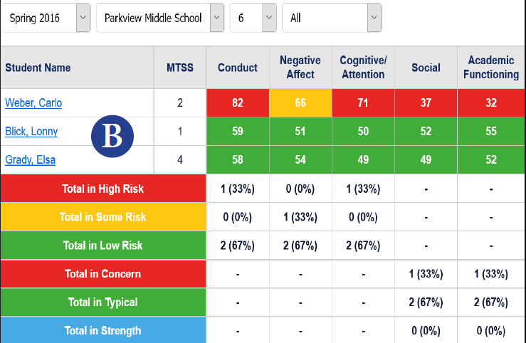
Response Plan Based upon Risk
High risk- same day
Moderate risk- within one week
Low risk- within a reasonable time frame as determined by team
Prepare crisis teams and local community mental health providers to be on call in advance of screening
Notes:
Develop a reasonable timeline of of actions beginning with planned data review- typically within 2 weeks of administering the screener

Slide 35
Stakeholder Feedback
Surveys
Focus Groups
Interviews
Notes:
Asked participating staff to complete feedback survey about their experience with administering the survey- what went well, what was challenging? What recommendations do they have for future administrations of the survey?
Sat with the screening teachers and reflected upon the process at a PD day and go additional grows and glows
Provided students with a survey asking about their experience, if the questions were easy to understand, if they knew what screening was, and why they were being screened. (this helped with future training for students- we found that we needed to define some of the terms within the screener)
Identify PD needs for staff- increased pd on the tool itself (critical question, affirmative vs negative questions)
Met with students individually and in small groups to ask about their experience and to answer any questions they had.

Slide 36
Communicating Findings with Stakeholders
Disseminate data amongst key stakeholders, including partners, teachers, students, administrators and/or district leaders.
Establish procedures for communicating concerns to families
Notes:
Teach them how to interpret and utilize data- data to be used for Tier I planning (SEL curriculum, PBIS) , teacher PD needs (relationship building, classroom management
Families- letter with outcome of screener (Tier I)
Tier II and III- Tier II contacted families to invite students to participate in tier II interventions; Tier III- contacted individual families about school based mental health and community interventions (Project AWARE)

Slide 37
Communicating with Families
Share concerns and screening results with parents/guardians.
Provide observations and concrete examples any additional supportive screening data.
Refrain from making judgments or assumptions about the parents/guardians’ decisions regarding treatments and/or services.
Provide current and accessible information about the student’s risk factors identified through screening
Provide information about local resources for the student and information about parent training and support groups
Substance Abuse and Mental Health Services Administration (SAMHSA)
Notes:
Families- letter with outcome of screener (Tier I)
Tier II and III- Tier II contacted families to invite students to participate in tier II interventions; Tier III- contacted individual families about school based mental health and community interventions (Project AWARE)

Slide 38
Communicating Positive Screen Results
(Tier II/Tier III) to Adolescents
Meet with the student individually in a private setting.
Reiterate the nature and intention of the screening tool.
Discuss range of results of screening (no risk, moderate risk, high risk) and potential reasons why students may fall in one category.
Explain the student’s individual screen results in an open, honest, and direct manner.
Reaffirm that screening is NOT a diagnosis of mental illness, but an indication of potential signs or risk factors.
Explain follow-up procedures for further assessment and supports. Substance Abuse and Mental Health Services Administration (SAMHSA)

Slide 39
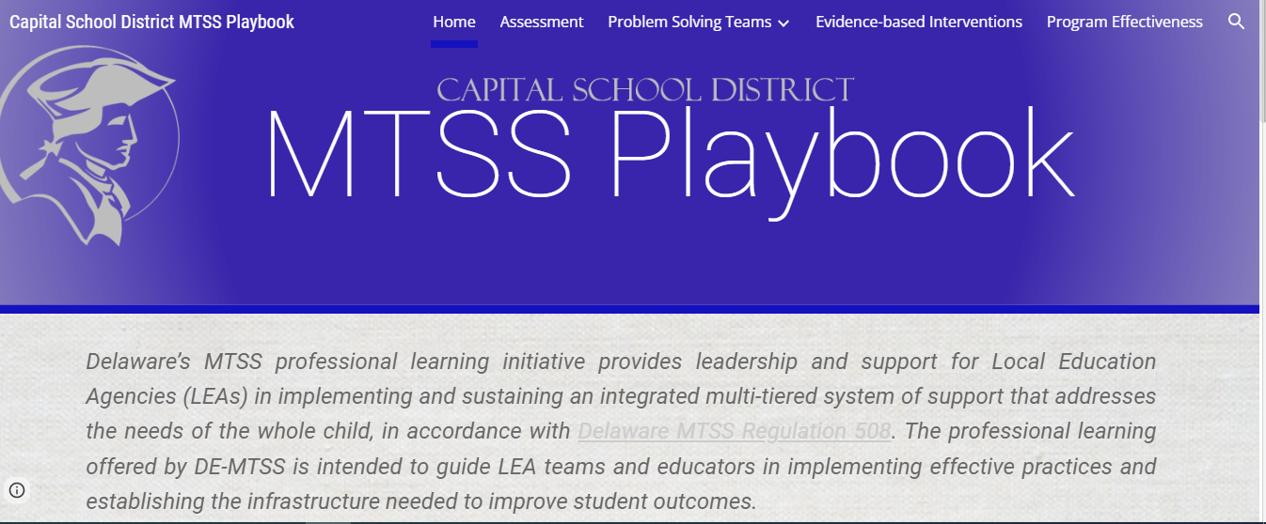
Notes:
All MTSS resources housed here, including SEB Screening
Other resources within the playbook:
Evidence Based Interventions
Evaluation Tools
Agenda Templates
Progress Monitoring Tools (Tier II)

Slide 40
Intervention Matching
Taxonomy of Intervention Intensity
Review existing resources and capacity
Resource Mapping Activity- Making Caring Common
Capital School District Resource Map
Capital School District Tiered Intervention Chart
Notes:
Aligning screening results with appropriate interventions to ensure youth are matched with interventions.

Slide 41
Progress Monitoring
Once students have been identified, problems targeted, interventions implemented, then progress monitoring begins.
Ongoing evaluation of the process, student progress with aligned interventions, identified students at risk who may require further assessment and tracking are crucial components.
Increased attention to assessing the extent of support being provided with fidelity and its effectiveness allows data based decision making to take place that may result in a change to interventions or termination supports.
Notes:
Sharing group- and potentially student level results with key stakeholders in a timely manner. Determine who is responsible for communicating the results of screening with various stakeholders. Strategy to engage parents that most likely will occur if youth identifies with concerns that warrant an aligned intervention.
May include parents, teachers, students and/or district leaders
Aggregate results across groups of students (i.e. grade level, school, demographic characteristics) can be shared with all schools taff, relevant district administrators, parent associations, and in newsletters to let stukjolder know how SEB screening is informing interventions and supports to improve student outcomes.
Results can be compared to current and previous SEB screening data or other data sources to demonstrate potential changes over time.
Sharing results can help school sand district leverag student, parent and community support, as well as funding opportunities for securing additional resources
School teams may need to exhibit caution when presenting data to stakeholders not familiar with seb screening to prevent misinterpretation of results (eg. diagnosis based upon screening at-risk

Slide 42
Documentation

Slide 43
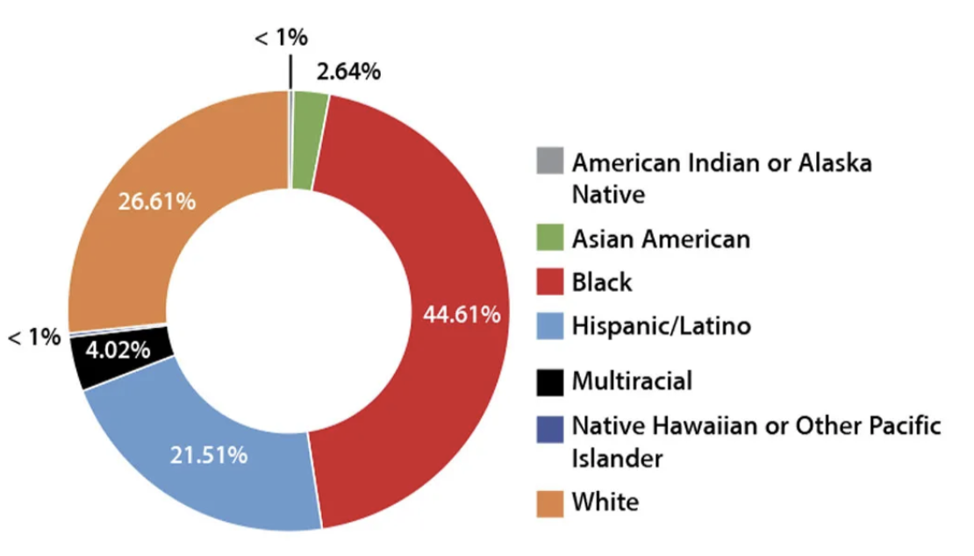
Colonial School District | New Castle, DE
Notes:
Christina

Slide 44
Universal SEB Screening Goals
Use data to provide more targeted interventions to at-risk students
Analyze data to evaluate systems-level needs (school- and class-wide) at a Tier I level
Include a universal SEB screening tool as a part of our process
Notes:
Aligned to DE-MTSS regulations

Slide 45
Getting Started
2019-2020
2020-2021
2021-2022
Gap analysis/resource mapping
--
Determined mySAEBRS (Social, Academic, and Emotional Behavior Risk Screener) would best meet our needs
High school received ongoing state- and district-level coaching through Project DelAWARE
--
Cross-sample of 9th grade students completed the SAEBRS
Larger 9th grade cohort
--
District decided to expand the SAEBRS pilot as a part of our universal screening process
Notes:
Tool you select depends on the need of your district! We selected mySAEBRS because we wanted more information on student voice, as well as information regarding academic engagement.

Slide 46
Expanding the Pilot
Intentionally planned our expansion
Utilized multiple data sources to select 3rd and 6th grade for our pilot
Developed a proposal for a stipend position: a Universal Screening Coordinator for each of our schools
Planned coaching structure: monthly PLC
Notes:
Learned from high school pilot: this is a big undertaking, takes a lot of training and time to support implementation
Does this get coordinated by someone in the building (added to their job description)? School psych shortage…ultimately developed a universal screening coordinator position, which provided us with many different perspectives: group is comprised of school psychologists, school counselors, therapists, a teacher, a math coach, special education coordinators, special education coach, RP coach
Proposed a monthly PLC for all screening coordinators; utilized our gap analysis data to select pilot grades: 3rd and 6th
Data indicated that 4th and 7th grade showed increases in ODRs and decreases in test scores - can we get ahead of this by providing more targeted intervention support for 3rd and 6th grade? (we chose 9th grade for pilot based on 10th grade data showing risk and very high retention rates for 9th grade)

Slide 47
Preparing to Expand
Developed a brief manual: Assessing Readiness for a Universal SEB Screening Process to share with screening coordinators/administrators
MTSS
SEL
Universal Screening process
Universal Screening tool (SAEBRS)
Next steps
Notes:
District expectations: consent, understanding screening, how to use the data through the PLC

Slide 48
Pilot Selection
Guidance provided to PLC:
Pilot will look slightly different for each school depending on building size, teaming structures, etc. and that’s okay!
3rd grade: select two to four teachers who have been trained in Responsive Classroom or are open to implementing new strategies in their classrooms
6th grade: select a team/subject area with strong Tier 1 supports or are open to implementing new strategies

Slide 49
PLC Purpose
✔ Connect
✔ Assess
✔ Analyze
with colleagues across the district to support an effective MTSS framework in each building
readiness to implement a universal screener for social, emotional, and behavioral needs
data to more effectively support students through evidence-based, tiered interventions

Slide 50
PLC: Diving in
Set goal of piloting the SAEBRS during the winter benchmark period (January)
Universal Screening Coordinators passed training/content along to administrators and pilot teachers
Used evaluation survey at the end of each PLC to plan for the next
Notes:
Discuss the structure: content, application, homework, evaluation

Slide 51
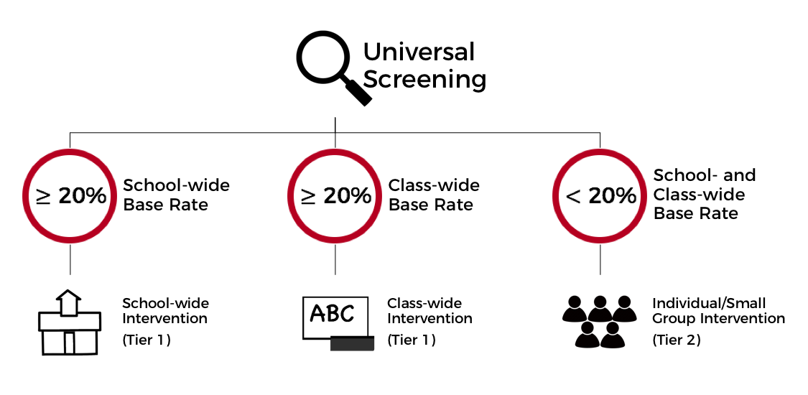
Coaching Focus: SEBA Model
See: Kilgus & Eklund, 2015
Notes:
Used SEBA model to drive our decision making practices
To do this, we needed to ground our work in common Tier 1 practices and move past the misperception that screening is implemented just to place students in interventions/identify those most at-risk. SEBA model aligns with DE MTSS regulations

Slide 52
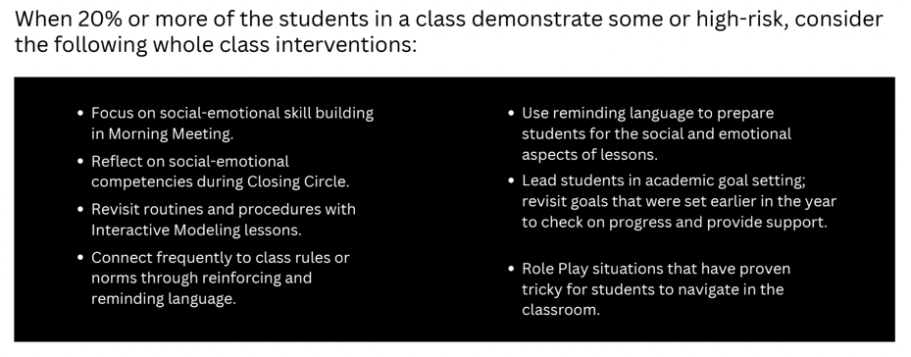
Coaching Focus: Tier 1
District SEL Coaches shared guidance documents on effective Tier 1 practices
Notes:
SEL Coaches shared guidance documents regarding Responsive Classroom practices the universal screening coordinators could easily recommend to classroom teachers piloting the SAEBRS

Slide 53
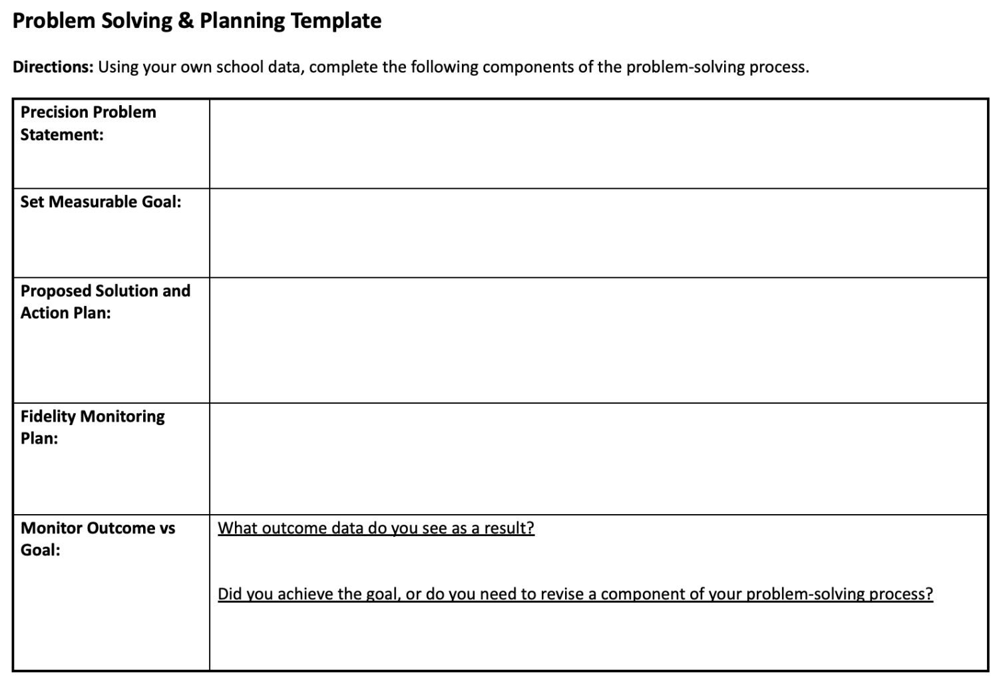
Coaching Focus: Tier 1
Analyze data: class/grade level trends
Utilize problem solving guide to identify areas of need, develop action plan, set measurable goals
Available on the DE-PBS Website

Slide 54
Coaching Focus: Tier 2
Intervention categories: skill building and relationship building
Intervention mapping
Take inventory of currently existing interventions
Develop/refine “in-on-out” rules to enhance data-based decision making
Continue this work with school-based teams
Notes:
Tool is on the website for the session

Slide 55
Tips for Success
Monthly PLCs
Develop a flexible scope and sequence for the year
Templates/spreadsheets
Screening windows added to assessment calendar
Community involvement: presented to school board
District-level coaching support
Notes:
Building a sense of community in PLC - community circles to get to know each other, sharing out successes at each school
Opportunities to share out and present to the group regarding school successes
PLC has been a success - will continue next year
Added resources/tools to the conference website - reach out with any questions

Slide 56
Contact Us!
Capital School District
Sonia Songui, LPCMH: sonia.songui@capital.k12.de.us
Colonial School District
Christina MacKerchar, Ed.S., NCSP: christina.mackerchar@colonial.k12.de.us
DE-PBS Project
Niki Kendall: robertsn@udel.edu

