Slide 1
DE-MTSS
Cadre Meeting
March 7, 2024
DE-MTSS Technical Assistance Center

Slide 2
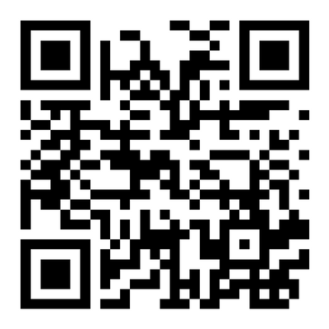
Wifi information:
You can use ‘Hilton Honors’ or ‘Hilton Honors Lobby’ networks, whichever is stronger
A landing page will come up when you try to connect to our internet
Select ‘I have a promotional code’
Agree to the T’s and C’s
Enter promo code Doverp
Access to all materials:
https://www.delawarepbs.org/2023-2024/#march-7-2024
Find a member of the DE-MTSS TA Center if you have any questions

Slide 3
DE-MTSS Technical Assistance Center
The Delaware Multi-Tiered System of Support TA Center proudly serves as a technical assistance provider for the
Delaware Department of Education.
Our TA Center provides professional learning and coaching to support the academic and nonacademic
development of all children.

Slide 4
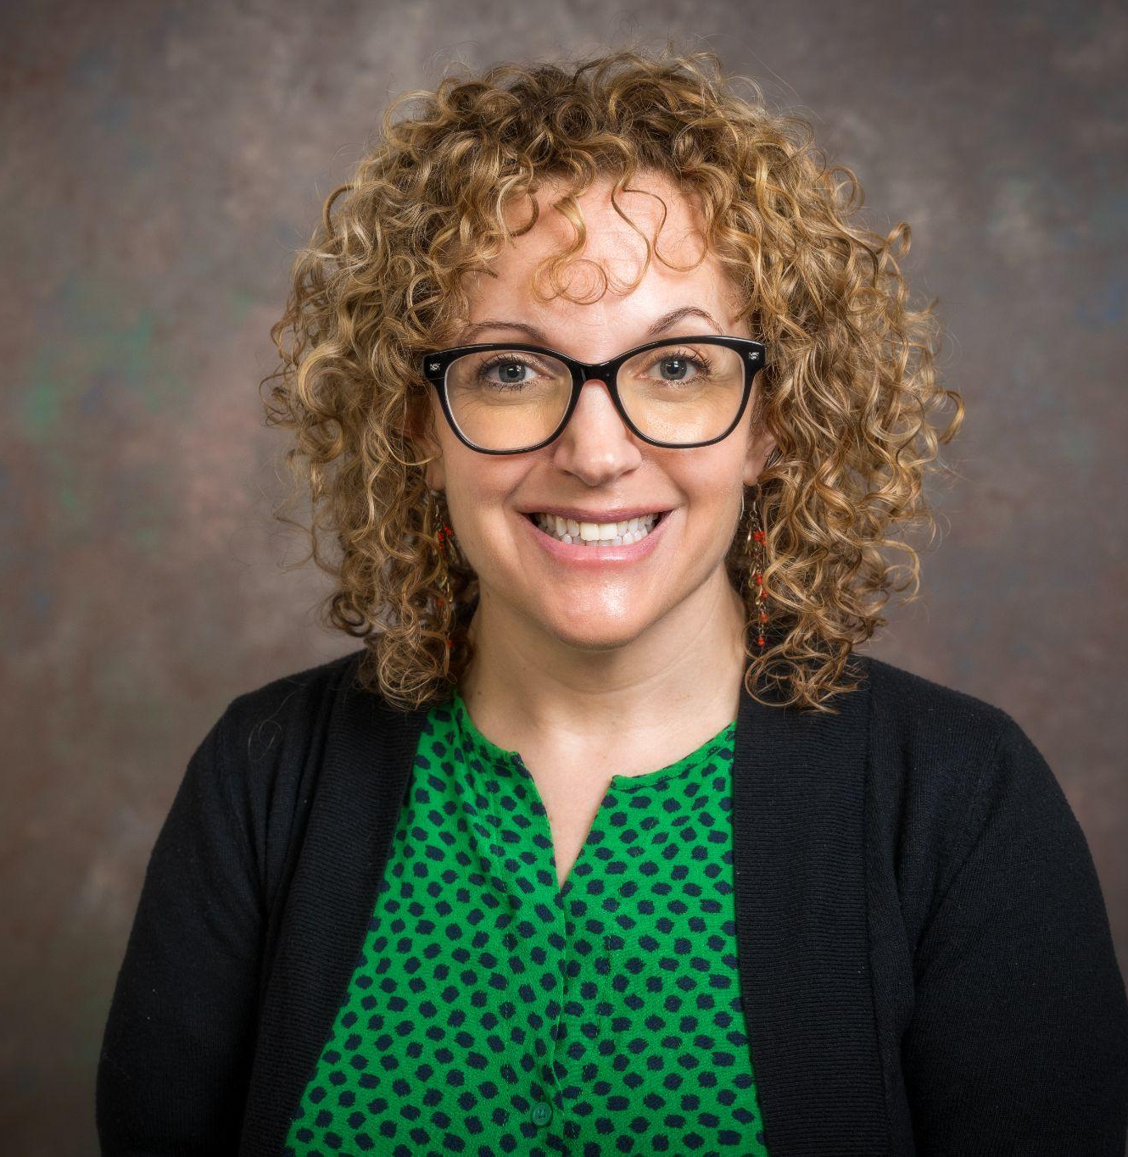
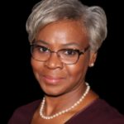
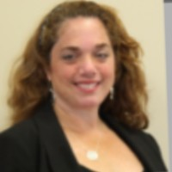
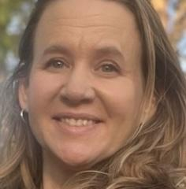
The DE-MTSS TA Center Team
Michelle Bastedo
Deborah Boyer
Valerie Brown
Brigid Dux
Brynn Fallah
Dana Farrior
Kristi Fry
Sarah Hearn
Niki Kendall
Kim McGinley
Megan Pell
Mackenzie Shane
Angelia Wilt

Slide 5
Our Cadre’s Purpose
Support District MTSS Coaches
Serve as conduit between state to district to schools
Promote networking among districts
Create opportunity for feedback on project activities & resources
Share project and national resources
Connect, align and integrate related activities for greater impact

Slide 6
Community Builder: The Compass Points
NORTH - Acting: Let’s do it!
Likes to act, try things, jump right in
WEST- Paying attention to detail
Likes to know the who, what, when, where, and why before acting
EAST - Speculating
Likes to look at the big picture, the possibilities, before acting
SOUTH - Caring
Likes to know that everyone’s feelings have been taken into consideration; that their voice has been heard before acting
https://nsrfharmony.org/wp-content/uploads/2017/10/north_south_0.pdf

Slide 7
Add your name to a text box and drag it to the compass point that is most like you.
The Compass Points
North • You take charge. • You run the daily operation. • You have lists of things to do and you need to get started and get them done. • You get assignments in early. • You don’t have to ask questions to begin your work or assignment. • You drive the work and get it done. • You teach our children a complete curriculum. • You will stitch the mosaic together and do the work. | East • You have the big picture, the frame that needs to be filled in. • You need to see the final product and will work with the end in mind. • You believe in working backwards, understanding by design. • You don’t get a project started until you are clear about the final product. • You teach our children the big concepts. • You know what the mosaic looks like in the end.
West • You ask the hard questions. • You live by inquiry. • You challenge us to identify the details. • You don’t start a project until you are clear about the details. • You make our picture more complete. • You lead by inquiry and engage in thoughtful discourse. • You make us think and teach detailed concepts to our children. • You fill in the details of the mosaic. | South • You take in the information, slow us down, and make sure everyone has voice and is heard. • You include everyone, and make sure the human side is nurtured. • You take care of us and bring up our affective domain. • You make sure the emotional side of our work is heard. • You make sure we are all included. • You teach our children with strong relationships and care. • You add beauty to the mosaic, make sure everyone participates in the creation, and keep us all comfortable.
Name
Name
Name
Name
Name
Name
Name
Name

Slide 8
Name:
My primary Compass Point:
What do you see as the strengths of your style? | What other compass point(s) could you also relate to? South
What style do you find most difficult to work with and why? | What do other people need to know about you so that we can work together more effectively?
I love it!
This is a new idea for me!
I have a connection!
?
I have a question!

Slide 9
In what ways might our preferences impact how we work with others?
How might this information support our team?
Where does our team have gaps in styles?
How might this community builder support our work?
Reflect
https://nsrfharmony.org/wp-content/uploads/2017/10/north_south_0.pdf

Slide 10
Collectively we are: | Operationally defined expectations…
Purposeful & Motivated | Assume positive intent Clear and transparent communication and expectations Work from a growth mindset perspective Be fully present, while still caring for yourself biologically, mentally, and emotionally
Resourceful & Knowledgeable | We are not here to be right, we are here to get it right Seek, offer, and encourage ongoing feedback, reflection, and learning/growth opportunities for all Listen to understand Ask for and offer support and clarification when needed Build on one another’s strengths and areas of expertise
Strategic & Goal-Oriented | Be solution focused Keep students and families at the center of all work

Slide 11
Today’s Topics
Welcome & DE-MTSS Cadre Orientation
Integrated MTSS
District Reflection for Integrated MTSS
Resource Reflection & Sharing Activity
Professional Learning Updates
Data & Data-based Decision Making
Equity Committee Supports & Updates
Wrap-Up

Slide 12
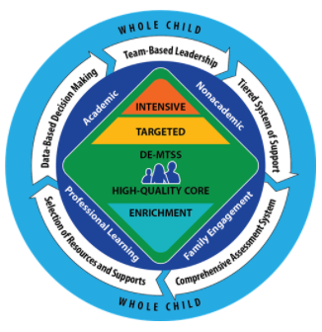
Defining MTSS in Delaware
DE-MTSS is a framework designed to meet the needs of the whole child through an integrated, multilevel prevention system that optimizes team-based leadership and data-driven decision making to meet the academic and nonacademic needs of all students. High quality core academic instruction and non-academic practices are provided as universal supports to all children. Evidence-based intervention and supports are matched to student needs and informed by ongoing progress monitoring and additional formative assessments.

Slide 13
District Reflection for
Integrated MTSS

Slide 14
Engagement check-in
Access?
Book study opportunities?
Highlights?

Slide 15
MTSS District Support Systems
Chapter 6 - Integrating District Support Systems
District-Level Team Checklist For Integrating District Support Checklist Components:
Operationalized implementation steps
Implementation status reflection
Action planning prompts for prioritized steps

Slide 16
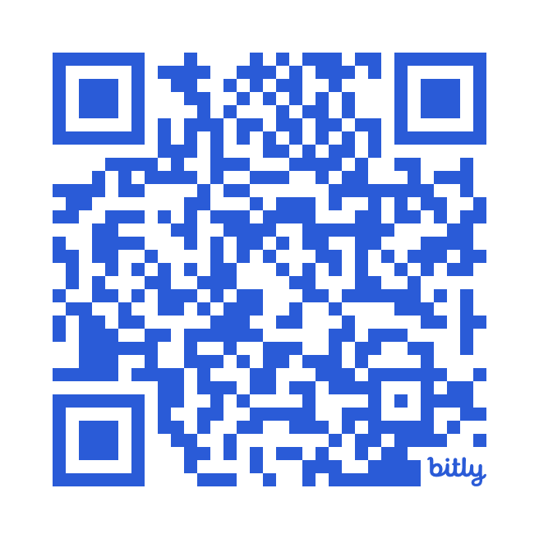
District Support Checklist Activity Steps
Gather with fellow district staff; If solo, feel free to find another solo participant to be a thought partner in review
See QR code or link https://bit.ly/3Te2Baq and locate the checklist file for your district; only work from one file
Reflect on implementation steps and mark status; if unsure leave blank
NOTE: It is OK to not know an answer or not have steps in place. We are all learning & growing!
Please use space under items to capture “Notes/Barriers/Questions”
Data will be summarized for you & notes will help inform TA Center focus

Slide 17
Continuing Our Discussion…
Exploring Current
DE-MTSS Materials

Slide 18
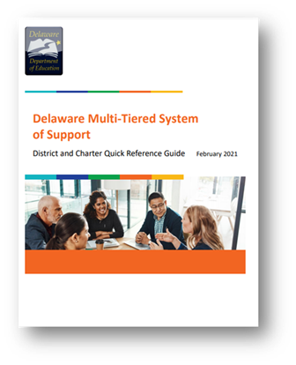
Current DE-MTSS Guide Resources
MTSS Implementation Guide
3 Quick Reference Guides – District, Building/School, Classroom

Slide 19
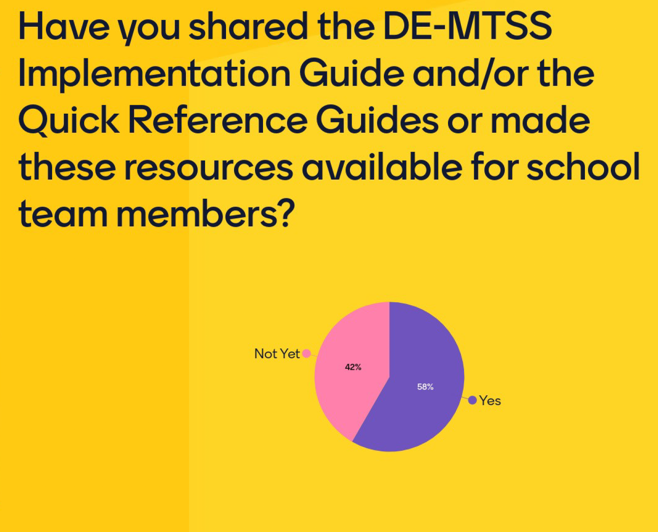
DE-MTSS Guide Resources Poll Questions

Slide 20
DE-MTSS Schoology Modules - PDMS Course 30130
This course has five self-paced modules that provide key information about MTSS and how to implement it in your site.
Module Topic | Guiding Questions
Overview of MTSS | What is MTSS and what are the essential components of MTSS? Which components of MTSS are already in place in my district, charter, or school?
Building an Effective Tier 1 System | Why is Tier 1 critical to successful MTSS implementation? What are evidence-based practices, high-leverage practices, and high-quality instructional materials?
Universal Screening Process | How are screening data used to make decisions within MTSS? What is the difference between a screening tool and the screening process?
Tier 2 and Tier 3 | What is an evidence-based or validated intervention? What are the characteristics of effective Tier 2 and Tier 3 systems? What is data-based individualization (DBI)?
Effective Progress Monitoring | What is progress monitoring and what are the purposes of progress monitoring within MTSS? What are the two types of progress monitoring tools and what distinguishes them? How do we set progress monitoring goals and make decisions based on progress monitoring data?

Slide 21
DE-MTSS Schoology Modules Poll Questions

Slide 22
Overall Utility Poll Question

Slide 23
Cadre Discussion Questions about DE-MTSS Resources
How have these DE-MTSS resources helped enhance MTSS understanding or support implementation of MTSS in your district/school?
How have you utilized these resources in your MTSS coaching? Ideas to share.
Specific ideas, needs, requests when it comes to MTSS implementation resources?

Slide 24
Some of what you shared last time…
You are adapting these tools to your own districts/LEAs (YAY!)
Graphics are utilized in presentations and one-pagers
Resources are being used for monthly coaching with MTSS team leaders (i.e. screening resources)
Quick reference guides and planning tools help guide discussion and recalibrate as an integrated group

Slide 25
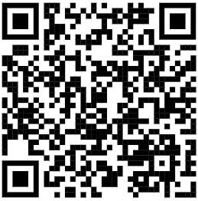
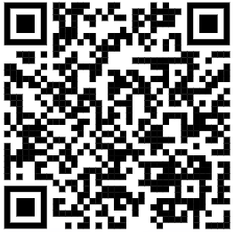
DE-MTSS Resource Activity
Notes:
Implementation tools: https://www.doe.k12.de.us/Page/4415
Professional Learning tools: https://www.doe.k12.de.us/Page/4414

Slide 26
DE-MTSS Resource Reflection Activity
Reorient to DE-MTSS Resources (solo) | 5 min
Small table group discussion/ Jot thoughts on Post-Its What resonates? What’s working? Which section, graphic, tool, etc is your “go to”? What’s missing? What’s not working? What do you still need to support your MTSS coaching? What other strategies/resources have you used to support integrated MTSS? | 10 min
Add your Post-Its to the chart paper around the room and gallery walk to review what others have noted. Please add any additional notes/questions. | 10 min

Slide 27
Professional Learning Opportunities

Slide 28
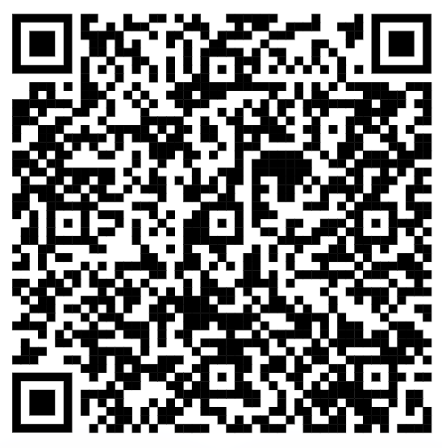
SCAN ME!

Slide 29
High School Forum
So good to see you!
43 folks in attendance
15 districts in the house
Understanding how to collect and use data to build student SEL skills and prosocial behavior has increased - 13/13
Understanding of how other high school are scheduling SEL skill-building has increased - 12/13
Learned about tools and resources to support our nonacademic MTSS implementation - 13/13
Meghan Covert
Christina MacKerchar
Susan Smathers
Jessica Spence-Weikle
&
Adrienne Stansbury and BSD Students

Slide 30
Tier 3 Updates - Recent Events
Prevent-Teach-Reinforce for Administrators
38 attendees
Slides
Survey data from school psychologists
Functional Thinking in the Classroom
55 attendees
Slides
Classroom ABC tracker
Prevent-Teach-Reinforce for Facilitators
48 attendees
Slides
People love the tools!

Slide 31
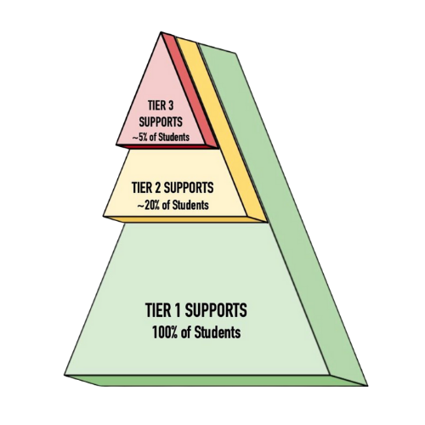
Tier 3 Updates
Upcoming Events:
PTR Coaching
Tier 3 Integrated Networking Session on Progress Monitoring
3/27/24 (10:00-11:30) on Zoom
Link to register
Tier 3 Integrated Networking Session
(Topic TBD)
4/11/24 (10:00-11:30) on Zoom

Slide 32
DE-MTSS & Parent Information Center
Partnering to offer sessions across the school year. Topics include:
MTSS 101
Universal Design for Learning
Universal Screening
SEL & DE-IEP
SPEACS: Augmentative and Alternative Communication

Slide 33
MTSS Resources
MTSS Parent Guide
Overview of MTSS
Breakdown of each tier
Questions to ask the school team
English, Spanish & Haitian-Creole
PIC of Delaware | MTSS (Multi-Tiered Systems of Support) Archives

Slide 34
PL and Delaware Teacher Growth and Support System
SPEACS and DTGSS
Provides background about communication and what to look for when it comes to supporting students who use AAC in the classroom
Dates:
3/12/24- 1-4 pm (Virtual) PDMS #85496
4/23/24- 1-4 pm (Virtual) PDMS #85497
UDL and DTGSS for educators
Explore how to align the DTGSS with Universal Design for Learning (UDL). Learn about UDL, which is an effective framework for tiered instructional strategies within MTSS, and how to use a crosswalk tool to provide educator feedback.
Date:
3/21/24- 4-5pm (Virtual) PDMS # 42379

Slide 35
YMHFA
DDOE is offering FREE virtual YMHFA training courses. Register via PDMS (course #32298), pre-work is required. All sessions are scheduled from 8:30 AM to 3:30 PM.
April 10, 2024 PDMS # 75107
May 16, 2024 PDMS # 75108
June 12, 2024 PDMS # 75109
July 9, 2024 PDMS # 75110
Aug. 14, 2024 PDMS # 75111

Slide 37
Social, Emotional & Behavioral Wellbeing Conference

Slide 38
Data Check-In

Slide 39
DE School Climate Survey Update & Check-in
Survey Administration Directions & Related Materials
Per STUDENT, TEACHER/STAFF, and HOME surveys, detailed directions with ONLINE SURVEY LINKS & sampling guidelines included (Review of directions is essential to the survey process.)
To support HOME survey administration, materials include:
Online Spanish HOME survey link
Printable HOME survey in Haitian Creole
Parent/Caregiver letter/message templates in English, Spanish & Haitian Creole
DSCS Timeline survey window - 2/20-3/29/2024

Slide 40
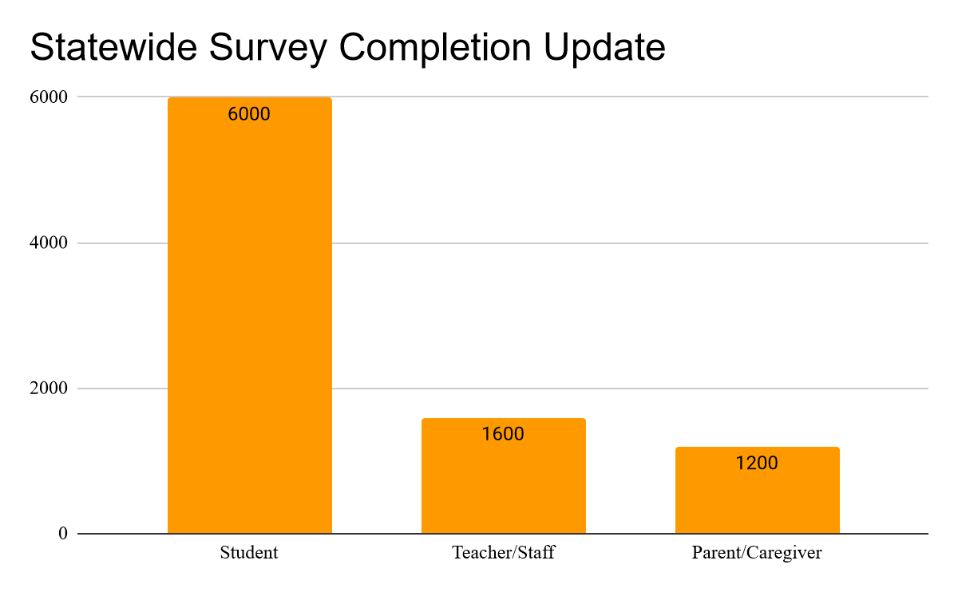
DE School Climate Survey Update & Check-in
Participation Update:
134 Schools
15 LEAs
Supports:
Weekly updates started
Administration Website
DSCS State Coordinator Support

Slide 41
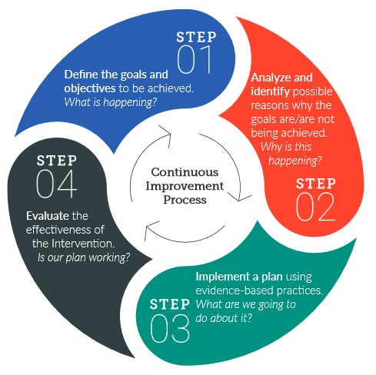
Data-based Decision Making Processes

Slide 42
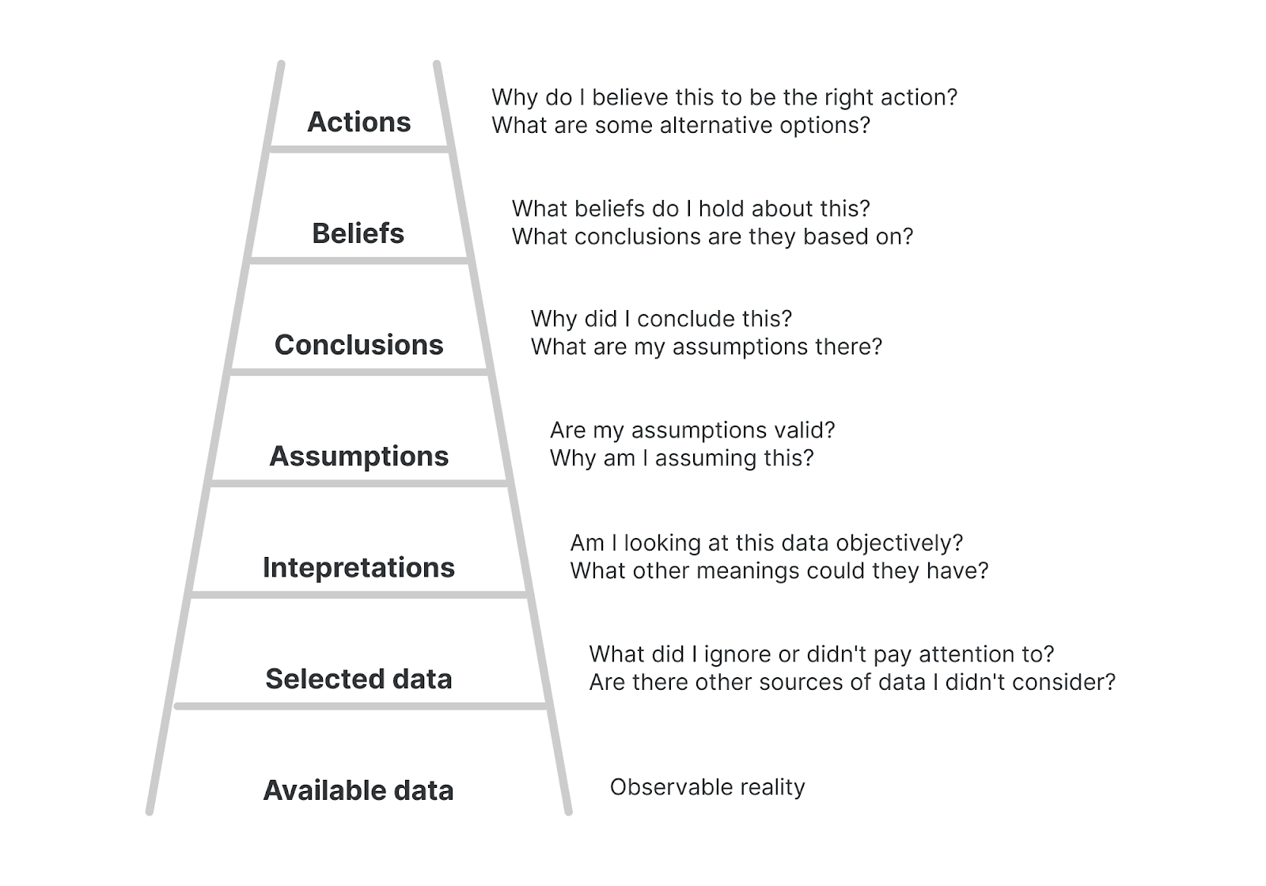
Argyris’ Ladder of Inference
K
Action
Beliefs
Conclusions
Our beliefs influence what we observe
Assumptions
Add Meaning
Select
Observe
(Aguilar, 2013)

Slide 43
Equity Committee Supports & Updates

Slide 44
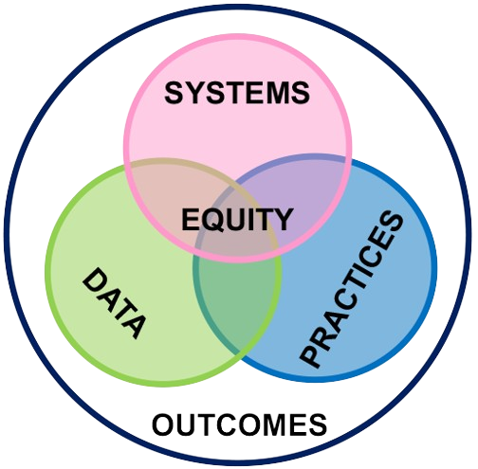
Equity Committee
March 20, 2024
1-2:30pm
Zoom
All Are Welcomed!
mpell@udel.edu
Adriane Simpson
Adrienne Stansbury
Cliffvon Howell
Dana Farrior
Debby Boyer
Jennifer Martin
Kelly Logan
Marqueia Davis
Megan Pell

Slide 45
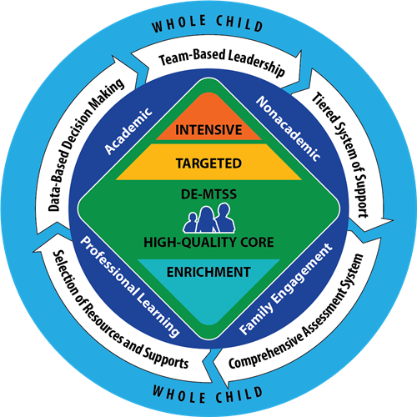
What is Equity?
Dr. Nikole Y. Hollins-Sims
Ensuring that every learner has access (& opportunity) to the educational resources and rigor they need at the right moment in their education across race, gender, ethnicity, religion, language, disability, sexual orientation, gender identity, family background and/or family income.
Source: www.ccsso.org & www.aspeninstitute.org/education

Slide 46
"When we embed equity into our data work,
we illuminate disparities, stories, and wisdom
that make our schools safer and stronger"
(Knipes, Lopez, Savoy, & LaParo, 2022)

Slide 47
What we do for and WITH kids and their families.
The experiences of our kids and their families (and staff)
Priorities for what we elevate and what we address

Slide 48
Data-based Decision Making Process
A process that uses all data relevant to the whole child to make informed decisions about academic and non-academic instruction and supports at the district, school, and student levels

Slide 49
What we do for and WITH kids and their families.
The experiences of our kids and their families (and staff)
Our Selected Data Sources
Our MTSS Team
Structures & Discussions
Priorities for what we elevate and what we address

Slide 50
Our Here and Now:
1. What are we measuring and why?
2. Who decides what data we need and from whom?
3. How do we analyze our data?
4. How do we use our data to make decisions?

Slide 51
What we do for and WITH kids and their families.
The experiences of our kids and their families (and staff)
Our Selected Data Sources
Our MTSS Team
Structures & Discussions
Priorities for what we elevate and what we address

Slide 52
Our Here and Now:
1. What are we measuring and why?
Data Asset Mapping

Slide 53
Asset Map Of Data Sources

Slide 54
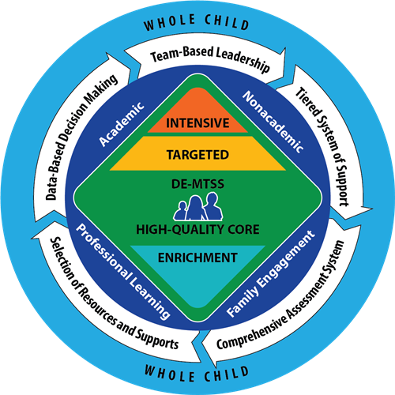
What Do We Include?
Academic
Non-Academic

Slide 55
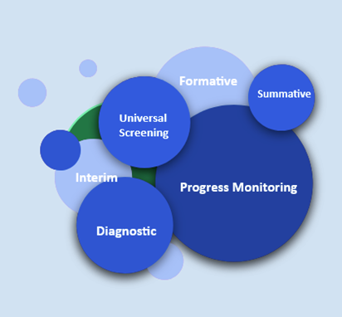
A Comprehensive Assessment System
Uses various types of valid and reliable assessment tools, processes and data (e.g., screening, diagnostic, progress monitoring, evaluation data) that combine to form a system of assessments with the goal of supporting student academic and non-academic growth

Slide 56
How Else Can We Grow Our Data Sources?
resource indicators: data that help to explain the allocation/distribution and use of resources (e.g., funding, staffing, etc.) in school and in the community
school community voice: qualitative and quantitative data from surveys, interviews, focus groups, and observations to better understand the school community, especially those groups that have been historically underserved
community-based indicators: outcome and other data related to community-based services, childcare and after-school programs, housing, green space, violence, health, and other risk and protective factors that influence education outcomes
implementation data: data that reflect different aspects of implementation (e.g., adherence, adaptation/codesign, dosage, quality) to evaluate whether interventions are being implemented; who has access to them; and how the programs, practices, and systems are being delivered and sustained
school-based indicators: outcome and other related data to academics, attendance, discipline, SEB well-being, climate, and culture

Slide 57
The Benefits of Time Spent Mapping
Efficiency
Transparency
Progress Monitoring
Trust Building
Find and Elevate Voices and Experiences

Slide 58
The Benefits of Time Spent Mapping
Efficiency
Transparency
Progress Monitoring
Trust Building
Find and Elevate Voices and Experiences

Slide 59
The Benefits of Time Spent Mapping
DE Film Impact Campaign for Change
Efficiency
Transparency
Progress Monitoring
Trust Building
Find and Elevate Voices and Experiences
Monique Martin
DDOE

Slide 60
Pushout: The Criminalization of Black Girls in Schools (Monique Morris)

Slide 61
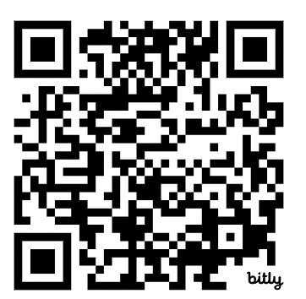
DE School Climate Survey: Teacher-Student Relationships Subscale
DE School Climate Survey: Teacher-Student Relationships Subscale
Teacher-Student Relations | 2. Teachers treat students of all races with respect.
 | 7. Teachers care about their students.
 | 17. Teachers listen to students when they have problems.
 | 22. Adults who work here care about the students.
 | 25. Teachers like their students.
SURVEY WINDOW OPEN 2/15 - 3/29
Slides from DE-PBS Project delwarepbs.org

Slide 62
Building Trust and Elevating Voices and Experiences
What questions do our data help answer?
What are the risks of using these data, and who is at risk?
Do students and families value these data (i.e., do they support the use of these data)?
How do you know?
Are these data valid for the different groups of students you serve?
Do these data inform how we distribute resources and supports in ways that are meaningful and decrease disparities?

Slide 63
What we do for and WITH kids and their families.
The experiences of our kids and their families (and staff)
Our Selected Data Sources
Our MTSS Team
Structures & Discussions
Priorities for what we elevate and what we address

Slide 64
National Teacher of the Year, Sean McComb, 2014

Slide 65
DE-MTSS Team Audit (aka - Working Smarter Matrix)
Directions
Identify all committees, teams, groups, etc. in building; be sure to include all that have social behavior improvement as part or all of their purpose.
Characterize the main features of each committee
Purpose
Data
Target Group
Membership
Schedule
Relationship to Tier 1 SEB Programming
After conducting the team audit, evaluate how the committee organization of the school might be enhanced
Based on this new/enhanced organizational structure, develop an action plan for putting it in place.
Purpose
The purpose of this activity & worksheet is to enable schools to assess and enhance the efficiency, effectiveness, and relevance of the committee and team organization of schools.

Slide 66
Reflection
After completing the Team Audit, ask the following questions:
Are there overlapping teams or redundancy among teams? If so, what groups can we combine?
Are there gaps for the intended SEB & academic needs of the school?
Are personnel on too many teams (are they over-extended)?
Do all teams have a clear purpose and data source to guide decisions around their effectiveness? If not, what supports are needed? Is there a need to eliminate?

Slide 67
Tier 1 MTSS Leadership Team Commitment to Equity
• Beneficence: the commitment to maximize benefits and avoid causing harm to the extent possible, even if it is not a formal or legal requirement
• Respect for persons: the responsibility to uphold people’s power to make decisions that are in their best interest and to protect people who are prevented from exerting that power
• Justice: the commitment to the fair distribution of burdens and benefits among people
Dialogue Guide for Key Question 2: Who decides what data we need and from whom?
Notes:
[Handout of excerpt]

Slide 68
Tier 1 MTSS Leadership Team Staff Asset Map | Who We Have | Who To Recruit
o Applied behavior support
o Mental health and trauma
o Academic instruction
o Coaching
o Equity
o Physical health and wellness (e.g., nurse, health teacher)
o Data systems and information regarding system and student academic, strengths and SEB needs
o Operations of the school across grade levels and programs

Slide 69
Centering Equity in Data-Based Decision-Making…Last pieces
Dialogue Guide for Key Question #3:
How Do We Analyze Our Data?
BEFORE Mtgs.
DURING Mtgs.
AFTER Mtgs.
Dialogue Guide for Key Question #4:
How Do We Use Our Data to Make Decisions?
ID of Goals and Barriers
ANALYSIS
PLAN Implementation
PLAN Evaluation

Slide 70
Inquiry Before Problematizing Student Behavior
Step 1: Here's What! Record 2-3 observations you made or information you heard that ‘pops out’ to you. | Step 2: So What? What are your interpretations or meaning of those observations or information you heard? | Step 3: Now What? What are possible implications for each idea recorded?
I am noticing… I heard … | I’m wondering ... | Can we consider doing ... As a result, we can …
What can we do to support implementation of these ideas reflected in our “Now What”?
Idea to implement | Resources Needed | Who? When ?
Center for Social Behavior Support at ODU, adapted from, Data-Driven Dialogue: A Facilitator’s Guide to Collaborative Inquiry,

Slide 71
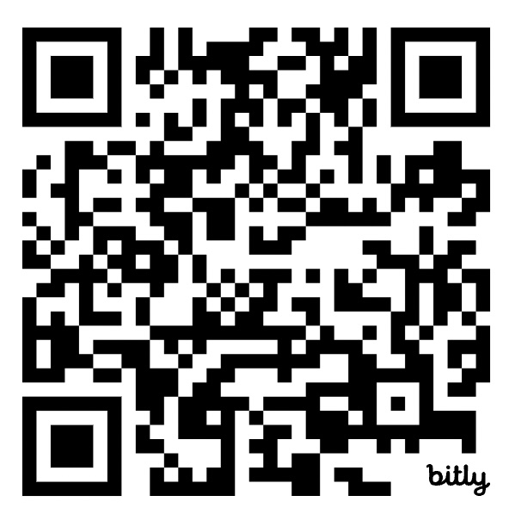
Resources Cultivated for DE Schools

Slide 72
Pushout: The Criminalization of Black Girls in Schools
DE Film Impact Campaign for Change

Slide 73
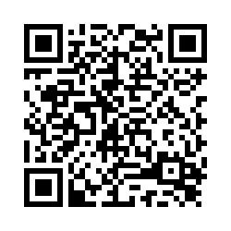
Evaluation
Please take a few minutes to complete this evaluation survey.
Your feedback is greatly appreciated.
https://delaware.ca1.qualtrics.com/jfe/form/SV_0rlu7gouleun92e

Slide 74
Next Meeting
Thursday May 2, 2024
9 am to 12 pm
Hilton Garden Inn
Dover, DE

