Slide 1
MTSS Summer Start-Up Workshop:
Tools to Boost your Systems
SESSION 1: Tier 1 Leadership Team System Resources
DE-MTSS Technical Assistance Center
June 27, 2024

Slide 2
DE-MTSS Technical Assistance Center
The Delaware Multi-Tiered System of Support TA Center proudly serves as a technical assistance provider for the
Delaware Department of Education.
Our TA Center provides professional learning and coaching to support the academic and nonacademic development of all children.

Slide 3
Today’s Agenda
Session 1 - 8:30 - 11:00
Tier 1 System Focus
Review & reflect on key features of efficient & effective teaming
Explore ways the Tier 1 team can use data and data-decision making procedures to identify and implement Tier 1 practices
Session 2 - 11:30 - 2:00
Tier 2 System Focus
Engage with systems components of data routines and team-based implementation through activities using tools for
IN/ON/OUT Criteria
Tier 2 Interventions Data Tracker
The Hexagon Tool

Slide 4
Cascade of MTSS Implementation to
Support the Whole Child
Classroom
Improved Student Outcomes
School
District
State

Slide 5
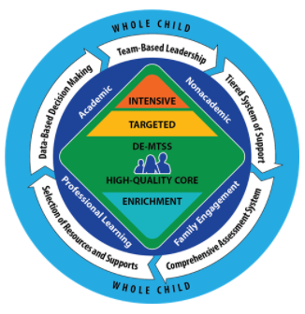
Defining MTSS in Delaware
DE-MTSS is a framework designed to meet the needs of the whole child through an integrated, multilevel prevention system that:
Optimizes team-based leadership and data-driven decision making.
Provides high quality core academic instruction and non-academic practices as universal supports to all children.
Matches evidence-based intervention and supports to student needs.
Is informed by ongoing progress monitoring and additional formative assessments.

Slide 6
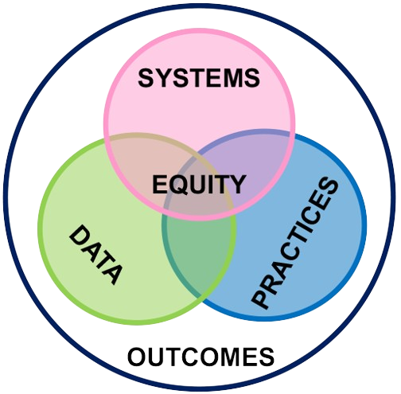
Guiding Principles for Integrated MTSS
S. Barrett, J. Freeman, B. Simonsen, & S. Goodman, (2022) Council for Exceptional Children- Integrating Academic, Social, Emotional, Behavioral, and Mental Health Supports for Student Need

Slide 7
Systems SUPPORT
implementation to occur with fidelity
Continuous Action Planning
Embedded & Ongoing Professional Development
Data Routines
Team-Based Implementation
Promoting & Sustaining Staff Engagement
Staff Recognition

Slide 8
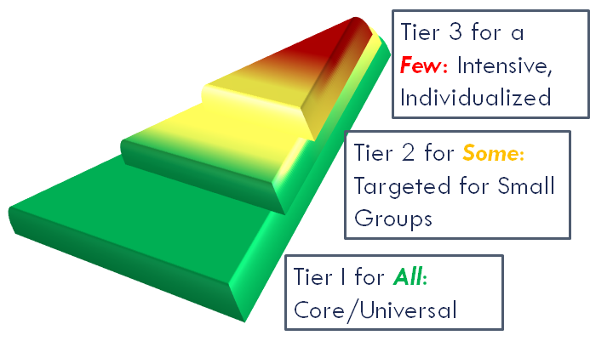
Tiered System of Support
Includes a multi-level prevention system that is focused on high-quality core curriculum and universal practices with evidence-based instruction and intervention organized along a continuum of supports

Slide 9
Teaming: Organizing for Efficiency

Slide 10
Keys to Successful Teaming
Predictability
Consistency
Positivity and Safety
Accountability
TIPS

Slide 11
Teams become more efficient and effective at solving problems with:
Meeting foundations (e.g. team vision, purpose/norms, authority, roles, agenda)
Data (timely, accurate, accessible)
Data informed decision making routines (e.g., defining problems with precision, building goals, monitoring implementation)
TIPS: Team Initiated Problem Solving by Rob Horner and partners

Slide 12
Habits of Efficient & Effective Teams…
Have a clear purpose, authority, efficient process, and defined roles
Transform data into clearly defined problems and solutions
Improve the likelihood their solutions are implemented
Improve the likelihood of improvement in student outcomes (both academic and non-academic)
Proactive
Habits of Inefficient & Ineffective Teams....
Meet without establishing their purpose, process and roles
Meet without data or use data to describe rather than solve a problem
Define problems with limited precision (e.g., the kids are rude in the cafeteria) and adopt solutions that are a poor match with the problem (e.g., a packaged social skills program)
Reactive
Adapted from Todd et al. (2019)

Slide 13
Reflect
What effective vs ineffective teaming habits are
you seeing at your school?
Select one habit of effective teams to prioritize today

Slide 14
Why is teaming so important?
Helps distribute the workload among members so that leadership is shared and stress is reduced
Ensures that the work can be sustainable, wherein if a member of the team leaves, the processes and structures in place can continue and do not leave with that person
Provides the infrastructure for systemwide evaluation and continuous improvement
AIR. Center on MTSS

Slide 15
Team Representation
Reflective of the population the team represents
Representative of key stakeholders
Can speak to desired team outcomes
Ability to make important decisions
Gives voice to students, families, community, BIPOC, LGBTQ+, disability community, behavioral and mental health needs, and other typically underrepresented groups
How are we organized to do WITH and not do TO?
- Kim Yanek

Slide 16
Tier 1 Team Composition
Tier 1 Systems Coordinator(s)/ Team Leader(s)
School Administrator
Academic, Social-Emotional-Behavioral, and Physical & Mental Health Expertise
Coaching Experience
Individuals with knowledge of:
Student academic and behavior patterns
Operations of the school across grade levels and programs
Representative/voice of:
Families
Students
Community

Slide 17
GOAL
A diverse interdisciplinary team

Slide 18
Team Composition Reflection
Is our team reflective of the population we serve?
Who are the key stakeholders on our team?
Do we have team members who can speak to our desired outcomes?
Do we have someone with authority who can make important decisions?
Do we have representation from typically underrepresented groups (students, families, community, BIPOC, LGBTQ+, disability community)?
Do we have relevant expertise (credentialed and/or lived experience) in the fields of academic content areas, special education, social-emotional-behavioral, mental, and physical health?

Slide 19
Dream Team Activity
What does your Dream Team look and sound like? What are the outcomes?

Slide 20
Meeting Foundations

Slide 21
Why are Meeting Foundations important?
Biggest meeting challenge = off-topic conversations.
Martin, 2020
The five main meeting problems are:
lack of participant preparation (28%)
no follow-up on tasks (25%)
poor communication (20%)
time allocated is not observed (17%)
no minutes (13%)
Turmel, 2022
The top reason people selected as the best way to get them excited about attending a meeting is for it to be well-planned (64%)
Martin, 2020
Team Initiated Problem Solving (TIPS) Training

Slide 22
Elements of Meeting Foundations
 | Common Purpose
 | Agenda
 | Logistics
 | Roles and Responsibilities
 | Authority
Mcintosh & Goodman, 2016 and DE-MTSS Modules
How School Teams Use Datas to Make Effective Decisions: TIPS

Slide 23
Common Purpose
Successful teams have:
Stated and agreed upon mission, purpose, and outcomes
Common purpose is shared across all faculty and staff
Complements the work of other teams in building and district
Integrated Multi-Tiered Systems of Support (McIntosh & Goodman) and
How School Teams Use Datas to Make Effective Decisions: TIPS

Slide 24
Structured Agenda: Purpose
Appropriate for any and all teams, universally and consistently utilized
Help to focus team on using data to make decisions
Student outcomes and fidelity of implementation of practices
Integrated Multi-Tiered Systems of Support (McIntosh & Goodman) and
How School Teams Use Datas to Make Effective Decisions: TIPS

Slide 25
Common Purpose
Successful teams ask themselves:
Are we addressing our team’s mission?
Are we taking on purpose of other teams and duplicating efforts?
Do we know what decisions need to be made during this meeting?
How do these decisions fit in with the team’s mission?
Integrated Multi-Tiered Systems of Support (McIntosh & Goodman) and
How School Teams Use Datas to Make Effective Decisions: TIPS

Slide 26
Tier 1 Team Mission Example
We coordinate the MTSS universal prevention systems by:
Collecting, analyzing, and sharing schoolwide data regarding implementation and outcomes with school staff and community
Identifying schoolwide needs (in literacy, math, and behavior)
Developing schoolwide goals/priorities/strategies to meet identified needs
Ensuring completion of overall goals/priorities/strategies
Integrated Multi-Tiered Systems of Support (McIntosh & Goodman)

Slide 27
Mission and Vision….
“Teams exist to uphold an organization’s mission, to fulfill its vision and to meet its goals. For a team to do this it needs a clear and articulated reason for existing -- an explicit articulation of the connection between the team’s work and the organization’s big picture goals.”
Teams need their own mission and vision so they know where they are headed…
Elena Aguilar, The Art of Coaching Teams: Building Resilient Communities that Transform Schools. Jossey-Bass, 2016.

Slide 28
Step 1 Toward a Mission & Vision
What’s your school and district mission & vision?
I see….
I think…
I wonder…
Mission: Fundamental purpose
Vision: Compelling future

Slide 29
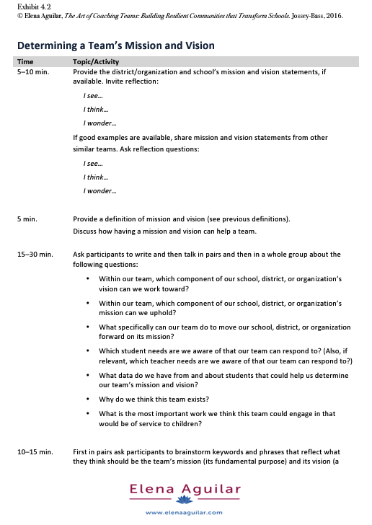
When your whole Tier 1 team can be together…

Slide 30
Why do we think this team exists?
What is the most important work we think this team could engage in that would be of service to children?
Within our team, which component of our school, district, or organization’s vision can we work toward?
Within our team, which component of our school, district, or organization’s mission can we uphold?
What specifically can our team do to move our school, district, or organization forward on its mission?
Which student needs are we aware of that our team can respond to? (Also, if relevant, which teacher needs are we aware of that our team can respond to?)
What data do we have from and about students that could help us determine our team’s mission and vision?
Elena Aguilar, The Art of Coaching Teams: Building Resilient Communities that Transform Schools. Jossey-Bass, 2016.

Slide 31
Honing in on the Tier 1 Team
Why do we think our [TIER 1 - Universal] team exists?
What is the most important work we think our [TIER 1 - Universal] team could engage in that would be of service to children?

Slide 32
Structured Agenda: Components
Suggested timing for each agenda item
Timing, tasks, person responsible, and due date
Brief self-assessment
Annual timetable for agenda items
Integrated Multi-Tiered Systems of Support (McIntosh & Goodman) and
How School Teams Use Datas to Make Effective Decisions: TIPS

Slide 33
Logistics
Set:
Location
Time
Date
Duration of meeting
Example: If the team meets every other Wednesday in the same place at the same time and the meeting always starts and end on time, members can meet those expectations.

Slide 34
Roles and Responsibilities
Facilitator
Ensure the group moves smoothly through tasks
Note Taker
Write down the work of the group
Data Analyst
Prepare, share, and present data summaries for the team
Time Keeper
Keep up with time and keep group on track
Authority
Power to make decisions
Newton, et al., 2014

Slide 35
Fidelity Tools

Slide 36
Fidelity Checks & Self-Assessment
Collective reflection
Individual and collective team functioning
Increase in self-awareness
Impact on behavior change
Individual and mutual accountability and buy-in
Improvement in successes and outcomes
The Art of Coaching Teams, Aguilar

Slide 37
School Leadership Team Agenda Self-Assessment Example
Evaluation of Team Meeting | Yes | So-So | No
Did we follow our expectations in the meeting today?
Did we focus on our team’s purpose in the meeting today?
Did we do a good job of completing the tasks we agreed on at previous meetings?
In general, are the completed tasks having the desired effects on student outcomes?
If some of the ratings are “So-So” or “No,” what can we do to improve things?
McIntosh, K., & Goodman, S. (2016). Integrated multi-tiered systems of support: Blending RTI and PBIS. Guilford Press.

Slide 38
Team Temperature Check
Indicator | 3=Usually 2=Sometimes 1=Rarely
1. I show up as my best self to our team meetings.
2. I look forward to our meetings.
3. I feel that I can meaningfully contribute during our meetings.
4. I feel that team members are respectful to each other.
5. I feel that we all learn from each other.
6. I feel that the facilitator/lead holds a safe space for learning and collaboration.
7. I feel that our work together will serve our students.
8. I feel that our work together stays focused on our purpose, goals, or projects.
9. I leave our meetings feeling stretched, energized, and/or inspired.
10. I feel that my feedback on our meetings is acknowledged.
TOTAL
Elena Aguilar, The Art of Coaching Teams: Building Resilient Communities that Transform Schools. Jossey-Bass, 2016.

Slide 39
Agenda Audit (part 1)
Does your agenda:
Reflect your team’s purpose and mission?
Include meeting role assignments?
Include an action plan with timing, tasks, persons responsible, and due dates for new and ongoing activities?
Use a brief meeting self-assessment?

Slide 40
Using Data to Select Tier 1 Instructional Practices

Slide 41
A 6 Step Problem Solving Process
Step 1: Problem Identification
Step 2: Problem Clarification
Step 3: Solution Planning
Step 4: Goal Setting
Step 5: Implementation
Step 6: Evaluation
Adapted from McIntosh & Goodman, 2016

Slide 42
Problem Definition/Identification
Determine if a problem exists.
Define the problem as precisely as possible with data.
Guiding Questions for Teams:
What specifically do we want students to know and be able to do when compared to what they currently know and are able to do?
Note: Adapted from McIntosh and Goodman (2016).

Slide 43
2. Problem Clarification
Analyze the problem to determine why the issue is occurring.
Generate a hypothesis (reasons why students are not meeting performance goals)
Gather information
Guiding Questions for Teams:
Why is/are the desired goal(s) not occurring?
What are the barriers to the student doing and knowing what is expected?
Note: Adapted from McIntosh and Goodman (2016).

Slide 44
The central question is not:
“What about the student is causing the performance discrepancy?”
But
“What about the interaction of the curriculum, instruction, learners, and learning environment should be altered so that the students will learn?”
-Ken Howell

Slide 45
Areas to analyze for hypothesis development
Key Hypothesis Domains
I | Instruction | Is the instruction evidence based, explicit, and intense enough?
C | Curriculum | Does the student have the prerequisite skills to access the curriculum successfully?
E | Environment | Does the environment support learning in a positive, proactive way?
L | Learner | Does the instruction, curriculum, and environment consider learner characteristics?

Slide 46
Possible sources of information
R | Review of historical records or products
I | Interview of key stakeholders
O | Observe performance in real time functional settings
T | Test student through careful use of appropriately matched diagnostic assessments

Slide 47
3. Solution Planning
Determine possible strategies that are feasible for your team to implement.
Select effective interventions and develop a clear plan for implementation.
Guiding Questions for Teams:
What are possible strategies?
Are the strategies feasible and likely to be effective?
Who will implement specific components, by when, and how will you monitor its effectiveness over time?
Note: Adapted from McIntosh and Goodman (2016).

Slide 48
Where can I find Tier 1 strategies?
High Leverage Practices:
Focus directly on instructional practice.
Occur with high frequency in teaching.
Research based and known to foster important kinds of student engagement and learning.
Broadly applicable and usable in any content area.
So important that skillfully executing them is fundamental to effective teaching (McLeskey & Brownell, 2015).

Slide 49
4. Goal Setting
Develop a clear goal with a measurable outcome.
Determine a date for reaching the goal and a plan for assessing progress along the way.
Guiding Questions for Teams:
What does success look like?
When do you expect to see the problem resolved?
How will you measure progress toward your goal?
Note: Adapted from McIntosh and Goodman (2016).

Slide 50
5. Intervention Implementation
Provide training and resources to effectively implement the intervention.
Monitor the fidelity of implementation.
Guiding Questions for Teams:
What is your plan to support staff to implement the solutions?
Do the solution implementers have necessary resources?
How will you measure the fidelity of staff implementation?
Note: Adapted from McIntosh and Goodman (2016).

Slide 51
“Students cannot benefit from interventions they do not experience.”
Dean Fixsen

Slide 52
6. Evaluation
Determine if the problem persists.
Use information gained from this cycle for future problem solving.
Begin this process again and apply new information if the problem persists.
Guiding Questions for Teams:
Review progress toward your goal:
Is the plan having the desired impact?
Is the plan being implemented with fidelity?
Does the original problem still exist?
If the problem still exists, how will you modify your plan with information learned?

Slide 53
Apply the steps to an example

Slide 54
Step 1: Problem Identification
A review of the Student Version of the School Climate Scale of the Delaware School Climate Survey (DSCS) resulted in: Students held unfavorable perceptions of student-student relationships, student engagement, and school safety. This trend was consistent across all grade levels (9-12). Student perceptions did not vary significantly based on subgroup membership. Student perceptions of student-student relationships and school safety have decreased since 2022. Based on their review, the team decides to prioritize instructional strategies that will boost their student-student relationships.

Slide 55
Step 2: Problem Analysis (Stu-Stu Relationships)
I | Instruction | Student-student relationships are not favorable because teachers don’t consistently use strategic feedback to encourage prosocial behavior.
C | Curriculum | Student-student relationships are not favorable because school and classroom expectations don’t prioritize relationship skills and social acceptance.
E | Environment | Student-student relationships are not favorable because classroom arrangements and activities don’t promote opportunities for positive social interactions and social acceptance.
L | Learner | Student-student relationships are not favorable because students have missed opportunities to experience positive social interactions during school closures, resulting in a lack of connection with peers.

Slide 56
Hypothesis #1 Problem Analysis
 | (Instruction) Student-student relationships are not favorable because teachers don’t consistently use strategic feedback to encourage prosocial behavior.
Review | Review of Student DSCS (Techniques Scale; Positive Techniques Subscale) Review of Teacher DSCS (Techniques Scale; Positive Techniques Subscale)
Interview
Observe
Test
Decision | Hypothesis 1 Decision: True Not True Need More Information

Slide 57
Hypothesis #2 Problem Analysis
 | (Curriculum) Student-student relationships are not favorable because school and classroom expectations don’t prioritize relationship skills and social acceptance.
Review | Review of Student DSCS (Techniques Scale; SEL Subscale) Review of Staff DSCS (Techniques Scale; SEL Subscale) Review of Student DSCS (Social and Emotional Competencies Scale) Review of schoolwide and classroom behavior matrices
Interview
Observe
Test
Decision | Hypothesis 2 Decision: True Not True Need More Information

Slide 58
Let’s practice completing the ICEL x RIOT Matrix for hypothesis 3 and 4

Slide 59
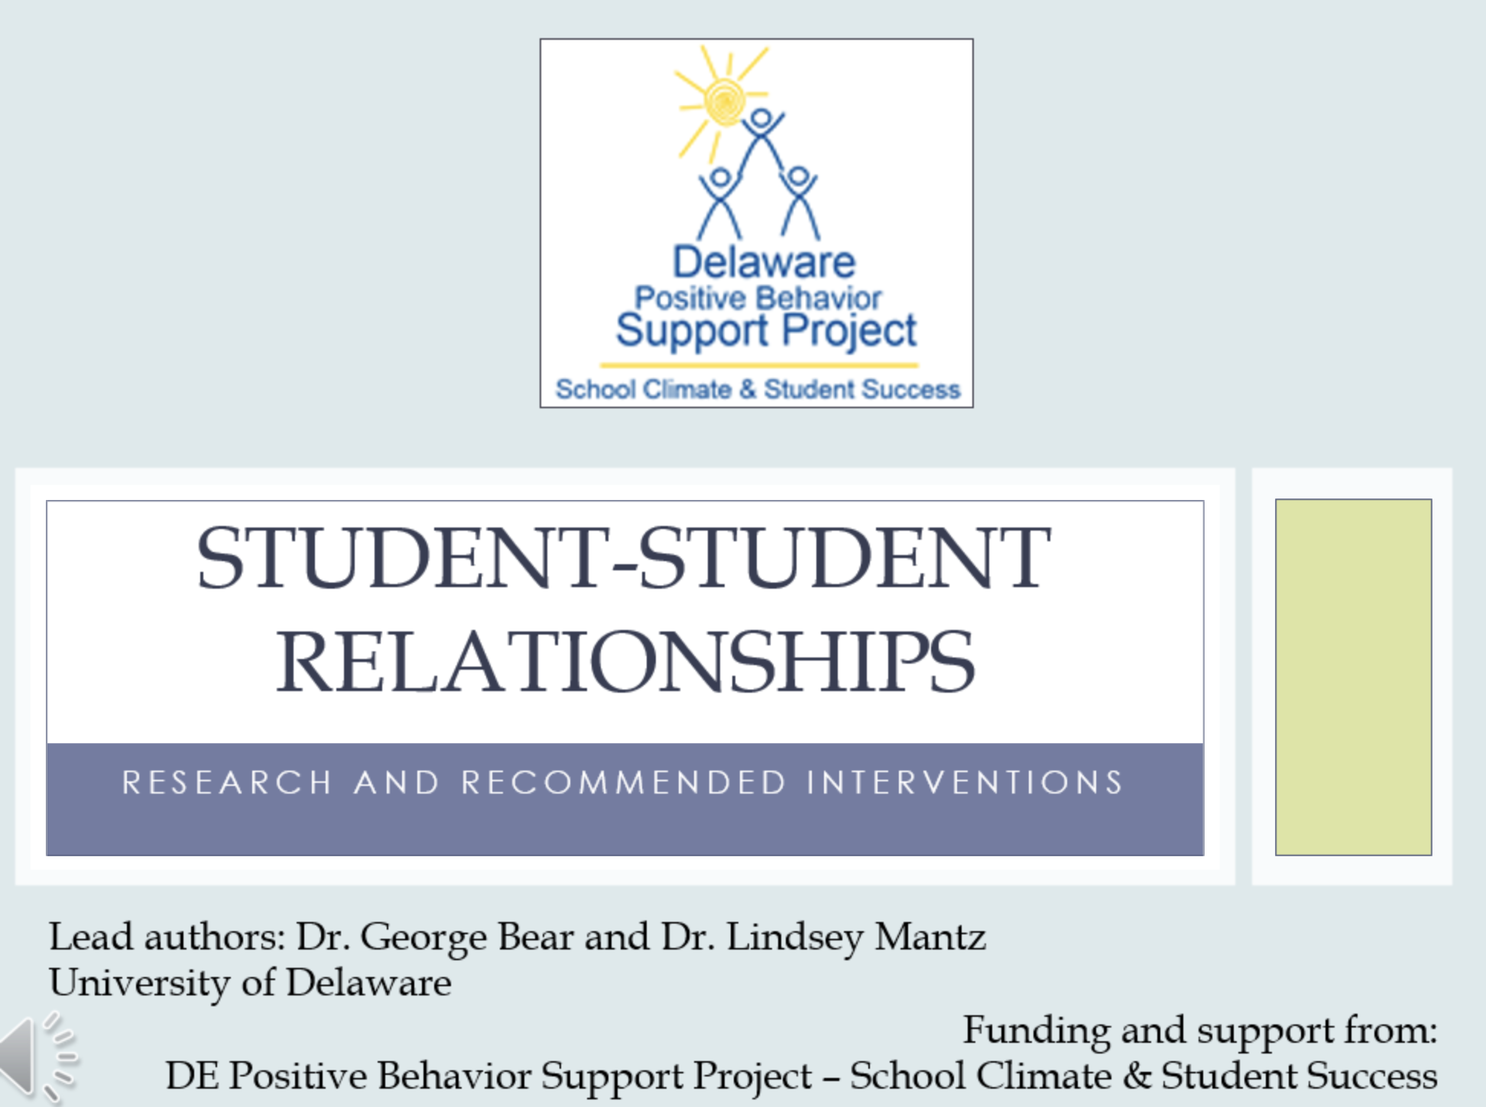
Step 3: Solution Planning
The team decides to: Establish and maintain classroom expectations about behavior that align with school wide expectations. Increase staff use of effective acknowledgement and praise.

Slide 60
Step 4: Goal Setting
Current Level of Performance: Average score of 2.42 on student-student relationships 2024-2025 Annual Goal: By the end of the 2024-2025 school year, our average score on the Student-Student Relationship subscale of the Student DSCS School Climate Scale, will increase to at least a 2.5.

Slide 61
Step 5: Intervention Implementation Planning
The team documents their action plan to include the following components. They revisit their action plan throughout the school year, during their Tier 1 team meetings.
Intervention Plan | PL/Coaching Plan | Fidelity Plan | Progress Monitoring Plan
Steps to establish expectations Steps to support staff use of effective acknowledgement | Steps to support staff to implement the intervention plan | Steps to monitor staff implementation of intervention plan | Steps to monitor progress toward annual goal

Slide 62
Step 6: Evaluation
Throughout the school year the team collects fidelity and progress monitoring data to inform and guide their action plan. They meet on designated days throughout the school year to update their action plan, including what to continue/stop/add.

Slide 63
Factors that influence group decision making
M
Learn about the Argyris’ Ladder of Inference
Read the handout
Write down what you think is the “MIP” (most important point)
Each person reads their “MIP” with the group
Action
Beliefs
Conclusions
Assumptions
Add Meaning
Select
Observe

Slide 64
Agenda Audit Part 2
What do you see in your team’s agenda that supports the effective use of a data-decision making process?
What would you change so it does?
DOCUMENT, DOCUMENT, DOCUMENT!

Slide 65
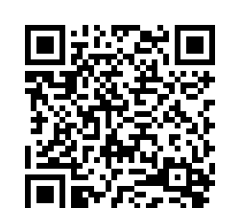
Thank you for being here!
SESSION 1 Feedback
Please complete this brief evaluation so we can plan for our next sessions with your feedback in mind.
Notes:
https://delaware.ca1.qualtrics.com/jfe/form/SV_4JE1YzOpo00nBFs

Slide 66
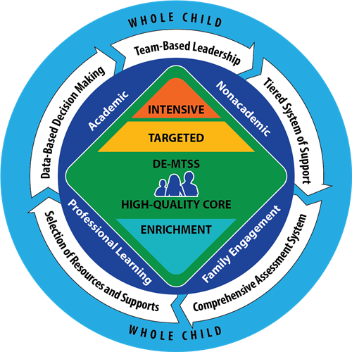
Thank YOU
for your ongoing engagement in implementing equity-grounded MTSS to support all students, staff, & families

Slide 67
DE-MTSS Resources and Supports
MTSS Implementation Guide
3 Quick Reference Guides – District, Building/School, Classroom
5 Essential Component One Pagers

Slide 68
References & Additional Resources
DE-MTSS TA Center:
DE Access Project - https://www.deaccessproject.org/
DE Positive Behavior Support Project - https://www.delawarepbs.org/
DE-MTSS (DDOE site)
Delaware MTSS regulation 508
Digital DE
High Quality Instructional Materials (DDOE site)
SWiFT Education Center - https://swiftschools.org/
Michigan MTSS TA Center - https://mimtsstac.org/

Slide 69
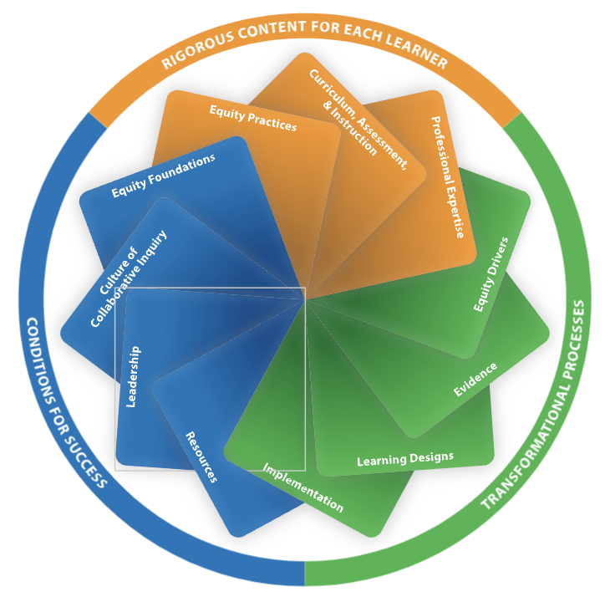
Today's session was grounded in the
Transformational Processes Standard
Transformational Processes Standard: IMPLEMENTATION
Professional learning results in equitable and excellent outcomes for all students when:
Educators understand and apply research on change management,
Educators engage in feedback processes, and
Educators implement and sustain professional learning.
(Learning Forward, 2023)
Learn more about the Professional Learning Standards here and the Delaware Professional Development Standards guidance here.

